Slide 1
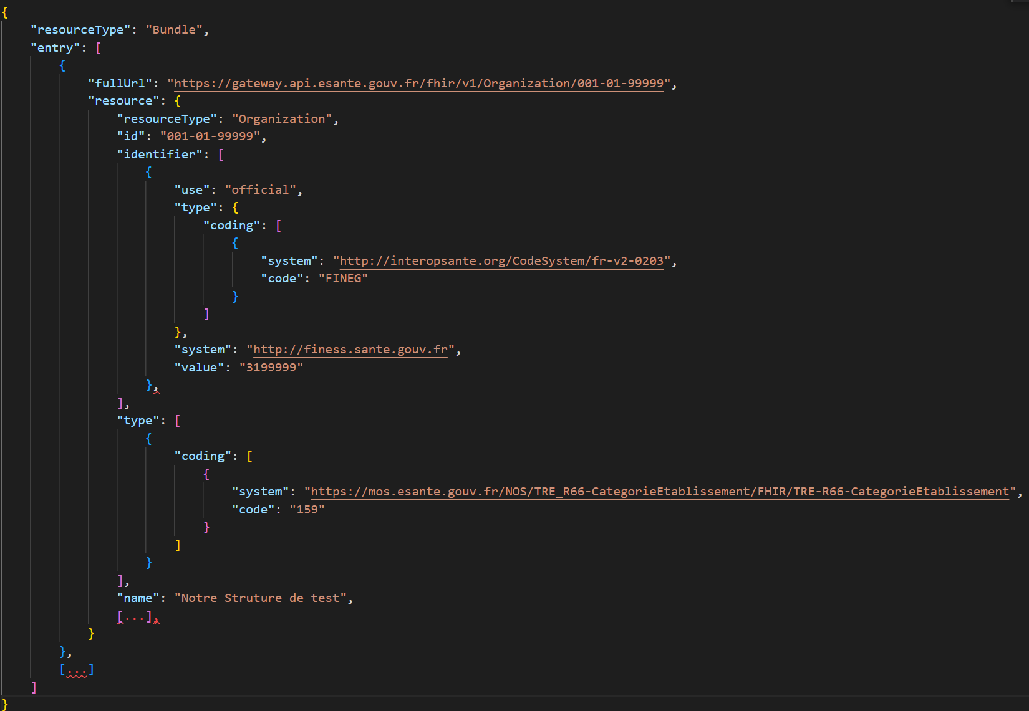
Couloir Ségur 1
1
2

Slide 2
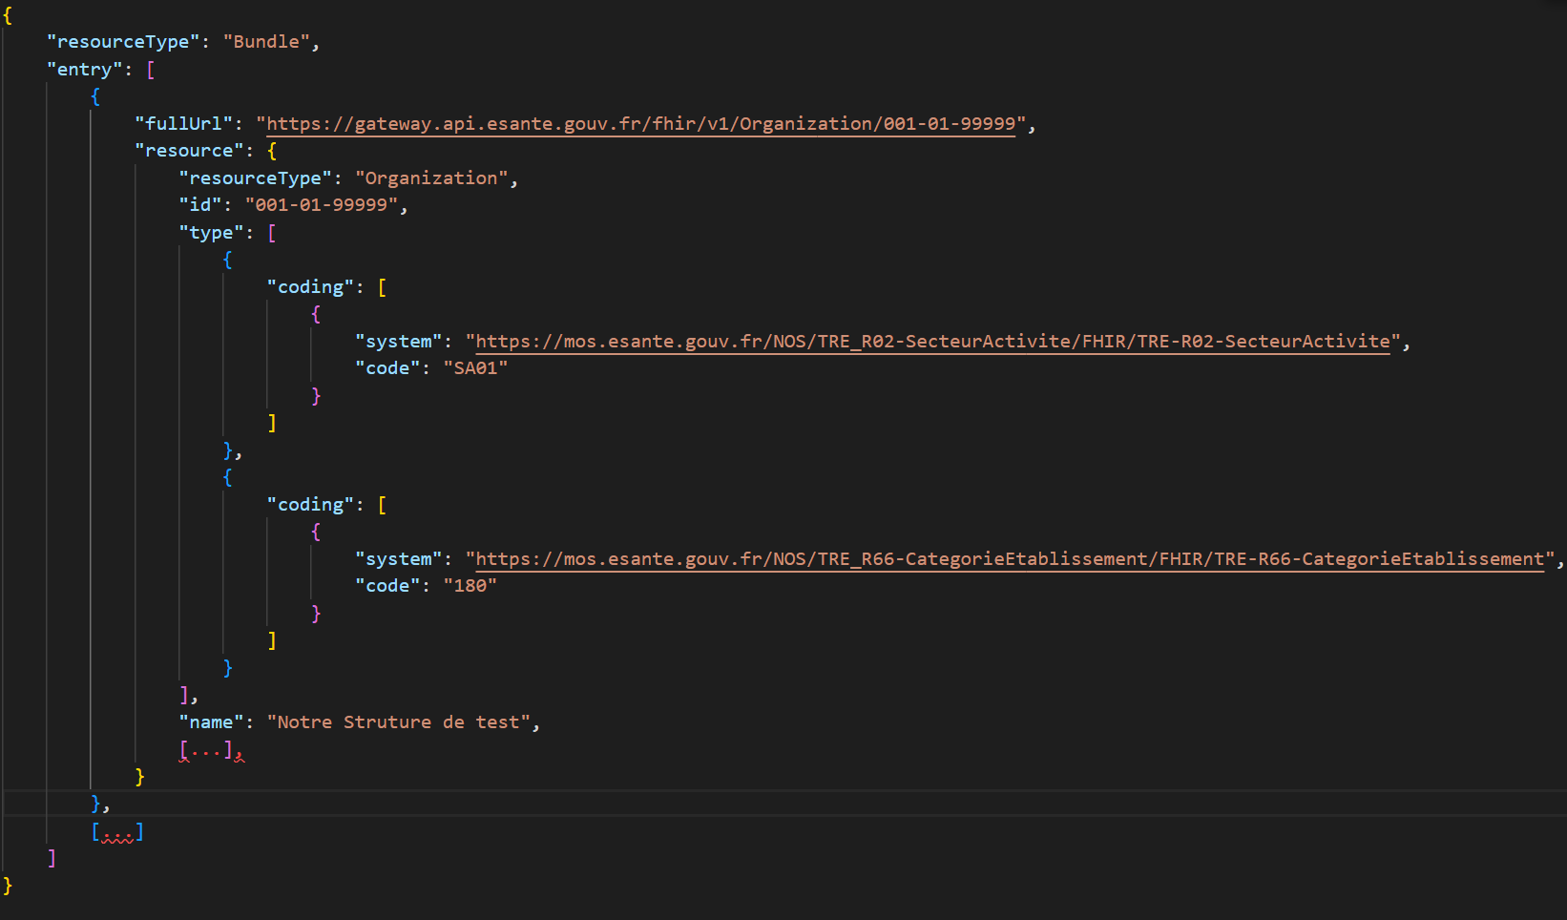
Couloir Ségur 2
1
2

Slide 3
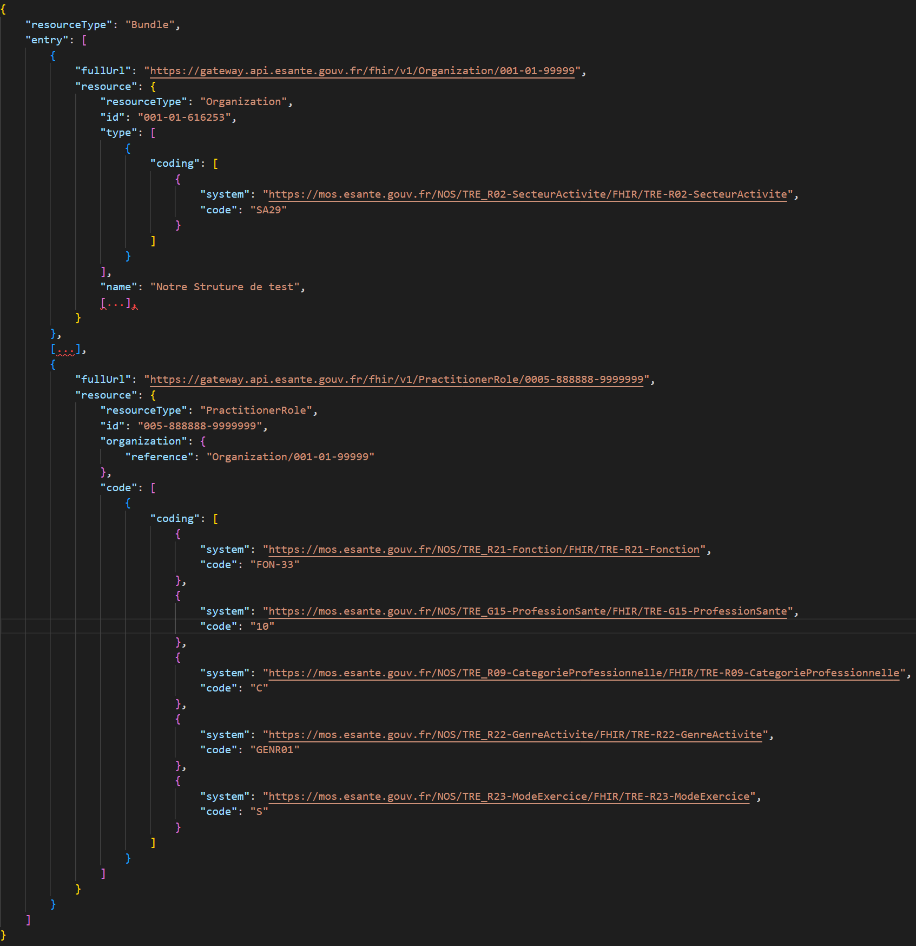
Couloir Ségur 3
1
2

Slide 4
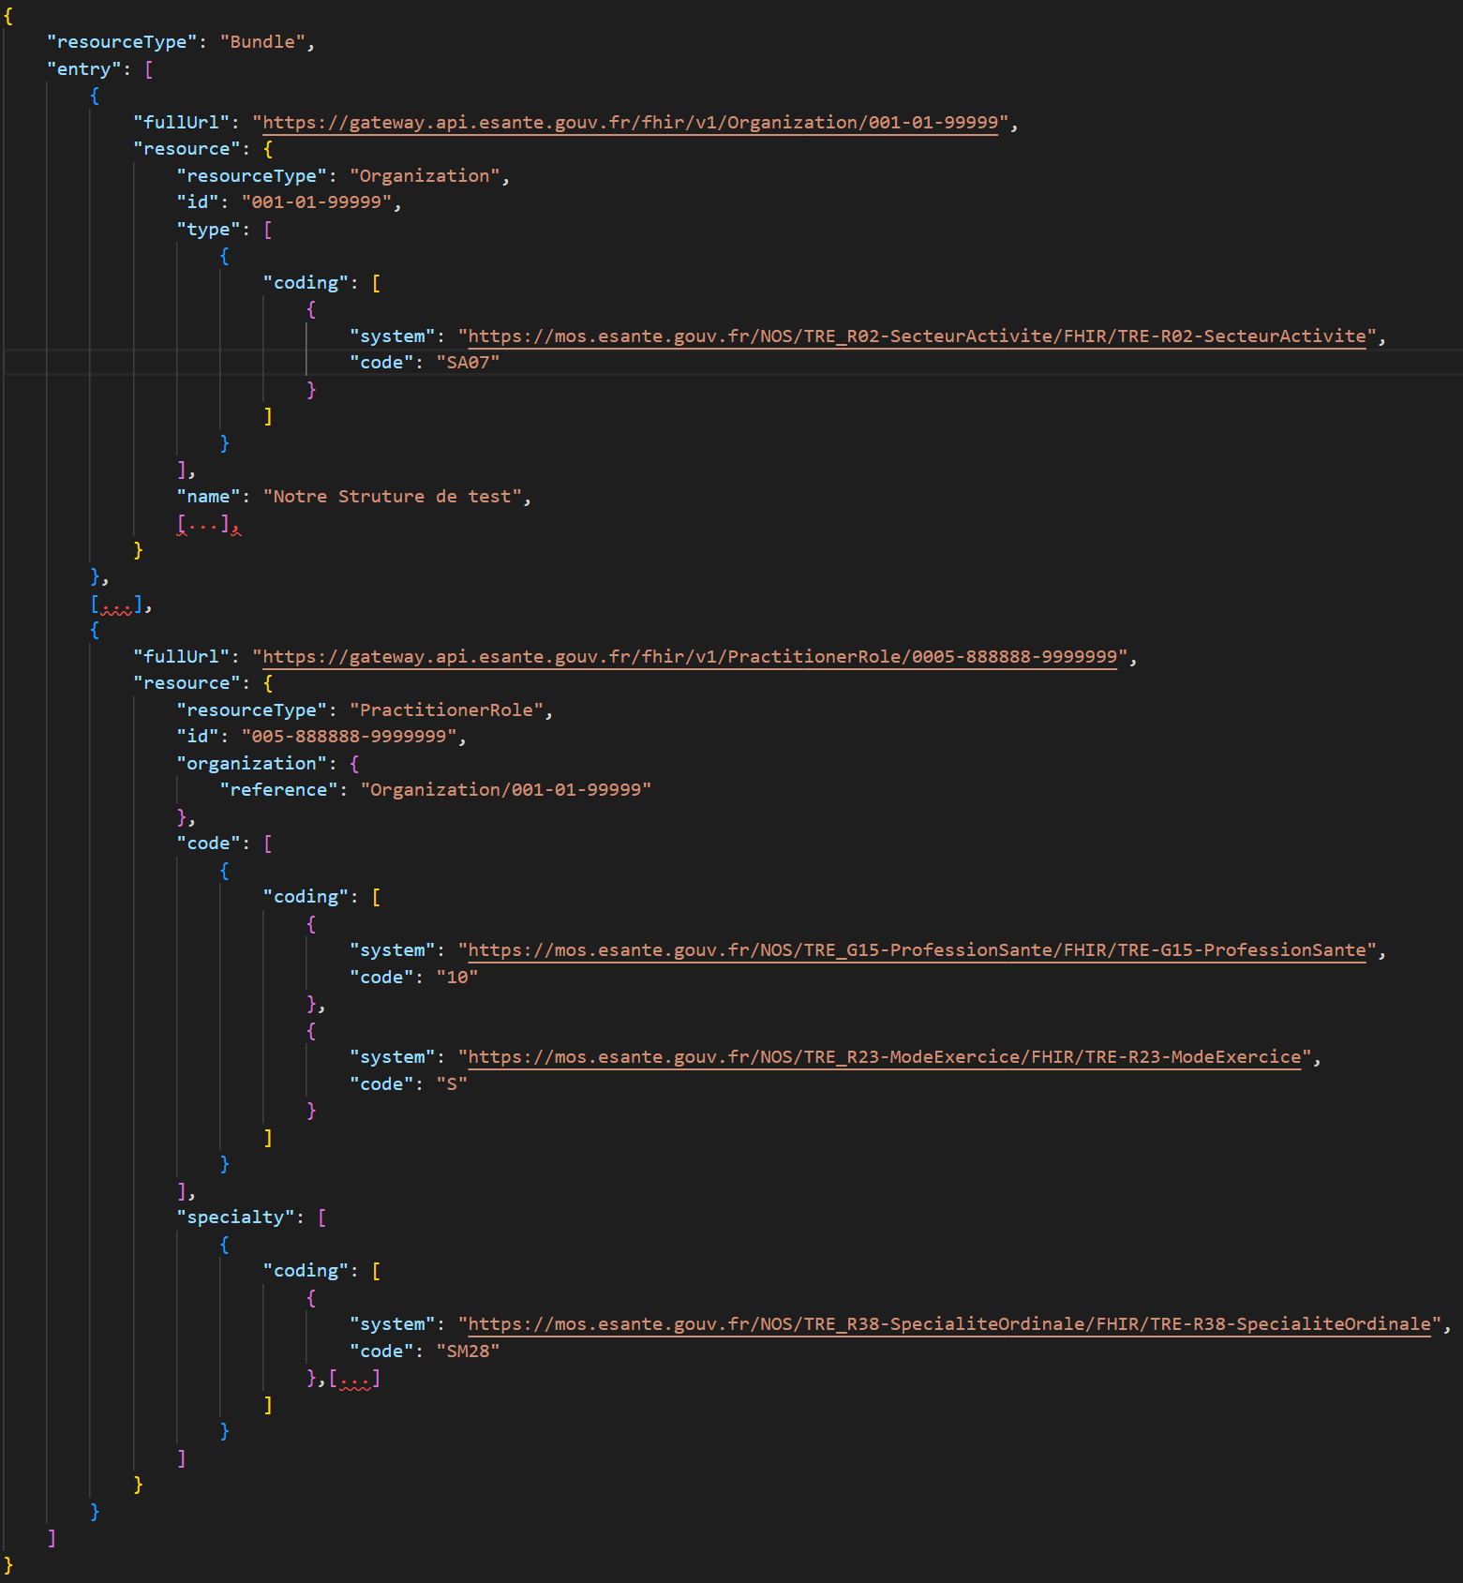
Couloir Ségur 4
1
3
2

Slide 5
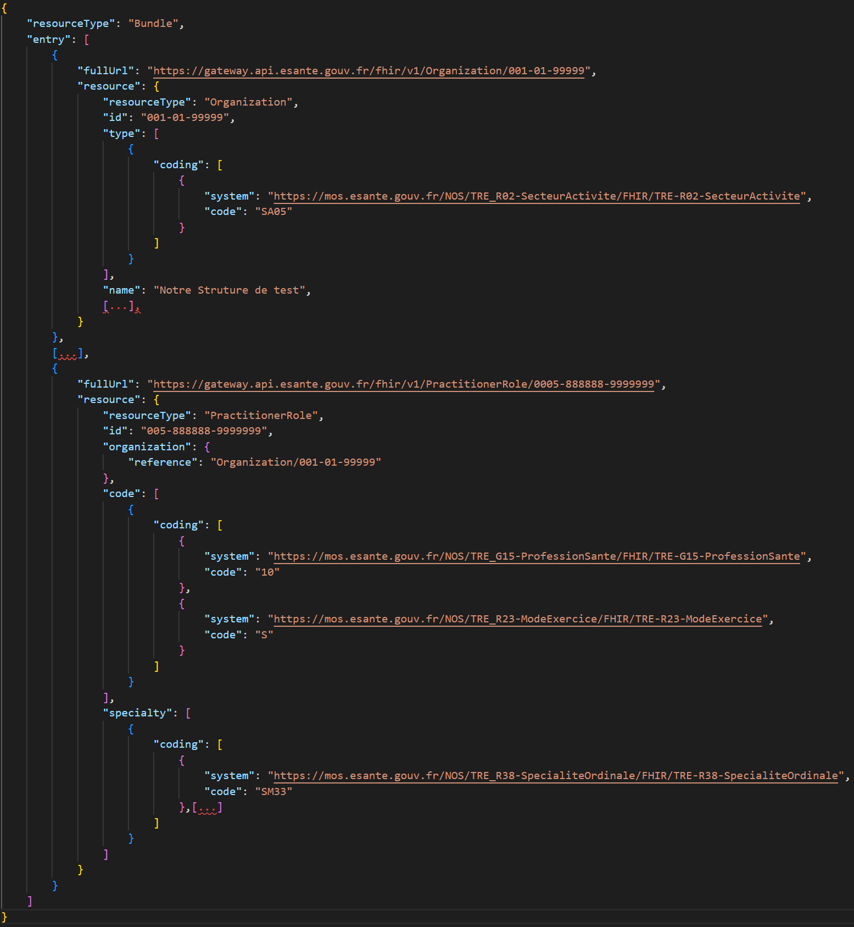
Couloir Ségur 5
1
3
2

