Slide 1
Ingest to FHIR

Slide 2
FHIR-Loader

Slide 3
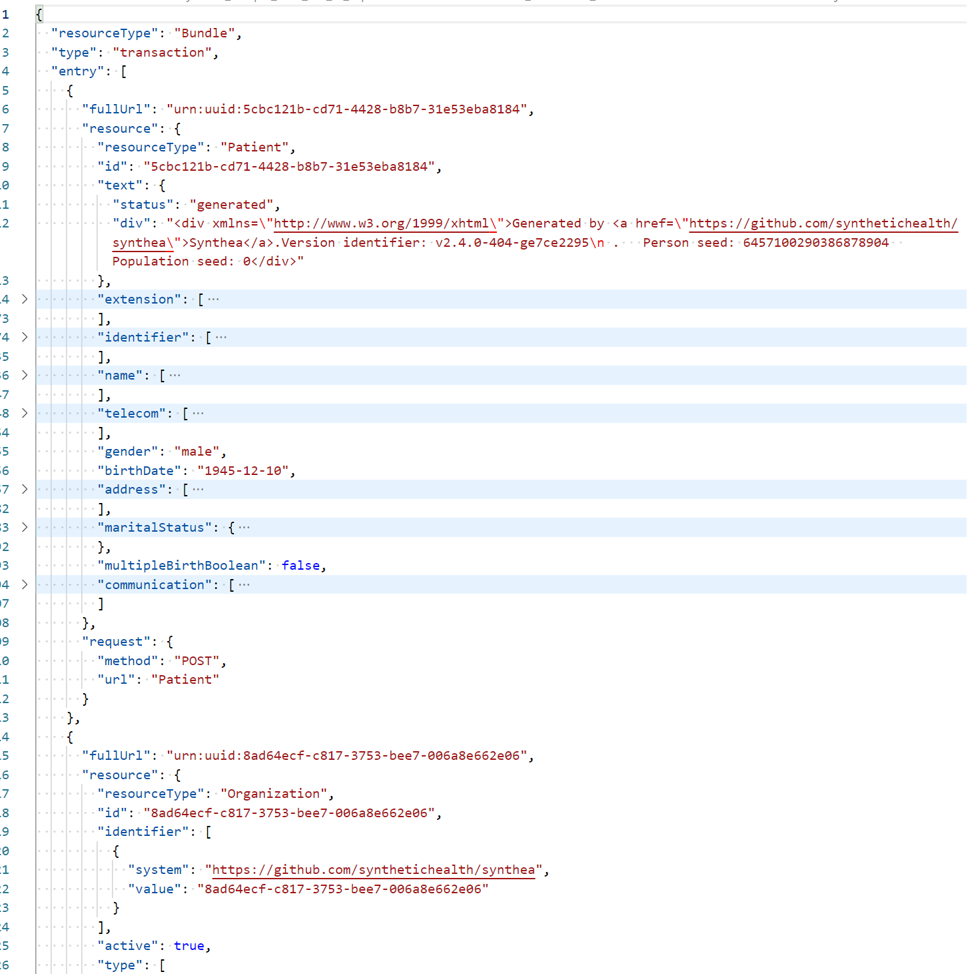
Ingest
Synthea Bundle
Things to note:
Bundle Type = Transaction
fullUrl = urn:uuid:5cbc121b...
request {
method: “POST”
url: “Patient”
Process:
Upload bundle to FHIR-Loader
Storage -> Container -> bundles
Validate
Storage -> Container -> bundlesprocessed

Slide 4
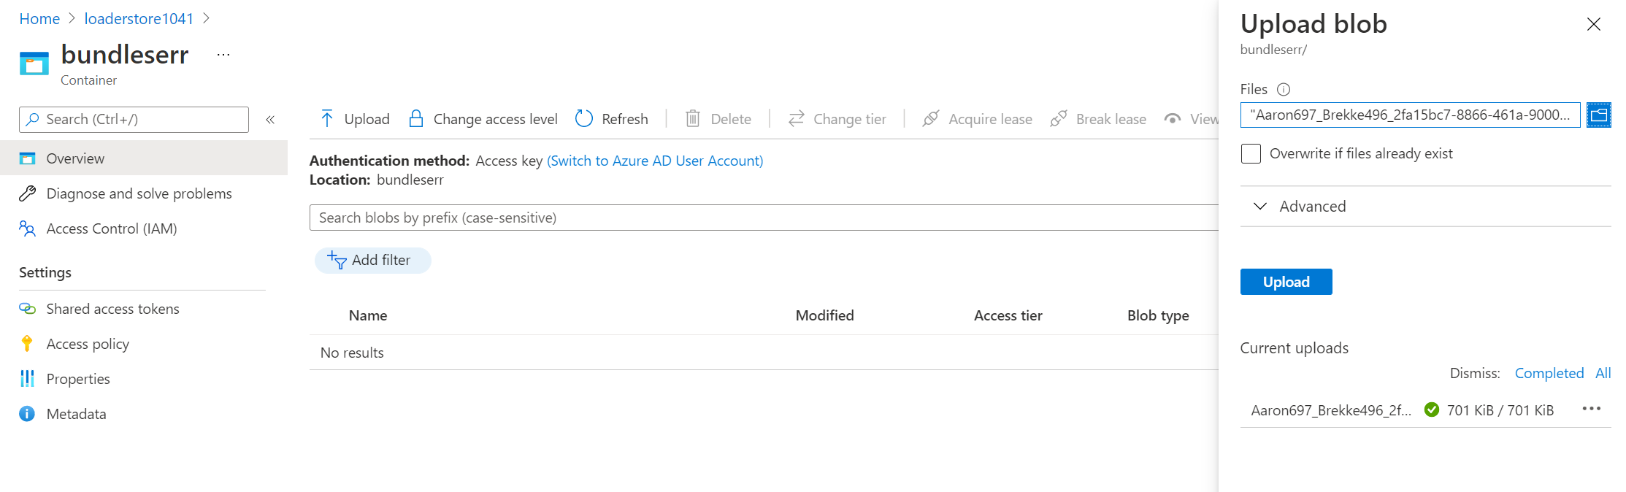
Ingest
Upload

Slide 5
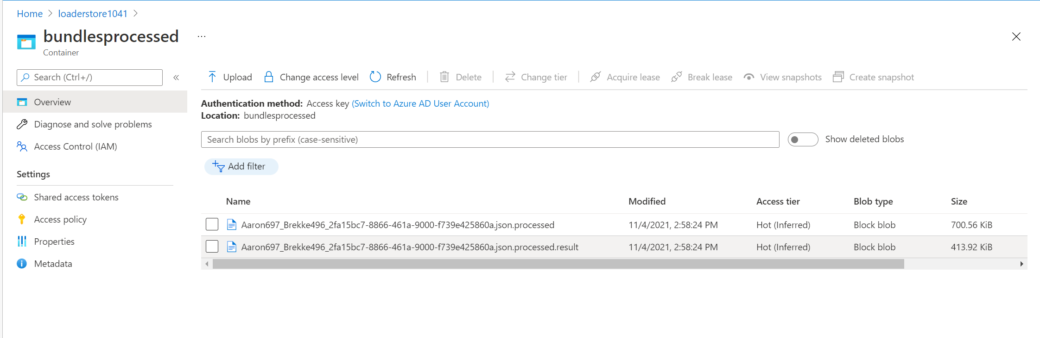
Ingest
Validate (use .result file)

Slide 6
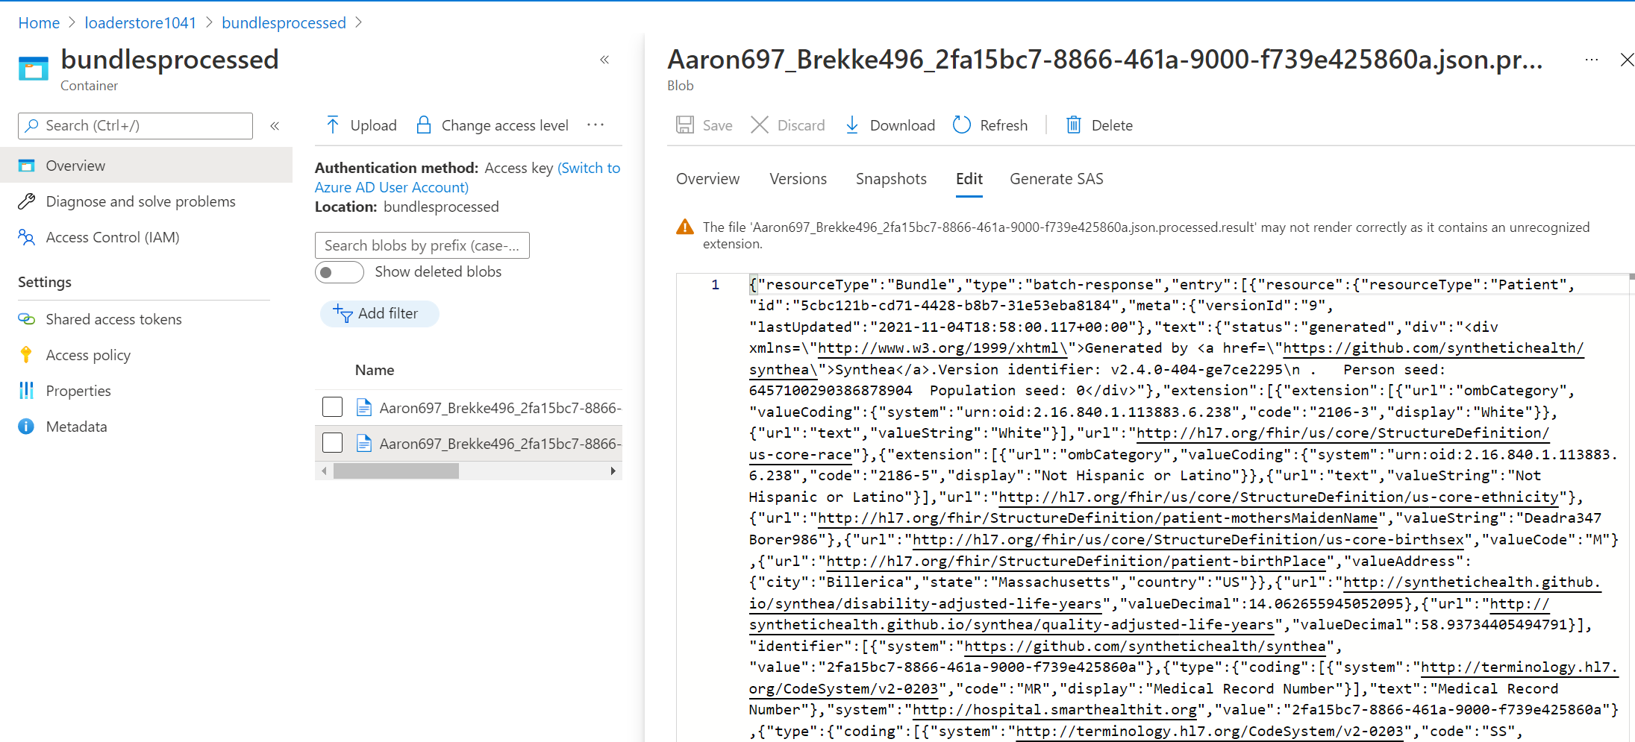
Ingest
Validate (can use Edit)

Slide 7
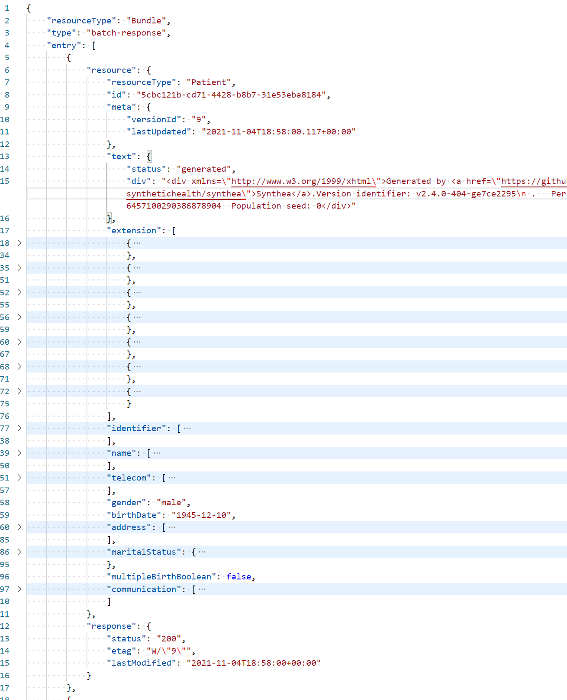
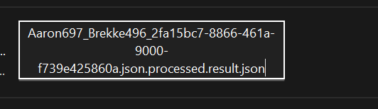
Ingest
Validate (the better method)
Validate locally
Download the file
Rename it to .json
Open in VS Code
Use Format Document to make it readable
Compared to Original Bundle :
Bundle Type = batch-response
fullUrl = ? missing
response {
Status: “200”
Etag
lastModified

Slide 8
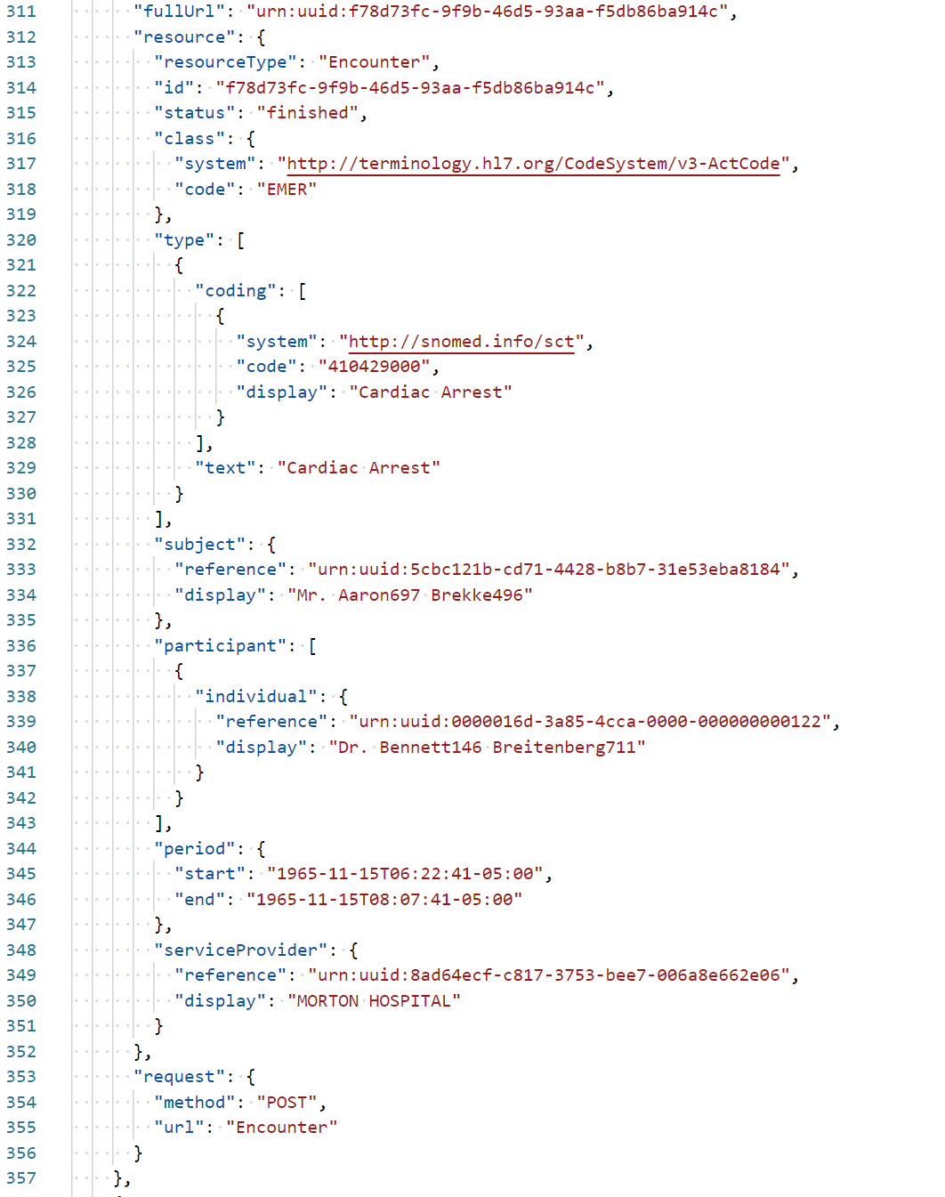
Ingest
Encounters
Original Encounter from the Bundle
Things to note:
Participant
reference: urn:uuid:00000016d…
ServiceProvider
- reference: urn:uuid:8ad…

Slide 9
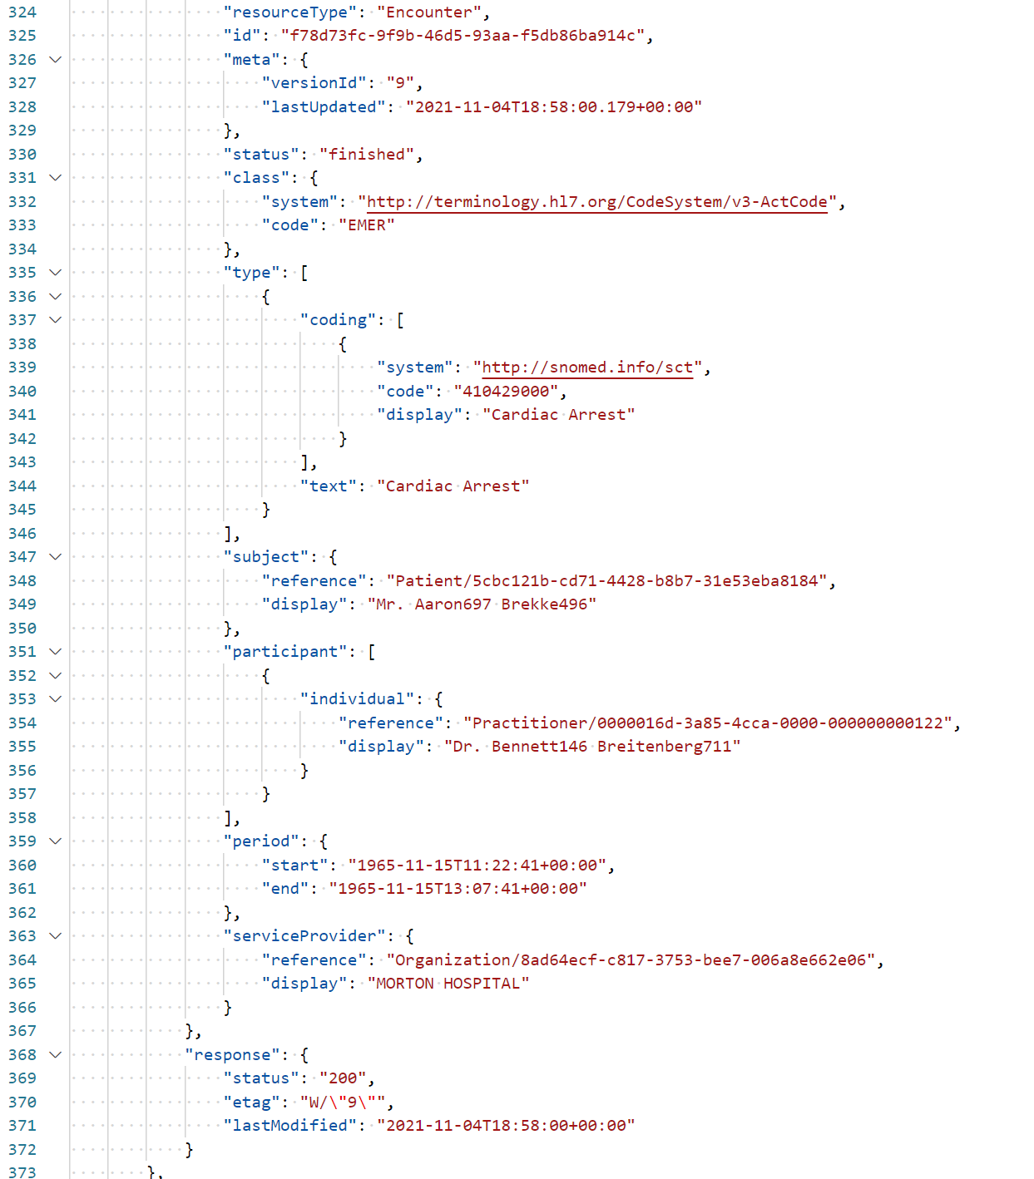
Ingest
Encounters
Processed Encounter
Things to note:
Participant
reference: Practitioner/00000016d…
ServiceProvider
- reference: Organization/8ad…

Slide 10
Things to note:
Bundles changed via the loading process
Transactions are converted to Batch
Reference URL’s (urn:uuid) are replaced by Resource Names
Action (ie POST) is replaced by Reply (Status = 200)
What does this
- FHIR-Loader and FHIR-Proxy have a module to Transform Transaction Bundles to Batch Bundles on loading.
How to Enable (Loader)
Enabled by default during deployment –or-
Set the Function -> Application Configuration variable
FBI-TRANSFORMBUNDLES = true

