Slide 1
Hospitality data analysis
Tools used : Microsoft Excel , MySQL , Tableau

Slide 2
Introduction
Problem Statement
The hospitality industry generates large volumes of booking and revenue data
Analyzing this data helps understand performance and customer behavior
This project analyzes hotel data to derive meaningful business insights

Slide 3
Objectives
Analyze performance of hotels and revenue trends
Measure key hospitality KPIs
Identify peak and low demand periods
Understand customer booking behavior
Provide actionable business insights

Slide 4
Tools & Techniques Used
Tool Used:
Excel / MySQL / Tableau
Data Cleaning:
Handled missing values
Data Analysis:
KPI calculation
Trend & Performance analysis
Data Visualization:
Bar charts
Line charts
KPIs

Slide 5
Key KPIs (Business Performance Summary)
Total Bookings: 134,590
Shows strong customer acquisition.
High booking volume indicates good marketing, OTA visibility, and brand awareness.
Total Revenue: ₹1,70,87,71,229 (~₹1.71 billion)
Indicates strong financial performance.
Occupancy: 58%
Indicates 42% room inventory is unused, indicates:
Inefficient capacity utilization
Pricing strategy gaps
Low weekday demand

Slide 6
Cancellation Rate: 25%
1 out of every 4 booking get cancelled.
This is significantly high.
Average Daily Rate (ADR): 12,696
The Average Daily Rate (ADR) is ₹12,696, indicating that the hotel earns approximately ₹12,696 for each occupied room per day.
This reflects the hotel’s pricing strategy and revenue generation capability.

Slide 7
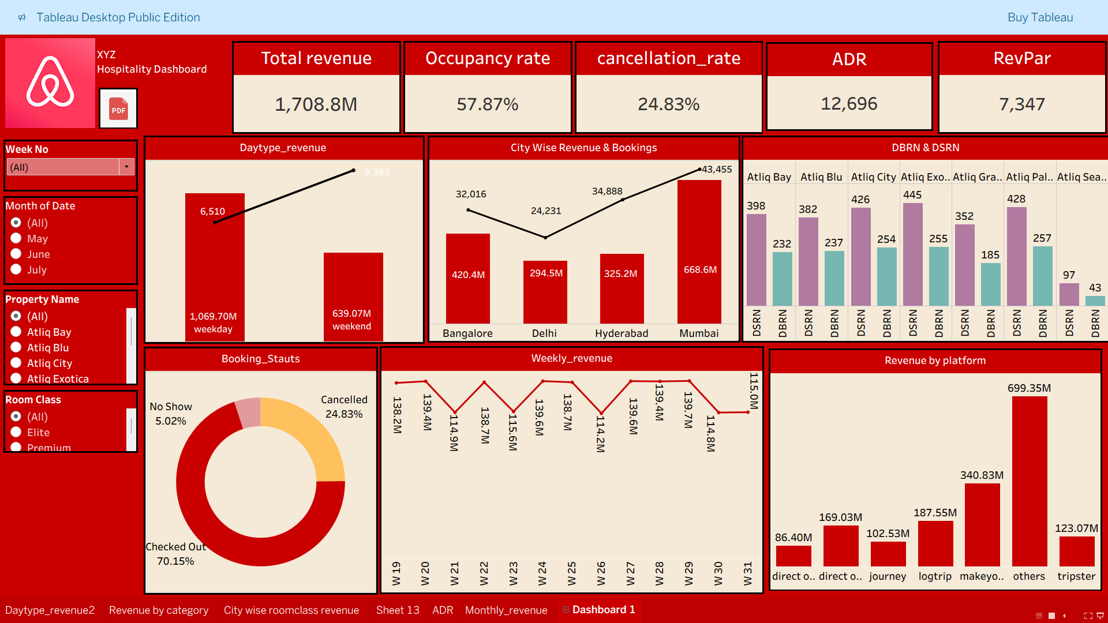
Revenue analysis
Revenue trend over time
Comparison across locations
High and low revenue periods

Slide 8
Occupancy analysis
Average Occupancy Rate
Occupancy by Properties

Slide 9
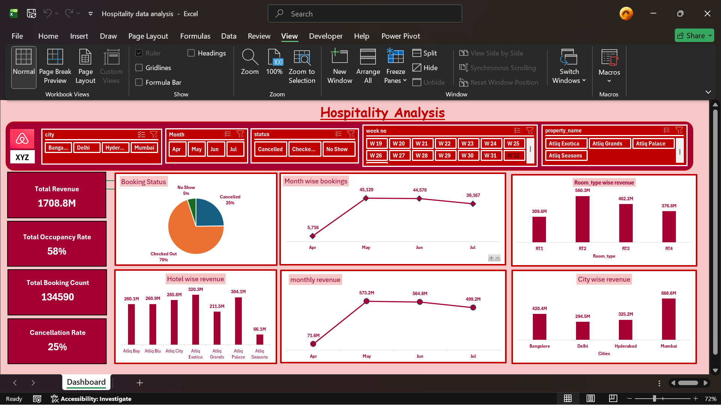
Customer & Booking Analysis
Booking patterns by customer segment
Room type preference
Seasonal demand behavior

Slide 10
Deep Business Insights (Overall)
Strengths:
High premium class revenue (Elite + Premium = 60%)
Strong weekday revenue
Good performance in Mumbai & Bangalore
Atliq Exotica performing exceptionally well
Weaknesses:
Only 58% occupancy → lots of empty rooms
25% cancellation rate → revenue leakage
Delhi & Seasons hotel underperforming
No-show issue (5%) blocks inventory
Opportunities:
Dynamic pricing for weak months
Reduce cancellations via policies
Target corporate clients for weekday demand
Push promotions for RT1 & Standard rooms

Slide 11
Tableau Dashboard

Slide 12
Excel Dashboard

Slide 13
Conclusion
Data analysis provides valuable insights for hospitality businesses
The dashboard shows strong revenue and booking performance but highlights challenges such as low occupancy and high cancellations.
Premium categories and major cities perform well, while some hotels lag behind.
Improving pricing, reducing cancellations, and optimizing capacity can significantly enhance overall business performance.
Helps improve decision-making and revenue management
This project demonstrates practical application of data analytics

Slide 14
Thank You

