Slide 1
Breaking a CAPTCHA system using Neural networks
Aman Kr Mishra – 20BCE1382
Ansh Goel - 20BCE1798

Slide 2
Abstract
Captcha or Completely Automated Public Turing test to tell Computers that the operator is human or not . Almost every website now have process of checking whether the website is being crawled by some sort of automated bots or not .Earlier there was too much attacks on the website using bots which used to cause a lot of harm to the big companies so they invented Completely Automated Public Turing test to tell Computers and Humans Apart which no doubt helped them a lot in preventing the attacks via bots but now the world is much more advanced and with some lines of codes we can break various types of captchas and that is what we are doing in this paper proving the point that now captchas are just a matter of hindrance that decreases the human experience with the various websites as even sometimes they cannot enter the captcha that a bot can easily break and waste the important time of human. So here in our study we proved our point by breaking the various sorts of captchas like numerical, alphanumerical, circle captcha, captcha v2 etc. . We are proving our points by getting pretty good accuracies .We used Convolutional neural network for our purpose some captchas were easy to break with only a few layers while some took pretty big networks. In the end we will also be discussing some ways that makes the websites more secure and much easy for the humans to enter a website

Slide 3
Contd.
Text-based CAPTCHAs are most commonly used by various websites to distinguish between humans and computers. It is used as a security measure. This work consists of a dynamic approach that is proposed to predict Text-based CAPTCHAs that challenges the supposition that they cannot be solved by computers. Three types of CAPTCHAs namely Rotated, Noisy Arc, Complicated Background have been taken.

Slide 4
PROBLEM IDENTIFIED/STATEMENT
Text-based CAPTCHAs are most common but we believe that it should not be used and is just a hurdle for the users which irritates them and to prove that we’ll be breaking the captcha using various neural networks. It’ll save the time of the users and prevent them from unnecessary steps, when we enter the captcha wrong we just have to enter our whole details again which is irritating to the user.

Slide 5
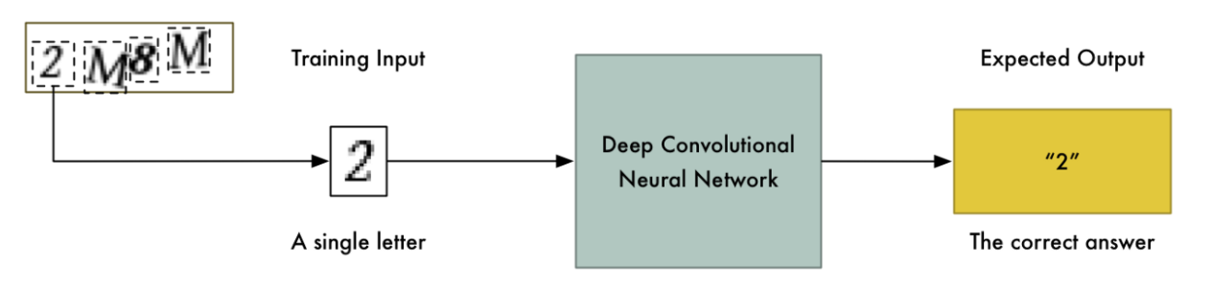
PROPOSED SOLUTION
Text-based CAPTCHAs are most common but we believe that it should not be used and is just a hurdle for the users which irritates them and to prove that we’ll be breaking the captcha using various neural networks. It’ll save the time of the users and prevent them from unnecessary steps, when we enter the captcha wrong we just have to enter our whole details again which is irritating to the user.

Slide 6
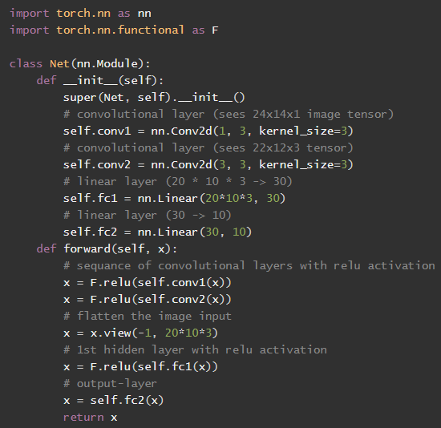
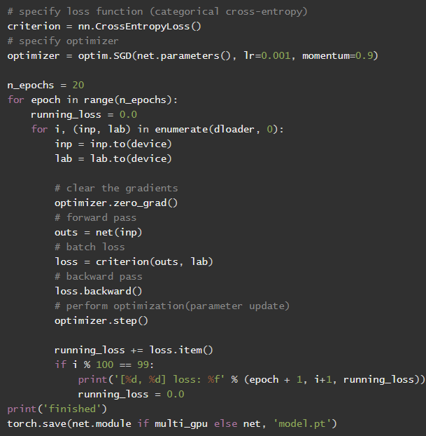
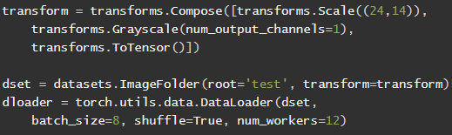
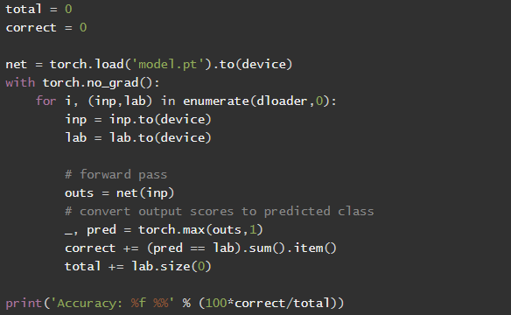
PROJECT STATUS
1. CODING

Slide 7
CONTD.
2. TECHNOLOGIES / SOFTWARE / HARDWARE
To complete this project, we needed the following:
A local development environment for Python 3 with
Modern Operating System:
Windows 7 or 10
Mac OS X 10.11 or higher, 64-bit
Linux: RHEL 6/7, 64-bit (almost all libraries also work in Ubuntu)
x86 64-bit CPU (Intel / AMD architecture)
4 GB RAM
5 GB free disk space
A working webcam to do real-time image detection.
We will build a sign language classifier using a neural network. Our goal is to produce a model that accepts a picture of a hand as input and outputs a letter.

Slide 8
Python 3
Python is a fun programming language with great libraries for machine learning and computer vision.
OpenCV
OpenCV is a popular framework for computer vision and image processing. We’ll use OpenCV to process the CAPTCHA images. It has a Python API so we can use it directly from Python.
Keras
Keras is a deep learning framework written in Python. It makes it easy to define, train and use deep neural networks with minimal coding.
Pytorch
PyTorch is a library for Python programs that facilitates building deep learning projects

Slide 9
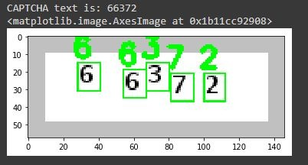
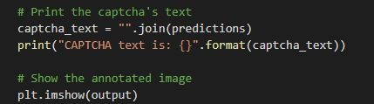
3. WORKING MODEL

Slide 10
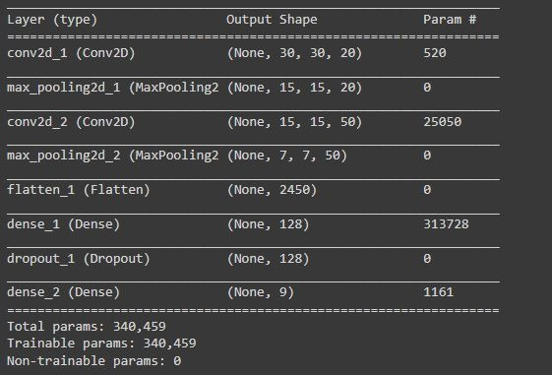
4. DEMO
We have compiled the code for this project on Google Colab Open Source Software.
Link - https://colab.research.google.com/#

Slide 11
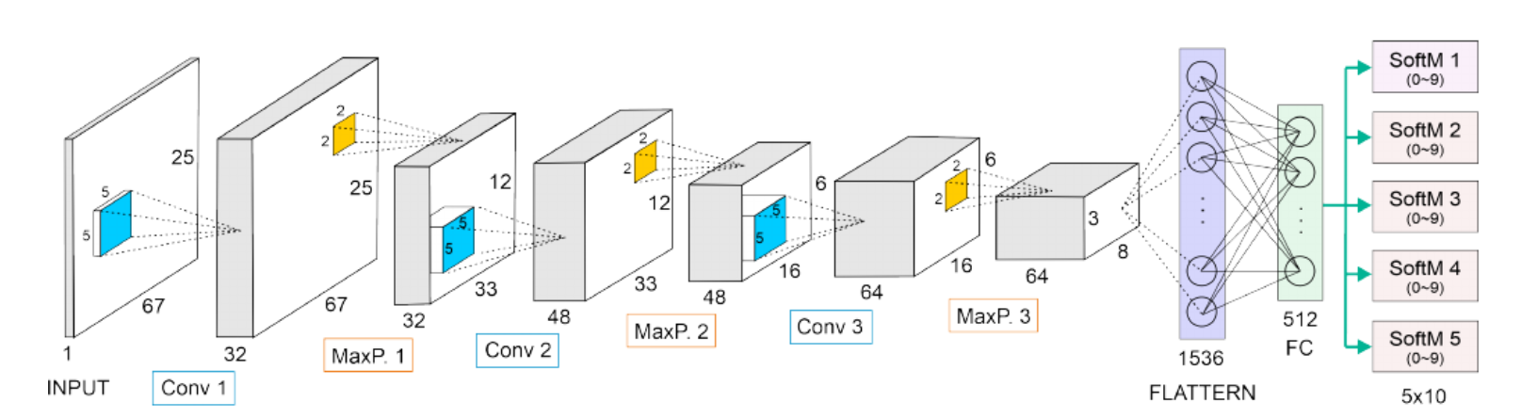
Our model architecture

Slide 12
Expected Contributions / Student wise
Aman Kr Mishra - Preparing the prediction Classifications Dataset
Building and Training the data
Data preprocessing and Testing
Ansh Goel - Saving Models and Weights
Define Keras neural network that includes the layers

Slide 13
Remaining Work:
DATASET PREPARATION
ENHANCEMENT AND UPGRADATION

