Slide 1


MENTAL HEALTH
COMPANION
SECTION - D
MAY - 2025
SUBMITTED BY :
ANSH SARASWAT
SHREYA PANCHOLI
ARYANDEEP SINGH
SUBMITTED TO:
M.S NEHA MISHRA

Slide 2

ORIGIN
Our companion was inspired by growing concern over the silent struggles people face daily. With increasing cases of mental illness—especially post-pandemic—it became clear that open conversations and support systems were needed more than ever. Mental health issues like anxiety, depression, and stress affect millions globally, yet stigma, misinformation, and lack of access often prevent people from seeking help.

Slide 3


OBJECTIVE
Encourage positive thinking with gratitude prompts and self-care tips
Provide immediate, stigma-free support through a chatbot or interactive tools
Support individuals in managing their mental health daily by providing accessible, user-friendly tools that promote emotional well-being, self-awareness, and positive mental health habits—anytime, anywhere.
Instant Support
Positive Habit Building
Education & Awareness

Slide 4





OUR LOGO
Symbolically represents the concept of mental health and personal growth. The tree is often used in psychology and wellness to symbolize resilience, healing, and the natural development of thoughts and emotions. The seamless blend of nature and the human mind in the image suggests that mental well-being is a living process, much like a tree that requires nurturing, care, and the right environment to thrive.

Slide 5

SOFTWARE & LANGUAGES
Visual Studio Code (VS Code) is a free, lightweight, and powerful code editor developed by Microsoft.
🖥️ Frontend (Client-side)
Languages used to build the visual part of websites:
HTML – Structure of the webpage.
CSS – Styling (colors, layout, fonts).
JavaScript – Interactivity (dropdowns, animations, etc.)
🔧 Backend (Server-side)
Languages and technologies used for logic, databases, and user management:
JavaScript – Server-side JS

Slide 6



SERVICES
A mental health companion often provides key services.
Journaling allows users to reflect on their thoughts and feelings, helping them track their mental state and reduce stress.
Meditation and relaxation features offer guided sessions and breathing techniques that promote calmness, focus, and better sleep.
An AI chatbot offers friendly, 24/7 emotional support, engaging users in conversation and providing coping strategies to help manage anxiety and loneliness.
Daily prompts
Calming soundscapes
Available 24/7 for support

Slide 7
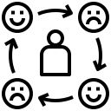

SERVICES
Supportive tools like mood tracking, gratitude journaling, and relaxation exercises to help users build emotional awareness and resilience.
Mood tracking allows users to log how they feel each day, helping them identify patterns, triggers, and changes in their mental well-being over time.
Gratitude journaling encourages users to focus on positive aspects of their lives by writing down things they’re thankful for, which can boost mood and reduce negative thinking.
Monitors progress
Builds resilience

Slide 8


SERVICES
Relaxation exercises, such as deep breathing, progressive muscle relaxation, and calming audio, are designed to ease stress and anxiety, offering users a moment of calm during their day.
Light and engaging games like puzzles or tic-tac-toe serve as a fun mental break, offering gentle distraction and relaxation during stressful times.
Improve focus and clarity
Healthy distraction

Slide 9
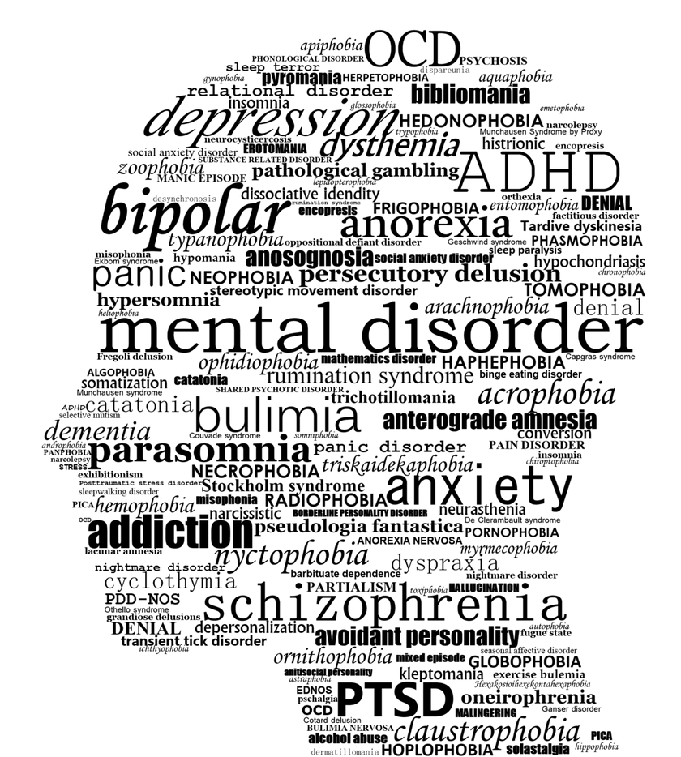
FACTS
1 in 4 people will experience a mental health issue at some point in their lives.
Mental health affects everyone, regardless of age, gender, or background.
Early intervention can significantly improve outcomes for mental health conditions.
Stigma remains a major barrier to people seeking help for mental health issues.
In many countries, over 75% of people with mental disorders receive no treatment.

Slide 10
PROMOTION
Promotes Routine and Structure
Provides 24/7 Support
Raises Mental Health Awareness
Offers educational content that helps users understand mental health, reduce stigma, and know when to seek help.
Improves Accessibility
Fosters Engagement and Motivation

Slide 11
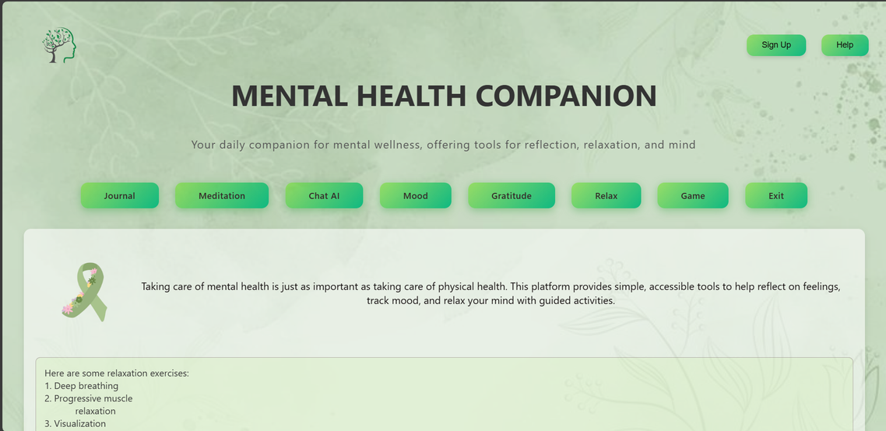
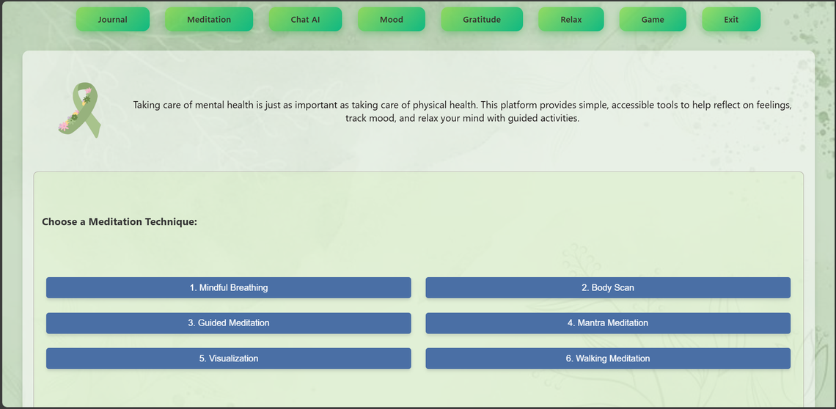
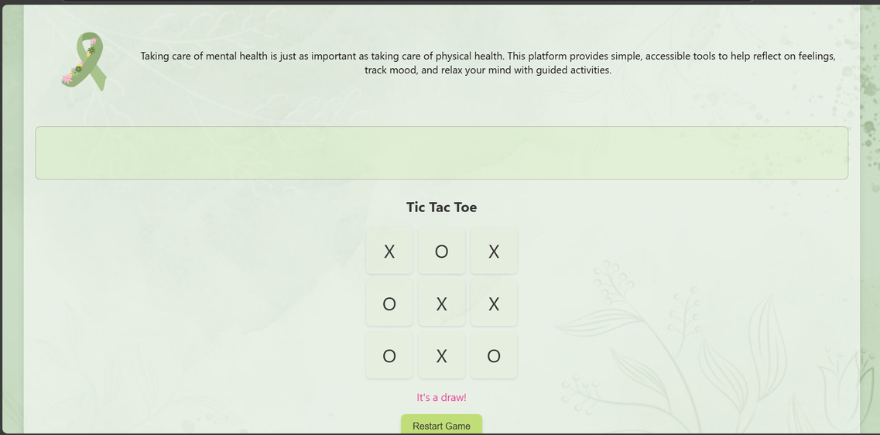
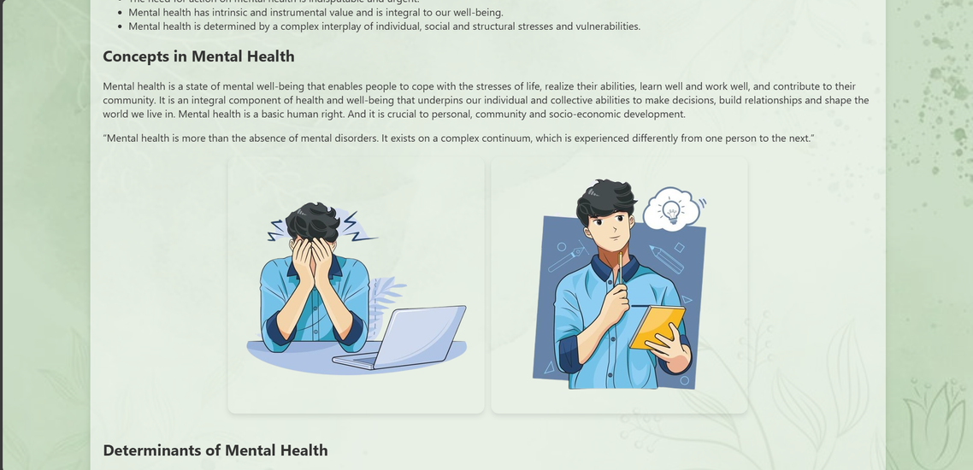
USER INTERFACE

Slide 12
TREATMENT
Early Detection and Monitoring
Guided Self-Help
Crisis Support
Some apps include access to emergency contacts, hotlines, or AI chatbots trained to offer immediate emotional support during distress.
Therapy Support
Habit Formation and Lifestyle Changes

Slide 13
STRENGTHS & OPPORTUNITIES
STRENGTHS
Safe space for self expression
Healthy habits
Personalized Experience
Boosts engagement with tools
Cost effective
OPPORTUNITIES
Growing global demand
Untapped markets
Personalized user experience
Partnership with clinics & therapists
Gamification and engagements

Slide 14
CHALLENGES & CONCLUSION
Privacy and Security Concerns
AI Limitations in Emotional Understanding
Over-Reliance on Technology
Lack of Personalization
Stigma and Reluctance to Use
Regulatory Challenges

Slide 15
Thank you

