Slide 1
ExactSpace
Data Science Assignment
Name: Ansh Dave
Email: ansh10dave@gmail.com

Slide 2
Data Preparation and Cleaning
→ Loading raw data into pandas dataframe
→ Discarding erroneous the values of the data - Found and dropped various erroneous data where values were
“I/O Timeout”,
“Scan Timeout”
“Not connect”
“Configure”
“Comm fail”.
→ Converting data type of columns to ‘datetime’ for time and ‘integer’ for Cyclone preheater columns
→ Checking and working with null values using isnull() function

Slide 3
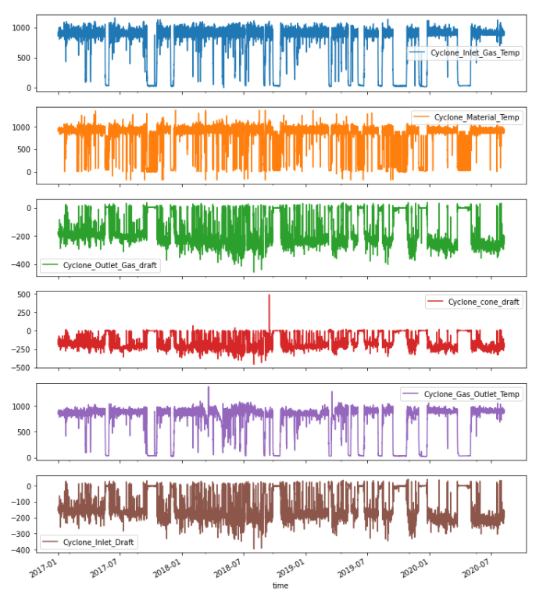
Data Analysis
→ Viewing descriptive statistical details using describe() fn.
→ Plotting those 6 variables with respect to time to get general idea about the data.
→ For detecting abnormalities during operations of cyclone preheater, we need to perform anomaly detection
→ As there is no predetermined labeling for outliers, we will use unsupervised learning.

Slide 4
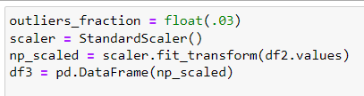
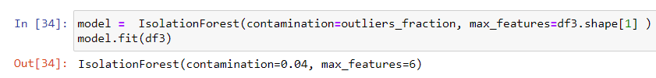
Detecting Abnormalities
→ Using Isolation Forest for detecting anomalies - Isolation Forest is based on decision trees for isolating anomalies
→ For generalization of data points, we scale the data using StandardScaler()
→ Creating Isolation Forest model with contamination factor of 0.02, which sets parameter where 2% data will be returned anomalous
→ Choosing max_features parameter considering cyclone inlet gas temp, outlet gas temp, cone draft, inlet draft, outlet draft, material temp as features of the model

Slide 5
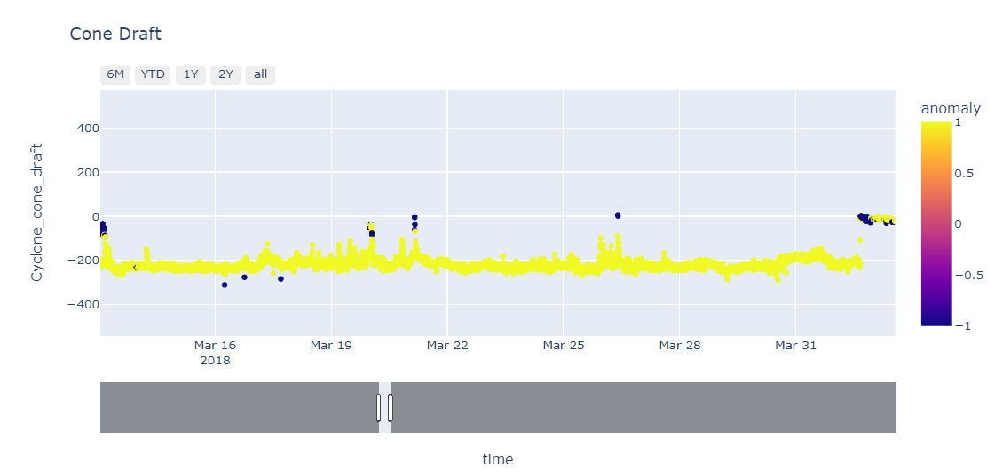
Detecting Abnormalities
→ Using model.predict(), we predict anomalies – creating a column ‘anomaly’ where an anomaly score of -1 is assigned to anomalies and score of 1 to normal data.
→ Using value_counts(), we can see that, there are around 7500 anomaly points out of 376k records.
→ Generating plots for visualizing anomalies
For eg: Anomalies in Cyclone cone draft
→ Generating “output.xlsx” file and highlighting timestamps with anomalies

Slide 6
Thank you

