Slide 1
RF Jamming Classification in Wireless Ad-Hoc Networks using Machine Learning
Submitted by :
Ansh Jain ( 712/IT/15 )
G S Kasturi ( 727/IT/15 )
Jahnvi Arya ( 732/IT/15 )
Supervised by :
Prof. Sanjay Kumar Dhurandher

Slide 2
Jamming Attack
Jamming attack is a type of Denial of Service (DoS) attack, which doesn’t allow other nodes from using the channel for communication by occupying the channel which they are communicating on.
A jammer in wireless sensor network is defined as an entity which purposefully tries to interfere with the transmission and reception of messages via wireless communication.

Slide 3
Motivation
Jamming attack is very easy to implement in wireless networks due to the open and shared nature of the 5 GHz Band
According to the current scenario it is easier to detect jamming from no jamming situation but it is difficult classify between various jamming situation.
We aim to classify different jamming attack models so that specific and appropriate countermeasures can be taken .

Slide 4
Jamming Attack Models
Constant jammers: A constant jammer continuously produces high-power noise that represents random bits. The bit generator operates independent of the channel sensing or traffic on the channel and does not follow any media access control (MAC) protocol
Random jammers: A random jammer operates randomly in both sleep and jam intervals. It sleeps irrespective of any traffic on the network during sleep interval,, and it acts as a constant or reactive jammer during jam interval.
Reactive jammers: A reactive jammer activates when it senses the transmission on the channel. It remains dormant if the channel is idle ,and keeps sensing the channel.

Slide 5
Jamming Detection Metrics
Packet delivery ratio: It is measure of the ratio of number of packets received that pass cyclic redundancy check (CRC) to the total number of packets received. The PDR is measured at the receiver side.
Carrier sensing time: It is the time a station has to wait for the channel to get idle in order to start its transmission.
Received signal strength: It is the signal power that is observed on the receiver end.
Noise: Noise is defined as the power measured on the channel during the idle time of the transmitting end. The strength of these jamming signals is recorded as the noise if the jammer transmits a signal when the transmitting end is idle.

Slide 6
System Design
Our project aims at detecting and classifying various jamming attacks in order to take necessary countermeasures. Our project involves mainly these tasks:
Simulation of jamming in Wifi Ad-Hoc Network.
Collection of data which is used for training and validating the machine learning algorithms
Use Gradient Boosting machine learning algorithm to detect and classify jamming attacks.

Slide 7
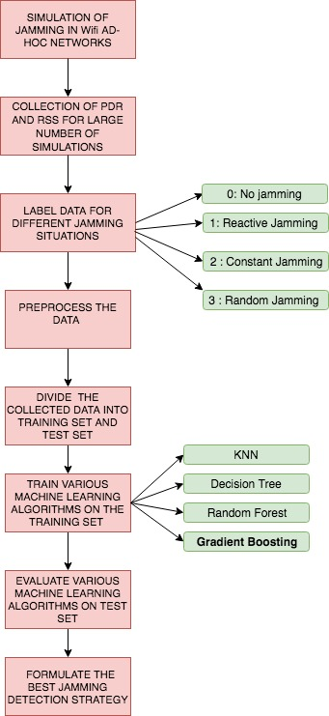
Our project
flow

Slide 8
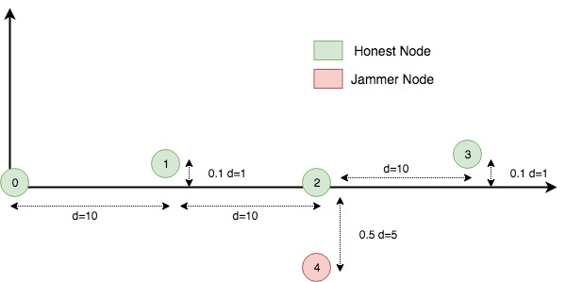
Network Topology
Our network topology comprises of 5 nodes . Among 5 nodes 1 node is the jammer node and other 4 nodes are honest nodes. Node 0 broadcasts UDP packets to all other nodes. The jammer, that is node 4, tries to jam node 3.

Slide 9
SIMULATION OF JAMMING IN WIRELESS AD-HOC NETWORKS
We simulate jamming attacks in wireless ad-hoc networks using the ns3- wireless jamming model. We simulate the jammed wifi ad-hoc network using Energy Model, Jammer, Wireless Module Utility and Wifi Phy modules.
Channel configuration: The main configurations of WifiChannel are propagation loss model and propagation delay model .We use Constant Speed Propagation Delay Model and Friis Propagation Loss Model.
Physical Layer Configuration: We set Tx gain of the transmitter as -10 dB and Rx gain of the receiver as 1 dB in the initial configuration .

Slide 10
Mac layer Configuration: We add a non-Qos upper MAC and disable rate control We use DSSS and a constant data rate of 1Mbps. We Fix non-unicast data rate to be the same as that of unicast. We configure the wifi architecture as Ad-hoc.
We use the 802.11 b Wifi Standard.
Network Layer Configuration: We use the InternetStackHelper Class in order to provide implementation of TCP/IPv4 and IPv6-related components. We use IPv4 protocol at network layer .
Transport Layer Configuration: We use UDP at transport layer .

Slide 11
Energy configuration: We install an energy source (Basic Energy Source) and energy model (Wifi Radio Energy Model) onto each node. Wifi Radio Energy Model represents energy model for Wifi radio devices. We set the initial energy of basic energy source installed on each device as 0.1J. We set the current draw of the Wifi radio devices as 0.0174A.
Wireless module utility installation: We install Wireless Module Utility onto every node for monitoring packet delivery ratio and received signal strength for the receiver.
Installation of jammer: We use Jammer class to install jammer onto node 4 to implement various types of jammer that are Constant jammer, Reactive jammer and Random jammer.

Slide 12
Creation Of Dataset
We vary various simulation parameters in order to collect Packet Delivery Rate (PDR) and Received Signal Strength (RSS) at receiver for different jamming situations.
Distance between sender and receiver
Distance ‘d’ between the nodes
Transmission power of the sender
After collecting packet delivery ratio (PDR) and received signal strength (RSS) for different jamming scenarios, we label the data. We use
0 for No Jamming
1 for Constant Jamming
2 for Reactive Jamming
3 for Random Jamming

Slide 13
Experiments
We performed a number of simulations by varying parameters like distance between nodes and power of transmission of nodes in order to collect data.
Jamming situation: We collected data for the three jamming attacks (Constant, Reactive and Random) by varying the distance ‘d’ between the nodes and the transmission power of the sender.

Slide 14
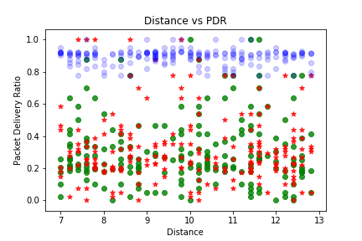
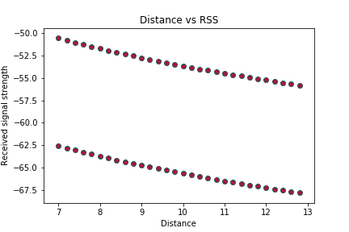
Variation of distance:

Slide 15
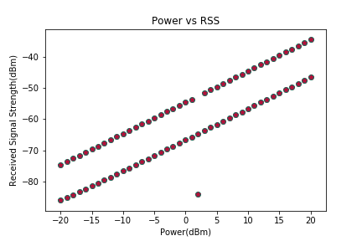
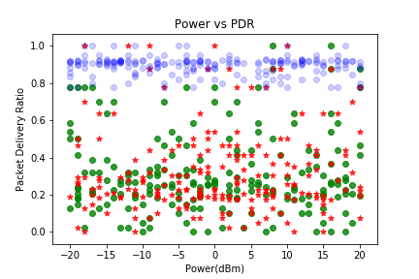
Variation of transmission power :

Slide 16
Application of ML for Jamming Detection & Classification
We divide the data collected into train set and test set and apply various machine learning algorithms . We evaluate the performance of various machine algorithms which are:
KNN
Decision tree
Random Forest
Gradient Boosting

Slide 17
Gradient Boosting
It is an ensemble of classification or regression models. It uses forward-learning ensemble models, which obtain predictive results using gradually improved estimations.
GBT build trees one at a time, where each new tree helps to correct errors made by previously trained tree.
Boosting helps improve the tree accuracy.

Slide 18
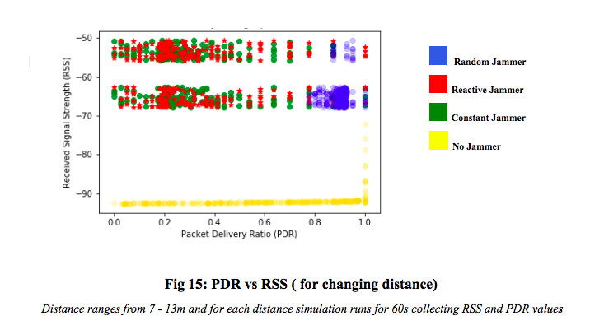
Results
Variation of distance :

Slide 19
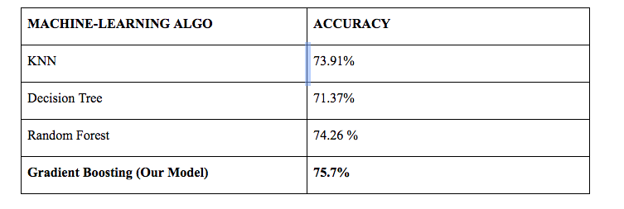
Evaluation of various models on data collected by varying the distance :
Proposed model using Gradient Boosting

Slide 20
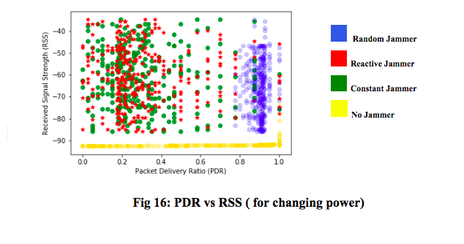
Variation of transmission power:

Slide 21
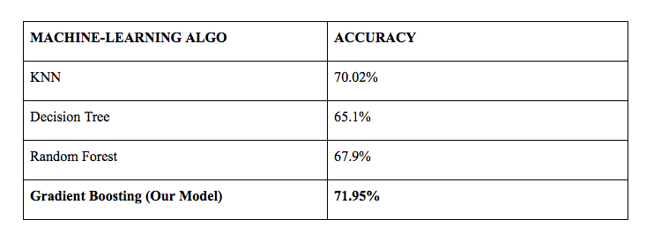
Evaluation of various models on data collected by varying the Transmission power of the sender :
Proposed model using Gradient Boosting

Slide 22
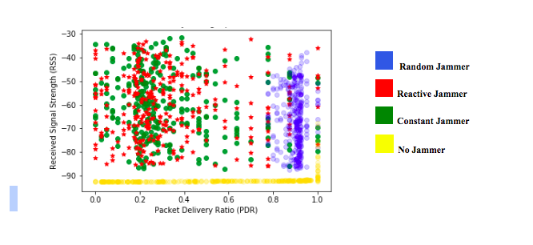
Variation of Power and distance ‘d’ simultaneously :

Slide 23
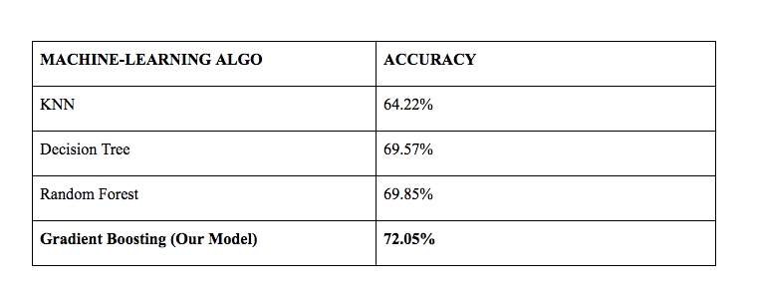
Evaluation of various models on data collected by varying the distance ‘d’ and Transmission power of the sender simultaneously :
Proposed model using Gradient Boosting

Slide 24
Confusion Matrix
 | 0 | 1 | 2 | 3
0 | 0.9907 | 0.0017 | 0.004 | 0.003
1 | 0.014 | 0.304 | 0.659 | 0.0217
2 | 0.02 | 0.69 | 0.266 | 0.02
3 | 0.021 | 0.016 | 0.029 | 0.93

Slide 25
Conclusion & Future Work
We collected data and used machine learning to classify different types of attacks so that appropriate countermeasures can be taken. Our simulation results show that Gradient Boosting gives the best performance.
We also conclude that it is difficult to classify between Reactive and Constant Jammers whereas detecting whether jamming is occurring or not is relatively simple task.
Further research on this topic can include extending these algorithms for networks with mobile nodes like VANETS by including features such as relative speed of nodes, location etc. The most natural step although, after classification of different types of jammers is to form techniques to prevent each type of attack. This is also a challenging and interesting research topic.

Slide 26
References
https://medium.com/greyatom/decision-trees-a-simple-way-to-visualize-a-decision-dc506a403aeb
https://towardsdatascience.com/the-random-forest-algorithm-d457d499ffcd
https://www.nsnam.org/wiki/Wireless_jamming_model
https://www.geeksforgeeks.org/computer-network-network-simulator-3/ https://www.cisco.com/c/en_in/solutions/small-business/resource-center/networking/wireless-network.html
https://www.igi-global.com/chapter/jamming-attacks-countermeasures-wireless-sensor/41122

Slide 27
Thank you

