Slide 1

CS-319 Project Presentation
Presenter: Fereshteh Vedadi
Lab Coordinator: Eray Tüzün
Project: BILSEN Review Process Automation

Slide 2

BILSEN Group
Vision Enhance the productivity of software engineering teams through data-driven and data science–based techniques.
Group Composition • Graduate students: 9 • Undergraduate students: 18
Notes:
Computer Science Department
(45 students) Scholarship students 250 / 3.500.000
(35 students) 50% scholarship students 2500/3.500.000
(80 students) top %0.4 students

Slide 3
Automating the BILSEN Internal Review Process
Context
BILSEN conducts internal paper reviews before conference/journal submission.
Reviews are essential for maintaining research quality and consistency.
Goal
Transform the current manual, and coordination-heavy review process into a structured, partially automated, and data-driven system.
Improve efficiency, traceability, and scalability.

Slide 4
Current Process (As-Is): Step-by-Step Flow
Paper Submission
Authors notify the lab coordinator upon completing the final version of their manuscript.
Reviewer Assignment
Coordinator manually assigns reviewers, sets the review deadline, shares the project Overleaf link with the assigned reviewers and notifies them by email.
The lab coordinator sometimes needs to remind reviewers of their tasks, as missed deadlines or late extension requests can prevent timely reassignment and lead to missed reviews.
Review Execution
Reviewers:
Join the Overleaf and read the manuscript
Leave free-form comments on Overleaf

Slide 5
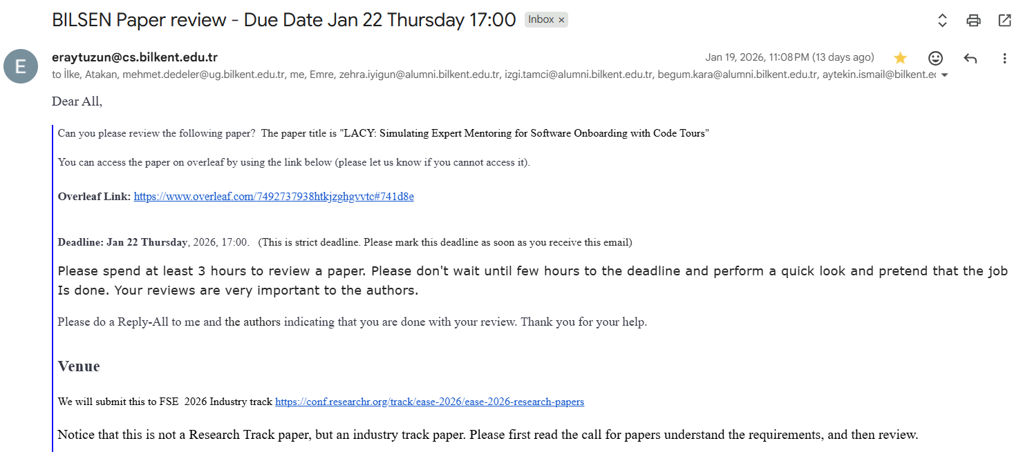
Sample Email Sent to Assigned Reviewers by the Coordinator

Slide 6
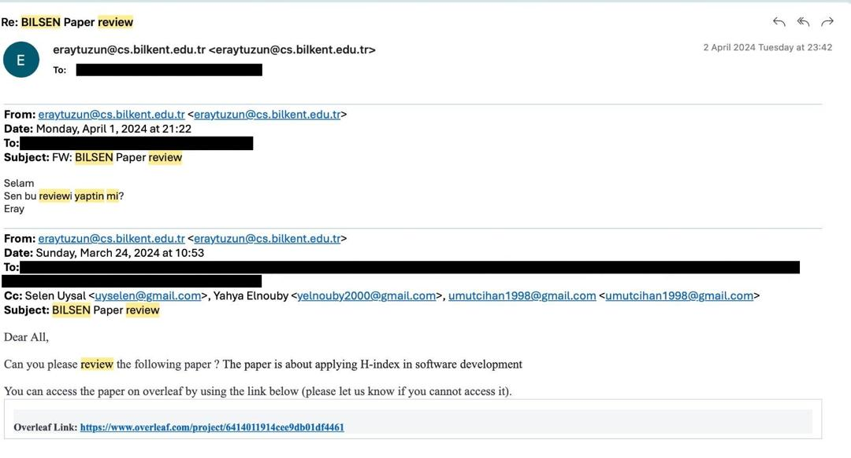
Sample Reminder Email Sent by the Lab Coordinator

Slide 7
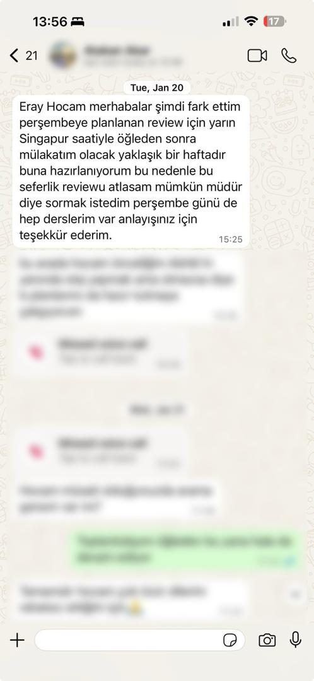
Example of a Reviewer Declining a Review for Personal Reasons

Slide 8
Current Process (As-Is): Step-by-Step Flow
4. Review Completion
Reviewers email authors and coordinator when done.
5. Feedback on Obtained Reviews
After the review deadline, the coordinator manually follows up with authors to assess:
Whether all assigned reviewers completed their reviews on time.
The perceived quality and usefulness of the received reviews.

Slide 9
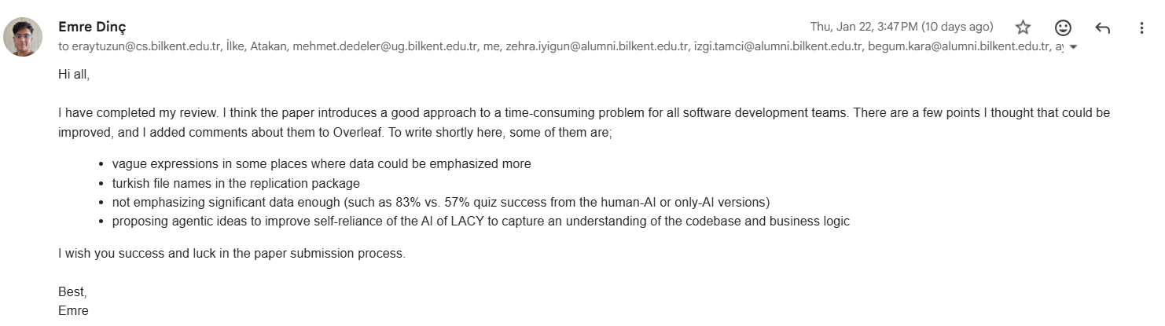
Sample Email Sent by a Reviewer After Completing the Review

Slide 10
Current Process (As-Is): Step-by-Step Flow
6. Iteration
Authors read comments, provide feedback and may ask clarifications on Overleaf comments.
Reviewers periodically revisit the Overleaf project to respond possible questions and engage in further discussion when needed.
In cases of rejection or major revision, the process is repeated after manuscript revision. Maintaining a record of previous reviewers is important, as new reviewers are usually assigned in later rounds.
7. Manual Author Checks
Authors:
Use AI-driven review tools for further improvement
Check venue requirements and formatting
Control a checklist appropriate to the paper type

Slide 11
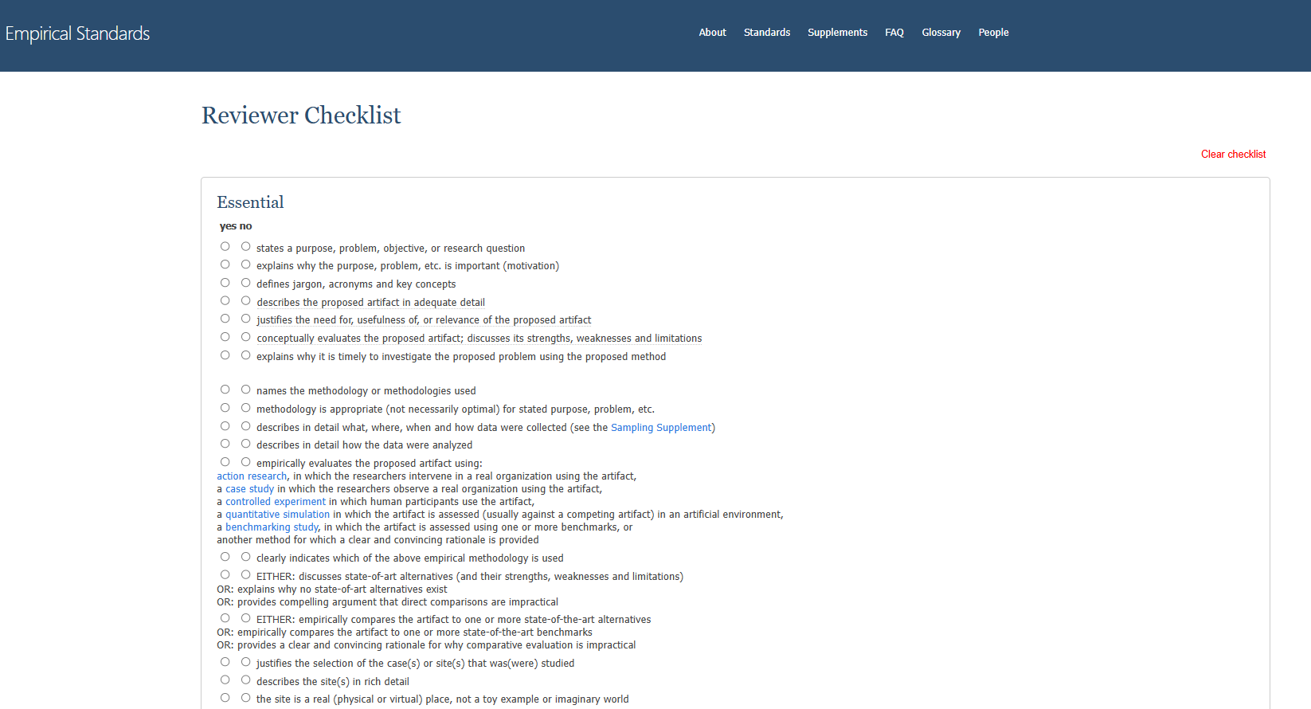
Sample of a Quality Checklist

Slide 12
Key Limitations of the Current Process
Manual & Error-Prone Coordination
Reviewer workload is not balanced.
Deadlines are tracked manually.
Missed or late reviews may go unnoticed.
Does not scale as submissions increase.
No Traceability of Reviewer Performance
Review quality feedback is: informal, subjective, and not stored.
No historical data on reviewer performance.

Slide 13
Key Limitations of the Current Process
Heavy Cognitive Load on Authors
Authors must manually handle:
Reviewers’ feedbacks
AI-based reviews
Venue-specific formatting rules (page limits, abstract length, anonymity check)
Quality checklist
These tasks are disconnected, undocumented, and error-prone.
No Centralized Visibility or Analytics
No insight into: reviewer timeliness, workload distribution, and papers previously reviewed by each reviewer.

Slide 14
Why Change Is Needed?
As BILSEN grows:
Number of papers increases
Number of reviewers increases
Number of review rounds increases
Current process does not scale. We need a system that:
Reduces coordination overhead
Improves consistency and traceability
Enables analytics and long-term improvement
Preserves academic rigor and human control

Slide 15
“To-Be” Automated Bilsen Review Process
Automated Pre-Check & Compliance Validation Based on the selected venue and track, the system should automatically verify compliance with:
Page limit
Abstract word count
Required sections
Reference format
Anonymity requirements by checking for organization and institution anonymization, ensuring PDF metadata (e.g., author and company fields) is cleared, and validating that tool or dataset links do not reveal author identities.
Detect paper type (research, survey, etc.) and activate the appropriate checklist dynamically.

Slide 16
“To-Be” Automated Bilsen Review Process
Reviewer Assignment & Workload Balancing
Coordinator selects reviewers & deadline
System:
Automatically notifies reviewers by email.
Tracks the assigned reviews per reviewer.
Enable reviewers to accept or decline review assignments (by providing a valid reason) or request deadline extensions.
Enables:
Balanced workload distribution.
Early detection of overload or inactivity.
Reviewer selection in future review rounds of a paper.

Slide 17
“To-Be” Automated Bilsen Review Process
Automated Coordination & Deadline Management
Send reminder emails to assigned reviewers as the deadline approaches.
Alerts to coordinator when deadlines are missed.
Reduces:
Manual follow-ups.
Missed or overdue submissions.

Slide 18
“To-Be” Automated Bilsen Review Process
AI-Assisted Review Support (for Authors)
The system supports automated review generation by:
Highlighting potential issues directly in Overleaf and providing improvement suggestions as free-form comments (ideal one).
Generating formal review reports based on predefined template.
Producing annotated PDF documents with highlighted issues and suggested improvements.
Performing structured, checklist-based compliance checks.
Ensure:
No hallucinated references
No unsupported claims

Slide 19
“To-Be” Automated Bilsen Review Process
Reviewer Evaluation Mechanism
After review completion, authors rate reviewers on:
Quality of comments
Quantity of feedbacks
Timeliness
Ratings contribute to:
Reviewer performance statistics
Long-term quality monitoring

Slide 20
“To-Be” Automated Bilsen Review Process
Reviewer Evaluation Mechanism
Dashboard should show:
Ranked list of reviewers based on performance metrics (review quality, quantity, and timeliness).
Assigned and completed reviews per reviewer, tracked monthly, yearly, and overall.
Review assignment acceptance and rejection rates per reviewer, tracked monthly, yearly, and overall.
Percentage of on-time versus delayed reviews per reviewer, tracked monthly, yearly, and overall.
Average reviewer score.
Purpose
Enable data-driven decisions.
Monitor health of the review process.

Slide 21
“To-Be” Automated Bilsen Review Process
Venue Recommendation & Submission Support (Optional)
Recommend suitable venues based on:
Paper type
Content
Allow authors to select a target venue
Enable direct submission once:
All checks are satisfied

Slide 22
Thanks for your Attention
Questions? Feel free to reach out via Slack (“Fereshteh Vedadi”).

