Slide 1

Assessment Portal for Online Exams

Slide 2
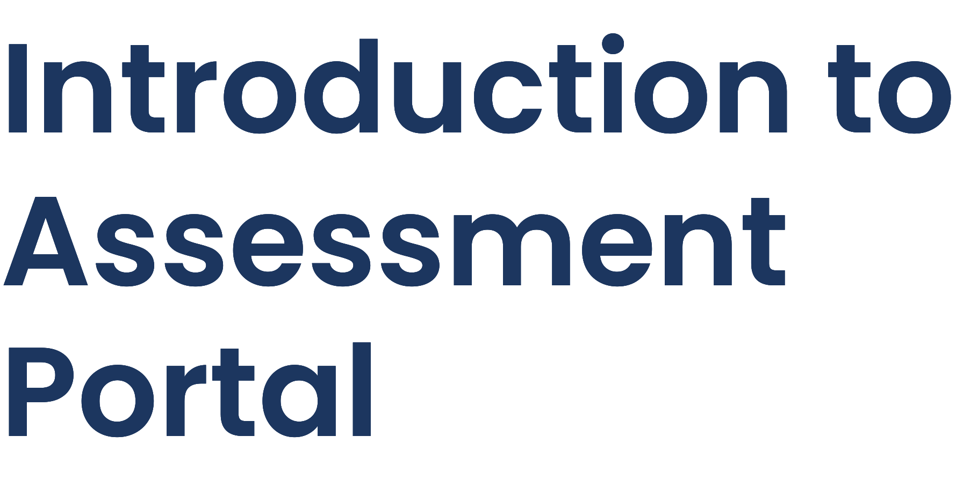

Assessment Portal is a platform designed to streamline the online exam experience. It is a Web Application for Managing and Taking Assessments. This presentation will provide a comprehensive overview of its features and benefits.

Slide 3


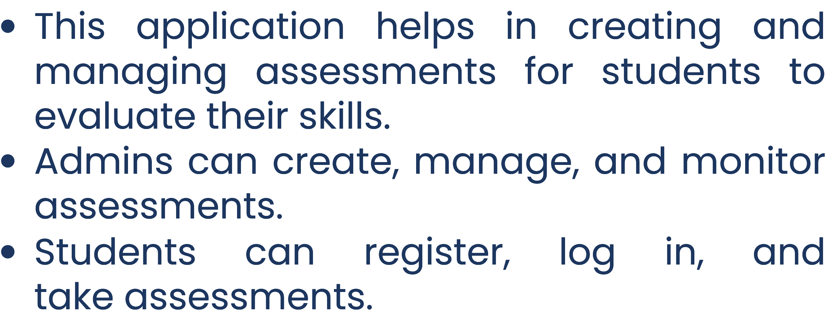

Slide 4



Development Environment
Technology Stack
Eclipse IDE Tomcat 9 Server MySQL Server MySQL
Workbench
Frontend: HTML,CSS,JS Backend: Java Database: MySQL

Slide 5
ADMIN ROLES
Login: Username and password for secure access.
Dashboard:
Lists tests with details (number of questions, participants)
Add New Test.
Provides Edit and Delete actions for each test.
Set Pass Mark: Define passing criteria for each test.
Logout: Secure session termination

Slide 6
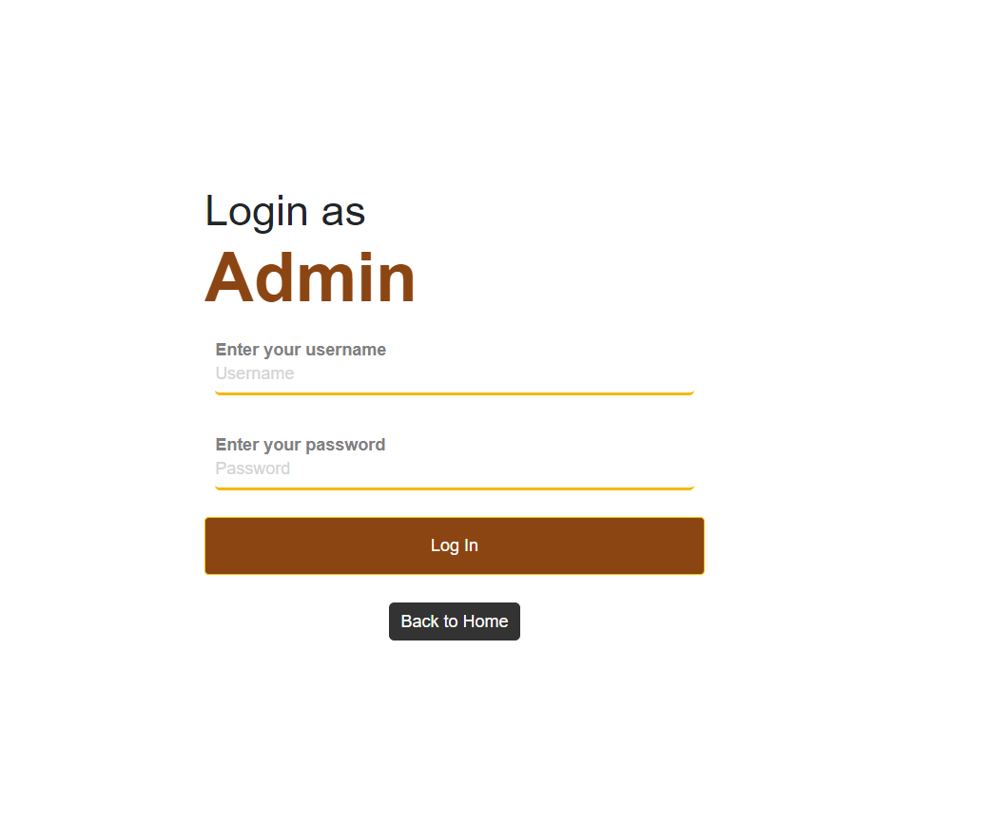

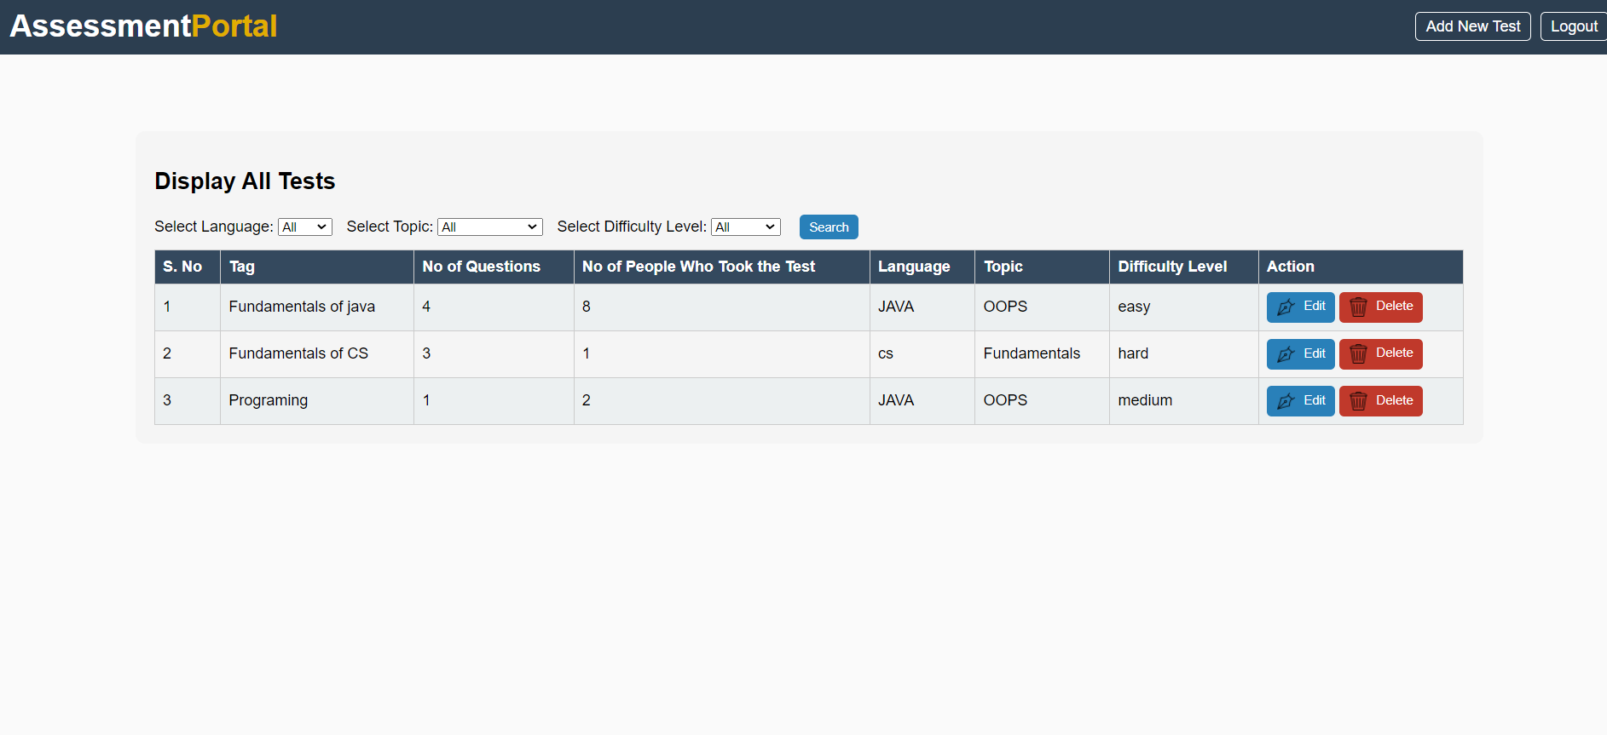
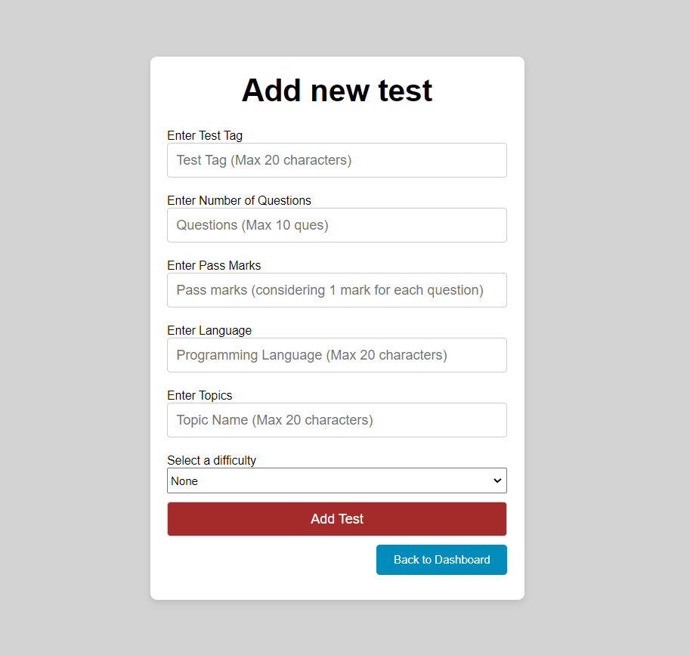
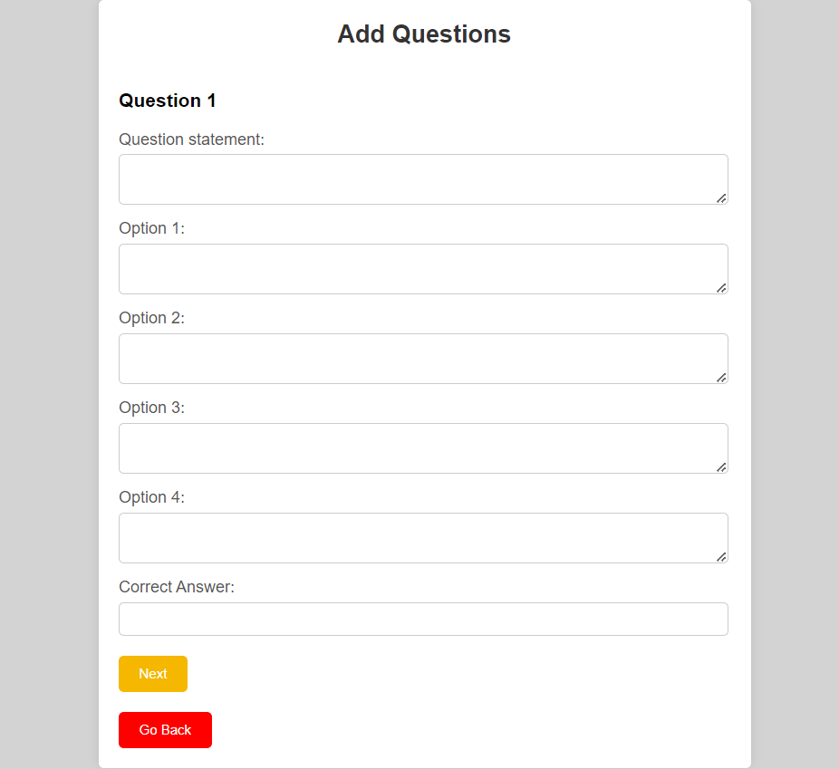
GLIMPSE OF ADMIN

Slide 7


Registration: Provide name, mobile number, and password.
Login: Use mobile number and password for access.
Test Options Page: Choose available assessments.
Test Participation: Answer questions, submit the test.
View Results : Check performance, go back or logout.

Slide 8
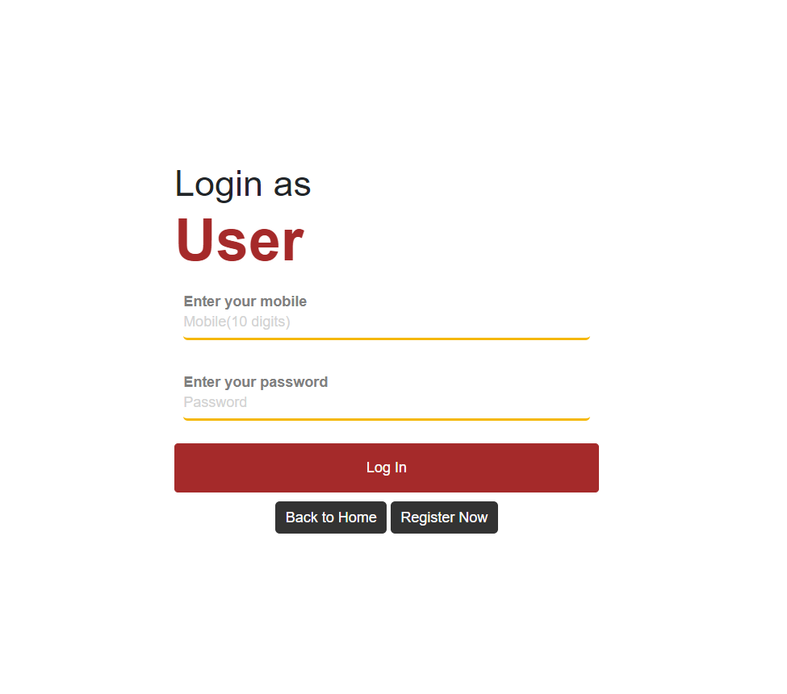
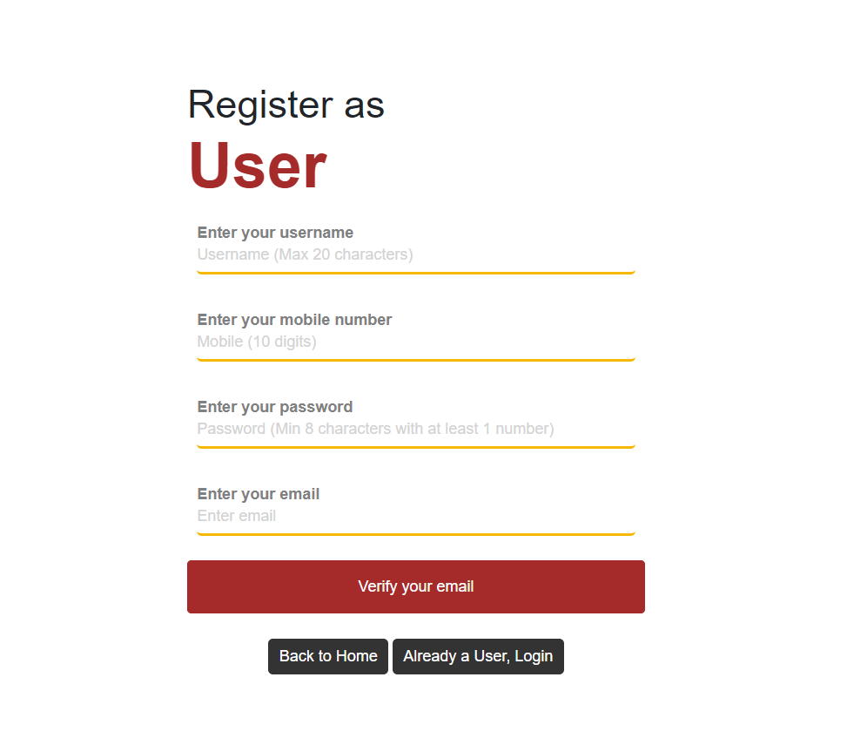
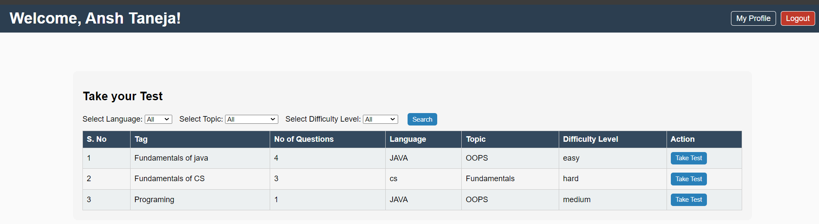
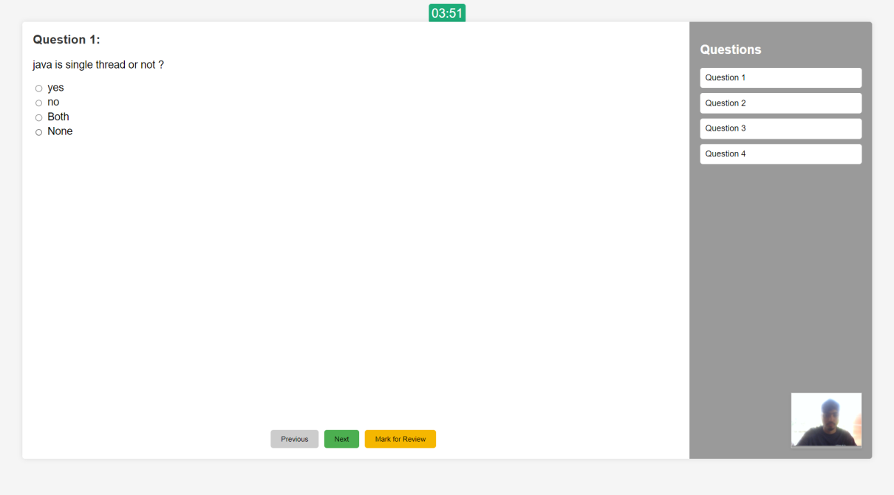
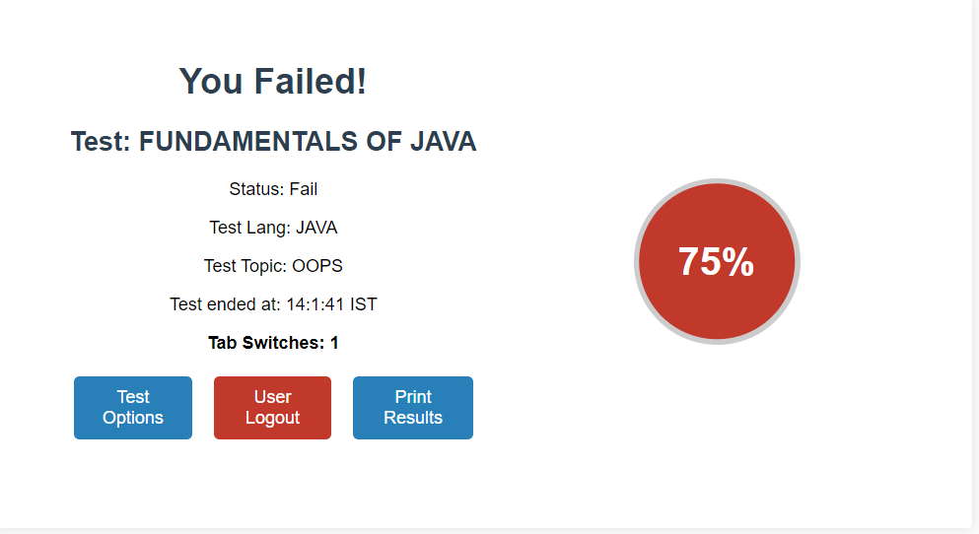
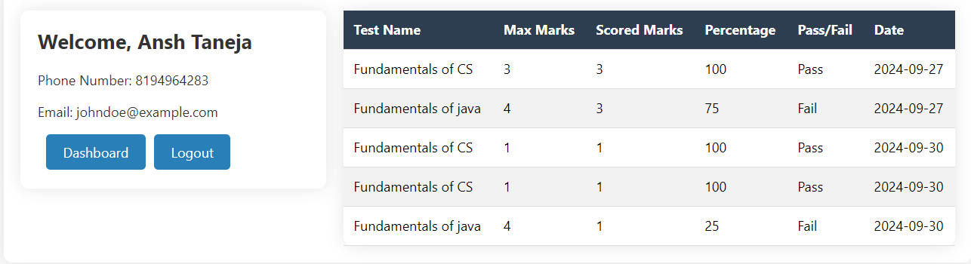
GLIMPSE OF USER

Slide 9
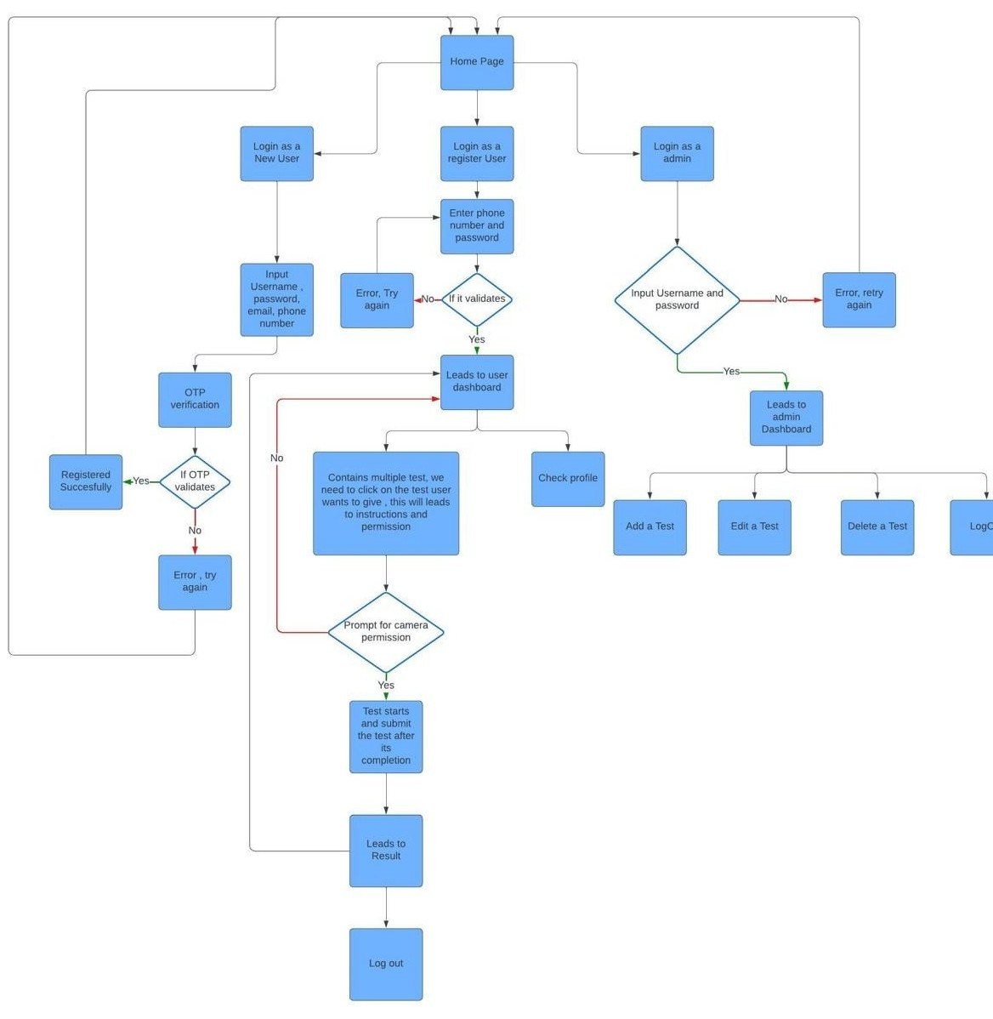


Slide 10

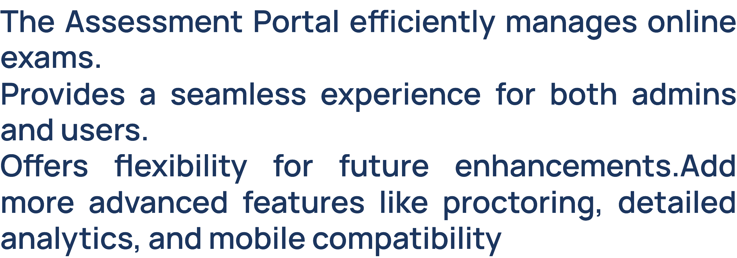

Slide 11

DO YOU HAVE ANY QUESTIONS?
ansht148@gmail.com

