Slide 1

Secure access for cloud object storage(COS)
IBM CLOUD IAM
Name : Ansh Varshney
Course : B-Tech 2nd year

Slide 2
What is COS
💻 In IBM Cloud context:
COS refers to Cloud Object Storage, a key service in IBM Cloud used for storing and accessing files (also called “objects”) over the internet.
Secure Access Control COS integrates with IAM (Identity and Access Management) to control who can view or modify your data, ensuring that your content is protected.
API & SDK Integration Developers can easily work with COS through various SDKs (Python, Java, Node.js, etc.) or RESTful APIs to automate file uploads, downloads, and management.
Highly Scalable & Reliable Storage COS is ideal for saving large volumes of data like images, videos, logs, or backup files — with high availability and durability.

Slide 3
What is IAM Identity and Access Management (IAM) is a system that helps organizations manage who can access their digital resources and what they can do with them. It ensures only the right people get the right level of access — nothing more, nothing less.
Main Functions of IAM:
User Verification (Authentication): Confirms a user's identity using methods like passwords, OTPs, or biometrics before granting access.
Permission Management (Authorization): Determines what actions a user is allowed to take .
for example, whether they can only view data or also modify and delete it.
Access Control Rules: Let’s organizations define custom rules such as giving edit rights only to managers or blocking access outside working hours.
Audit & Tracking: Maintains records of user activities to detect suspicious behavior and support compliance with security regulations.

Slide 4
Technologies Used : IBM Cloud IBM COS (Cloud Object Storage) IBM IAM (Identity & Access Management) API Key Management Python (with ibm_boto3) Visual Studio Code (VS Code .
Objective To securely upload, store, and retrieve files on the cloud using IBM Cloud Object Storage with IAM authentication and Python.
Steps Followed
Created a COS bucket on IBM Cloud
Generated API key and Service Instance ID
Wrote Python script to:
Upload file to COS
Download file from COS
4. Verified file storage via IBM Cloud Console .

Slide 5
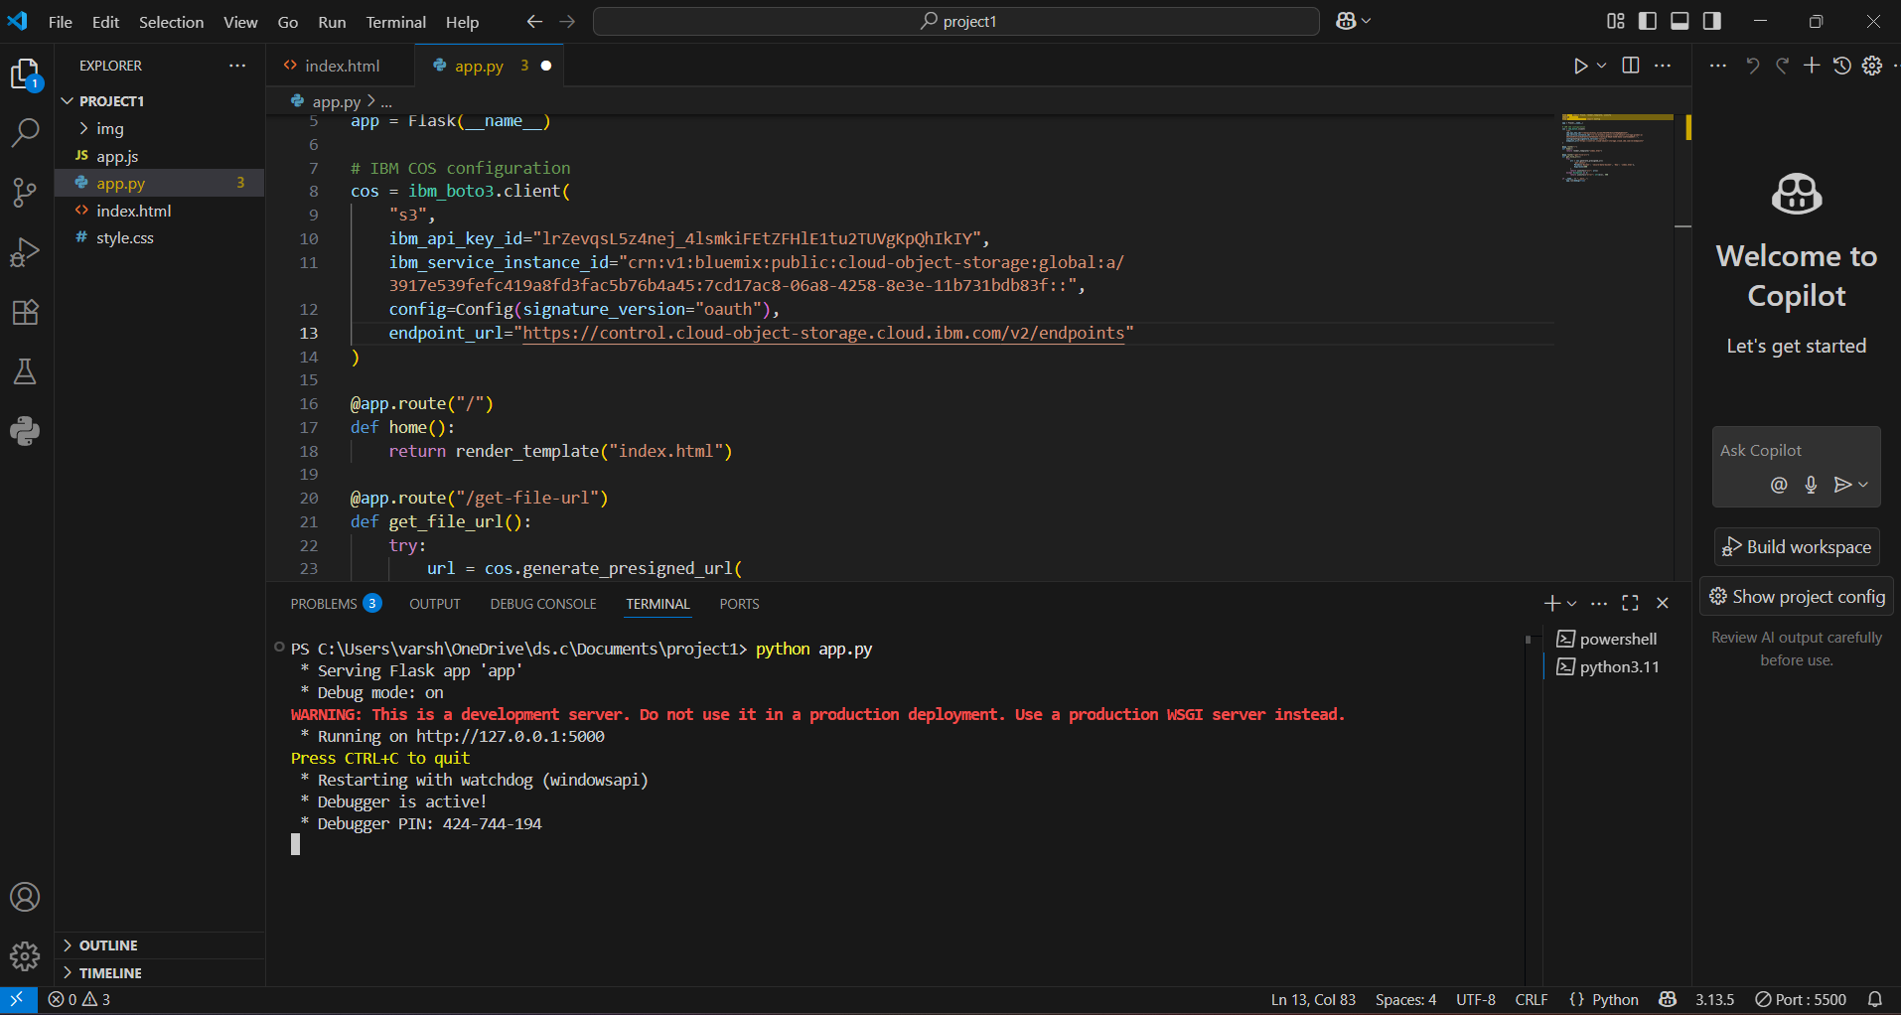
Upload python script

Slide 6
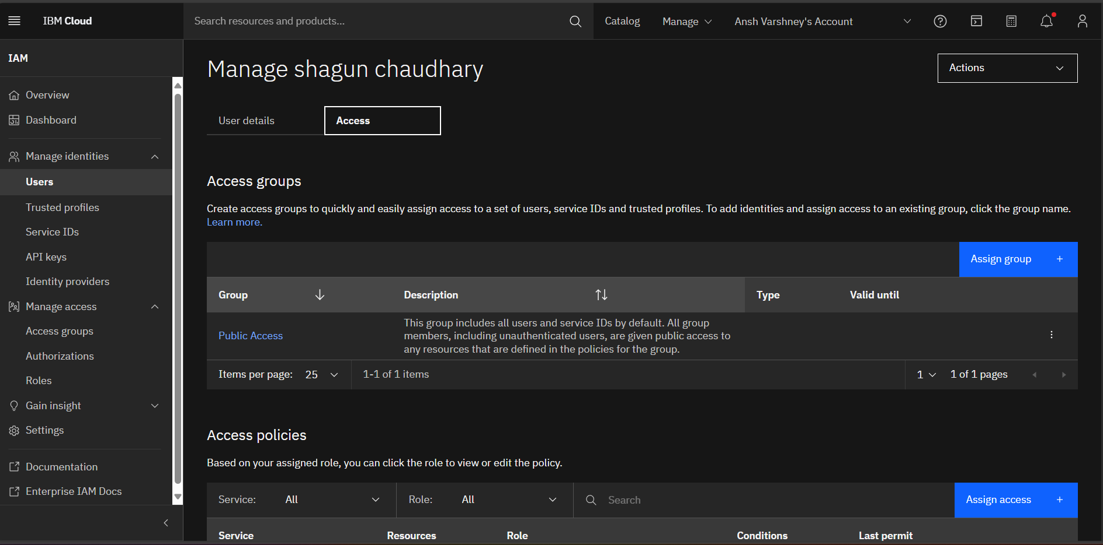
Access page first

Slide 7
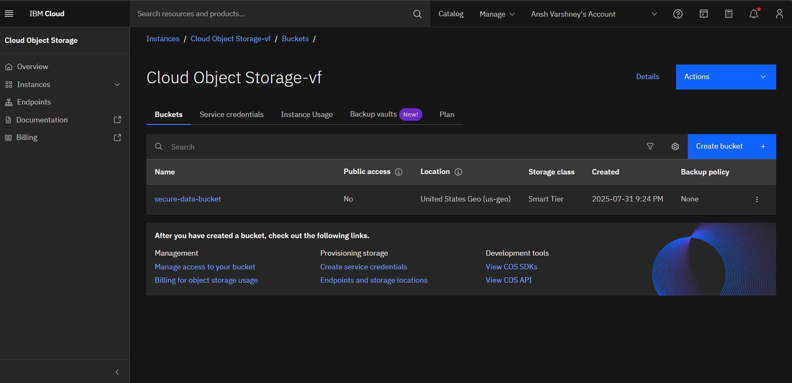
Bucket creation in COS

Slide 8
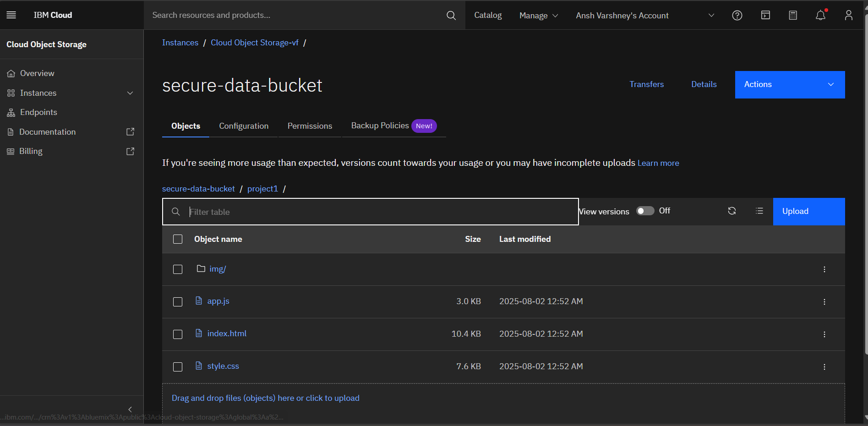
Upload Files/Projects

Slide 9
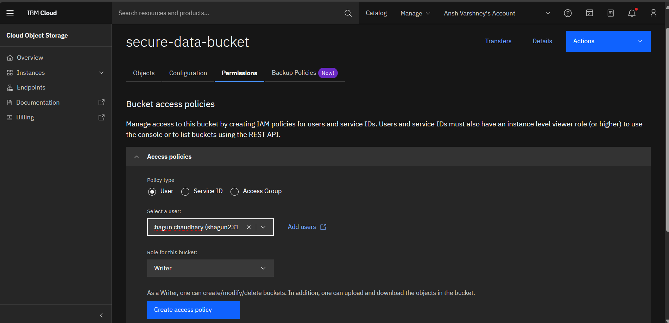
Access page second

Slide 10

Uploaded Files/Projects

Slide 11
Security API key securely used in code IAM authentication for access control Private bucket (accessible only by authenticated users)
Conclusion
IBM COS provides a reliable and secure way to manage cloud file storage. With Python integration, automation becomes easy and scalable.

Slide 12

THANK YOU

