Slide 1
Gold Price Prediction
A Predictive model
Ansh/02 Mar 2024

Slide 2
Overview
Time Series Visualization
Future Gold Price forecasting
Back – Test treading strategies
Market Sentiment Analysis
Statistical Analysis

Slide 3
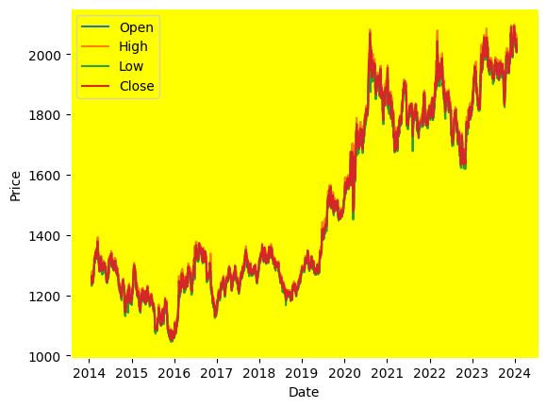
Time Series Analysis
Data Collection : gold stock dataset from 2014 to 2024. Obtained from Nasdaq.
Exploratory Data Analysis (EDA):
Mean and Standard Deviation of closing price is 1498.726085 and 298.824811 respectively.
Minimum and Maximum values of closing price is 1049.600000 and 2093.100000 respectively.

Slide 4
Stationarity Testing:
Augmented Dickey-Fuller (ADF) test : The Augmented Dickey-Fuller (ADF) test is a statistical test used to determine whether a time series is stationary or non-stationary. Stationarity is a key assumption in many time series models, and a stationary time series is one whose statistical properties such as mean, variance, and autocorrelation do not change over time.
Result:
ADF Statistic: -0.6413674258701233
p-value: 0.8613580932341661 Critical Values:
1%: -3.432959008741782
5%: -2.862692648021296
10%: -2.567383598871881
Fail to reject the null hypothesis. The data is non-stationary.

Slide 5
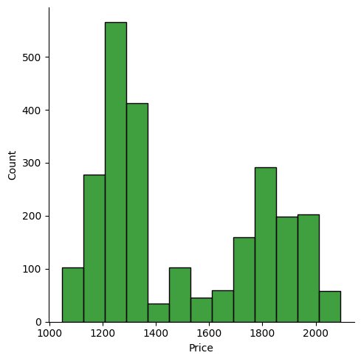
Distribution of Closing Price

Slide 6
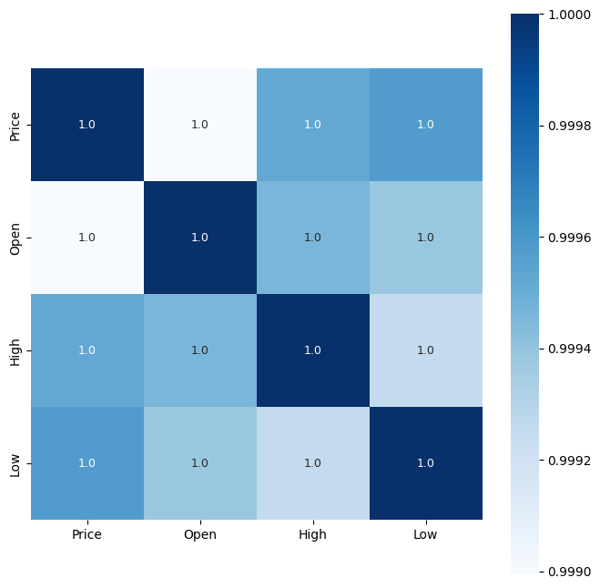
Correlation
Positive Correlation : A positive correlation between two variables means that as one variable increases, the other variable also tends to increase.
Negative Correlation : A negative correlation between two variables means that as one variable increases, the other variable tends to decrease.
Correlation with Price
Price 1.000000
Open 0.998994
High 0.999524
Low 0.999576

Slide 7
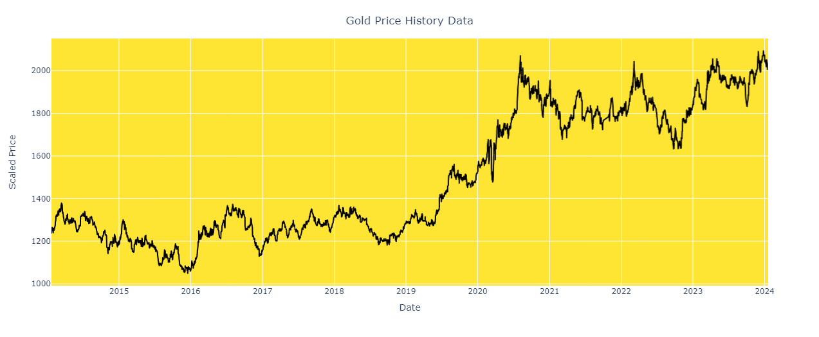
Trend Analysis: In Daily trend the Gold Price may be in uptrend or downtrend, but for long – term trend the Price is in Uptrend.

Slide 8
Predictive model for Future Gold Price forecasting
Long Short Term Memory (LSTM) is a type of recurrent neural network (RNN) architecture that is well-suited for processing and making predictions based on sequential data, such as time series data. LSTMs are designed to overcome the limitations of traditional RNNs in capturing long-term dependencies by introducing specialized memory cells and gating mechanisms.
LSTM Architecture :
LSTM units consist of a cell state, an input gate, a forget gate, and an output gate.
The cell state serves as a memory unit that can retain information over long sequences.
The input gate controls the flow of information into the cell state.
The forget gate regulates the retention or forgetting of information in the cell state.
The output gate controls the flow of information from the cell state to the output.

Slide 9
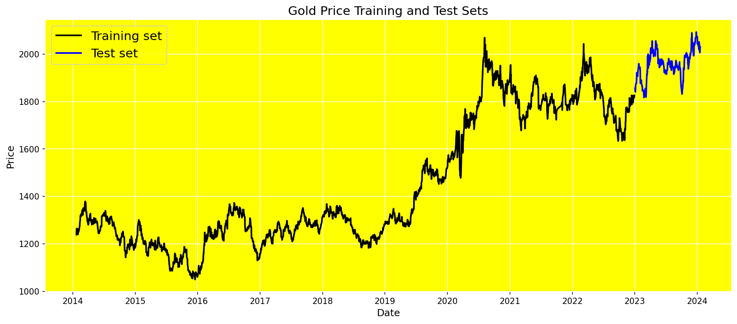
Splitting Data to Training & Test Sets : Since we cannot train on future data in time series data, we should not divide the time series data randomly. In time series splitting, testing set is always later than training set. We consider the last year for testing and everything else for training.

Slide 10
Model Evaluation
MAPE (Mean Absolute Percentage Error) is a commonly used metric for evaluating the accuracy of a forecasting model, especially in the context of time series forecasting. It measures the average percentage difference between predicted values and actual values.
Result :
Test Loss: 0.0007768330397084355
Test MAPE: 0.023328957058081398
Test Accuracy: 0.9766710429419186

Slide 11
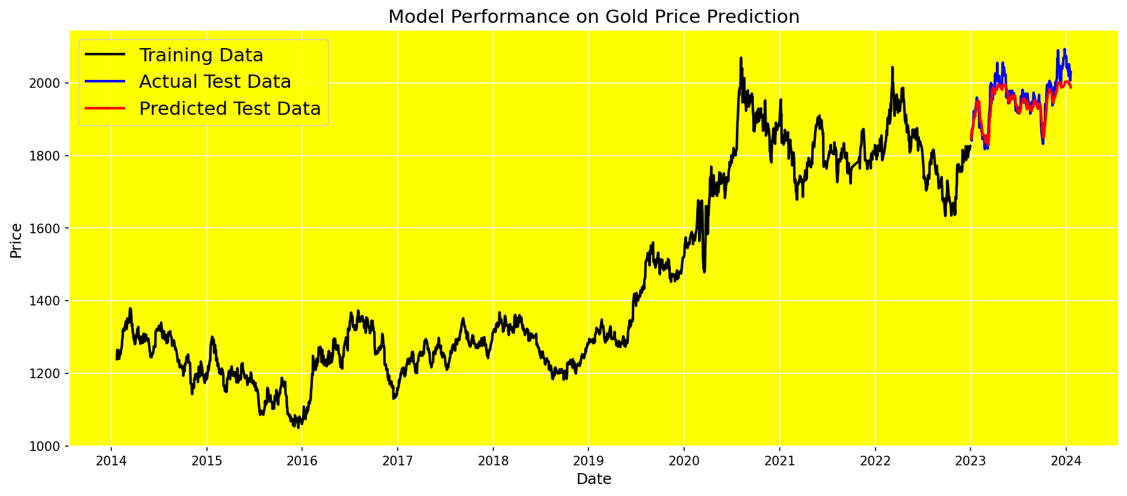

Slide 12
Back – Test treading strategies
Strategy Rules:
Select Moving Averages: Choose two moving averages with different time periods, such as a short-term moving average (e.g., 50-day) and a long-term moving average (e.g., 200-day).
Generate Signals:
Buy Signal: When the short-term moving average crosses above the long-term moving average, it signals a potential uptrend or bullish signal.
Sell Signal: When the short-term moving average crosses below the long-term moving average, it signals a potential downtrend or bearish signal.
Trade Execution:
Buy: Enter a long position (buy) when the buy signal is generated.
Sell: Exit the long position (sell) or enter a short position (sell) when the sell signal is generated.
Performance metrics :
Cumulative Returns: 0.01453237005412844
Sharpe Ratio: 0.0931580016868362

Slide 13
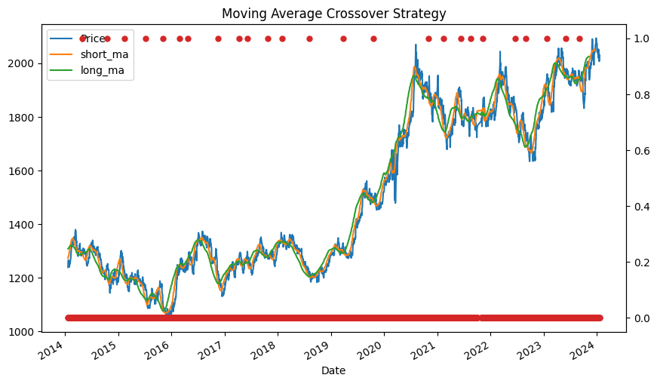
Moving Average Crossover Strategy Moving Average Crossover Strategy is a popular trading strategy used in technical analysis to identify trends and generate buy or sell signals based on the crossover of two moving averages of different time periods.

Slide 14
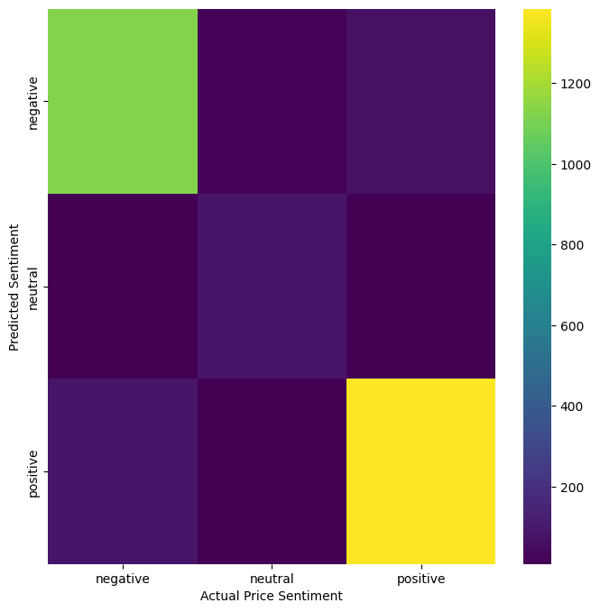
Market Sentiment Analysis :
The Price Sentiment column contains 4 classes (positive, neutral, negative and none)
Positive denotes upward movement in price.
Negative denotes downward movement in price.
Neutral denotes sideways (steady) movement in price.
None denotes that no assessment about prices can be made from the news headline.

Slide 15
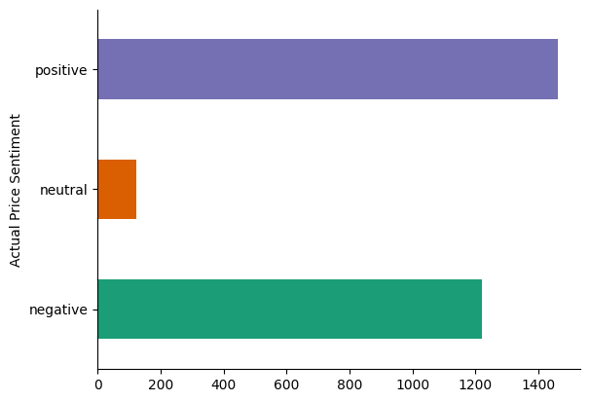
Key Events and Distribution
Gold expected to beat expectations and mcx gold oct contract gains nearly 2, impact Gold Price Positively.
The price of gold continues declining and gold futures head lower after a three session gain impact Gold Price Negatively.
Gold price expected to remain steady and Expect Gold to trade sideways Sushil Finance impact Gold Price Neutrally.

Slide 16
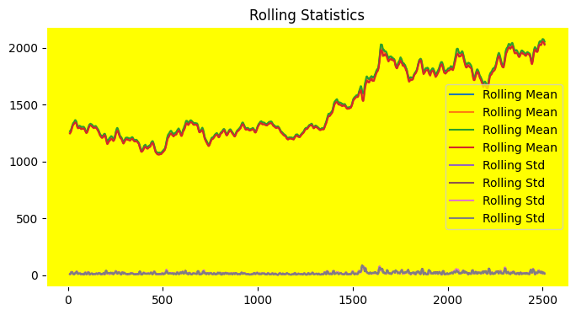
Calculate and plot rolling statistics

Slide 17
Conclusion
Summary of the main findings:
Gold Price is in Upward trend. Market Gold Price increasing after year 2020.
Forecasting Gold Price using LSTM is 97% Accureate.
Market sentiment and investor psychology can influence short-term fluctuations in gold prices.
Positive sentiment towards gold as a safe-haven asset or negative sentiment towards riskier assets can drive demand and price movements.
Prioritize thorough research and analysis before making investment decisions.

Slide 18
Thank You

