Slide 1
Java Database Connectivity (JDBC)

Slide 2
Introduction
Database
  Collection of data
DBMS
  Database management system
  Storing and organizing data
SQL
  Relational database
  Structured Query Language
JDBC
  Java Database Connectivity
  JDBC driver

Slide 3
JDBC
Programs developed with Java/JDBC are platform and vendor independent.
“write once, compile once, run anywhere”
Write apps in java to access any DB, using standard SQL statements – while still following Java conventions.
JDBC driver manager and JDBC drivers provide the bridge between the database and java worlds.

Slide 4
Java application
JDBC API
JDBC Driver Manager
JDBC Driver API
vendor-
supplied
JDBC driver
JDBC/ODBC
Bridge
ODBC
driver
Database
Database

Slide 5
ODBC
JDBC heavily influenced by ODBC
ODBC provides a C interface for database access on Windows environment.
ODBC has a few commands with lots of complex options. Java prefers simple methods but lots of them.

Slide 6
Type 1
3rd Party API
Database
Type 3
Type 2
Native C/C++ API
Local API
Network API
Type 4
Type 1: Uses a bridging technology to access a database. JDBC-ODBC bridge is an example. It provides a gateway to the ODBC.
Type 2: Native API drivers. Driver contains Java code that calls native C/C++ methods provided by the database vendors.
Type 3: Generic network API that is then translated into database-specific access at the server level. The JDBC driver on the client uses sockets to call a middleware application on the server that translates the client requests into an API specific to the desired driver. Extremely flexible.
Type 4: Using network protocols built into the database engine talk directly to the database using Java sockets. Almost always comes only from database vendors.

Slide 7
Relational-Database Model
Relational database
  Table
  Record
  Field, column
  Primary key
    Unique data
SQL statement
  Query
  Record sets

Slide 8
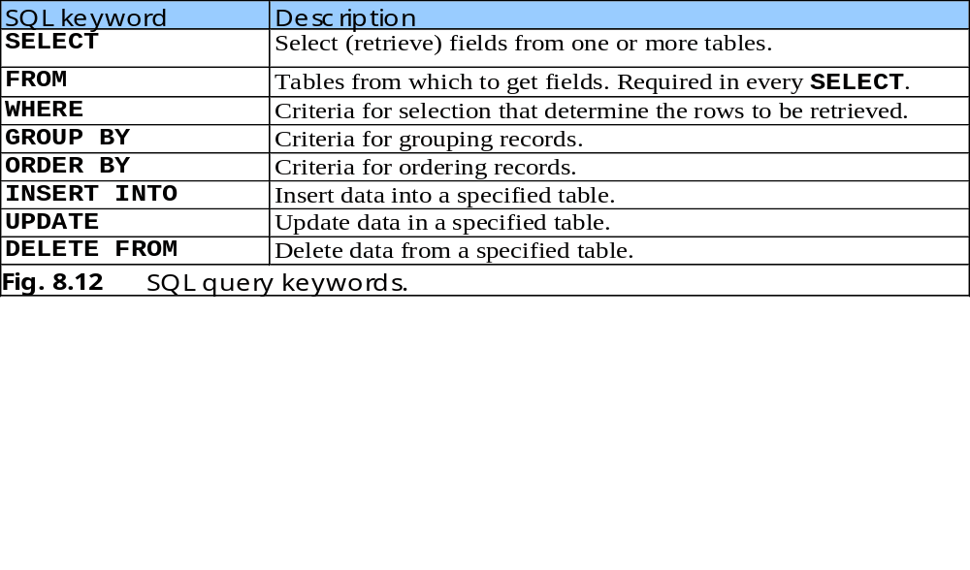
Structured Query Language (SQL)
SQL overview
SQL keywords

Slide 9
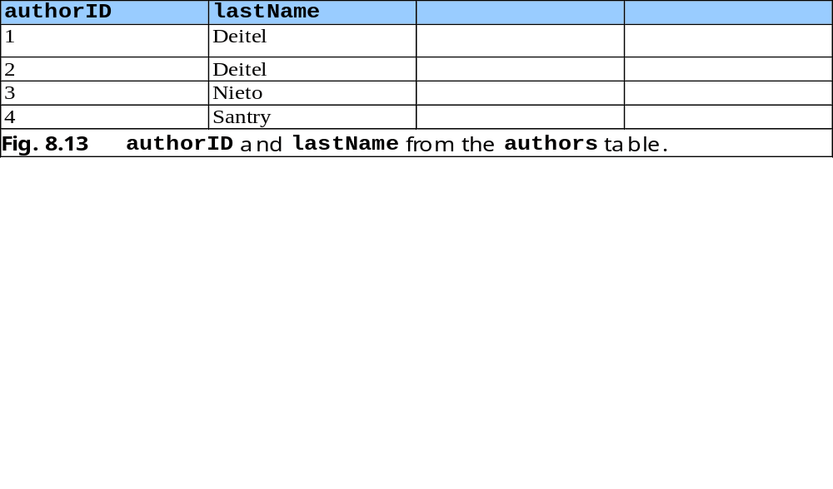
Basic SELECT Query
Simplest format of a SELECT query
  SELECT * FROM tableName
    SELECT * FROM authors
Select specific fields from a table
  SELECT authorID, lastName FROM authors

Slide 10
WHERE Clause
specify the selection criteria
  SELECT fieldName1, fieldName2, … FROM tableName WHERE criteria
    SELECT title, editionNumber, copyright
      FROM titles
      WHERE copyright > 1999
WHERE clause condition operators
  <, >, <=, >=, =, <>
  LIKE
    wildcard characters % and _

Slide 11
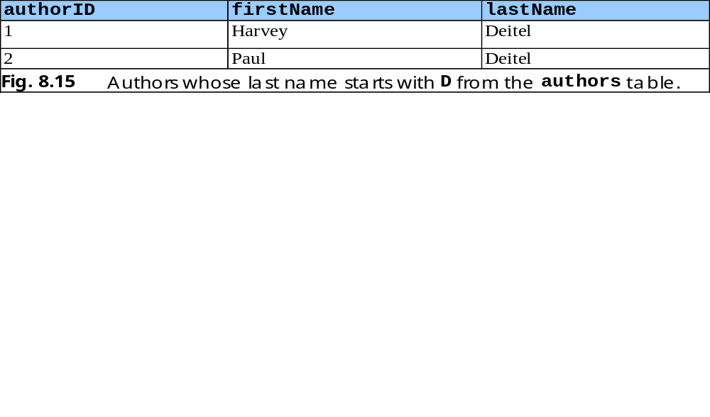
WHERE Clause (Cont.)
    SELECT authorID, firstName, lastName
      FROM authors
      WHERE lastName LIKE ‘D%’

Slide 12
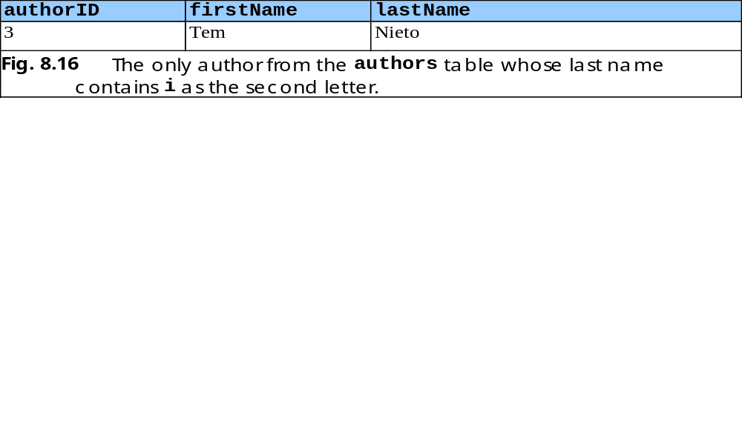
WHERE Clause (Cont.)
    SELECT authorID, firstName, lastName
      FROM authors
      WHERE lastName LIKE ‘_i%’

Slide 13
ORDER BY Clause
Optional ORDER BY clause
  SELECT fieldName1, fieldName2, … FROM tableName ORDER BY field ASC
  SELECT fieldName1, fieldName2, … FROM tableName ORDER BY field DESC
ORDER BY multiple fields
  ORDER BY field1 sortingOrder, field2 sortingOrder, …
Combine the WHERE and ORDER BY clauses

Slide 14
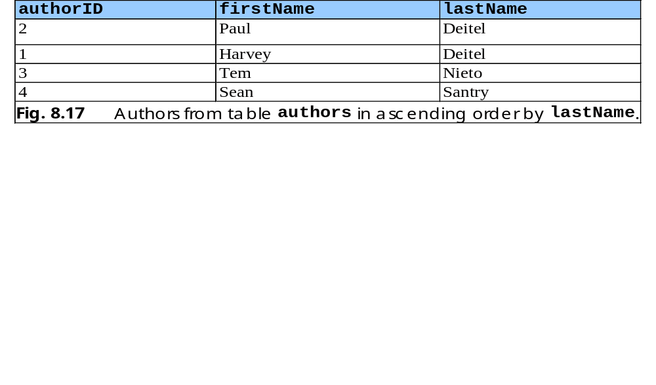
ORDER BY Clause (Cont.)
    SELECT authorID, firstName, lastName
      FROM authors
      ORDER BY lastName ASC

Slide 15
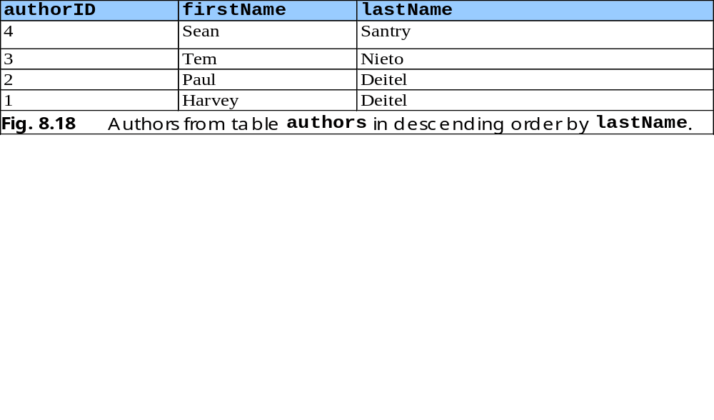
ORDER BY Clause (Cont.)
    SELECT authorID, firstName, lastName
      FROM authors
      ORDER BY lastName DESC

Slide 16
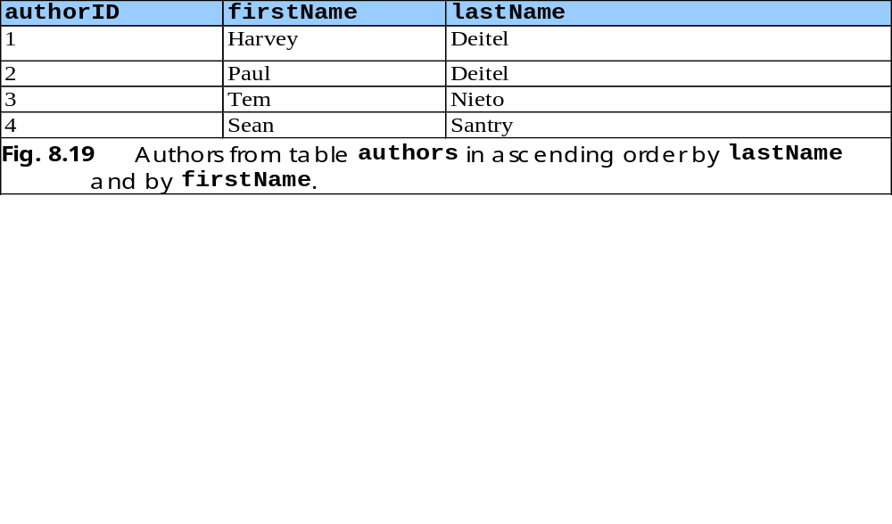
ORDER BY Clause (Cont.)
    SELECT authorID, firstName, lastName
      FROM authors
      ORDER BY lastName, firstName

Slide 17
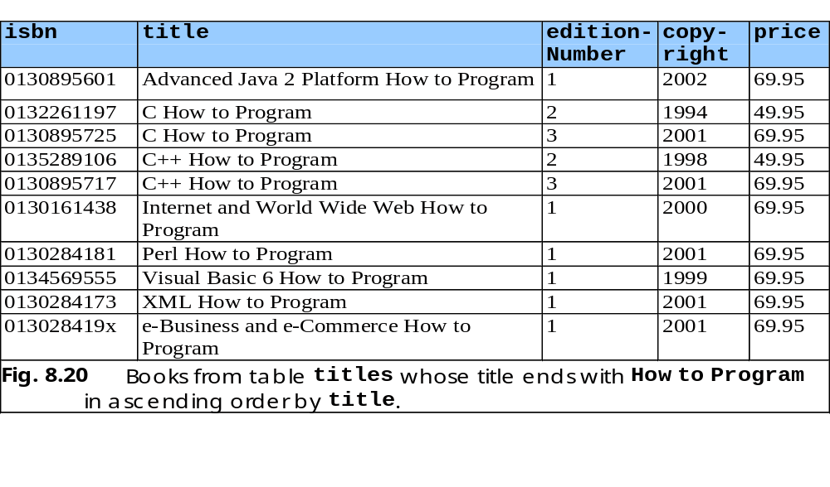
ORDER BY Clause (Cont.)
    SELECT isbn, title, editionNumber, copyright, price
      FROM titles WHERE title LIKE ‘%How to Program’
      ORDER BY title ASC

Slide 18
Merging Data from Multiple Tables: Joining
Join the tables
  Merge data from multiple tables into a single view
  SELECT fieldName1, fieldName2, …
  FROM table1, table2
  WHERE table1.fieldName = table2.fieldName
  SELECT firstName, lastName, isbn
  FROM authors, authorISBN
  WHERE authors.authorID = authorISBN.authorID
  ORDER BY lastName, firstName

Slide 19
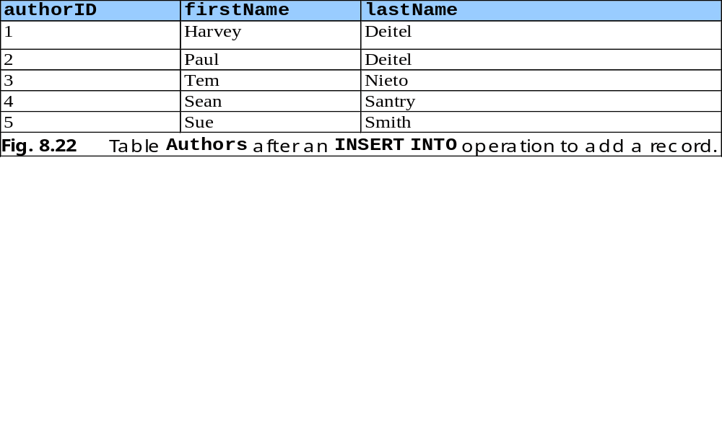
INSERT INTO Statement
Insert a new record into a table
  INSERT INTO tableName ( fieldName1, … , fieldNameN )
  VALUES ( value1, … , valueN )
    INSERT INTO authors ( firstName, lastName )
    VALUES ( ‘Sue’, ‘Smith’ )

Slide 20
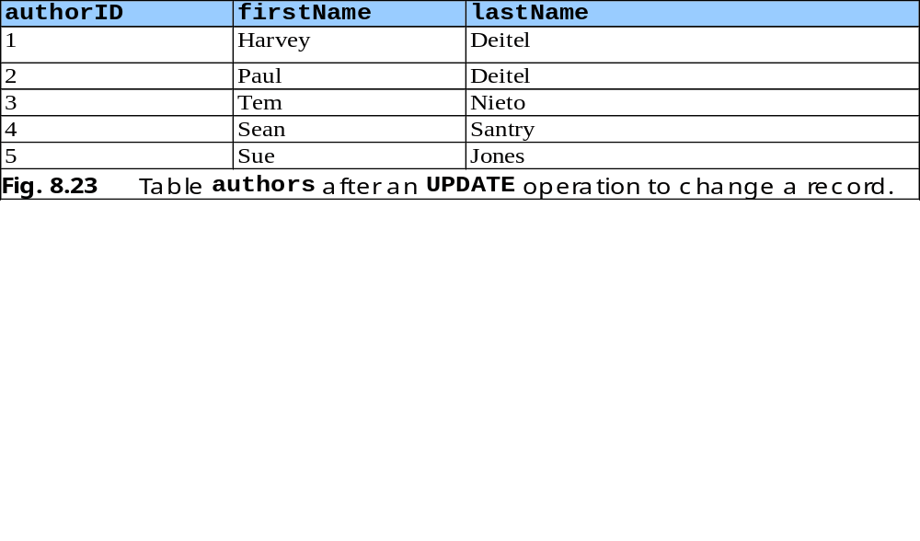
UPDATE Statement
Modify data in a table
  UPDATE tableName
  SET fieldName1 = value1, … , fieldNameN = valueN
  WHERE criteria
    UPDATE authors
    SET lastName = ‘Jones’
    WHERE lastName = ‘Smith’ AND firstName = ‘Sue’

Slide 21
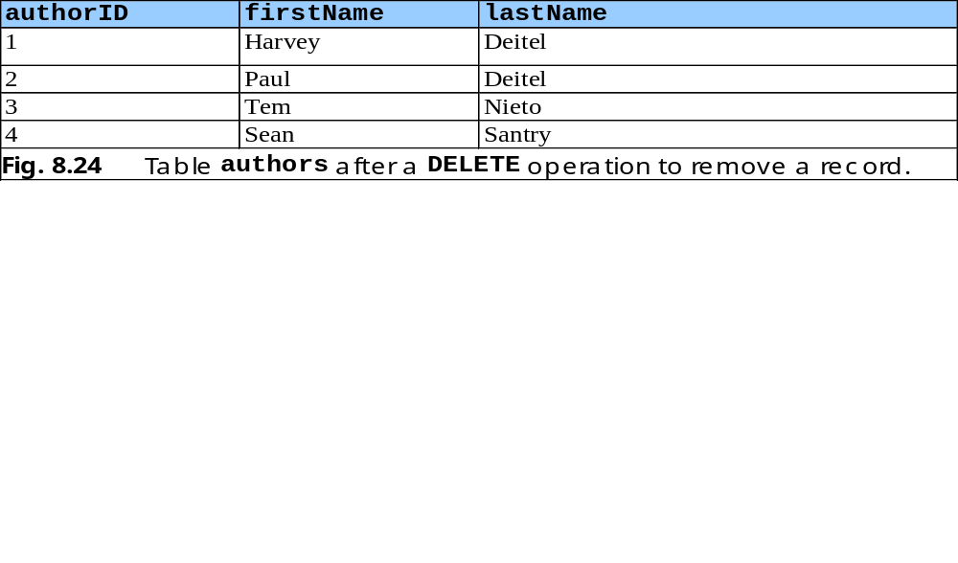
DELETE FROM Statement
Remove data from a table
  DELETE FROM tableName WHERE criteria
    DELETE FROM authors
    WHERE lastName = ‘Jones’ AND firstName = ‘Sue’

Slide 22
Manipulating Databases with JDBC
Connect to a database
Query the database
Display the results of the query

Slide 23
JDBC Classes for DB Connection
java.sql.Driver
  Unless creating custom JDBC implementation, never have to deal with it. It gives JDBC a launching point for DB connectivity by responding to DriverManager connection requests
java.sql.DriverManager
  Maintains a list of Driver implementations and presents an application with one that matches a requested URL.
  getConnection(url, uid, password)
  getDrivers(), registerDriver()
java.sql.Connection
  Represents a single logical DB connection; used for sending SQL statements

Slide 24
Database URLs
Uses syntax similar to net URLs
  jdbc:odbc:CoreJava
  jdbc:pointbase:CATS
General syntax
  jdbc:subprotocol_name:other_stuff
  Where subprotocol selects the specific driver
  Format for other_stuff depends on subprotocol, but in general:
  jdbc:subprotocol://hostname:port/other
  jdbc:odbc://whitehouse.gov:5000/CATS;PWD=Rice would connect to the CATS DB on port 5000 of whitehouse.gov, using the ODBC attribute value of PWD set to “Rice”.

Slide 25
JDBC – Making the Connection
Register the Driver implementation of the DB. JDBC requires a Driver class to register itself with DriverManager when it is instantiated.
  Explicitly call new to load the driver (needs to be hardcoded)
  Or, use Class.forName(“DriverClass”)
Establish a connection with the DB
  Connection c = DriverManager.getConnection(url, uid, password);
  DM searches the registered Drivers until it finds the match.
  The Driver class then establishes the connection, returns a connection object to DM, which in turn returns it back.
Notes:
O’Reilly JDBC and Java

Slide 26
JDBC – Database Access Classes
java.sql.Statement
  Most basic class. It performs all the SQL statements
  executeQuery( String ), executeUpdate( String ), execute( String )
java.sql.ResultSet
  One or more rows of data returned by a query
  Statement st = c.createStatement();
  ResultSet rs = st.executeQuery(“…”);
  Methods: next(),getString(column),getInt(..), last(), getRow()
  Be careful about SQL NULL and Java NULL
  Always use wasNull()
  Always call close() on all ResultSet, Statement, and Connection objects. Some drivers (e.g., IBM’s native DB2) will not close the rs and st objects even when you close the connection.
Notes:
O’Reilly JDBC and Java

Slide 27
JDBC – DB Access Classes (Cont.)
java.sql.ResultSetMetaData
  Provides extra information about (data about data) the ResultSet object
  getColumnCount(), getColumnName(column)
  ResultSetMetaData md = rs.getMetaData();
java.sql.DatabaseMetaData
  Provides extra information about the database for a given connection object
  What tables exist, what username is being used, is the DB read-only, what are the primary keys for a table, etc.
  DatabaseMetaData dmd = c.getMetaData();
  Lets developers write apps that are DB-independent

Slide 28
Prepared SQL
For each SQL statement received, the DB builds a query plan by
  parsing the SQL statement
  reading the SQL to determine what to do
  formulating a plan for executing the SQL
Repeatedly executing SQL with same query plan is very inefficient
  UPDATE account SET balance = XXX WHERE id = YYY
Statement st = c.createStatement();
for (int i=0; i<accounts.length; i++ )
st.executeUpdate(“UPDATE account “ +
“SET balance = “ + accounts[i].getBalance() +
“WHERE id = “ + accounts[i].getId());

Slide 29
Prepared SQL (contd.)
DBs enable you to optimize repeated calls through prepared SQL.
Create a Java instance of a prepared statement that notifies the DB of the kind of SQL call it represents.
DB can then create a query plan for that SQL even before it is actually executed.
If the same prepared statement is executed more than once, the DB uses the same query plan without rebuilding a new one.

Slide 30
Prepared SQL (contd.)
// create SQL statement with parameters
PreparedStatement st = c.prepareStatement(
“UPDATE account “ +
“SET balance = ? “ +
“WHERE id = ?”);
for (int i=0; i<accounts.length; i++) {
// bind the parameters
st.setFloat(1, accounts[i].getBalance());
st.setInt(2, accounts[i].getId());
st.execute();
st.clearParameters();
}

