Slide 1
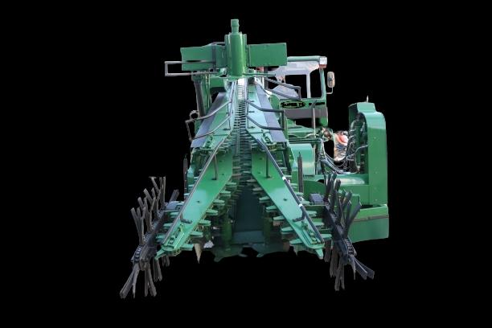
1. About the Startup/Innovative idea
Super Cane Harvester Machines Pvt Ltd was incorporated in April 2017 to study the harvesting systems in India and to develop Harvester that solves the problem of Cane harvesting by farmer duet to acute shortage of labour and increased cost of harvesting
We have developed Whole stalk sugarcane harvesters that reduces the labour requirement, cost of harvesting, empowering local labour and energy saving
Registered office Address : D/6, 5th floor, Everest Building, Tardeo Road, Mumbai -400 034
Factory Address Plot No.916, Badarana, Jaipur, Rajasthan – 302 032
Administration Office: Plot No.25/A, Opp: FCI Godown, Bhairidevarkoppa, HUBBALLI – 580 025.
Corporate Identity Number : U29309MH2017PTC293785.
Web site: www.supercaneharvester.co.in

Slide 2
PROBLEM STATEMENT
Sugar Cane is harvested by Sugar Mills in India arranging the contract labour .
The cost of manual harvesting cane is around Rs.300 per MT
Farmer in addition pays minimum of Rs.100 per MT additional to the labour to get the harvesting done in time.
Thus TOTAL COST OF MANUAL HARVESTING IS RS.300 + 100 = Rs. 400 per MT
In the absence of labour, the Sugar Mills get the harvesting done with the help of Machine Harvesters, which cut the cane into small pieces of 6 to 8 inches.
The cost of harvesting by these machines is Rs.400 per MT which is paid to the machine operators.
In addition, farmers looses cane value, as these machines cut the cane into small pieces of 6 to 8 inches, in the form of evaporation loss (apprx. 2% cane value, i.e., Rs. 60 per MT), in the form of small pieces left out in the farm (apprx.3% cane value, ie.., Rs. 90 per MT).
These mechanized harvesting also carries trash along with cane, hence Sugar Mills deduct apprx. 10 to 12% weight, which results in cane value loss of Rs. 300 per MT.
Thus TOTAL COST OF MECHANISED HARVESTING IS : Rs.400+60+90+300 = Rs.850.00/MT
If harvesting is not done during the cane crushing period, farmers looses entire crop and incurs heavy loss.

Slide 3
BRIEF ABOUT OUR SOLUTION
We have designed & developed SUPER 75 whole stalk harvesters that gives benefits of both Manual Harvesting and Mechanical Harvester.
The Unit harvests Cane into whole stalk just like manual harvesting, cutting the cane at the bottom and top; which are hard jobs.
This cut cane is ready for loading with the help of SUPER GRABBER.
The Grabber unit, which is supplied along with Harvester, as a unit, loads these cane bundles onto a Tractor Trolley or Truck as the case may be
The cost of harvesting with SUPER 75 is around Rs.250 to Rs.280.00 / MT.
Considering the cost of fuel consumed (Apprx. 60-70 litres per day as compared to 250 litres of the existing Harvesters) and cost of labour (around 6 to12); this works out very economical.
THUS THE MAIN PROBLEM OF SCARCITY OF IMPORTED LABOUR IS SOLVED, in addition to saving in Harvesting cost as compared to other MECHANICAL HARVESTERS

Slide 4

BUSINESS MODEL
VALUE PROPOSITIN :
Mechanized harvesting of whole stalk Sugarcane and effective cost saving
MARKET OPPORTUNIGY
The total area of cultivation of sugar cane in India is around 49.70 lakh hectares (UP 22.61, Maharashtra 9.18, Karnataka 4.45) as per ISMA and Ministry of Agriculture for the FY.2017-18.
Considering an average of 60 MT yield per acre in Karnataka, the total harvesting Cane for the state would be approximately = (4.45 lakh hectares x2.5 = 11,12,500 acre x 60 = 6,67,50,000 MT ).
This 6.675 Crore MT need to be harvested in 6 months time, which is apprx. 3,70,800 MT per day.
One harvesting machine cuts appx.100 MT per day. i.e. number of machines required would be around 3700
Considering only 20% of the area can be mechanized, the requirement would be around 750 machines.
TARGET CUSTOMER:
1. SUGAR MILLS, LABOUR CONTRACTORS AND FARMERS
2. The targeted market for the current & next financial year – Maharashtra, Karnataka & Madhya Pradesh States.

Slide 5
Harvesting operation & requirements
Normal tractor operator can operate the machine with minimal training on hydraulic system. However, an assistant is recommended till the operator gets trained properly.
Two assistants at the front side, to cut off any fallen cane or any obstructive plant coming in the way and one assistant at the back, to pick any cane dropped or left over by the harvester. Normal unskilled labours would suffice to work as assists
Normal working of 10 hours in a day is considered as optimum, however the unit can be operated during night also and provision is given to the machine accordingly.
One should inspect the land before harvesting to avoid the damage to the bottom cutters in case of stones obstructing them which would hamper the harvesting severely.
As entire crop is harvested at the ground level, farmer gets the benefit of ratooning of crop for the next year and sugar mills get better recovery, as maximum sugarcane content is at the bottom of the stalk
All the green tops are chopped by the machine, the farmer can collect the same, if that is to be used for cattle feeding
The trash is totally removed by the machine and it would be effective manure for the land, which benefits the farmer, avoids transportation cost to the Sugar Mills and also helps in better recovery for the Sugar Mills
By putting additional worker at the back and front of the machine, farmer gets the benefit of 100 percent crop being harvested and taken to the Sugar Mills, giving him better yield and return per acre of land (No stalk is left out in the field, as this is whole stalk)
Since the cane is cut as whole stalk, the problem of evaporation loss is avoided; as faced in the case of existing harvesters that cut cane into small pieces. This also helps sugar mills in getting the supplies from far off places also (at reduced cost per MT, since only cane is being transported and not the trash content, as in case of other machines)

Slide 6
Contact Details
BASAVARAJ TATAWATI –Chief Promoter.
Mobile: 9448289995,
Email : tatawati@rediffmail.com
Email: supercaneharvester@gmail.com
Website: www.supercaneharvester.co.in

Slide 7
VALIDATION
N Punjab Sugar Mills, Chindwara, M.P. have appreciated the effective working of SUPER 75, as the “Field trials” were done at their field before giving delivery to our customer at Lokapur, in Karnataka.
The technical team of Prabhulingeshwar Sugars headed by their MD, Mr.Jagdish Gudagunti inaugurated the Demo process in the field of Mr.Siddu Choudry, on 24th Feb 2021 in presence of Farmers of surrounding villages.
The technical team of Nirani Sugars headed by Mr.Padiyar, has validated the performance of concept of whole stalk harvesting
Farmers from Maharashtra have appreciated the performance of the machine and few of them have already confirmed their orders on us with necessary advance payments.
Few Farmers of Karnataka have seen the demo of the machine and have promised placing of orders in the days to come.
Technical teams from Davanagere Sugars, headed by Mr.Basavaraj Galgali; KCL Sugars, Mandya, headed by Mr. Baburaj; NSL Sugars, Mandya, headed by Mr. Ketan Kumar, have all given their Positive responses to the working of SUPER 75 which has bought good cheers to our technical staff, who have come all the way from Jaipur, Rajasthan.

