Slide 1
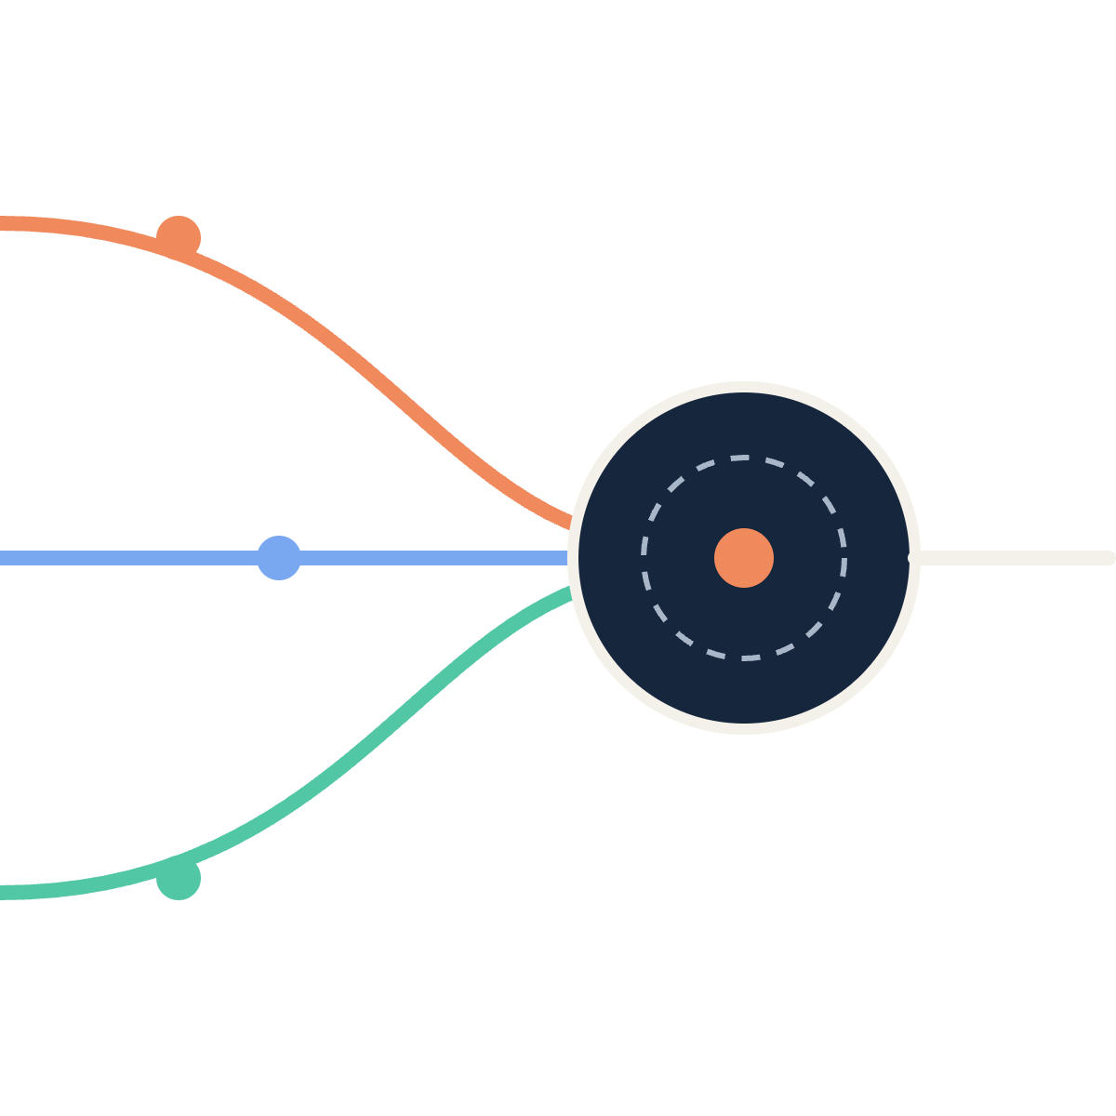
Three workflows,
one engine.
PBJ-2 · CAMUNDA 8 PRACTICAL · LABS 1–3
LOAN
ORDER
Loan approval, order fulfilment and hospital triage — modelled in BPMN, decided in DMN, run by Java workers on Camunda 8.8.
ENGINE
TRIAGE
Ansh Agarwal
Workflow Automation Engineering · B.Tech CSE · SRM Institute of Science and Technology
Notes:
Good morning, sir. I’m Ansh Agarwal, and this is my PBJ-2 practical on Camunda 8. The assignment had three labs: a loan approval process, an e-commerce order process, and a hospital appointment and triage process. They look like three very different businesses, but the point I want to make today is on this slide: underneath, all three run on the same engine and the same small set of building blocks. The picture on the right is the idea of the whole project. Each coloured line is one business process. They all flow into one engine, Zeebe, which is the heart of Camunda 8, and the engine decides what happens next. In the next thirteen slides I’ll show the architecture, walk one real application through the engine step by step, go through each lab, and then spend some time on the part I think matters most in real systems: what happens when things fail, and how I recover from that in Operate.

Slide 2
Six building blocks, three domains
ASSIGNMENT SCOPE
Building block | Lab 1 · Loan approval | Lab 2 · Order fulfilment | Lab 3 · Hospital triage
DMN decision | loan-eligibility · 8 rules | order-priority · 6 rules | triage-category · 8 rules
Java job workers | validate · offer · reject | price · fulfil · notify | register · book · notify
REST connector | POST credit bureau | POST payment gateway | GET scheduling slots
Human task | Underwriter review | High-value order check | Clinician & staff review
Failure drill | Bad data → fix, retry | Payment outage → retry | Slot API outage → retry
Every lab is a BPMN process on the same Camunda 8.8 engine, monitored in Operate and worked on in Tasklist.
PBJ-2 · Camunda 8 practical · Ansh Agarwal
02 / 14
Notes:
Before going lab by lab, here is the whole assignment on one page. The brief asked for three end-to-end workflows, and each one had to use the same set of building blocks. Reading across a row, you can see the same idea showing up in three different businesses. Every lab has a DMN decision table that makes the business decision: is this loan eligible, how urgent is this order, how urgent is this patient. Every lab has Java job workers written with Spring Boot that do the actual computing, like validating data, pricing an order or booking a slot. Every lab calls an external system through Camunda’s REST connector: a credit bureau, a payment gateway, and a hospital scheduling API. I built these three as mock services so I could control them and switch them off on purpose. Every lab also has a human step in Tasklist, because real processes always have a person making the final call somewhere. And the last row is the failure drill: in each lab I deliberately break something and show how the process recovers. I’ll come back to that row in detail near the end, because I think it’s the most important part of the project.

Slide 3
Who does what at runtime
SYSTEM ARCHITECTURE
LAB 1 · :8091
poll · complete
connector jobs
BUNDLED
Loan workers
CAMUNDA 8.8
REST connector
Zeebe engine
Holds every running instance, evaluates DMN, routes gateways, creates jobs.
HTTP + JSON
LAB 2 · :8092
Order workers
Tasklist · people complete user tasks
MOCK · :8090
External systems
Credit bureau
LAB 3 · :8093
Operate · monitor, fix, retry
Payment gateway
Triage workers
Scheduling API
PBJ-2 · Camunda 8 practical · Ansh Agarwal
03 / 14
Notes:
This is the runtime architecture, and the best way to read it is: who does what. In the middle is the Zeebe engine, which comes with Camunda 8 Run. It holds every running process instance, evaluates the DMN tables, decides which path a gateway takes, and whenever it reaches a service task, it creates a job. The engine itself never runs my business code. On the left are my three Spring Boot applications, one per lab, on ports 8091 to 8093. Each one polls the engine for jobs of its own type, runs the Java logic, and completes the job with new process variables. When an app starts, it also deploys its BPMN, DMN and form files to the engine automatically. On the right is the REST connector runtime, which is bundled with Camunda. It picks up the connector tasks and makes the actual HTTP calls to my mock services app on port 8090, which plays the credit bureau, the payment gateway and the hospital scheduling system. I built it with a fault switch, so I can make any of them go down or become slow during a demo. And inside the engine box are the two tools people use: Tasklist, where users complete human tasks through forms, and Operate, where I watch instances, read incidents, edit variables and retry.

Slide 4
Following one loan through the engine
ONE INSTANCE, STEP BY STEP · APPLICATION LA-1003
1
START EVENT · APPLICANT
loanAmount 800000 · income 60000 · 60 months
Application submitted
2
SERVICE TASK · JAVA JOB WORKER
proposedEmi 17795.56 · dtiRatio 0.430
Validate applicant information
3
REST CONNECTOR · CREDIT BUREAU
creditScore 690 · riskGrade C
Request credit assessment
4
BUSINESS RULE TASK · DMN
rule 7 → MANUAL_REVIEW · risk MEDIUM
Evaluate loan eligibility
5
USER TASK · TASKLIST
reviewDecision APPROVE
Manual underwriting review
6
SERVICE TASK · JAVA JOB WORKER
finalOutcome APPROVED · rate 12.50%
Issue loan offer
PBJ-2 · Camunda 8 practical · Ansh Agarwal
04 / 14
Notes:
Architecture diagrams can feel abstract, so here is one real application, LA-1003 from my test data, moving through the engine. The grey boxes on the right are the actual process variables at each step. One: the applicant submits the form, asking for eight lakh rupees over sixty months on an income of sixty thousand a month. Two: the engine hands a job to my Java validation worker. It checks the fields and calculates the EMI at an assumed twelve percent, which comes to about seventeen thousand eight hundred, and the debt-to-income ratio, which is 0.43. That means 43 percent of the income would go to loan repayments. Three: the REST connector calls the credit bureau. This synthetic applicant has a score of 690, grade C. Four: the DMN table looks at those numbers. 690 is too low for automatic approval, which needs 720, but it’s not bad enough to reject, so rule 7 matches: manual review, medium risk. Five: the engine creates a user task, and an underwriter opens it in Tasklist, sees all these numbers in the form, and approves. Six: the offer worker builds the offer. The medium risk band gives a 12.5 percent rate, and the instance ends as APPROVED. The key point: the engine moved between four different kinds of worker, Java, a connector, a decision table and a human, and none of them needed to know about each other.

Slide 5
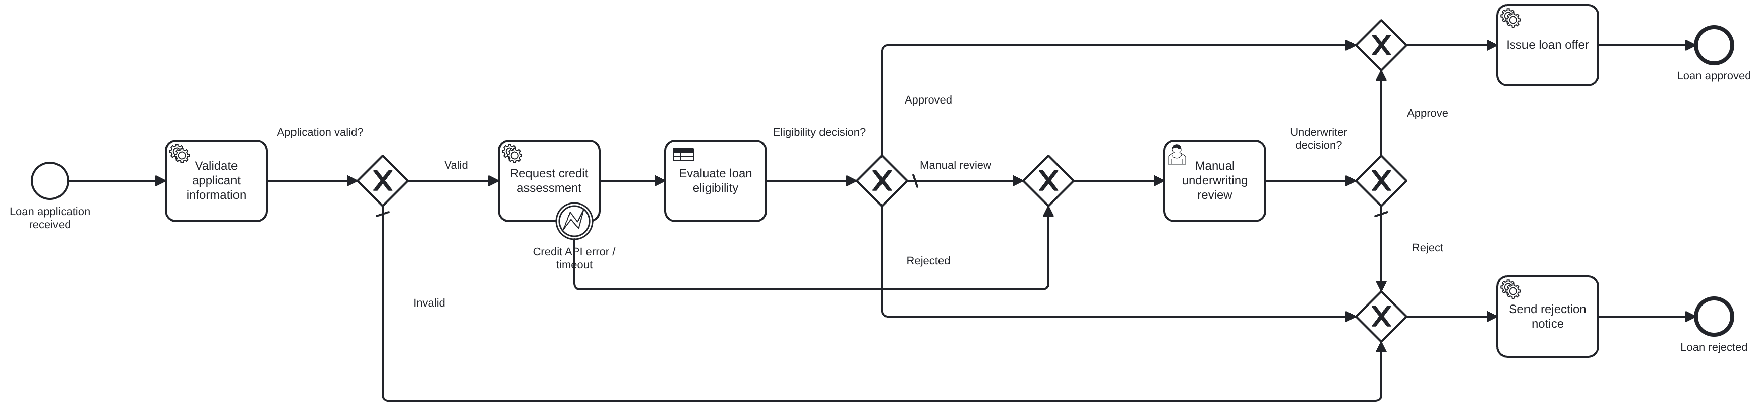
Loan approval process
LAB 1 · BPMN MODEL
01 · VALIDATE
02 · CHECK CREDIT
03 · DECIDE
Java worker computes EMI and debt-to-income.
Timeout or HTTP error → BPMN error → underwriter.
DMN approves, rejects, or refers to a person.
PBJ-2 · Camunda 8 practical · Ansh Agarwal
05 / 14
Notes:
This is the actual BPMN model for Lab 1, rendered straight from my loan-approval.bpmn file. Reading left to right: the application arrives through a Camunda form, and the first service task is my validation worker. It checks things like age between 21 and 65, the loan amount range, and that the applicant ID is a synthetic SYN number. It also computes the EMI and the debt-to-income ratio. If anything fails, the gateway sends the application straight down to the rejection notice, and we never waste a credit bureau call on it. Second, the credit check. This is the REST connector, and you can see the small error event attached to its border. That’s an error boundary event. I wrote an error expression on the connector so that any failure, whether it’s an HTTP 500 or no answer within five seconds, becomes a BPMN error called CREDIT_API_ERROR. The boundary event catches it and sends the application to an underwriter, so a bureau outage doesn’t block the customer; a person decides instead. Third, the decision. The business rule task calls the DMN table, and the gateway after it has three exits: approved, rejected, or manual review. Every gateway in my models has a default flow, so a token can never get stuck because of an unexpected value. Both the approved and rejected paths end in a worker that builds the offer or the rejection notice and sets a variable called finalOutcome, which I later use to check the test results automatically.

Slide 6
Eligibility rules, read top to bottom
LAB 1 · DMN LOAN-ELIGIBILITY · HIT POLICY FIRST
Asha · score 780 · DTI 0.18
Bharat · score 520 · DTI 0.32
Chitra · score 690 · DTI 0.43
# | Rule | Outcome | Asha | Bharat | Chitra
R1 | Defaults in last 24 months ≥ 2 | REJECTED | no | no | no
R2 | Credit score below 550 | REJECTED | no | MATCH | no
R3 | Debt-to-income above 0.60 | REJECTED | no |  | no
R4 | Loan more than 8× annual income | REJECTED | no |  | no
R5 | Unemployed | REJECTED | no |  | no
R6 | Score ≥ 720 · DTI ≤ 0.40 · no defaults · loan ≤ 3× income | APPROVED | MATCH |  | no
R7 | Score ≥ 650 and DTI ≤ 0.50 | MANUAL REVIEW |  |  | MATCH
R8 | Anything else (catch-all) | MANUAL REVIEW
Blank cell = rule never evaluated: the first match ends the search. Thresholds are educational, not real lending policy.
PBJ-2 · Camunda 8 practical · Ansh Agarwal
06 / 14
Notes:
This is the eligibility decision table, and the most important word on this slide is FIRST, the hit policy. The engine reads the rules from the top, and the first rule that matches wins; nothing below it is even checked. That’s why the order matters so much. The first five rules are knock-outs: two or more defaults, a credit score under 550, repayments over 60 percent of income, a loan more than eight times annual income, or no employment. Then comes rule 6, the only automatic approval, which needs everything to be good at once. Rule 7 refers near-prime applicants to an underwriter, and rule 8 is a catch-all, so every applicant always gets exactly one answer and there’s no case where no rule matches. The three columns on the right show three of my test applicants going down the table. Bharat, with a score of 520, is stopped at rule 2 and rejected; you can see his column is empty after that, because the search stopped. Asha passes every knock-out and matches rule 6, so she’s approved automatically. Chitra is the applicant from the earlier walkthrough: she passes the knock-outs, fails rule 6 because 690 is under 720, and lands on rule 7, manual review. I tested this table against twelve cases, including the exact boundaries, like a score of 720 against 719, and all twelve gave the expected result.

Slide 7
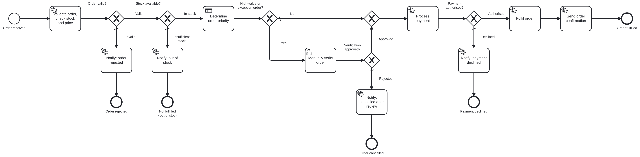
Order processing and fulfilment
LAB 2 · BPMN MODEL
01 · STOCK FIRST
02 · HUMAN CHECK
03 · SAFE PAYMENT
Out-of-stock orders never reach payment.
INR 1,00,000+, or INR 25,000+ from a new customer.
Idempotency key: a retry can never charge twice.
PBJ-2 · Camunda 8 practical · Ansh Agarwal
07 / 14
Notes:
Lab 2 is an e-commerce order, from receiving it to dispatching it. The happy path runs along the top line of the diagram, and every branch that drops down is a different way an order can end: rejected as invalid, out of stock, cancelled after review, or payment declined. Each of those has its own notification task and its own end event, so in Operate you can see at a glance how many orders ended which way. Three design decisions I want to point out. First, the order of the checks. My worker validates the order, looks up the simulated inventory and calculates the total in one step, and the stock gateway comes before payment. So we never charge a customer for something we can’t ship. Second, the human check. Orders of one lakh rupees or more, or twenty-five thousand or more from a new customer, go to a person in Tasklist before payment. I put this rule in the gateway rather than the DMN table, because it’s a control rule, not a priority rule. And it’s deliberately before payment, so a rejected order is never charged. Third, the payment itself. It’s a REST connector to my mock payment gateway. The validation worker only accepts test tokens and refuses anything that looks like a real card number. And I send the order ID as an idempotency key, so if the payment is retried after an outage, the gateway returns the original charge instead of charging the customer a second time. That becomes important on the incident recovery slide.

Slide 8
From order total to dispatch deadline
LAB 2 · PRICING WORKER + DMN ORDER-PRIORITY
Six rules set the dispatch clock
ORD-2001 · SCENARIO 01
CRITICAL · same-day delivery
How the total is built
6 h
2 × Wireless Headphones
4,998.00
HIGH · premium customer + express
GST 18%
899.64
12 h
Delivery (free from 999)
0.00
HIGH · order value ≥ INR 50,000
24 h
5,897.64
MEDIUM · express delivery
Total (INR)
24 h
MEDIUM · premium customer, standard delivery
DMN result → LOW · dispatch within 72 h
48 h
LOW · everything else
72 h
PBJ-2 · Camunda 8 practical · Ansh Agarwal
08 / 14
Notes:
This slide shows how the numbers move through Lab 2. On the left is a real order from my test data, ORD-2001: two wireless headphones. The pricing worker multiplies the unit price by the quantity to get 4,998 rupees, adds 18 percent GST, which is 899.64, and adds a delivery fee. Standard delivery is free above 999, so the fee is zero. That gives an orderTotal of 5,897.64, and this number becomes the input to everything after it: the priority decision, the manual-check rule and the payment amount. On the right is the order-priority DMN table, drawn as a chart. Each bar is one rule, and its length is the dispatch deadline it sets. Same-day delivery always wins and becomes CRITICAL with six hours. A premium customer paying for express gets twelve hours. Any order of fifty thousand or more is HIGH with twenty-four hours, and so on, down to the catch-all LOW rule with seventy-two hours. Again the hit policy is FIRST, so the order of the rules is the business priority: same-day is checked before value, value before customer type. Our ORD-2001 is a regular customer with standard delivery and a small total, so it falls through to the last rule: LOW, dispatch within 72 hours. The fulfilment worker later turns that number into an actual dispatch time by adding it to the current time.

Slide 9
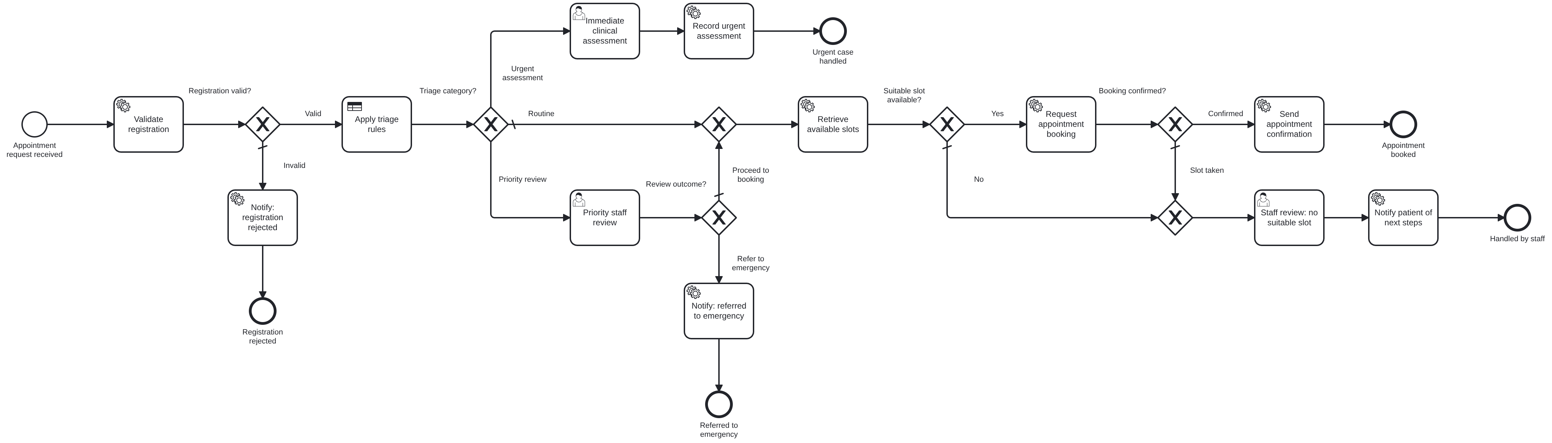
Hospital appointment and triage
LAB 3 · BPMN MODEL
01 · TRIAGE FIRST
02 · FIND A SLOT
03 · NO SLOT
Urgent cases skip booking and go to a clinician.
Connector GETs free slots; worker books the earliest.
Front-desk staff waitlist or assign by hand.
PBJ-2 · Camunda 8 practical · Ansh Agarwal
09 / 14
Notes:
Lab 3 is a hospital appointment request. I want to say up front that all patients here are synthetic, with references like SYN-PAT-3001, and the triage rules are an educational model for a simulated workflow, not clinical guidance. The validation worker actually rejects a request if someone types a real-looking name instead of a synthetic reference. The shape of this process is different from the other two. After registration is validated, the triage decision splits it three ways, and the most important design choice is the top branch: urgent cases never touch the scheduling system. If someone reports chest pain, the process doesn’t go looking for an appointment slot; it creates a task for a clinician straight away, with the highest task priority. Priority cases go to a nurse in Tasklist, who can either send them on to booking or refer them to the emergency department. Routine cases, and approved priority cases, go to the REST connector, which does a GET on the mock scheduling API for the department, date and session the patient asked for. Then my booking worker picks the earliest slot and books it. If the slot was taken in the meantime, the API returns 409 and the worker routes the case to staff instead of failing. And when there are no slots at all, which I simulate with dermatology being fully booked, a front-desk staff member gets a task to put the patient on a waiting list or assign a slot manually. So every path ends with a person or a confirmed booking, never a silent dead end.

Slide 10

Triage rules, most severe first
LAB 3 · DMN TRIAGE-CATEGORY · HIT POLICY FIRST
URGENT ASSESSMENT
PRIORITY REVIEW
ROUTINE
Immediate
2 – 24 hours
Next free slot
Any one of
Checked in this order
Catch-all
Chest pain
Breathing difficulty
Pain score 8–10
Fever, under 5 or 65+ (2 h)
Pain score 5–7 (4 h)
High fever (4 h)
Symptoms over 14 days (24 h)
No urgency indicators
e.g. mild cough, pain 2/10
→ Clinician task, priority 100
→ Nurse review, then book or refer
→ Slot lookup and auto-booking
Chest pain and fever is still URGENT: red flags are checked first. Educational rules for a simulated workflow — not clinical guidance.
PBJ-2 · Camunda 8 practical · Ansh Agarwal
10 / 14
Notes:
Here is the triage decision table, turned into three columns. It has six inputs: chest pain, breathing difficulty, pain score, high fever, age and how many days the symptoms have lasted. Read it left to right, because that’s the order the engine checks it. Hit policy FIRST again, so the most severe category is checked first. Any single red flag, whether chest pain, breathing difficulty or a pain score of eight or more, makes the case an urgent assessment, and it goes straight to a clinician. If there are no red flags, the priority rules are checked, and even inside this column the order matters. A high fever in a child under five or an adult over sixty-five gets a two-hour target, which is checked before the general high-fever rule with four hours. Moderate pain gets four hours, and symptoms lasting more than two weeks get twenty-four. Everything else is routine, which is the catch-all, and goes to automatic booking. The sentence at the bottom is the real reason for using FIRST here: a patient with chest pain and a fever matches both an urgent rule and a priority rule, and because urgent is checked first, they are correctly treated as urgent. I tested the table with twelve cases, including the boundaries, pain seven against eight and fourteen days against fifteen, and all twelve matched the expected category.

Slide 11



Three kinds of failure, three responses
DESIGNING FOR FAILURE
A job fails. Why?
LAB 1 · WORKER
LAB 1 · CREDIT API
LABS 2 & 3 · CONNECTOR
Bad data
External API error
Service outage
income sent as “45k”
HTTP 500 or 5 s timeout
payment or scheduling down
Fail fast
Catch and reroute
Retry, then escalate
retries = 0 → incident at once → fix the variable, Retry
error boundary → underwriter decides; customer is not blocked
3 attempts, 10 s apart → incident → service back up → Retry
PBJ-2 · Camunda 8 practical · Ansh Agarwal
11 / 14
Notes:
This is the slide I care about most, because this is where workflow automation is different from just writing code. When a job fails, the first question isn’t “how do I retry it?” but “why did it fail?”, because the right response depends on the cause. In my project there are three kinds of failure, and each gets a different response. On the left: bad data. In Lab 1, one test application sends the monthly income as the text “45k”. Retrying that a hundred times will fail a hundred times. So my worker fails the job with zero retries, and an incident appears in Operate immediately. The fix is a person correcting the variable to 45,000 and clicking Retry. In the middle: an external API error. If the credit bureau returns HTTP 500 or doesn’t answer within five seconds, that isn’t the applicant’s fault, and the business can still carry on. So I model it as a BPMN error caught by the boundary event, and an underwriter decides without the credit score. No incident, and the customer isn’t stuck. On the right: a temporary outage, like the payment gateway or the scheduling API going down. That probably will fix itself, so the connector retries three times, ten seconds apart. Only when all three fail does the engine raise an incident, and once the service is back, one click on Retry continues the instance from exactly where it stopped. So: fail fast for bad data, catch and reroute for business-tolerable errors, and retry for transient outages.

Slide 12

Incident recovery in Operate
LAB 2 · SCENARIO 05 · PAYMENT OUTAGE
1 · FAIL
2 · DETECT
3 · DIAGNOSE
4 · FIX
5 · RECOVER
Three attempts
Incident
Read Operate
Restore service
Retry
HTTP 503, 10 s apart
on “Process payment”, retries 0
503 from the API; order data intact
payment mock switched back UP
continues from the failed task
AT THE INCIDENT
AFTER RETRY
orderId
ORD-2005
paymentStatus
AUTHORISED
orderTotal
22717.82
shipmentId
SHP-2005
priority
CRITICAL · 6 h
finalOutcome
FULFILLED
paymentStatus
not set
charges made
1 (Idempotency-Key)
PBJ-2 · Camunda 8 practical · Ansh Agarwal
12 / 14
Notes:
Now let me walk through one recovery from start to finish. This is Lab 2, scenario 5, and it’s the drill I’d show live if there’s time. Before starting the order, I switch the payment mock to DOWN using its admin endpoint, so every payment call returns HTTP 503, Service Unavailable. Step one: the payment connector tries three times, ten seconds apart, and fails each time. Step two: after the third failure the job has zero retries left, so the engine raises an incident on the Process payment task. The instance doesn’t disappear and it isn’t marked as failed; it simply waits at that exact point. Step three, diagnose. In Operate I open the instance and read the incident message, which shows the 503 from the payment API. The variables on the left panel show the order itself is fine: it’s ORD-2005, worth 22,717.82, priority CRITICAL with a six-hour SLA, and paymentStatus has never been set, so we know no payment went through. Step four, I fix the actual cause by switching the payment service back UP. Step five, I click Retry on the incident. The engine re-runs only the payment task, not the whole process. The payment is authorised, the order is fulfilled with shipment SHP-2005, and finalOutcome becomes FULFILLED. And the last line on the right is the safety net: because every charge carries the order ID as an idempotency key, the customer is charged exactly once, no matter how many retries there were.

Slide 13
How the work was checked
VERIFICATION AND RESULTS
21
33/33
25
test scenarios: 7 loan · 8 order · 6 triage
DMN sample cases give the expected result
JUnit tests passing for the worker logic
0
8
GET /api/scenarios/results.md
Each lab app reads every instance back from the engine and prints expected vs actual outcome.
lint findings on 3 BPMN files, Camunda 8.8 rules
Camunda forms valid against the official schema
PBJ-2 · Camunda 8 practical · Ansh Agarwal
13 / 14
Notes:
This slide is about how I made sure all of this actually works, at several levels. Twenty-one test scenarios across the three labs, seven for loans, eight for orders and six for triage. They cover every minimum scenario in the assignment: approval, rejection, manual review, API errors, outages and recovery. Each scenario is a JSON file with the input and the expected outcome written into it. Thirty-three out of thirty-three DMN sample cases: I evaluated all three decision tables against test cases, including the exact boundary values, and every one gave the expected rule and result. Twenty-five JUnit tests cover the Java logic in the workers, like the EMI formula, GST and pricing, card-number rejection, date handling and slot selection. Zero lint findings: I checked all three BPMN files with the same Camunda 8.8 rule set that the Desktop Modeler uses before deployment, which also checks the syntax of every FEEL expression. And all eight forms pass the official Camunda forms schema. The dark tile is the part I’m happiest with. Each lab app has an endpoint that goes back to the engine for every instance I started, reads its state, any incident and its final variables, and prints a table of expected versus actual outcome with pass or fail. So the test-case table in my report isn’t typed by hand; it’s generated from what the engine actually did.

Slide 14
Three lessons from three labs
CONCLUSION
01
02
03
Model the business, not the code
Give every step one owner
Design the failure paths
The engine routes, workers compute, connectors call, people decide.
Fail fast, catch, or retry — and recover in Operate without losing data.
BPMN and DMN keep the rules visible; a new threshold is a table edit, not a Java change.
NEXT STEPS
Timer escalations on human tasks · OIDC auth and connector secrets · compensation if fulfilment fails after payment
Thank you · Questions?
github.com/anshagarwxl/workflow-automation-engineering
Notes:
To wrap up, here are the three things I take away from building these three labs. First, model the business, not the code. In all three labs the business logic, meaning the flow and the decisions, lives in BPMN and DMN files that anyone can open and read. If the bank decides the approval score should be 700 instead of 720, that’s one cell in a decision table, not a change in Java. Second, give every step one owner. Once I separated the work so that the engine only routes, the workers only compute, the connectors only call external systems and people only make decisions, each part became small, testable and easy to replace. That’s also why the same pattern worked for a bank, a shop and a hospital. Third, design the failure paths on purpose. Most of my thinking went into what happens when something breaks: fail fast for bad data, catch and reroute for errors the business can live with, and retry for outages, with Operate as the place to diagnose and recover without losing the instance or its data. If I took this further, the next steps would be timer escalations so a human task can’t wait forever, proper OIDC authentication and connector secrets instead of the open local setup, and a compensation path to refund an order if fulfilment fails after payment. All the code, models, test data and reports are in my GitHub repository shown on the slide. Thank you, sir, and I’m happy to take any questions or run one of the scenarios live.

