Slide 1

EDA LAB PROJECT REPORT · SIT PUNE · 2025–26
Exploratory Data Analysis on Students' Academic Performance
Department of Electronics & Telecommunication Engineering · First Year B.Tech
By: Ansh Yadav · Faculty In-charge: Mrs. Snehal Bhosale

Slide 2

Introduction & Project Objectives
This project applies 14 EDA techniques from the Semester 2 curriculum to the Students Performance in Exams dataset (Kaggle) — analyzing 1,000 students across Math, Reading, and Writing scores alongside demographic and socioeconomic factors.
01
02
Score Distribution
Gender Impact
Statistical and visual analysis across all three subjects
Subject-wise performance comparison by gender
03
04
Parental Education
Test Prep Effectiveness
Correlation between parent education and student outcomes
Scores of students who completed vs. skipped the course
05
06
Socioeconomic Role
Grade Classification
Lunch type as a proxy for economic status
Categorize students: Distinction, First Class, Pass, Fail

Slide 3
Dataset at a Glance
The Kaggle Students Performance in Exams dataset — 1,000 rows, 10 columns (8 raw + 2 computed), zero missing values.
1000
10
Students
Columns
Total rows in dataset
8 raw + 2 computed
0
5
Missing Values
Categorical
Fully complete dataset
Gender, race, education, lunch, test prep
Column Overview
gender
Male / Female
race_ethnicity
Group A through E
parent_education
High school to Master's degree
lunch
Standard / Free-reduced
test_prep
Completed / None
math / reading / writing_score
Integer scores 0–100
total
Sum of three subject scores
average_score
Mean of three subject scores

Slide 4
Libraries Used
Four Python libraries formed the complete EDA pipeline — from data loading and computation to publication-quality visualisation.
Pandas
NumPy
Core library for loading, cleaning, and manipulating the DataFrame. Used for read_csv(), groupby(), crosstab(), filtering, and derived columns.
Foundational numerical computing library. Powers all statistical computations internally; used directly for np.round() on float values.
Matplotlib
Seaborn
Primary visualisation library. Step 13 uses it to generate 7 chart types — line, scatter, histogram, box plot, bubble, area, and heatmap.
Statistical visualisation built on Matplotlib. Step 14 uses it for 5 polished charts — scatter, KDE histogram, box plot, pairplot, and annotated heatmap.

Slide 5

Descriptive Statistics & Data Quality
Subject Score Summary
Missing Value Analysis
All 10 columns recorded zero missing values — an exceptionally clean dataset. No imputation or row-dropping was required, allowing all 1,000 rows to be used in every analysis step.
Statistic
Math
Reading
Writing
Avg
Mean
66.09
69.17
68.05
67.77
Median
66.00
70.00
69.00
67.33
Std Dev
15.16
14.60
15.20
13.14
Dataset completeness: 100% — all columns fully populated across all 1,000 student records.
Min
0
17
10
9.00
Max
100
100
100
100.00
Reading leads in mean score; Math is lowest. Close mean–median proximity indicates symmetric distributions.

Slide 6

Visualisations
Step 13 — Matplotlib
Step 14 — Seaborn
Seven chart types demonstrating raw Matplotlib versatility:
Five statistical charts with polished, publication-ready styling:
Line chart — average score trend over student index
Scatter plot — Math vs. Average Score
Histogram — average score distribution (bell-shaped, centered ~67)
Box plot — five-number summary with outliers
Bubble chart — Math vs. Average, bubble size = Reading
Area plot — Math score volume over index
Correlation heatmap — inter-subject correlations
Scatter plot — Math vs. Average Score (refined aesthetics)
Histogram + KDE — distribution with smooth density curve
Box plot — automatic outlier detection
Pairplot — 4×4 matrix of all score variable relationships
Correlation heatmap — annotated coefficients (0.80–0.95 between subjects)
All three subject scores are strongly correlated (0.80–0.95), confirming consistent performance patterns across subjects.

Slide 7
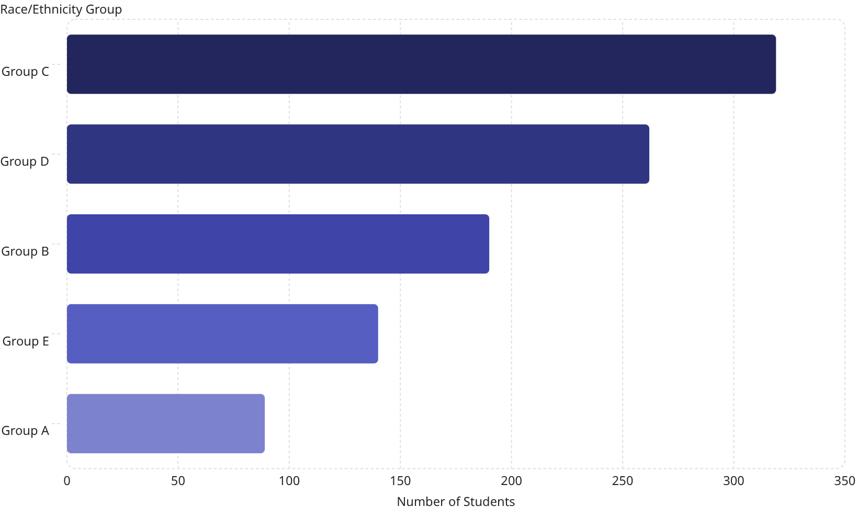
Categorical Distributions
Key Demographic Insights
Gender: 518 Female (51.8%) vs. 482 Male (48.2%) — near-equal split
Race/Ethnicity: Group C dominates at 31.9%; Group A is smallest at 8.9%
Parent Education: 'Some college' (22.6%) and Associate's degree (22.2%) most common; Master's only 5.9%
Lunch Type: 64.5% standard, 35.5% free/reduced — a key socioeconomic proxy
Test Prep: Only 35.8% completed the course — a major controllable factor

Slide 8
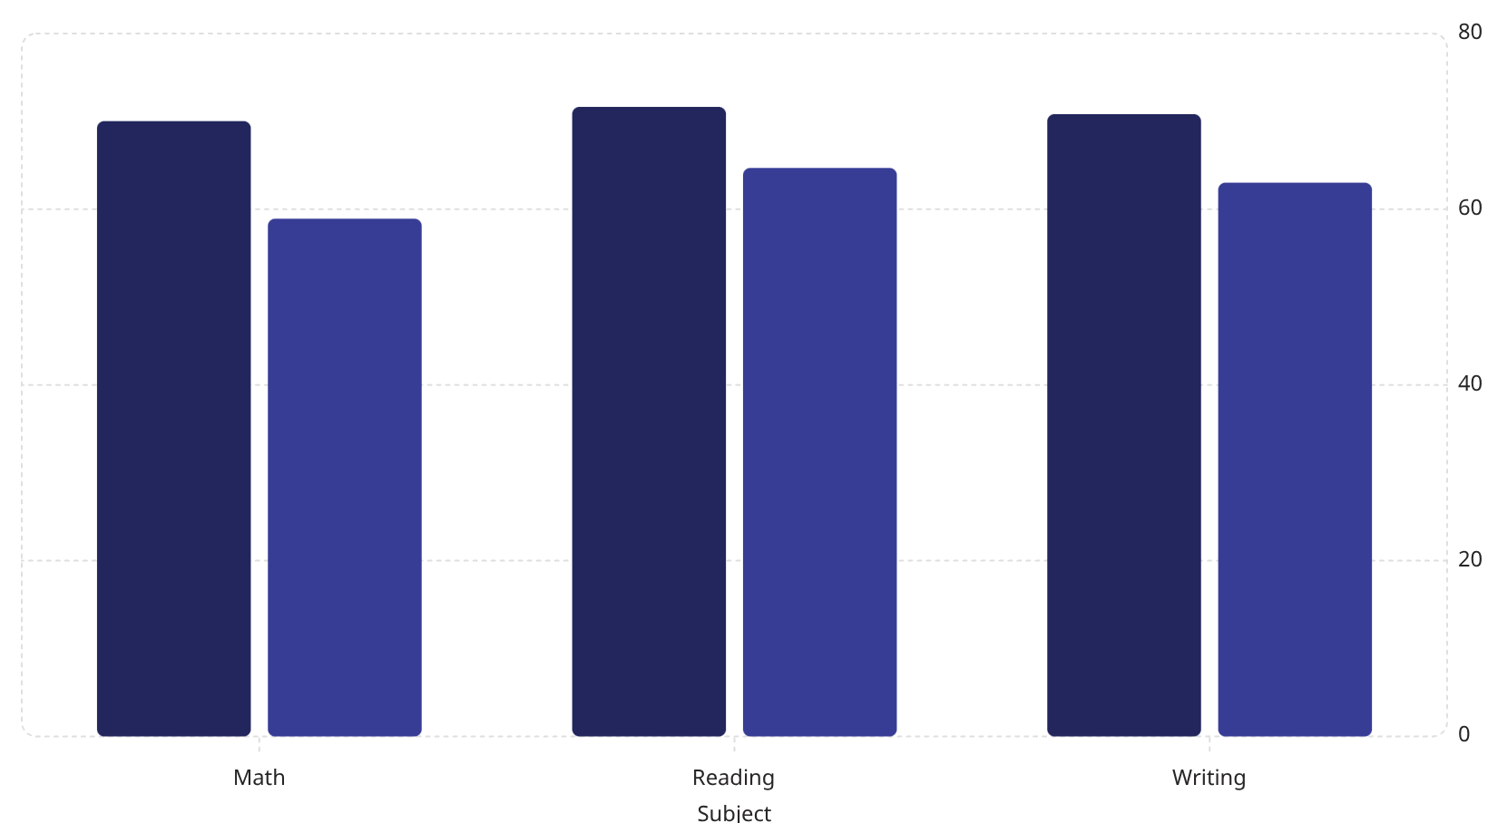
Groupby Analysis: What Drives Performance?
Grouping by categorical variables reveals clear performance patterns across gender, test preparation, and socioeconomic status.
Standard Lunch
Free/Reduced Lunch
Key Findings
Gender Gap: Males lead in Math (+5.1 pts); Females dominate Reading (+7.1) and Writing (+9.2)
Test Prep Impact: Completers score ~5–10 pts higher across all subjects; Writing shows the largest gain (~10 pts)
Lunch Type: Standard lunch students outperform by 7–11 pts per subject — the strongest single predictor
Parental Education: Master's degree parents → highest avg scores; clear positive gradient across all six levels

Slide 9
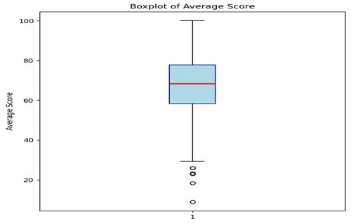
Boxplot of Average Score — Matplotlib
Key Observations
Median: ~69 — slightly above the dataset mean of 67.77
IQR: ~62–76; most students cluster in the 60–80 range
Outliers: Few low-score outliers below 30 — rare but present
Spread: Whiskers extend from ~30 to 100 — wide but skewed high

Slide 10
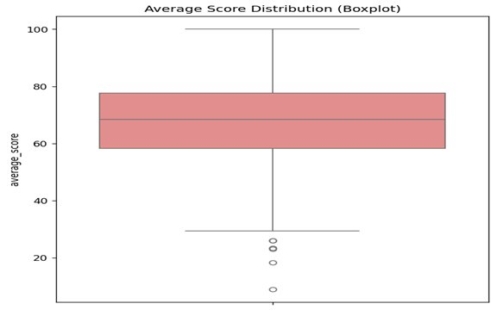
Average Score Distribution — Seaborn Boxplot
Key Observations
Distribution: Median near 68; box spans ~60–78 (IQR ≈ 18)
Symmetry: Near-symmetric with slight left tail toward lower scores
Outliers: Four extreme outliers below 30 identified by Seaborn
Range: Scores span from ~8 to 100 — full range utilised

Slide 11
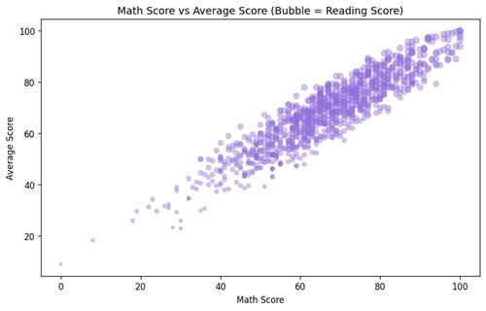
Math Score vs Average Score — Bubble Chart
Key Observations
Correlation: Strong positive linear trend between Math and Average Score
Bubble Size: Bubble radius = Reading Score; larger bubbles cluster top-right
Consistency: High Math scorers also tend to have high Reading scores
Outliers: A few low Math scores (below 20) with disproportionate averages

Slide 12
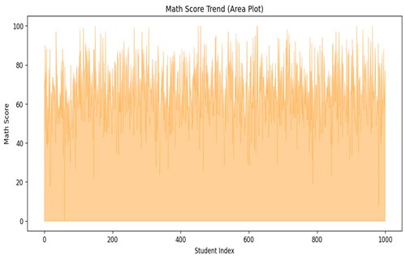
Math Score Trend — Area Plot
Key Observations
Volatility: Scores fluctuate widely across all 1,000 student indices
Central Band: Most scores cluster between 40–80 throughout the dataset
No Trend: No temporal trend — data is not ordered by performance
Extremes: Occasional spikes to 100 and dips to 0 visible throughout

Slide 13
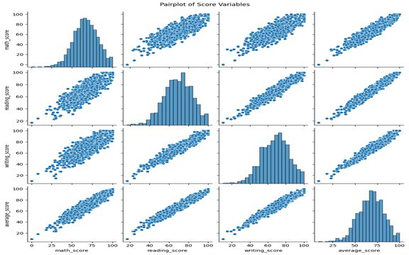
Pairplot of Score Variables — Seaborn
Key Observations
Diagonals: Histograms on diagonal — all three scores show bell-shaped distribution
Off-diagonal: Scatter plots show tight linear clusters for all subject pairs
Average Score: Average score closely mirrors each individual subject distribution
Outliers: A few isolated low-score students visible in every scatter panel

Slide 14
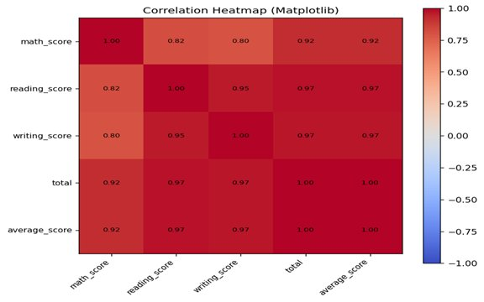
Correlation Heatmap — Matplotlib
Key Observations
Reading–Writing: Strongest pair correlation at 0.95 — near-identical skill sets
Math Correlation: Math correlates at 0.80–0.82 with Reading and Writing
Total & Avg: Total and average_score are perfectly correlated (1.00)
All Strong: All inter-subject correlations exceed 0.80 — consistent performers

Slide 15

Conclusion & Key Takeaways
Gender Gap
Males lead in Math (+5 pts); Females dominate Reading & Writing (+5–9 pts). Subject-specific pedagogy may help.
Test Prep Works
Completers score 5–10 pts higher. Only 35.8% participated — significant room to improve outcomes.
Socioeconomic Impact
Standard lunch students outperform by 7–11 pts — the strongest single predictor of academic performance.
Parental Education
Clear positive gradient: Master's degree parents → highest scores. Intergenerational education effect is evident.
~71% achieved First Class or Distinction; only ~3.5% failed. The combination of free/reduced lunch + no test prep is the primary bottleneck for low scores. This project successfully demonstrated all 14 EDA techniques using Pandas, NumPy, Matplotlib, and Seaborn in a Jupyter Notebook environment.

