Slide 1
EDA LAB PROJECT REPORT · SIT PUNE · 2025–26
Exploratory Data Analysis
On Student’s Academic Performance
Department of Electronics & Telecommunication Engineering · First Year B.Tech
By: Ansh Yadav · Faculty In-charge: Mrs. Snehal Bhosale

Slide 2
Introduction & Project Objectives
This project applies 14 EDA techniques from the Semester 2 curriculum to the Students Performance in Exams dataset (Kaggle) — analysing 1,000 students across Math, Reading, and Writing scores alongside demographic and socioeconomic factors.
01
Score Distribution
02
Gender Impact
Statistical and visual analysis across all three subjects
Subject-wise performance comparison by gender
03
Parental Education
04
Test Prep Effect
Correlation between parent education and student outcomes
Scores of students who completed vs. skipped the course
05
Socioeconomic Role
06
Grade Classification
Lunch type as a proxy for economic status
Categorize students: Distinction, First Class, Pass, Fail

Slide 3
Dataset at a Glance
The Kaggle Students Performance in Exams dataset — 1,000 rows, 10 columns (8 raw + 2 computed), zero missing values.
1000
10
0
5
Students
Columns
Missing
Categorical
Total rows
8 raw + 2 comp.
Fully clean
Demo. factors
Column Overview
gender
Male / Female
race_ethnicity
Group A through E
parent_education
High school to Master's
lunch
Standard / Free-reduced
test_prep
Completed / None
math / reading / writing_score
Integer 0–100
total
Sum of three subjects
average_score
Mean of three subjects

Slide 4
Libraries Used
Four Python libraries formed the complete EDA pipeline — from data loading and computation to publication-quality visualisation.
Pandas
Core library for loading, cleaning, and manipulating the DataFrame. Used for read_csv(), groupby(), crosstab(), filtering, and derived columns.
NumPy
Foundational numerical computing library. Powers all statistical computations internally; used directly for np.round() on float values.
Matplotlib
Primary visualisation library. Step 13 uses it to generate 7 chart types — line, scatter, histogram, box plot, bubble, area, and heatmap.
Seaborn
Statistical visualisation built on Matplotlib. Step 14 uses it for 5 polished charts — scatter, KDE histogram, box plot, pairplot, and annotated heatmap.

Slide 5
Descriptive Statistics & Data Quality
Statistic | Math | Reading | Writing | Avg
Mean | 66.09 | 69.17 | 68.05 | 67.77
Median | 66.00 | 70.00 | 69.00 | 67.33
Std Dev | 15.16 | 14.60 | 15.20 | 13.14
Min | 0 | 17 | 10 | 9.00
Max | 100 | 100 | 100 | 100.00
Reading leads in mean score; Math is lowest. Close mean–median proximity indicates symmetric distributions.
Missing Value Analysis
All 10 columns recorded zero missing values — an exceptionally clean dataset.
No imputation or row-dropping was required, allowing all 1,000 rows to be used in every analysis step.
Dataset completeness: 100% — all columns fully populated across all 1,000 student records.

Slide 6
Visualisations
Step 13 — Matplotlib
Step 14 — Seaborn
Line chart — average score trend over student index
Scatter plot — Math vs. Average Score
Histogram — average score distribution (bell-shaped, ~67)
Box plot — five-number summary with outliers
Bubble chart — Math vs. Average, bubble size = Reading
Area plot — Math score volume over index
Correlation heatmap — inter-subject correlations
Scatter plot — Math vs. Average Score (refined aesthetics)
Histogram + KDE — distribution with smooth density curve
Box plot — automatic outlier detection
Pairplot — 4×4 matrix of all score variable relationships
Correlation heatmap — annotated coefficients (0.80–0.95)
All three subject scores are strongly correlated (0.80–0.95), confirming consistent performance patterns across subjects.

Slide 7
Categorical Distributions
Key Demographic Insights
Gender
518 Female (51.8%) vs. 482 Male (48.2%) — near-equal split
Race/Ethnicity
Group C dominates at 31.9%; Group A is smallest at 8.9%
Parent Education
'Some college' (22.6%) and Associate's (22.2%) most common; Master's only 5.9%
Lunch Type
64.5% standard, 35.5% free/reduced — key socioeconomic proxy
Test Prep
Only 35.8% completed the course — a major controllable factor

Slide 8
Groupby Analysis: What Drives Performance?
Grouping by categorical variables reveals clear performance patterns across gender, test preparation, and socioeconomic status.
Standard Lunch
Free/Reduced Lunch
Math: 70.0 Reading: 71.7 Writing: 71.0
Math: 58.9 Reading: 64.7 Writing: 63.0
Key Findings
Gender Gap: Males lead in Math (+5.1 pts); Females dominate Reading (+7.1) and Writing (+9.2)
Test Prep Impact: Completers score ~5–10 pts higher across all subjects; Writing shows the largest gain (~10 pts)
Lunch Type: Standard lunch students outperform by 7–11 pts per subject — the strongest single predictor
Parental Education: Master's degree parents → highest avg scores; clear positive gradient across all six levels

Slide 9
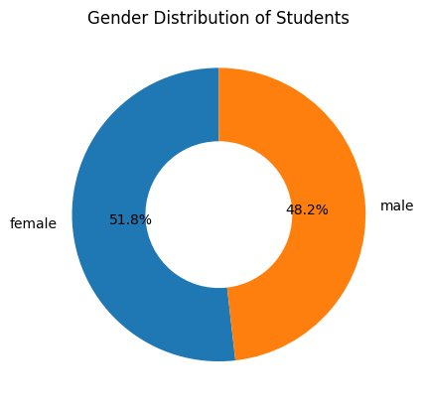
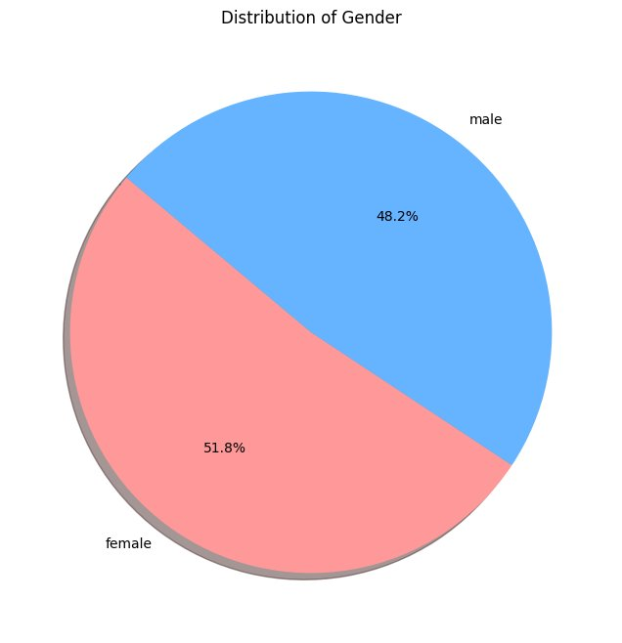
Gender Distribution of Students — Two Chart Views
Donut Chart (Matplotlib)
Pie Chart (Seaborn)
Donut Chart: 51.8% Female, 48.2% Male — the hole emphasizes proportion elegantly without clutter. Pie Chart: Same data rendered as a full pie; pink/blue palette makes the gender split immediately intuitive.

Slide 10
Boxplot of Average Score — Matplotlib
Key Observations
Median: ~69 — slightly above the dataset mean of 67.77
IQR: ~62–76; most students cluster in the 60–80 range
Outliers: Few low-score outliers below 30 — rare but present
Spread: Whiskers extend from ~30 to 100 — wide but skewed high

Slide 11
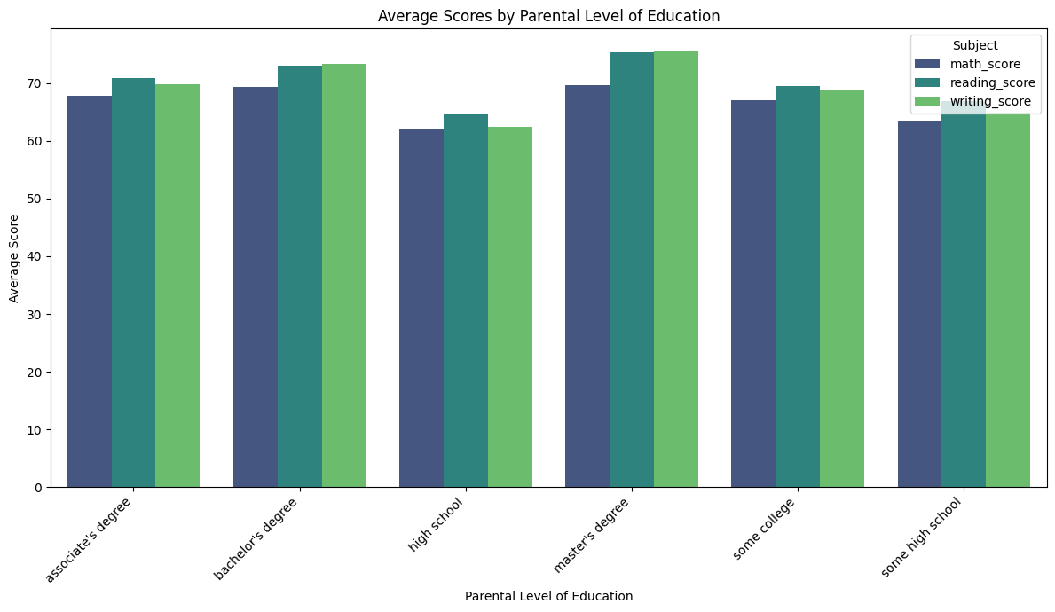
Avg Score by parental Level of Education
Key Observations
Demographics: The student population is unevenly distributed, with Group C being the largest (31.9%) and Group A being the smallest (8.9%).
Math Performance: Math scores follow a normal, bell-shaped distribution that peaks around the 66-point average, though a few extreme low outliers create a slight left tail.
Parental Influence: There is a strong, positive link between a parent's education level and a student's academic success. Students whose parents hold a master's degree achieve the highest average scores overall

Slide 12
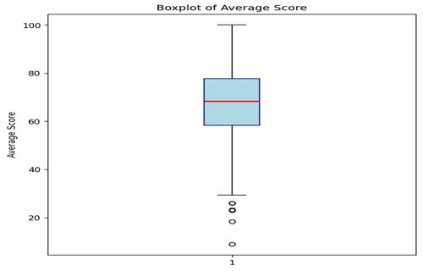
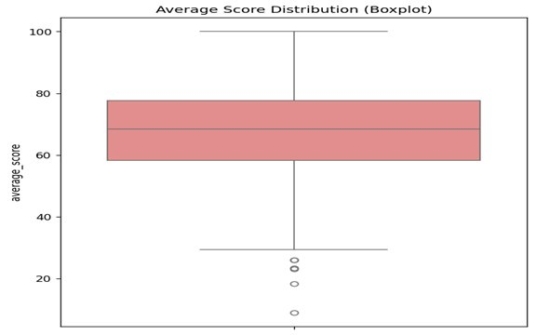
Avg Score Distribution of Students — Two Chart Views
Box Plot (Matplotlib)
Box Plot (Seaborn)
Box Plot: Median: ~69 Outliers: Few low-score outliers below 30 Range: Scores span from ~8 to 100

Slide 13
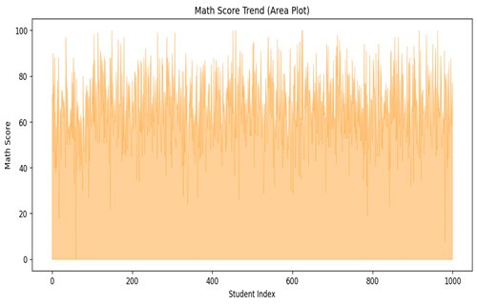
Math Score Trend — Area Plot
Key Observations
Volatility: Scores fluctuate widely across all 1,000 student indices
Central Band: Most scores cluster between 40–80 throughout the dataset
No Trend: No temporal trend — data is not ordered by performance
Extremes: Occasional spikes to 100 and dips to 0 visible throughout

Slide 14
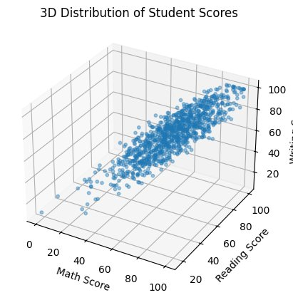
3D Distribution of Student Scores — 3D Scatter Plot (Matplotlib)
Key Observations
Three axes — Math (X), Reading (Y), Writing (Z) — capture all score dimensions at once
Data forms a tight diagonal cluster from low-left-front to high-right-back
Confirms extremely strong positive correlation across all three subjects simultaneously
Outlier students (near-zero scores) visible as isolated low points in the front-left corner
Top-right cluster: students with 80–100 across all three subjects — consistent high performers
3D visualisation reveals joint distribution patterns impossible to see in 2D scatter plots

Slide 15
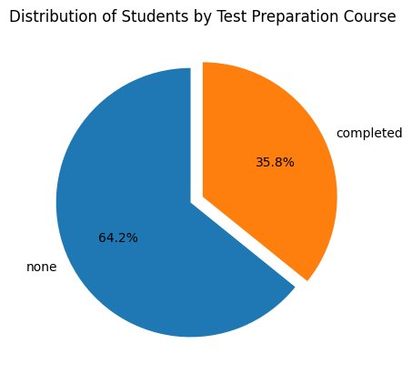
Distribution of Students by Test Preparation Course — Exploding Pie
Key Observations
64.2% of students (642) did NOT complete test prep
Only 35.8% (358 students) completed the course
The 'completed' slice is exploded to highlight the minority group and draw immediate attention
Students who completed prep score ~5–10 pts higher across all subjects
Writing scores show the largest gain from prep (~10 pts boost)
Massive 64.2% of students skipped prep — significant room to improve outcomes institution-wide

Slide 16
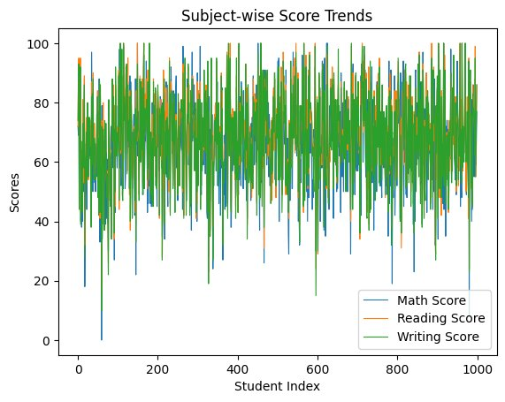
Subject-wise Score Trends — Advanced Line Chart (Seaborn)
Key Observations
All three subjects — Math, Reading, Writing — fluctuate tightly together across all 1,000 students
No clear upward or downward trend confirms data is not ordered by performance
Reading & Writing lines track extremely closely, confirming 0.95 correlation
Math dips lower more frequently, reflecting its slightly lower mean (66.09 vs 69.17)
Frequent spikes to 100 and drops to 0–20 show wide individual variation
Seaborn's clean styling (thicker lines, better defaults) improves readability over raw Matplotlib

Slide 17
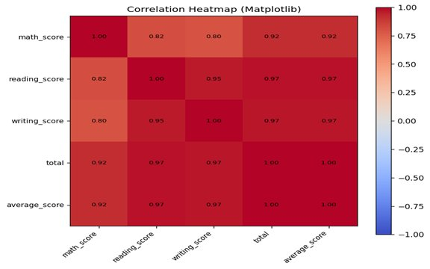
Correlation Heatmap — Matplotlib
Key Observations
Reading–Writing: Strongest pair correlation at 0.95 — near-identical skill sets
Math Correlation: Math correlates at 0.80–0.82 with Reading and Writing
Total & Avg: Total and average_score are perfectly correlated (1.00)
All Strong: All inter-subject correlations exceed 0.80 — consistent performers

Slide 18
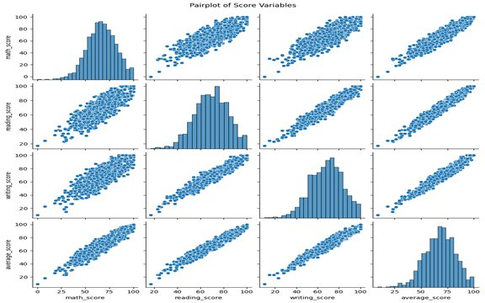
Pairplot of Score Variables (Seaborn)
Key Observations
Diagonals: Histograms on diagonal — all three scores show bell-shaped distribution
Off-diagonal: Scatter plots show tight linear clusters for all subject pairs
Average Score: Average score closely mirrors each individual subject distribution
Outliers: A few isolated low-score students visible in every scatter panel

Slide 19
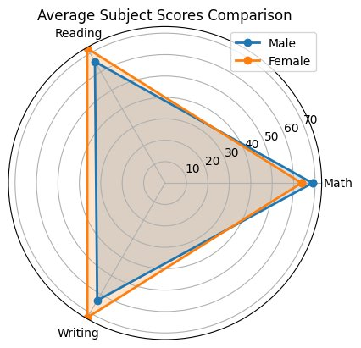
Average Subject Scores Comparison — Radar Plot / Spider Chart (Matplotlib)
Key Observations
Male and Female lines overlap significantly — both groups perform at a similar overall level
Math axis: Males extend slightly further (~68.7 vs 63.6 for females)
Reading & Writing axes: Female polygon extends noticeably beyond male for both
The 'crossed' shape of the two polygons shows each gender has a distinct strength profile
Spider chart makes multi-dimensional gender comparison intuitive in a single glance
Area overlap confirms consistent performers in both groups with subject-specific differences

Slide 20
Conclusion & Key Takeaways
Gender Gap
Test Prep Works
Males lead Math (+5 pts); Females dominate Reading & Writing (+5–9 pts). Subject-specific pedagogy may help.
Completers score 5–10 pts higher. Only 35.8% participated — significant room to improve outcomes.
Socioeconomic Impact
Parental Education
Standard lunch students outperform by 7–11 pts — the strongest single predictor of academic performance.
Clear positive gradient: Master's degree parents → highest scores. Intergenerational education effect is evident.
~71% achieved First Class or Distinction. Free/reduced lunch + no test prep = primary bottleneck. All 14 EDA techniques demonstrated successfully.

