Slide 1
Deep Shadow Mapping
CS 580 Final Project Group 24
Ansh Bahri
Sandeep Thippeswamy
Sohil Himanish
Anuja Chandorkar

Slide 2
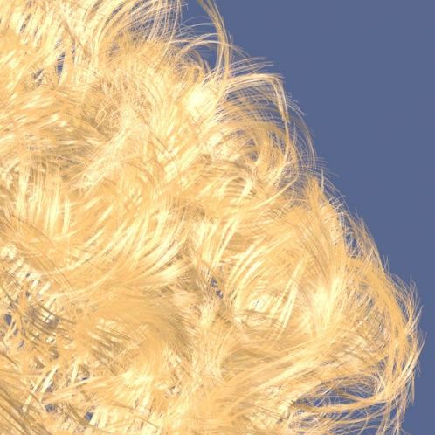
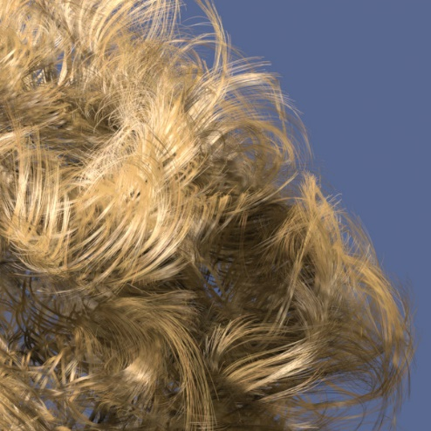
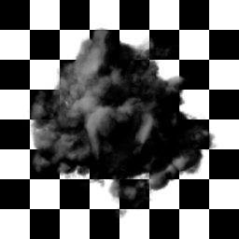
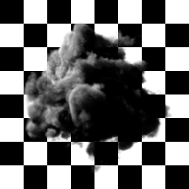
Deep Shadow Maps
Without self-shadowing
With self-shadowing

Slide 3
Traditional Shadow Maps
  depth values from the light source’s point of view are stored for each point in the scene
  when objects are rendered individually, their visibility is determined by comparing their depth values to corresponding depth map values
  Higher quality images require
    Percentage closer filtering - multiple shadow map comparisons are made per pixel and averaged together.

Slide 4
Advantages
  Renders large objects well
  Stores only one depth value per pixel
Disadvantages
  Poorly renders highly detailed geometries like fur and hair
  Produces artifacts, especially in animation
  Rendering time and memory allocation for detailed renders rapidly increase due to super sampling

Slide 5
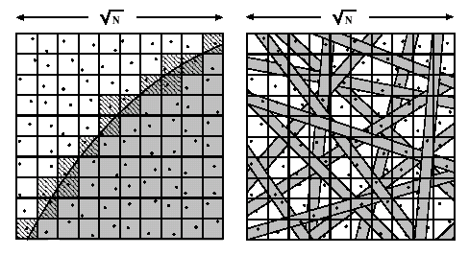
Deep Shadow Maps
because accurate self-shadowing is so important, rendering hair, fur and smoke is difficult.
in traditional Shadow Maps, inadequate sampling results in artifacts(sparkling) in animation.
Deep shadow maps
  Construct a continuous visibility function at each pixel that records the approximate amount of light that passes through the pixel to each depth
shadow maps:
depth value / pixel
deep shadow maps:
visibility function / pixel

Slide 6

Deep Shadow Maps
A deep shadow map is a rectangular array of pixels in which every pixel stores a visibility function.
Transmittance function
The fraction of light that penetrates to a given depth z is known as the transmittance
Visibility function
Visibility function for a given depth is fraction of the beam’s initial power that penetrates to that depth.

Slide 7
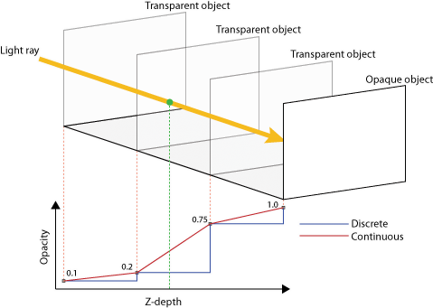

Slide 8
Comparing DSMs to TSMs
Advantages
Support semitransparent surfaces and volumetric primitives, such as smoke
Support prefiltering, which allows faster shadow lookups and much smaller memory footprints than regular shadow maps of similar quality
Support mip-mapping, which can dramatically reduce lookup costs when objects are viewed over a wide range of scales.
Disadvantages
Significantly more expensive to compute than a regular shadow map at the same pixel resolution
Bias artifacts possible, due to constant z depths

Slide 9
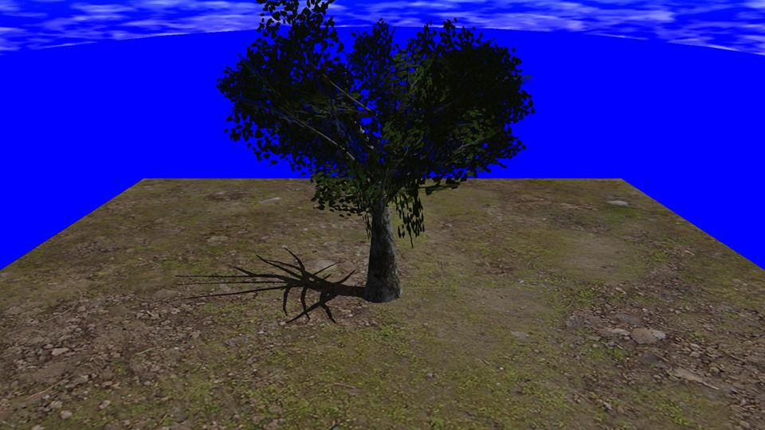
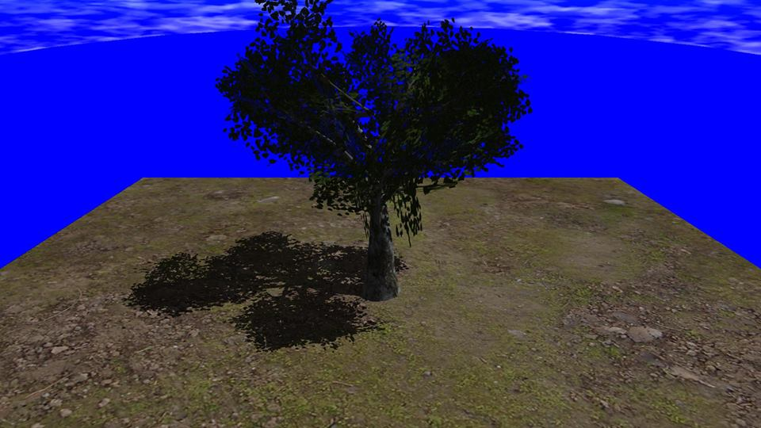

Results

Slide 10
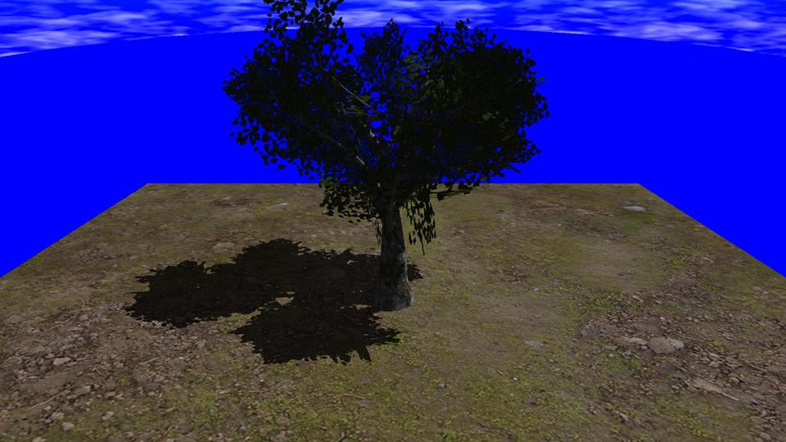
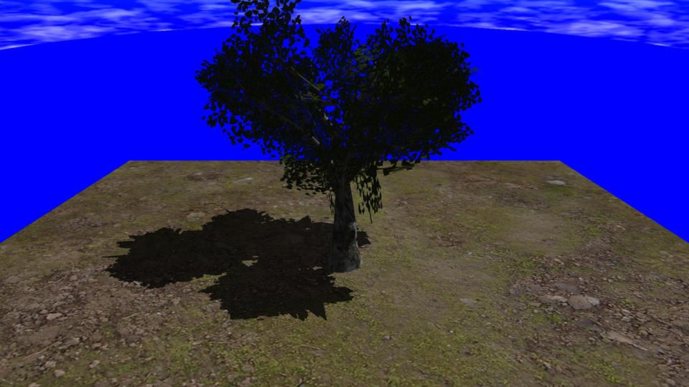
Results

