Slide 1
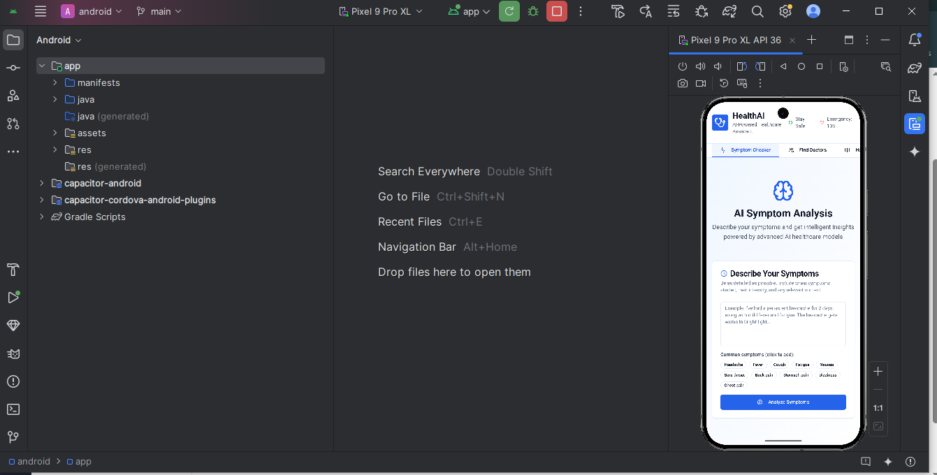
Team Name: Ctrl Alt Elite
Topic : Doctor AI

Slide 2
Abstract
Objective / Aim: The objective of DoctorAI is to create an intelligent, AI-powered system that can accurately understand users’ health queries, provide verified medical insights, and guide them toward appropriate next steps, such as consulting a doctor or scheduling a health checkup.
Proposed Solution / Approach: DoctorAI leverages Natural Language Processing (NLP) and Large Language Model (LLM) technology to interpret user queries in natural language. The system integrates a curated medical knowledge base with machine learning models to generate reliable, explainable responses. It can process doctor-patient conversation datasets, classify symptoms, and match them with possible conditions using confidence-based reasoning. The platform can be deployed as a chatbot or integrated with telemedicine portals for real-time support. Future enhancements include multilingual capabilities and integration with wearable health data.
Expected Impact / Outcome: DoctorAI will serve as a virtual pre-diagnosis assistant, improving early health awareness, reducing misinformation, and supporting overburdened healthcare systems. It empowers users with trustworthy information, facilitates quick triage, and helps medical professionals focus on critical cases. In the long run, the solution aims to bridge the healthcare accessibility gap through intelligent, inclusive, and data-driven support.

Slide 3
Problem Understanding
Limited Access to Medical Guidance: Many people struggle to get quick and reliable basic medical guidance due to long hospital queues, lack of nearby doctors, or high consultation fees.
Information Overload & Inaccuracy: Users often Google symptoms and receive confusing, unreliable, or overly generic information, which may cause panic or wrong assumptions.
Delayed First-Level Diagnosis: Minor health concerns escalate because people don’t know whether the situation needs immediate care, home remedies, or a specialist visit.
Lack of Personalized Suggestions: Existing symptom-checker apps give generic outputs and fail to consider user's age, condition, history, or context.

Slide 4
Objective of the Project
Provide instant, reliable first-level medical guidance using AI to help users understand symptoms and possible causes.
Simplify medical reports (CBC, LFT, KFT, lipid profile, prescriptions, etc.) by explaining results in easy-to-understand language.
Reduce unnecessary hospital visits by telling users whether a condition is mild, moderate, or needs immediate medical attention.
Assist doctors and clinics by filtering common queries and reducing repetitive questions.
Offer personalized healthcare advice based on age, symptoms, vitals, and user context.
Bridge the healthcare access gap for rural, remote, or low-resource areas with AI-powered support.
Promote preventive healthcare through reminders, risk alerts, and lifestyle suggestions.
Provide multilingual medical assistance so users can understand health information in their preferred language.
Act as a smart companion that stores and analyzes previous interactions, symptoms, and report history.

Slide 5
Solution Design & Innovation
Frontend: Chat UI with voice, report upload, history, multilingual support.
Backend: Node.js API orchestrating AI, OCR & rule engine.
AI Layer:
LLM for conversation & explanations.
OCR for report extraction.
Rule-based triage for safety (red/yellow/green).
Database: Encrypted user data, report storage, medical knowledge base.
Admin Panel: Doctors view flagged cases & summaries.
Hybrid safety-first architecture — LLM creativity + deterministic medical rules ensures better safety than pure chatbots.
Report auto-explain with context-aware ranges — explains labs with age/sex-specific ranges and simple actions.
Conversational escalation with pre-filled doctor summary — saves doctor time and improves triage efficiency.

Slide 6
Solution Workflow / Approach
User Entry
Inputs: free-text chat, structured symptom form, voice, or upload (image/PDF of reports).
Quick pre-check: collect age, sex, major conditions, allergies, current meds.
Pre-processing
Sanitize text, normalize units, run language detection/translations.
If voice → speech-to-text; if image/PDF → OCR.
Information Extraction
Parse OCR → identify test names, values, units, reference ranges.
Extract symptom entities, durations, severity from text (NER + regex).
Context Assembly
Build a structured context bundle: user profile, vitals reported, extracted lab values, symptom timeline, recent history.
Deterministic Safety Check (Rule Engine)
Apply hard safety rules (red flags). Example: chest pain + breathlessness → urgent escalation.

Slide 7
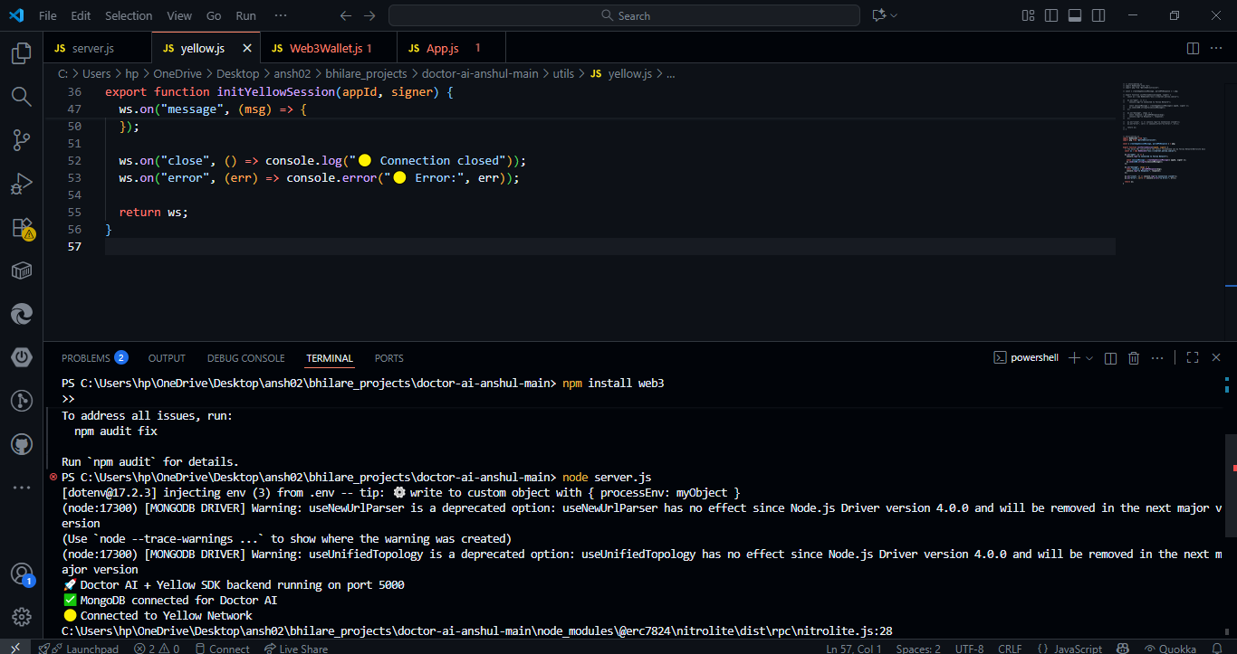
Architecture Diagram

Slide 8
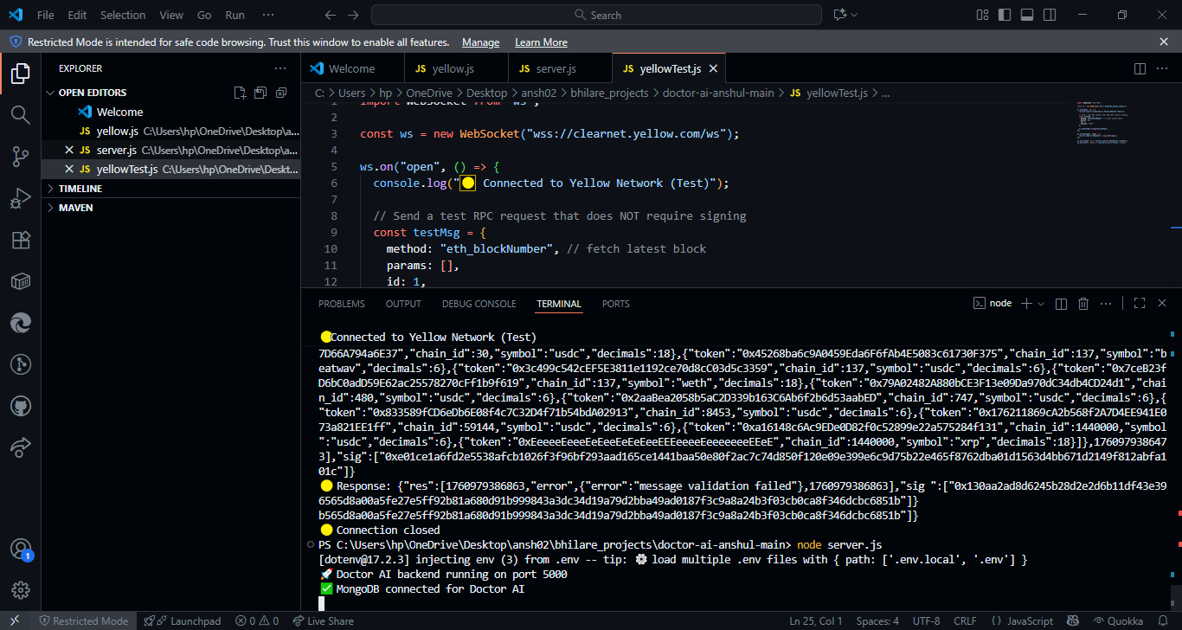

Slide 10
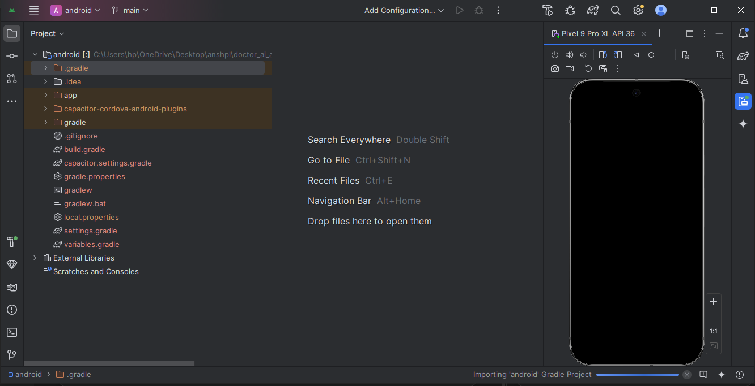

Slide 11
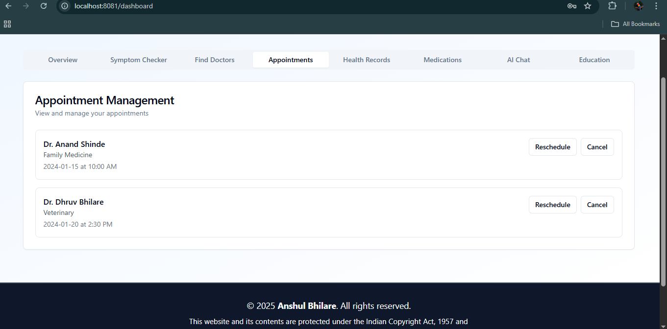

Slide 12
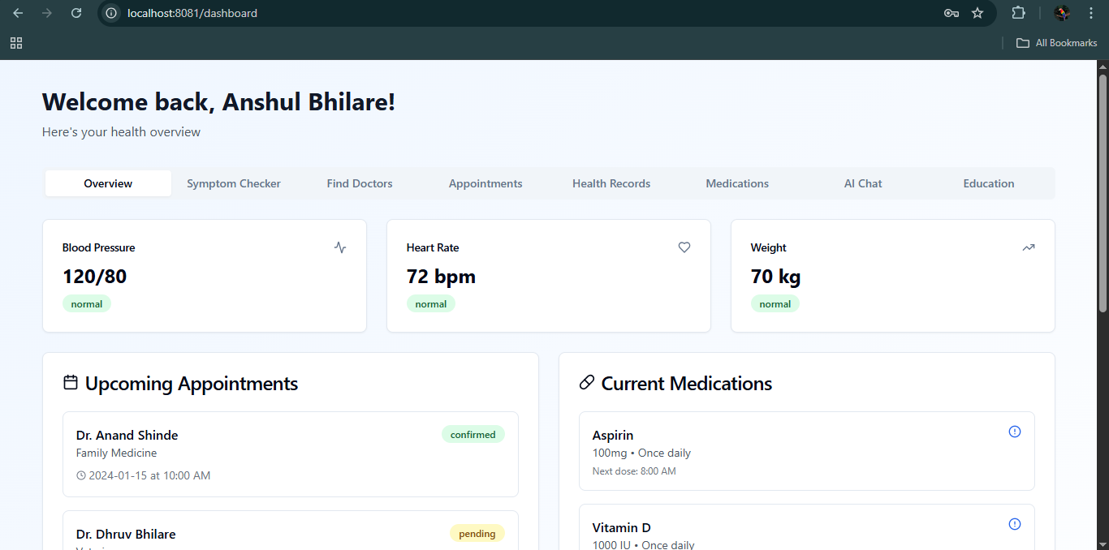

Slide 13
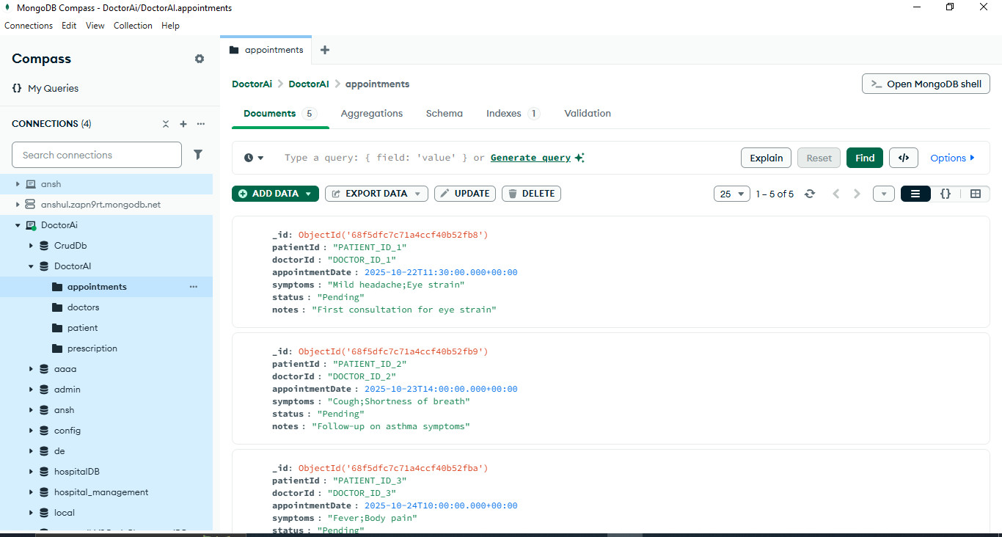

Slide 14
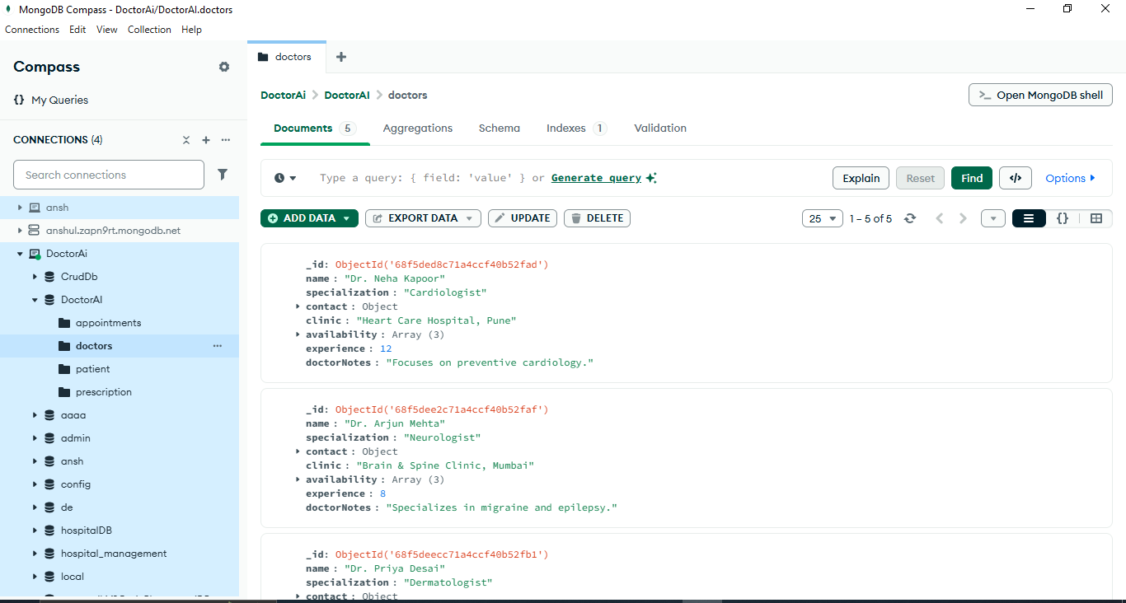

Slide 15
Key Features
Intelligent Symptom Analysis
Users enter symptoms in natural language; AI identifies possible causes and urgency levels.
Quick triage: Green (mild), Yellow (moderate), Red (critical).
2. Lab Report Auto-Explanation
Upload any medical report (CBC, LFT, KFT, Lipid, Thyroid, etc.).
OCR extracts values → AI explains results in simple, easy language.
3. Prescription Understanding
AI reads doctor prescriptions and explains medicines, dosage, and precautions.
Highlights interactions and contradictions based on user history.
4. AI-Generated Personalized Health Advice
Gives custom suggestions based on age, symptoms, history, and lifestyle.
Helps users decide: home care vs. test required vs. doctor visit.
5. Multilingual Support
Assistant can answer in multiple Indian languages for better accessibility.

Slide 16
Technology Stack
Frontend
React.js / Next.js (Web)
React Native (optional mobile app)
TailwindCSS for UI styling
Speech-to-Text API (Web Speech API)
🔹 Backend
Node.js with Express/Fastify
REST APIs / GraphQL
JWT Authentication
Multer for file uploads (reports)
🔹 AI / ML Models
LLM APIs: OpenAI / Gemini / LLaMA hosted model
OCR: Tesseract OCR or Google Vision API
Symptom Classification: lightweight ML model (XGBoost / Scikit-learn)
Rule Engine: Custom red-flag safety rules (JSON + Node service)

Slide 17
Domain-Specific Deep Dive
Frontend: React (PWA) with file upload, voice capture (Web Speech), chat UI, language toggle.
API / Orchestrator: Node.js + Express/Fastify. Manages flow & invokes services.
OCR: Tesseract (open) or Google Vision (production).
Parser: Maps OCR tokens → test names, values, units, reference ranges.
Rule Engine: Deterministic JSON rules for red flags (always overrides LLM).
Classifier: Light ML model (XGBoost / sklearn) for predicting urgency from structured features.
LLM: Prompt-engineered model for natural explanations + next steps (OpenAI/Gemini or local Llama variant).
Storage: PostgreSQL for structured data, S3 for files, Redis for cache.
Admin: Dashboard to view flagged cases and accept handoffs.

Slide 18
Prototype / UI Screens

Slide 19
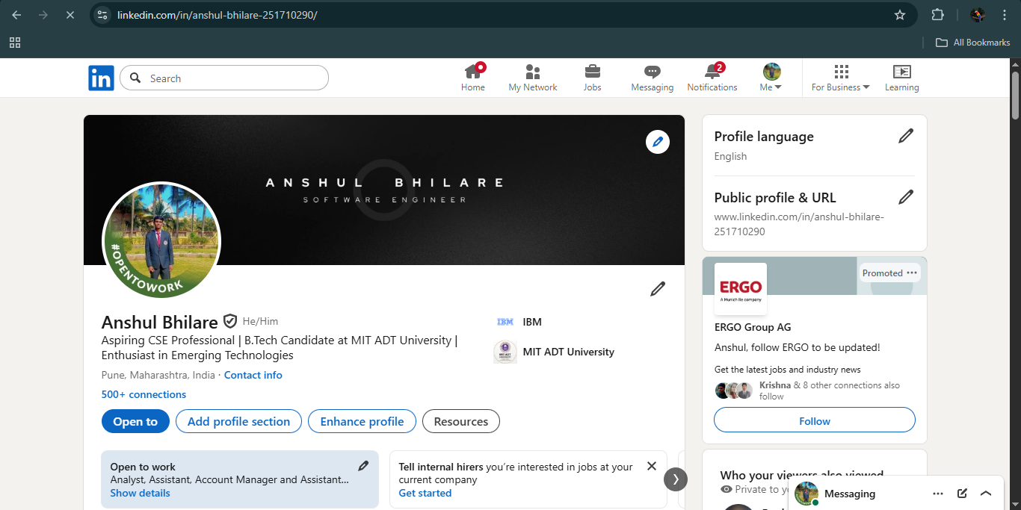

Slide 20
Innovation & Uniqueness
Multi-Domain Medical Intelligence
Doctor AI uniquely blends symptom investigation, medical report understanding, medicine guidance, and risk prediction into one unified LLM pipeline—unlike typical symptom checkers that give only basic suggestions.
2. Hybrid LLM + Medical-Knowledge Graph
Uses a dual-engine approach:
LLM for natural conversation + reasoning
Medical ontology (ICD-10, drug database) for accurate disease mapping This drastically reduces hallucinations.
3. Context-Aware Dynamic Triage
Provides emergency severity scoring based on symptoms, history, vitals, and report data—making it more actionable than simple chatbot responses.

Slide 21
Impact Analysis
1. Improved Healthcare Accessibility
Doctor AI offers instant, 24×7 medical assistance, especially for rural users, students, senior citizens, and those who lack quick access to doctors. This significantly reduces the dependency on physical consultations for minor issues.
2. Reduction in Self-Medication Risks
Instead of blind Googling or guessing medicines, the system gives safe, evidence-based guidance, lowering chances of wrong drug usage or harmful combinations.
3. Faster Pre-diagnosis & Early Detection
The AI can identify red-flag symptoms, abnormal report values, and high-risk patterns, leading to earlier treatment opportunities and preventing complications.
4. Lower Clinical Workload
Basic queries, report explanations, lifestyle suggestions, and triage scoring are automated. Doctors can focus on critical cases, reducing consultation time by 30–40%.

Slide 22
Future Enhancements & Challenges Faced
1. Wearable Device Integration
Sync real-time health data (SpO₂, Heart Rate, BP, Sleep Patterns) for continuous monitoring & instant alerts.
2. Advanced Report Scanner (OCR + Vision AI)
Support X-rays, ECGs, MRIs using open-source medical imaging models for automated anomaly detection.
3. Personalized Health Records (PHR) Vault
User-specific encrypted health profiles, medication history, allergies, and prescriptions.
4. Multi-Lingual Voice Assistant
Support for 10+ Indian languages, allowing rural users to interact fully via voice.
5. Doctor Collaboration Portal
Doctors can verify AI outputs and provide corrections—creating a human-in-the-loop learning cycle.
6. Integration with ABDM / Ayushman Bharat APIs
To fetch digital health records and offer connected public healthcare services.

Slide 23
Conclusion & Thank You
Deployed Link:
https://doctoraiviaaanshul.netlify.app/
LinkedIn: https://www.linkedin.com/in/anshul-bhilare-251710290/
Portfolio: https://anshulbhilareportfolio.netlify.app/
GitHub Link: https://github.com/anshbytecode/DoctorAiadvance
This Topic got selected at IIT Delhi , and we were Finalist at IIT Delhi Hackathon.
We have made this project frontend,backend and made it upto web3 and integrated into android studio as well, and made apk out of it and now it is working on mobile phones as well. Also participated in various competitions at IIT Bombay.

