Slide 1
DoctorAi
doctoraibyanshul.netlify.app

Slide 2
Problem Statement
In today’s digital age, individuals frequently search online for health-related information, leading to misinformation, self-diagnosis, and delayed professional care. Access to accurate and personalized health guidance remains limited, especially in rural areas.

Slide 3
Objective / Aim
DoctorAI aims to build an intelligent AI-powered system that understands users’ health queries and provides verified insights, guiding them toward next steps such as consulting doctors.

Slide 4
Proposed Solution / Approach
• Uses NLP and LLMs to interpret user queries.
• Integrates curated medical databases.
• Provides reliable, explainable responses.
• Supports classification of symptoms and real-time triage.
• Future additions: multilingual support, wearable data.

Slide 5
Expected Impact
• Acts as a virtual pre-diagnosis assistant.
• Reduces misinformation.
• Supports overburdened healthcare systems.
• Enhances accessibility in rural and semi-urban regions.

Slide 6
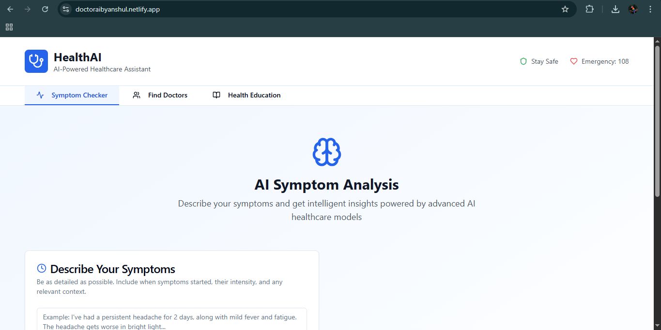

Slide 7
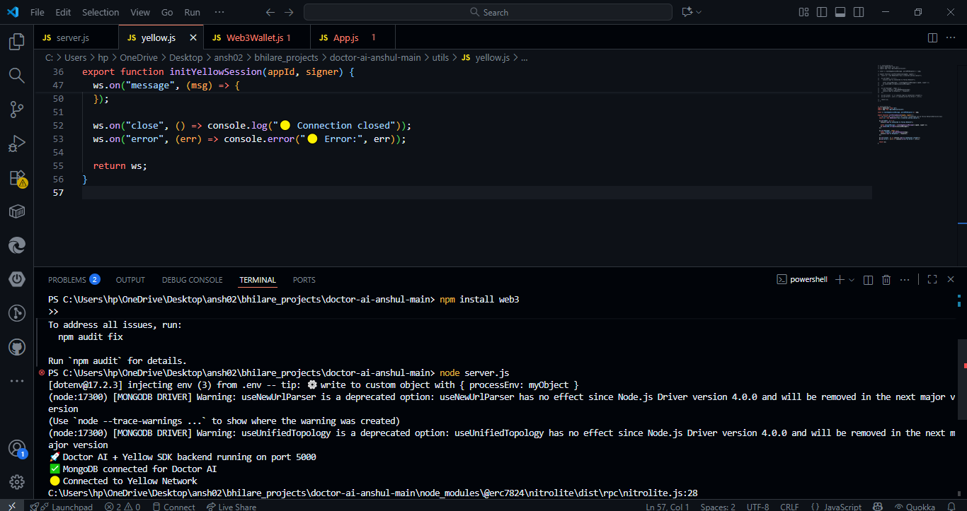

Slide 8
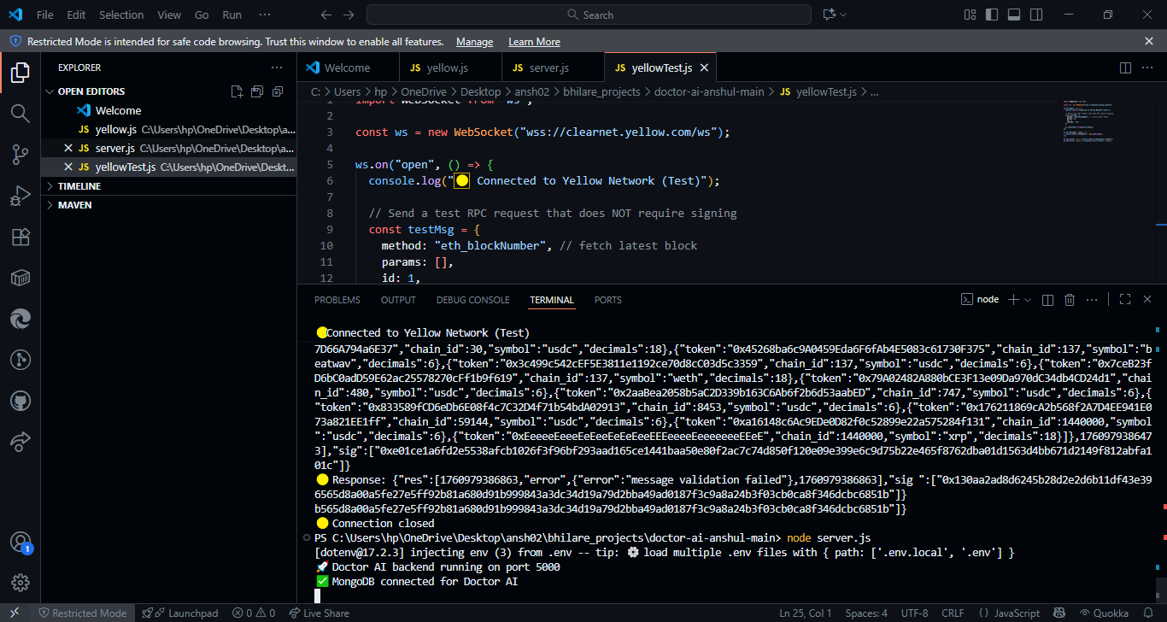

Slide 10
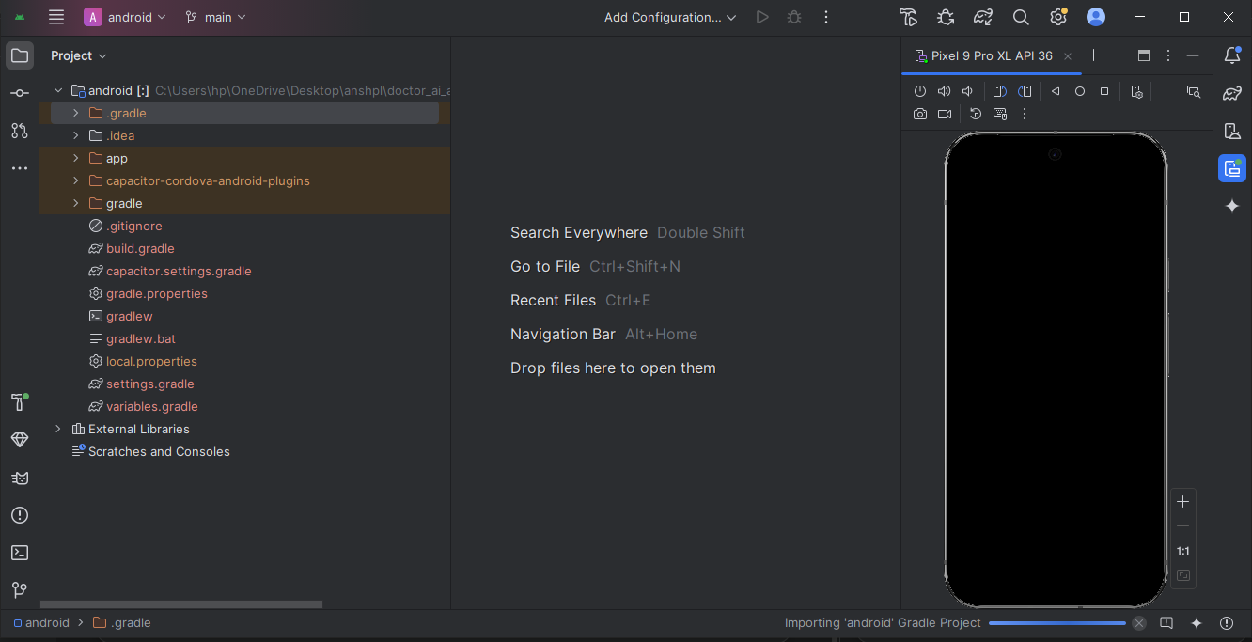

Slide 11
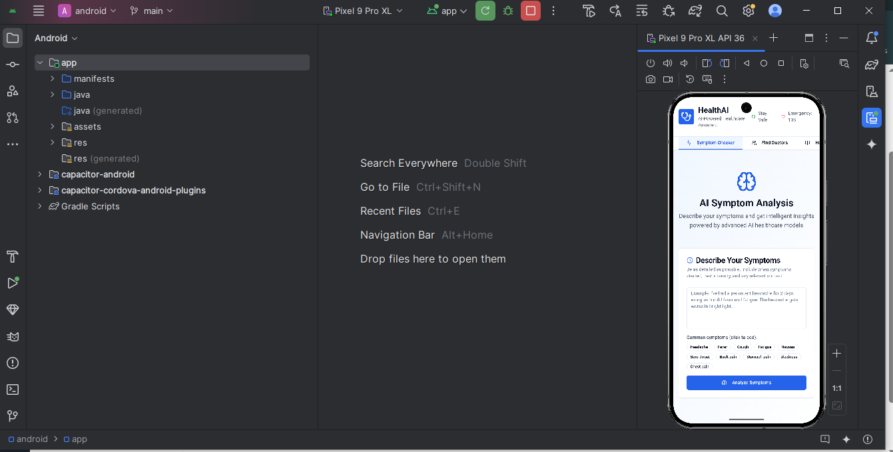

Slide 12
Project Links & Info
Deployed Link: doctoraibyanshul.netlify.app
LinkedIn: linkedin.com/in/anshul-bhilare-251710290/
Portfolio: anshulbhilareportfolio.netlify.app
This project was selected at IIT Delhi Hackathon.
Developed frontend, backend, Web3, Android integration, and APK.

