Slide 1
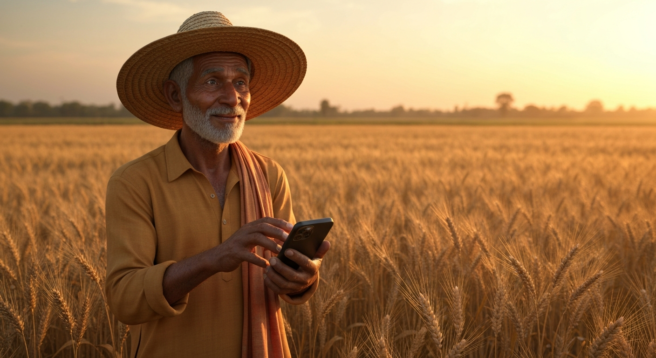
Fasal Seva
Smart Farming for Everyone

Slide 2
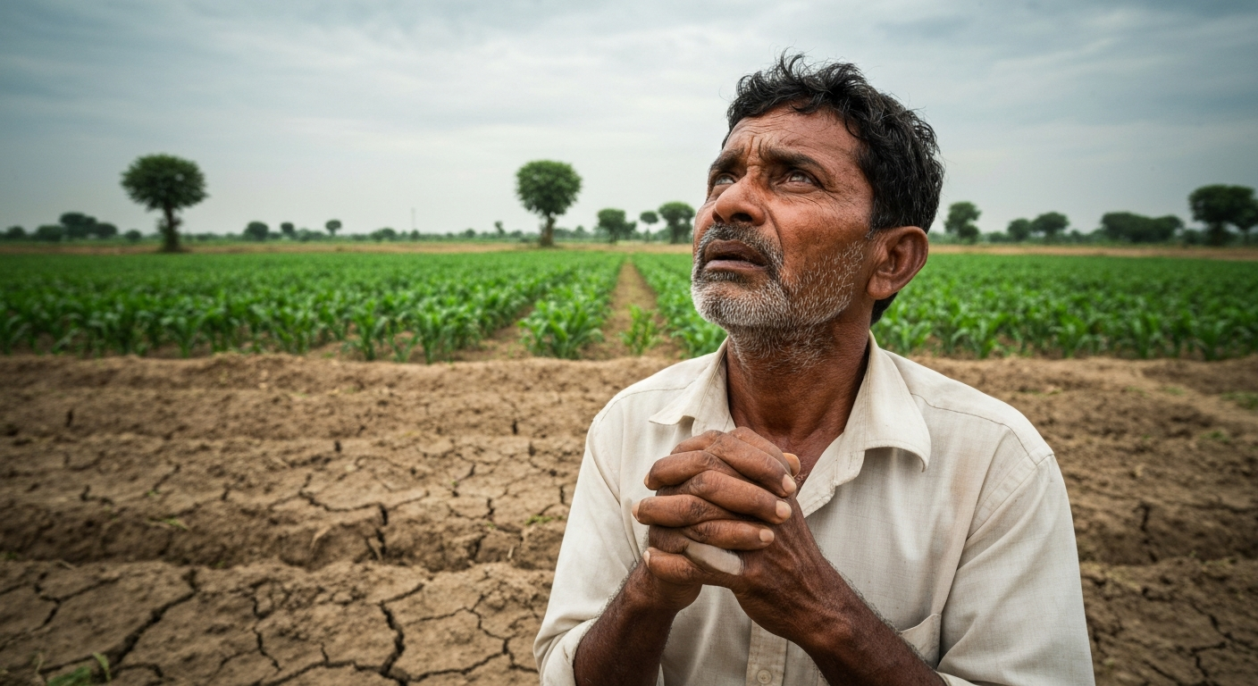
The Problem
Gambling with nature.
86% of farmers rely on guesswork.

Slide 3

The Solution
Voice-First Super App.
Satellite + IoT + AI.
Just talk to your farm.

Slide 4
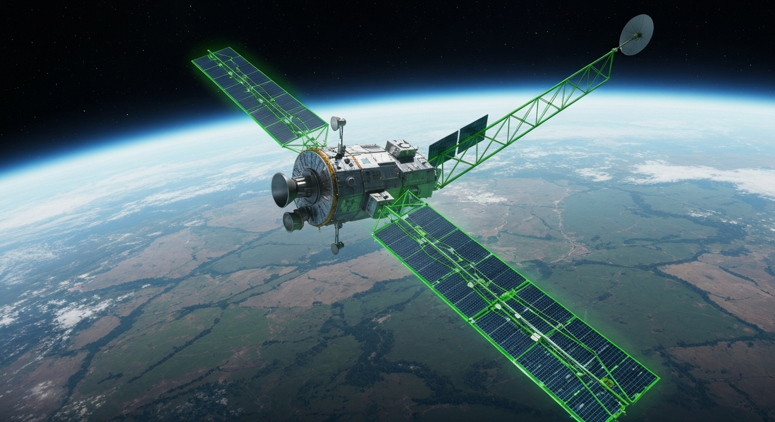
The Technology
Real-time NDVI Maps.
IoT Calibration.
Hyper-local weather.

Slide 5
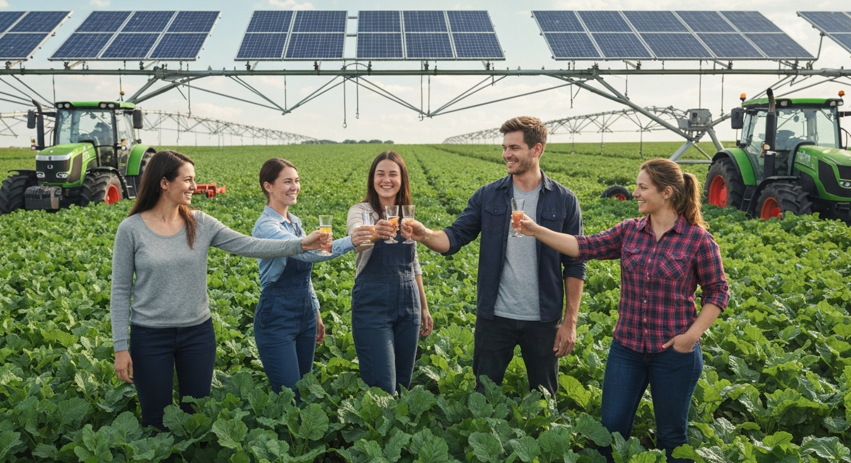
The Vision
100% Free.
Data-driven farming as a right, not a luxury.
Ab Kheti Hogi Smart.

