Slide 1


SAMSUNG PRISM · GENERATIVE AI HACKATHON
1.0.0
THEME 05 · INTERRUPTIBLE REAL-TIME AGENTS
THREAD
Go on.
A voice assistant you can interrupt
and correct without losing the task.
ReflexAi
SRM Institute of Science and Technology
Kattankulathur
SOURCE RELEASE PRISM_GENAI_HACKATHON_Y2026
Notes:
Introduce THREAD as the ReflexAi team's Theme 05 project. The user can correct a request without discarding every valid constraint. The controller checks current authority before a tool can run and records the outcome of work already dispatched. Source: tag PRISM_GENAI_HACKATHON_Y2026 on main. The benchmark runtime was measured at development commit 4e88d4b in run 20261003T192003Z-cf861d7d on 4 October 2026; the tagged commit carries byte-identical runtime files (hashes in docs/fdb3/evidence/final-windows-20261004.json). Sphere artwork is cropped from the team-supplied THREAD-opus-film-3min-v3-1080p60.mp4 at 147 seconds, not generated proof of runtime behavior.

Slide 2

T H R E A D
PROBLEM / WHY INTERRUPTION IS HARD
Stopping speech is not
stopping an action.
ILLUSTRATIVE REQUEST
LATEST INTENT
“Add two. Actually, one.”
1
PROPOSED: 2
CORRECTION ARRIVES
ADMIT: 1
Keep valid context
Reject stale work
Account for effects
A correction does not require
throwing away the whole task.
Old intent cannot authorize
a new tool dispatch.
An interruption cannot pretend
an action already sent never happened.
REFLEXAI / SAMSUNG PRISM 2026
Architecture & correction semantics
02 / 08
Notes:
This is an illustrative request, not a claimed benchmark recording. The technical problem is larger than cutting off audio: a tool may still be pending, a late result may arrive, or a write may already have reached the client. THREAD distinguishes pre-dispatch cancellation from reconciliation after admission. The intended benefit is preserving valid context while limiting outdated actions; this slide does not claim measured superiority over another assistant or universal safety.
SOURCES
https://github.com/anshcantcode/thread-team-guide/blob/f83e38968abd3d91b5b05795d99a36d73f0a0575/docs/ARCHITECTURE.md
https://github.com/anshcantcode/thread-team-guide/blob/f83e38968abd3d91b5b05795d99a36d73f0a0575/README.md

Slide 3
T H R E A D
ARCHITECTURE / SELECTED LOCAL-MODEL PATH
The planner proposes.
The controller authorizes.
Speech onset fences old work before recognition completes
01
02
03
04
05
Recognize
Propose
Authorize
Execute
Respond
Whisper small.en
Qwen3.5-4B
Q4_K_M
Revision + clause
+ tool admission
12 FDB-v3 tools
or client checklist
Actual result
+ local speech
Receipt / outcome → original operation
Python 3.11 · asyncio · LiveKit WebRTC · llama.cpp · local speech
Kitchen: PCM WebSocket + client-owned storage. Gemini app mode is separate from this measured path.
REFLEXAI / SAMSUNG PRISM 2026
Source map & runtime boundaries
03 / 08
Notes:
The selected FDB-v3 path is cascaded and locally hosted: paced LiveKit WebRTC audio, faster-whisper small.en, Qwen3.5-4B Q4_K_M via llama.cpp, ParticipantAgent and the admission bridge, tool output, and local speech. ParticipantAgent owns state. Authorization is bound to clauses and revisions, not just whatever text appears in the conversation. Unknown writes are tracked and reconciled, not blindly retried. The benchmark dispatches official mock tools; Kitchen uses real client-owned checklist storage. Kitchen transport is PCM WebSocket with a LiveKit AgentSession, distinct from benchmark WebRTC. The separate original Gemini mode is not the measured local-model path. No on-device 4B execution is claimed.
SOURCES
https://github.com/anshcantcode/thread-team-guide/blob/f83e38968abd3d91b5b05795d99a36d73f0a0575/docs/ARCHITECTURE.md
https://github.com/anshcantcode/thread-team-guide/blob/f83e38968abd3d91b5b05795d99a36d73f0a0575/README.md
https://github.com/anshcantcode/thread-team-guide/blob/f83e38968abd3d91b5b05795d99a36d73f0a0575/docs/submission/RESULTS.md

Slide 4
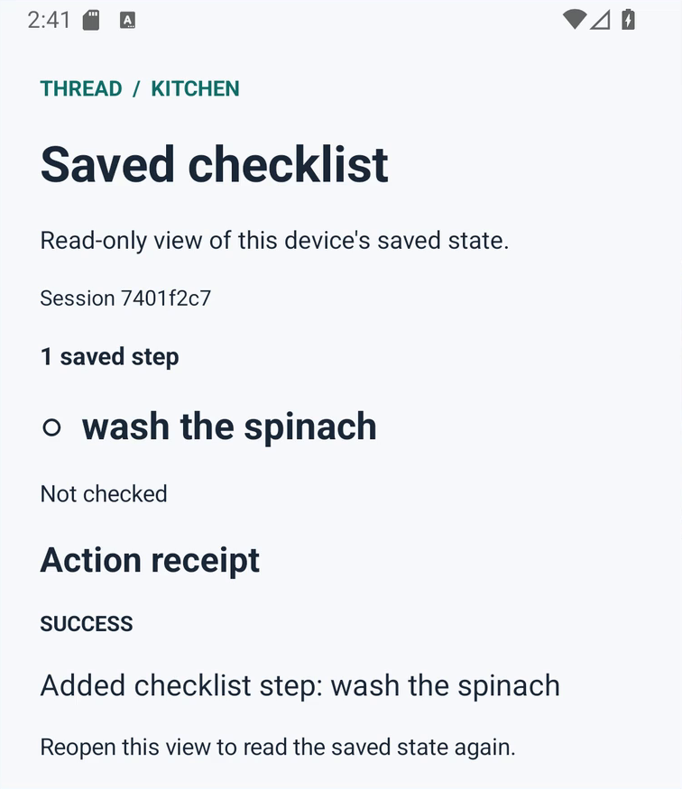
T H R E A D
EXTENSION / KITCHEN
One correction.
One saved action.
The same controller, beyond the benchmark.
“Add chop the celery.”
Withdrawn before execution
“Add wash the spinach.”
Surviving instruction → one recorded add
Reopen. It is still there.
Saved item + durable action receipt
READ / ADD / UPDATE
HISTORICAL ANDROID EMULATOR CAPTURE
Browser + Android storage. Tethered local host; not on-device inference.
extension015 · runtime fecb5c2 · viewer 8e9324a
REFLEXAI / SAMSUNG PRISM 2026
Extension boundaries & recorded demo
04 / 08
Notes:
This image is cropped, without rewriting its content, from the team-supplied THREAD-product-evidence-review-v2-1080p60.mp4 at 135 seconds. It is a historical emulator capture explicitly identified as extension015, desktop/runtime fecb5c2, viewer 8e9324a. The source video states that it is a captured native view, separate from the benchmark, after reopening. The latest launch film also presents the withdrawn celery / retained spinach sequence with shortened waits and re-voiced replies. This screenshot is not claimed to show the final release, a physical phone, live microphone capture, or independent acoustic verification. Current release verification separately reports one native and one browser-module typed turn producing two real checklist writes and returned PCM. Kitchen implements read_checklist, add_checklist_item and set_checklist_item; clients own persistent storage and idempotent receipts.
SOURCES
https://github.com/anshcantcode/thread-team-guide/blob/f83e38968abd3d91b5b05795d99a36d73f0a0575/docs/ARCHITECTURE.md
https://github.com/anshcantcode/thread-team-guide/blob/f83e38968abd3d91b5b05795d99a36d73f0a0575/docs/submission/VERIFICATION.md
https://github.com/anshcantcode/thread-team-guide/blob/f83e38968abd3d91b5b05795d99a36d73f0a0575/docs/submission/media/README.md

Slide 5
T H R E A D
BENCHMARK / FDB-V3
Measured, not estimated.
100 human recordings · 79 scenarios · 12 tools · four domains
THREE COMPLETE LOCAL RUNS
FINAL-SOURCE RUN · 4 OCT 2026
63
RECOGNIZER / SOURCE
TOOL
REPLY
BOTH
INFRA
small.en / 771981a
59
69
55
0
/100
small.en / 8dd530f
61
77
59
0
strict tool passes
small.en / 4e88d4b · final
63
79
58
0
100 evaluated. Zero infrastructure errors.
Measured source: 4e88d4b · Whisper small.en
All counts /100. BOTH = tool pass + correct spoken reply.
Local Qwen3.5-4B judge — diagnostic results, not Samsung’s score.
37 misses, each traced: 13 planner · 8 held by the controller · 7 undeclared arguments (6 × pets_allowed) · 5 form only · 4 misheard.
REFLEXAI / SAMSUNG PRISM 2026
Run identities, hashes & limitations
05 / 08
Notes:
Final source 4e88d4b, run 20261003T192003Z-cf861d7d, 4 Oct 2026: strict 63/100, spoken answer correct 79/100, both 58/100, 100/100 evaluated, 0 infrastructure errors. By domain: ecommerce 19/29, finance 23/25, housing 8/26, travel 13/20. Windows 11, RTX 4050 Laptop 6 GB, paced local LiveKit WebRTC, faster-whisper small.en, Qwen3.5-4B Q4_K_M planner, seed 42, temperature 0. Judge: local Qwen3.5-4B (upstream alias gpt-4o requested); qualification=false; not Samsung's score. Earlier rows: 20260929T123808Z-ff6e52b3 (771981a) and 20260929T201004Z-010c0644 (8dd530f). A large-v3-turbo experiment on 771981a scored 64/73/59/0; it is not the selected default. Six housing recordings expect search_apartments(pets_allowed=True); neither official tool declaration lists pets_allowed, and the name appears only in the released answer key, so THREAD does not send it. Miss groups come from the per-case dossier: planner = wrong value, missed call, asked, premature plan, omitted argument (+1 unclassified); controller = proposed but held, superseded or blocked by a gate; form only = strict matching of the same value, e.g. 'the gym' vs 'Gym'. Evidence: docs/fdb3/evidence/final-windows-20261004.json and final-windows-20261004-failures.md.

Slide 6
T H R E A D
VERIFICATION / REPRODUCIBILITY
A release you can inspect.
1,965
111
22 × 2
Provider-free Python tests
Real LiveKit SDK tests
Reproduction guards
Controller · protocol · authorization
Checks against the installed SDK
22 on Windows/Git Bash + 22 on Ubuntu
bash scripts/reproduce_fdb3_linux.sh
Declared Linux / CUDA / speech / LiveKit prerequisites and dataset required.
Source + APK + browser + evidence + presentation + two videos
Linux one-command run: 100/100 recordings, 0 infrastructure errors (8ef5b59, 61/100). Final source 4e88d4b measured on Windows.
REFLEXAI / SAMSUNG PRISM 2026
Verification scopes & commands
06 / 08
Notes:
These are engineering tests, not FDB-v3 passes. At 4e88d4b: 1,965 provider-free Python tests and 111 real installed-LiveKit-SDK tests passed (CPU only). The reproduction-guard count is carried over from the 30 September release and was not re-counted. The 3 October Linux one-command run (WSL Ubuntu 24.04, RTX 4050 6 GB, local Qwen judge) completed and evaluated all 100 recordings at 8ef5b59 with zero infrastructure errors and 61/100 strict. A clean Linux run of the final source 4e88d4b has not been done; its 63/100 is from Windows. The one-command reproduction still requires the declared prerequisites and the separately downloaded dataset.

Slide 7
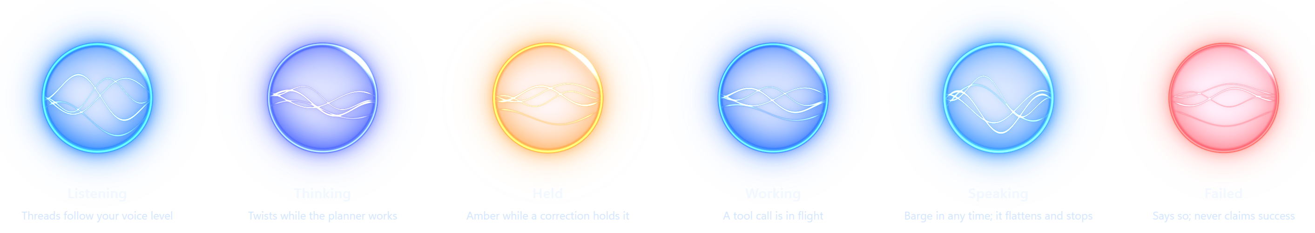
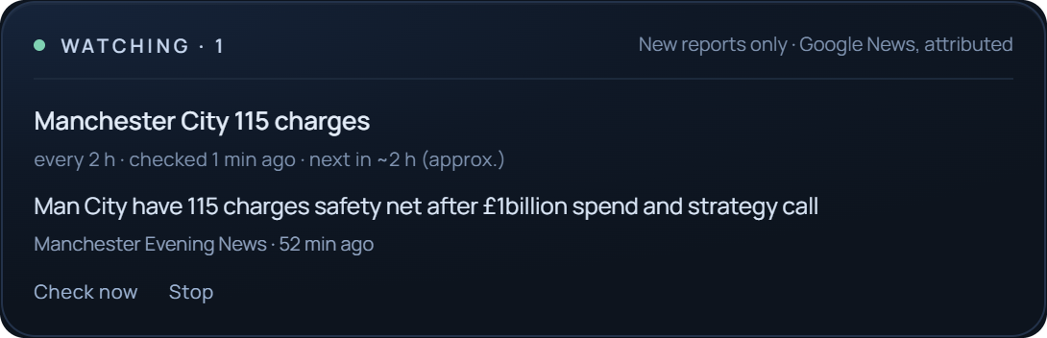
T H R E A D
COMPANION / BEYOND THE BENCHMARK
It keeps working.
One living orb. Real app handoffs. Watches that keep checking.
“Open YouTube and search for Manchester City 115 charges.”
One request becomes a bounded Android app handoff.
“Every 2 hours, give me updates…” starts a Watch.
Drafts stay drafts; you press send.
REAL CAPTURE · 3 OCT 2026 · GOOGLE NEWS, EVERY 2 H, NEW REPORTS ONLY
Floating bubble running on a Galaxy S24. The planner stays on the paired PC.
REFLEXAI / SAMSUNG PRISM 2026
Watches, app actions & floating bubble
07 / 08
Notes:
The orb strip is rendered by web/orb-strip.html with the apps' own web/orb.js (docs/images/orb-states.png); every state is driven by a real event: voice level, planner work, a held correction, a tool call, a barge-in, a failure. The Watch card is a real capture of the browser Watches strip on 3 Oct 2026 after a Google News check for 'Manchester City 115 charges'; a Watch re-checks every 2 hours and surfaces only new, attributed reports. Watches and Android app actions (open an app, search, draft) are CPU-tested; drafts are never sent without the user. The Android APK is installed on the owner's Galaxy S24 (SM-S921B) and the floating bubble was verified running. The planner runs on the paired PC; this is not on-device inference and not part of the FDB-v3 benchmark path. The limits from the 30 Sep version remain on slides 2 to 6: Kitchen is tethered, cancellation is not rollback, and the final source still needs a clean Linux run.

Slide 8


THREAD 1.0.0 · REFLEXAI
Go on.
THE TEAM
Nidhee Kunal Chandan
nc0399@srmist.edu.in
Correct the instruction. Keep the task.
Ansh Golcha
ag6536@srmist.edu.in
Get the release
Recorded demo
Raiyan Kamal
Rk0288@srmist.edu.in
Watch the launch film
Nargis Sultana
ns7824002@srmist.edu.in
Source. App. Evidence.
SRM Institute of Science and Technology
Kattankulathur
github.com/anshcantcode/
thread-team-guide
AI-assisted engineering and media are disclosed. Film includes labelled synthetic / re-voiced speech.
Notes:
All four names and institutional email addresses are preserved from the supplied team presentation and current repository submission index. Links point to the public release, recorded demonstration and launch film. The original team-supplied film exists and should not be listed as pending. Film artwork / synthetic voices / re-voiced replies are disclosed; the separate recorded demo is historical and edited, not a continuous final-release acoustic test. Publishing a repository release does not submit the organizer form. The signed human disclosure and final organizer form should be confirmed by the team. This presentation refresh does not update GitHub release assets or their checksums automatically.
SOURCES
https://github.com/anshcantcode/thread-team-guide/blob/f83e38968abd3d91b5b05795d99a36d73f0a0575/docs/submission/README.md
https://github.com/anshcantcode/thread-team-guide/blob/f83e38968abd3d91b5b05795d99a36d73f0a0575/docs/submission/AI_DISCLOSURE.md
https://github.com/anshcantcode/thread-team-guide/blob/f83e38968abd3d91b5b05795d99a36d73f0a0575/docs/submission/media/README.md
https://github.com/anshcantcode/thread-team-guide/releases/tag/PRISM_GENAI_HACKATHON_Y2026

