Slide 1
THREAD
FDB-v3 implementation evidence
Draft updated 28 September 2026
Qualification and submission gates remain unmet
Notes:
Secondary evidence deck, originally prepared 25 September and refreshed 28 September without changing its structure. Use CollegeName_TeamName_Submission_DRAFT.pptx as the current official-template draft. Run #4 is PENDING: candidate 18ad4ea, held-out-012 and acceptance gate before any full run. Run ID, gate verdict and score are unknown here, not passes. The candidate merges 1fb0572, fc580db and historical review branch (13 independently reproduced wrong-authorization classes, report at 1b905bb). Task C natural spoken answers (2e6762f, merge cb31fec) are for the next candidate, not 18ad4ea, and are unmeasured. No later source inherits run #3's score.

Slide 2
Executed voice path
Recording → LiveKit WebRTC → local Whisper
THREAD controller → actual FDB tool registry → outcome ledger
Windows speech synthesis → received audio → transcription and evaluator
Local GPU planner and recognition. Run #3 reports zero paid requests.
Notes:
Source: docs/fdb3/SUBMISSION.md; Run #3: 20260928T033707Z-18db0ad9, frozen f6329dd, 100 evaluated, 53/100 strict and window-strict, 47 non-passes, 0 paid requests. Judge: local Qwen3.5-4B, not the organizers' judge. Judge-free exact rescore: 45/100 with 55 non-passes, same saved inference, not a fresh run. Source: eb6bdb3:docs/fdb3/SPRINT2.md and eb6bdb3:.thread-run/experiments.jsonl. The 1387-entry manifest is C:/Users/ANSH/fdb3-evidence/20260928T033707Z-18db0ad9.SHA256SUMS. Task D counted/hashed the manifest and read the committed record, not all raw files or a new judge run. See docs/fdb3/evidence/task-d-docs-20260928.json. One diagnostic, no qualification, response-quality, latency or organizer-score claim. Previous run 20260927T175531Z-6dcc34fa on 088cf6f remains 50/100 local-Qwen strict and 42/100 judge-free exact, canonical archive C:/Users/ANSH/fdb3-evidence/20260927T175531Z-6dcc34fa/. The video retains that earlier source and score. Its companion note is in docs/fdb3/submission/VIDEO_AND_SLIDES.md.

Slide 3
Authority and outcome controls
A proposal cannot bypass current user authority or executor admission.
A corrected transcript replaces earlier words; provisional text cannot grant permission.
Submitted effects retain their outcome. Cancellation does not prove non-submission.
Independent review reproduced and verified repairs for duplicate grants and dropped corrections.
Notes:
Sources: participant/agent.py; thread_agent/fdb3.py; tests/test_fdb3_transcript_revision.py (20 tests); tests/test_fdb3_bridge.py. Native Whisper remains final-only. These controls do not establish all required live safety families.

Slide 4
Engineering evidence
Source 0cd94de: 1,527 base and 94 SDK tests passed on Windows.
Viewer 8e9324a: 7 JVM and 5 selected device tests passed.
Evaluator controls reject malformed judgments and hidden exact-match fallback.
Live interruption, reconnect, task-scoped cancellation and clean reproduction remain incomplete.
Notes:
Sources: docs/fdb3/evidence/sprint3-engineering-20260928.json (0cd94de base/SDK suites, earlier engineering snapshot); docs/fdb3/evidence/extension015-summary.json (viewer 8e9324a). These are engineering checks, no judge and no benchmark-score claim. The selected device tests do not establish all Android coverage. Task D did not rerun these tests. No claim that newer candidate 18ad4ea inherits them.

Slide 5
Benchmark status
Run #3 on f6329dd: 53/100 strict and window-strict. All 100 evaluated.
Exact rescore: 45/100. Strict non-passes: 47/100, all retained. Zero paid requests.
Judge: local Qwen3.5-4B, not the organizers' judge. Run #4 (18ad4ea): PENDING.
Three fresh frozen runs with 100/100 strict passes: not achieved.
Notes:
Run #3: 20260928T033707Z-18db0ad9, frozen f6329dd, 100 evaluated, 53/100 strict and window-strict, 47 non-passes, 0 paid requests. Judge: local Qwen3.5-4B, not the organizers' judge. Judge-free exact rescore: 45/100 with 55 non-passes, same saved inference, not a fresh run. Source: eb6bdb3:docs/fdb3/SPRINT2.md and eb6bdb3:.thread-run/experiments.jsonl. The 1387-entry manifest is C:/Users/ANSH/fdb3-evidence/20260928T033707Z-18db0ad9.SHA256SUMS. Task D counted/hashed the manifest and read the committed record, not all raw files or a new judge run. See docs/fdb3/evidence/task-d-docs-20260928.json. One diagnostic, no qualification, response-quality, latency or organizer-score claim. Previous run 20260927T175531Z-6dcc34fa on 088cf6f remains 50/100 local-Qwen strict and 42/100 judge-free exact, canonical archive C:/Users/ANSH/fdb3-evidence/20260927T175531Z-6dcc34fa/. The video retains that earlier source and score. Its companion note is in docs/fdb3/submission/VIDEO_AND_SLIDES.md.
Run #4 is PENDING: candidate 18ad4ea, held-out-012 and acceptance gate before any full run. Run ID, gate verdict and score are unknown here, not passes. The candidate merges 1fb0572, fc580db and historical review branch (13 independently reproduced wrong-authorization classes, report at 1b905bb). Task C natural spoken answers (2e6762f, merge cb31fec) are for the next candidate, not 18ad4ea, and are unmeasured. No later source inherits run #3's score.

Slide 6
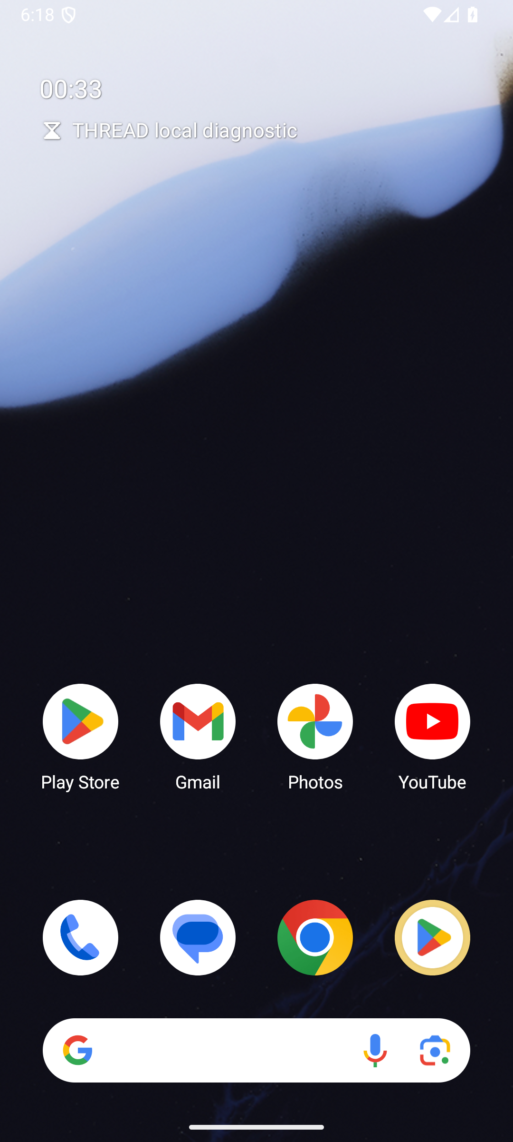
Observed Android extension
A checked checklist item survived app restart.
Repeated request identity did not duplicate the item.
Clock received a real timer request. A second request was blocked.
Earlier timer image. Later extension015 adds checklist correction, restart proof and a video draft.
Notes:
The image and first three observations retain the earlier native-extension001 evidence: docs/fdb3/evidence/native-extension001-result.json and native-extension001-device.png. They do not depict extension015. Later extension-audio015, desktop fecb5c2 and viewer 8e9324a, records one corrected spinach write, no celery, visible native receipt and restart persistence: docs/fdb3/evidence/extension015-summary.json. The 4:10 video draft combines separate, labelled sources and authored synthetic input. It remains unreviewed in full by a human and has no public URL. Clock evidence proves a handoff, not timer creation.

Slide 7
Competitor evidence
Keel reports 43/100 without a judge. Run 20260927T083931Z_keel_gemini_realtime.
Paper Pass@1: GPT-Realtime 0.600, Gemini Live 3.1 0.540. Both use a judge.
THREAD run #3: 45/100 exact, 53/100 local-Qwen strict. No comparable rerun or ranking.
Unknown, private and untested implementations remain unknown.
Notes:
Dated 28 September source-review context, not a like-for-like ranking. Keel main snapshot 9cc18bb, run 20260927T083931Z_keel_gemini_realtime, source 8c6ef4c with uncommitted changes, reports 43/100 (57 failures) with Gemini Live and no judge (exact arguments). Source: https://github.com/PROSTLE/samsung/blob/9cc18bb/README.md. FDB-v3 paper arXiv:2604.04847v1 Table 2 reports GPT-Realtime Pass@1 0.600 and Gemini Live 3.1 0.540, each on 100 recordings with GPT-4o judging: https://arxiv.org/html/2604.04847v1. Other repositories in the implementation reviewer's reviewed cohort have no published full FDB-v3 run. TriageLine's 89.1/100 is its own nine-scenario harness, not FDB-v3. No competitor was executed by this documentation task and no result here is an organizer result. See docs/fdb3/COMPETITOR_REFRESH_20260927.md, 28 September section.
Run #3: 20260928T033707Z-18db0ad9, frozen f6329dd, 100 evaluated, 53/100 strict and window-strict, 47 non-passes, 0 paid requests. Judge: local Qwen3.5-4B, not the organizers' judge. Judge-free exact rescore: 45/100 with 55 non-passes, same saved inference, not a fresh run. Source: eb6bdb3:docs/fdb3/SPRINT2.md and eb6bdb3:.thread-run/experiments.jsonl. The 1387-entry manifest is C:/Users/ANSH/fdb3-evidence/20260928T033707Z-18db0ad9.SHA256SUMS. Task D counted/hashed the manifest and read the committed record, not all raw files or a new judge run. See docs/fdb3/evidence/task-d-docs-20260928.json. One diagnostic, no qualification, response-quality, latency or organizer-score claim. Previous run 20260927T175531Z-6dcc34fa on 088cf6f remains 50/100 local-Qwen strict and 42/100 judge-free exact, canonical archive C:/Users/ANSH/fdb3-evidence/20260927T175531Z-6dcc34fa/. The video retains that earlier source and score. Its companion note is in docs/fdb3/submission/VIDEO_AND_SLIDES.md.

Slide 8
Reproduction and remaining gates
Pinned local dependencies, retained traces and a fresh-run command are available.
The owner authorized INR 0. Billed testing is deferred.
Missing: official configuration, repeated strict perfection, independent reproduction and measured competitors.
Edited video draft recorded. Human review, public URL, release checks and sign-off remain pending.
Notes:
Sources: docs/fdb3/REPRODUCE.md; docs/checkpoint/SAMSUNG.md; docs/fdb3/submission/VIDEO_AND_SLIDES.md. Full Linux reproduction, repeated strict perfection and final human sign-off remain pending. No push, tag, submission, signature, remote operation or task-B phase-2 command is authorized in task D. Run #4 is PENDING: candidate 18ad4ea, held-out-012 and acceptance gate before any full run. Run ID, gate verdict and score are unknown here, not passes. The candidate merges 1fb0572, fc580db and historical review branch (13 independently reproduced wrong-authorization classes, report at 1b905bb). Task C natural spoken answers (2e6762f, merge cb31fec) are for the next candidate, not 18ad4ea, and are unmeasured. No later source inherits run #3's score.

