Slide 1

SAMSUNG PRISM
THREAD
Go on.
Theme 05 · Interruptible Real-Time Agents
ReflexAi
SRM Institute of Science and Technology Kattankulathur
Nidhee Kunal Chandan nc0399@srmist.edu.in
Ansh Golcha ag6536@srmist.edu.in
Raiyan Kamal Rk0288@srmist.edu.in
Nargis Sultana ns7824002@srmist.edu.in
Samsung PRISM 2026 / THREAD 1.0.0
01
Notes:
Team metadata copied from the team-supplied SRMISTKtr_ReflexAI.pptx, modified 2026-09-29. Source: https://docs.google.com/presentation/d/18xPcva5_ZhwgMaCuTGuzG6NWwtpp6_dG/edit . Release: https://github.com/anshcantcode/thread-team-guide/releases/tag/PRISM_GENAI_HACKATHON_Y2026 .

Slide 2
Change direction. Keep the task.
THE PROBLEM
“Add two. Actually, one.”
USER REQUEST
An interruption changes what may run.
Stopping the voice is only the first step.
ACTIVE TASK
State and constraints
Already submitted?
Track the real outcome.
Do not invent rollback.
CORRECTION
CURRENT REVISION
Preserve relevant context
AUTHORIZED ACTION
Continue from current state
Mechanism illustration; inspect actual tool receipts in the demo and run evidence.
02
Notes:
Implementation: participant/agent.py and participant/authorization.py. Speech onset fences obsolete work in thread_agent/fdb3.py. An admitted write remains accounted for through success, error or unknown outcome. Illustration is not a new benchmark recording.

Slide 3
The model proposes. THREAD authorizes.
A correction revises the task.
The execution boundary checks the current revision before dispatch.
Input
›
Proposal
›
Authorization
›
Execution
Speech onset
Recognition
Qwen planner
Public tool schema
Current revision
Clause permission
Actual tool call
Durable receipt
Reconcile the original operation.
It cannot authorize new work.
Late result
State revisions, admission fence, effect ledger and playback receipts are independently tested.
03
Notes:
Source map: participant/agent.py, participant/authorization.py, participant/schema.py, thread_agent/fdb3.py, thread_agent/fdb3_client.py. The old raster diagram was replaced by native editable shapes to describe the measured FDB-v3 path accurately.

Slide 4
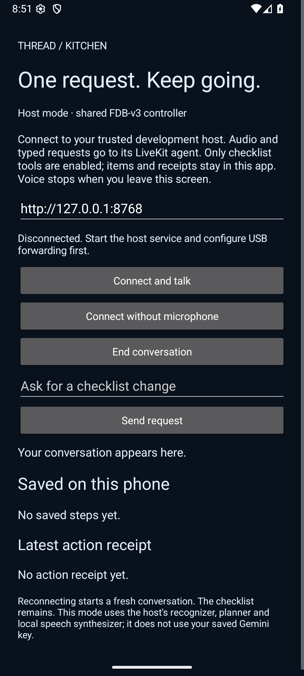
A real extension: Kitchen
“Add rinse lentils to my checklist.”
The client performs the write.
The receipt records what changed.
The checklist survives reopening.
Browser storage or native app storage.
Local host required. Android 12+.
Three device tools: read, add and update.
Current release UI capture. Spoken example is a tour input, not a guaranteed model result.
04
Notes:
Screenshot: .thread-run/submission-20260930/clients/native-release-smoke-002.png, current minified release emulator navigation smoke. Actual tool/persistence evidence is in release client receipts and historical THREAD_Recorded_Demo.mp4. Kitchen uses PCM WebSocket transport with a LiveKit AgentSession and the shared controller. It is not an autonomous on-phone model. The four old Gemini screenshots were replaced with the current native client image.

Slide 5
Local runtime. Pinned reproduction.
LiveKit WebRTC carries benchmark audio.
Whisper small.en recognizes the request.
Qwen3.5-4B Q4_K_M proposes structured actions.
THREAD validates authority and accounts for tool outcomes.
Local speech returns the result.
bash scripts/reproduce_fdb3_linux.sh
Supply the released dataset, local LiveKit binary and declared GPU prerequisites.
Model, data and dependency hashes are checked. Every failed case remains visible.
Full clean Linux / NeMo / GPU evaluation is not yet qualified on organizer hardware.
05
Notes:
Reproduction: docs/fdb3/REPRODUCE.md and config/fdb3-candidate.json. Pinned upstream3e799c45a045256f47d5f1c9cda90157e2d2ec9e; llama.cpp b10930. The root submission.yaml is legacy queue-kit metadata. Local Qwen judging is default; no hosted spending is authorized. Historical Windows runs used temperature0 and no explicit seed.

Slide 6
Measured on all 100 recordings
61/100
59 → 64 / 100
Strict tool passes
Separate recognizer experiment
Same source 771981a
small.en compared with large-v3-turbo
One pair: seven gains, two losses
Selected small.en path
Source 8dd530f
100 evaluated · 0 infrastructure errors
Local Qwen diagnostic judge. Samsung determines the official score.
These historical runs are not a fresh final-release evaluation.
All per-case records and original source/configuration identities are preserved.
06
Notes:
Source: docs/submission/RESULTS.md and three-run-archive-audit.json. Run20260929T201004Z-010c0644 source8dd530f strict61/100, response77/100, joint59/100. Control20260929T123808Z-ff6e52b3 source771981a strict59; turbo20260929T144039Z-33e49402 strict64. Recognizer change affects both input recognition and output transcription for judging. Actual judgeQwen3.5-4B, requested aliasgpt-4o. qualification=false for all. Runtime source matches measured Windows path, but final source was not freshly evaluated for100.

Slide 7
What is verified. What comes next.
Controller and SDK
1,891 base tests
102 SDK tests
Zero failures or skips
Native release
11 JVM tests
10 emulator checks
Minified-release smoke
General repairs
Equivalent write defaults
Natural missing-argument questions
Independent regressions
Model quality
Reduce recognition and planning errors
Repeat frozen full-data evaluation
Target environment
Complete clean Linux / GPU run
Measure physical-device acoustics
Submission limits
No official score yet
Signed human disclosure pending
No 100/100 qualification claim
Component checks and emulator evidence have narrower scope than a full official benchmark.
07
Notes:
Current-source test receipt: final-suite-receipt.json, 1891base and102SDK, zero failures/errors/skips, identical before/after runtime sources. Android tests:11JVM10device plus minified UI smoke. Check docs/submission/RESULTS.md and client receipt for exact sources and preserved failure attempts. Human review/signature is mandatory and has not been fabricated.

Slide 8
Go on.
THREAD 1.0.0
github.com/anshcantcode/thread-team-guide
Tag: PRISM_GENAI_HACKATHON_Y2026
README: install, tour, architecture and results.
Release: APK, browser, source, deck, film, recorded demo and evidence.
ReflexAi / SRM Institute of Science and Technology Kattankulathur
The animated launch film and historical recorded demo each disclose their source and scope.
08
Notes:
Release URL: https://github.com/anshcantcode/thread-team-guide/releases/tag/PRISM_GENAI_HACKATHON_Y2026 . Latest animated film SHA2565ffb13cbf23ec9f76df45a2f25b5cc0114973fd5a7056eb533ba305d079fe7e4. Recorded demo preserves original historical benchmark input/received speech and native extension capture. See docs/submission/media/README.md. Required human disclosure signature and organizer form submission remain separate actions.

