Slide 1
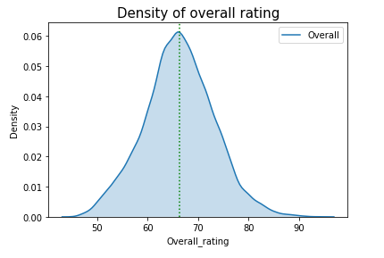
Distribution of Overall rating for all players
The mean of overall rating for all the player is around 66.
The plot is almost symmetric and similar to bell curve.
Very minute skewness of 0.06.

Slide 2
Top 20 players ranked by Overall score and whose contract expires in 2020
The average wage of this set of player is around €220100.
The average age of this set of player is around 30.
The correlation between the Overall rating and Value for these players is positive ,which means increase in overall rating means increase in value.

Slide 3
Table containing the top 5 players by Overall rating for each unique position
No players are repeated in the table.
The average wage for top 5 from all the position is represented in the bar graph in next slide.

Slide 4
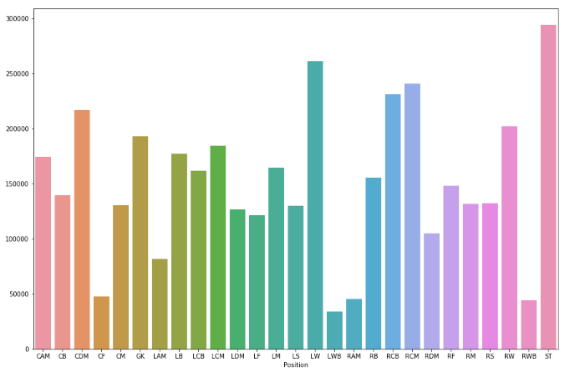
Position Vs Average wage for top 5 players

