Slide 1
Project Presentation of Back End Engineering Project (BEE) (22CS026)
On
Tripx -Tour & Travel Web App
Ansh, Ansh Arora
2210991289, 2210991290
Supervised By
Ms. Preenu Mittan
Department of Computer Science and Engineering,
Chitkara University, Punjab

Slide 2
Introduction
Tripx is a dynamic and user-friendly travel booking platform developed using React. The platform is designed to offer an engaging experience for users looking to explore and book travel packages. Key features include:
Destination Listings: Users can browse a curated list of travel destinations, each accompanied by images, pricing, and duration details.
Package Details: Detailed information about each travel package, including descriptions, itineraries, and user ratings.
Booking Process: A seamless and intuitive booking process, with real-time confirmation and toast notifications to enhance user interaction.
Responsive Design: Built with Tailwind CSS, the platform ensures a consistent experience across all devices, from desktops to mobile phones.
User Engagement: Features like likes and ratings allow users to interact with the platform, providing feedback and helping others make informed decisions.
Tripx combines a clean and modern design with robust functionality, making it easy for users to find and book their next adventure.
2

Slide 3
Abstract
Tripx is an innovative travel booking platform developed using React, tailored to provide users with a seamless and engaging experience in planning and booking their travel adventures. The platform features a comprehensive list of travel destinations, each presented with detailed information such as images, pricing, duration, and user reviews. Through an intuitive user interface and responsive design, Tripx ensures accessibility across all devices, offering a consistent and enjoyable experience for all users.
Key functionalities include a dynamic destination listing, real-time booking confirmations, and interactive user engagement features such as likes and ratings. The platform is designed with a modern aesthetic, utilizing Tailwind CSS for a responsive layout, ensuring that users can easily navigate and interact with the platform whether they are on a desktop or mobile device. The project emphasizes user satisfaction by providing clear, concise information and a straightforward booking process.
Tripx not only simplifies the travel booking process but also enhances it with interactive elements that allow users to make informed decisions and share their preferences. This project represents a comprehensive solution to modern travel booking needs, combining functionality, design, and user experience in a single platform.
3

Slide 4
Problem Statement
In the digital age, planning and booking travel can often be a fragmented and cumbersome process, involving multiple platforms and sources of information. Users face challenges such as:
Difficulty in Finding Comprehensive Information: Travel platforms often lack detailed information about destinations, including pricing, duration, and user reviews, leading to a fragmented experience.
Inconsistent User Experience: Many travel websites are not optimized for all devices, resulting in a poor user experience across different platforms.
Complex Booking Processes: Users frequently encounter complex and non-intuitive booking systems that complicate the travel planning process.
Lack of Interactive Features: Many travel platforms do not offer interactive features such as ratings and likes, which can help users make informed decisions and engage with the content.
Tripx aims to address these issues by providing a unified, user-friendly platform that consolidates travel information, simplifies the booking process, and enhances user engagement through interactive features. The platform’s goal is to streamline the travel planning experience, making it easier for users to find, evaluate, and book their desired travel packages
4

Slide 5
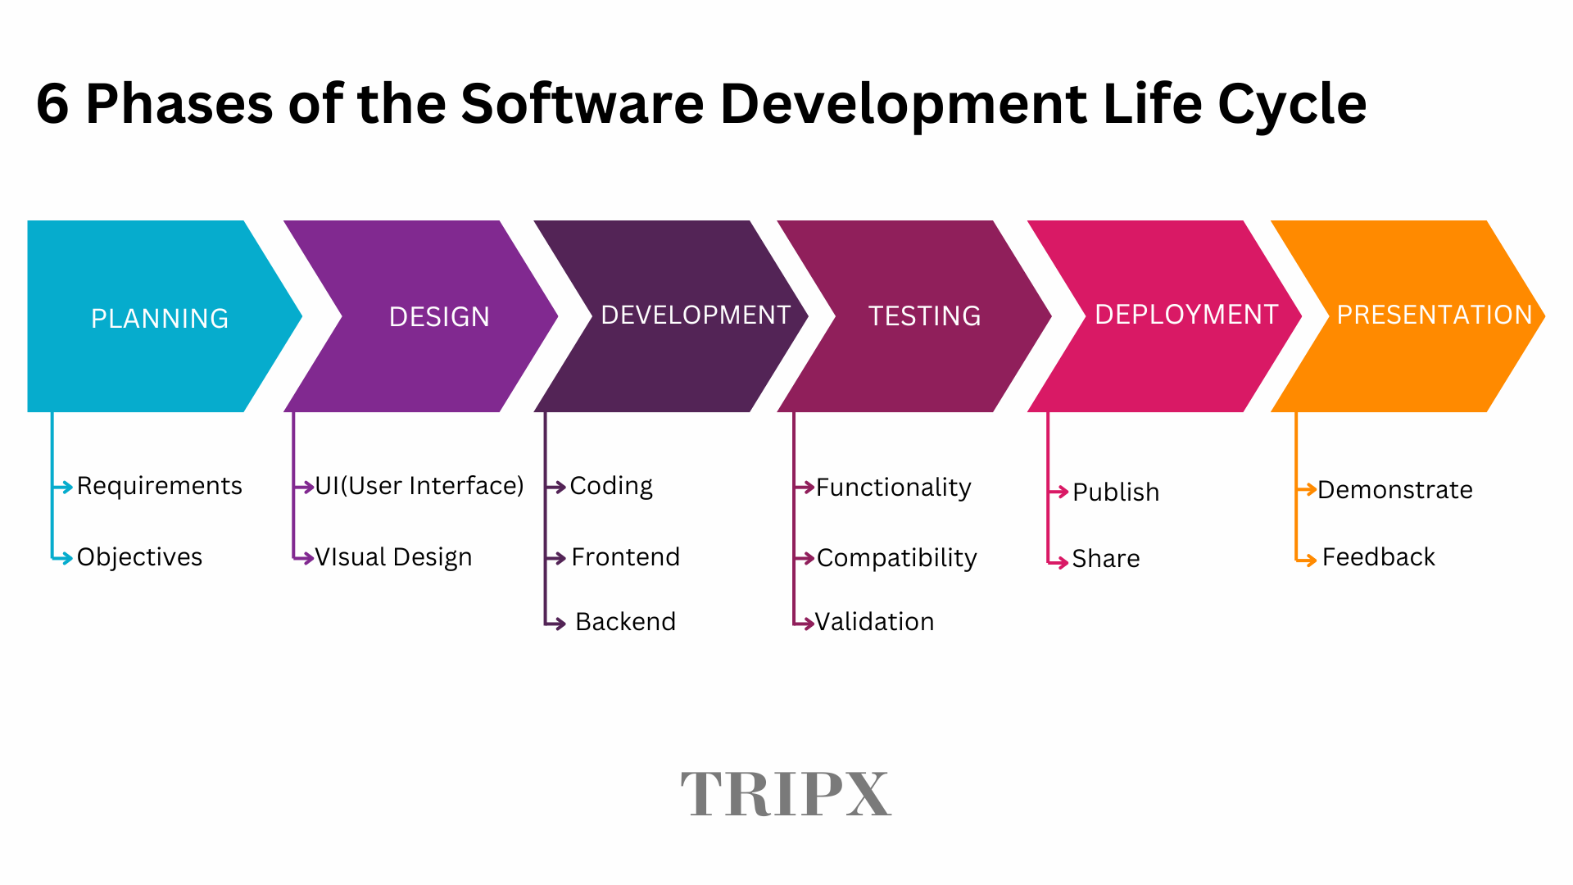
SDLC
<Text Times New Roman>
5

Slide 6
Tech Stack
Frontend:
React: A JavaScript library for building user interfaces, used to create a dynamic and responsive front end for the Tripx website.
Tailwind CSS: A utility-first CSS framework used for styling the application, ensuring a modern and consistent design.
React Router: A library for handling routing within the React application, allowing for seamless navigation between different pages such as Home, Packages, and Booking.
Backend:
Node.js: A JavaScript runtime used for building the server-side of the application, providing a scalable and efficient environment for handling backend operations.
Express.js: A web application framework for Node.js, used to build the API endpoints for the Tripx application, facilitating communication between the frontend and backend.
Database:
MongoDB: A NoSQL database used to store and manage data such as user information, destination details, and booking records. MongoDB provides flexibility in handling diverse data types and structures.
6

Slide 7
Future Scope
Flight and Car Rental Bookings: Extend the app’s capabilities to include flight reservations and car rentals, providing a more comprehensive travel solution.
Local Experiences and Tours: Partner with local service providers to offer users the ability to book unique experiences, guided tours, and activities at their destination.
User Reviews and Ratings: Allow users to leave reviews and ratings for accommodations, attractions, and services, helping others make informed decisions.
Social Sharing and Trip Journals: Enable users to create and share trip journals or travel blogs directly within the app, fostering a community of travelers.
Carbon Footprint Calculator: Include features that allow users to calculate the carbon footprint of their travel plans and suggest eco-friendly alternatives.
Eco-Friendly Travel Options: Partner with eco-friendly accommodations and services to promote sustainable travel options to users.
7

Slide 8
Conclusion
The Tripx successfully provides a comprehensive travel solution that enables users to explore, book, and manage their travel packages efficiently. By integrating a user-friendly interface with key features such as destination browsing, package booking, and real-time updates, Tripx addresses the core needs of travelers seeking a seamless and engaging experience.
The project's implementation showcases effective use of modern technologies and design principles, ensuring both functionality and aesthetic appeal. While the current version meets the essential requirements and provides a solid foundation, there is potential for future enhancements to further improve user experience and expand functionality.
In summary, Tripx not only meets its initial objectives but also sets the stage for ongoing development and improvement, promising to evolve into a robust platform that adapts to the changing needs of its users.
8

Slide 9
Bibliography
References:
React documentation: https://reactjs.org/docs/getting-started.html
Tailwind CSS documentation: https://tailwindcss.com/docs
React Router documentation: https://reactrouter.com/en/main
React Toastify documentation: https://fkhadra.github.io/react-toastify/introduction
9

Slide 10

Thank You
10

