Slide 1
FreshBasket demand forecasting
13-week forecasts for 1,782 SKU-market series: hybrid global gradient boosting, calibrated uncertainty, driver attribution and scenario simulation
Notes:
Introduce the problem: weekly unit forecasts, 13 weeks ahead, for every store x product-family series. Set the tone: leakage-safe validation, honest uncertainty, explainable drivers. About 12 minutes in total; roughly 45 seconds per slide.

Slide 2
The task, and what the data actually allowed
Goal: weekly unit forecasts for the next 13 weeks, with uncertainty, drivers and what-if scenarios
Supplied files: train, test, stores, transactions, oil, holidays - not the FMCG schema in the brief
Mapping: store = market (54), product family = SKU (33) giving 1,782 series; daily data rolled up to weeks
Not available: price, weather, media, true distribution. Proxies: promo item count, availability proxy, traffic, oil price
Consequence: the price and distribution questions in the brief are answered with proxies only
Brief concept -> used here
market_id -> store_nbr
sku_id -> product family
promotion -> items on promo
price -> not available
distribution -> availability proxy
weather -> oil price (macro proxy)
media -> not available
calendar -> holidays, events, paydays
extra -> store transactions (lag-only)
Notes:
Be upfront: the supplied files are the Store Sales retail dataset, not the FMCG schema in the brief. We mapped store to market and product family to SKU. Price, weather, media and distribution are not in the data, so they cannot be modelled or ablated - we use proxies and say so.

Slide 3
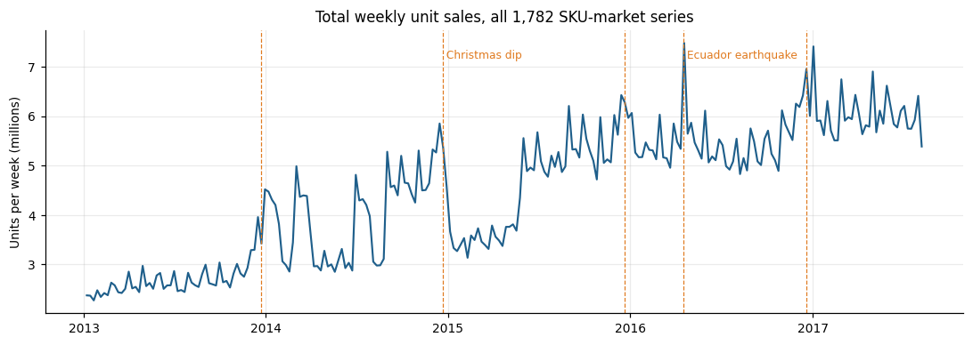
Data quality: five findings that shape the model
5%
786
Mar 2014
54
4
of series-weeks are reporting gaps (8+ zero weeks, then sales resume)
series launched after the first two months (new stores / families)
promo tracking starts - earlier values are missing, not zero
whole-week store closures, masked from training and scoring
missing 25-Dec days: stores close, weeks have 6 days
Pre-launch zeros are treated as missing, not demand
Delisted series (8+ trailing zero weeks) forecast zero, unless seasonal
Anomalies are kept in the targets when the calendar explains them
Notes:
The biggest surprise: whole product families vanish for months and then return - about 5 percent of active data, mostly 2014-15. We treat these as reporting gaps, not zero demand, and mask them from training targets using only knowledge available at each fold origin. Promotion tracking only starts 31 March 2014, so earlier promo values are missing, not zero.

Slide 4
Method: one global model, direct 13-week horizon
Weekly panel
Leakage-safe features
Global GBM
Hybrid + rules
Intervals
240 weeks, masks for launch, closure, gaps
>
lags, seasonality, promo plan, calendar, traffic
>
log deviation from run-rate, horizon 1..13
>
0.9 GBM + 0.1 seasonal naive; cold-start; delist rule
>
conformal, by horizon x volume tier
Future inputs: calendar is known; the promo plan is known for 2.6 weeks (test file) then assumed = last 28 days; traffic and oil are lag-only, so no future assumption is needed
Baselines for comparison: naive 4-week mean, seasonal naive x growth, damped-trend Holt
Cold start: series with under 13 weeks of history use the best-validated fallback (damped Holt)
Notes:
One global gradient-boosting model serves all series and horizons; the horizon is a feature. The target is the log deviation from each series own recent run-rate, so the trees learn drivers rather than 1,782 volume scales. A 10 percent blend of seasonal-naive adds a little robustness. Rules handle never-sold and delisted series; conformal calibration gives intervals.

Slide 5
Validation: four rolling origins, no random splits
Fold 1
Fold 2
Fold 3
Fold 4
2013-01
2017-08 (last observed week)
training rows (targets up to the origin only)
13-week test window (Aug-Nov 2016, Nov-Feb, Feb-May, May-Aug 2017)
Scoring excludes whole-week closures and reporting gaps (2% of series-weeks); a sensitivity table includes them.
Notes:
Four expanding-window folds, each forecasting 13 weeks, tile the last 52 observed weeks, so every season including Christmas and Carnival is tested once out-of-sample. The model for each fold only sees targets up to its origin. A unit test scrambles all post-origin data and checks that features do not change.

Slide 6
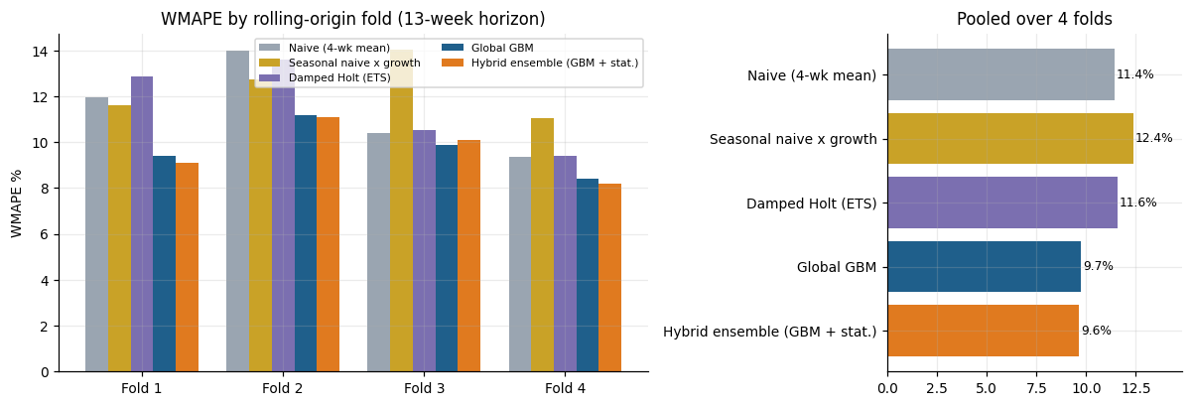
Accuracy: the global model beats every baseline
-16%
0.40
WMAPE vs naive (11.4% to 9.6%)
RMSLE vs 0.51 for naive
Bias is -2.8% (mild under-forecast); small-volume series stay hard (bottom-quartile WMAPE about 49%).
32 of 33 families and 53 of 54 stores beat naive
Median per-series WMAPE 18% vs 21% for naive
Ensemble 0.9 GBM + 0.1 seasonal naive; weight chosen on folds 1-3 only
Fold 3 is close (10.1% vs 10.4%): gains are not uniform
Notes:
Pooled over four folds and 85,695 series-weeks: naive 11.4 percent WMAPE, global GBM 9.7, ensemble 9.6. RMSLE falls from 0.51 to 0.40. Be honest: the ensemble adds little over the GBM alone, and in fold 3 the margin over naive is thin. Bias is a mild under-forecast of about 3 percent.

Slide 7
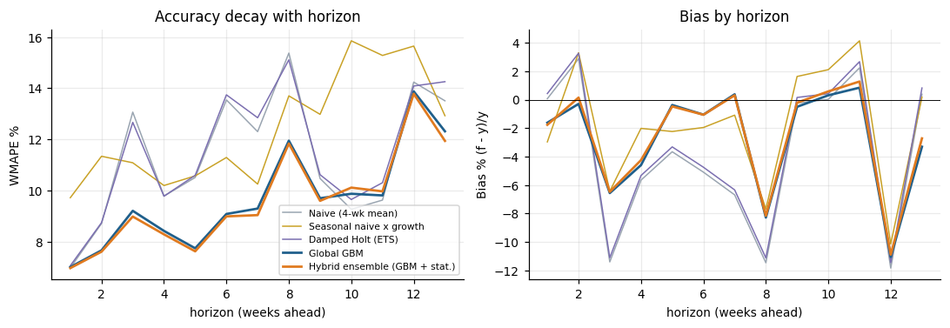
Accuracy by forecast horizon
7.0% to 13.8%
ensemble WMAPE, week 1 to week 13
Equal to naive in week 1, better at most later weeks
Biggest gains vs naive at weeks 3, 5, 6 and 7 (3-4.5 points)
Weeks 10-11: ensemble is slightly WORSE than naive (10.1% vs 9.3%, 10.0% vs 9.6%)
Notes:
Error grows with horizon, from about 7 percent in week 1 to 12 to 14 percent by weeks 12 and 13. The model equals naive at week 1 and wins at most horizons, but is slightly worse than naive at weeks 10 and 11. Bias stays within a few percent, mostly a mild under-forecast.

Slide 8
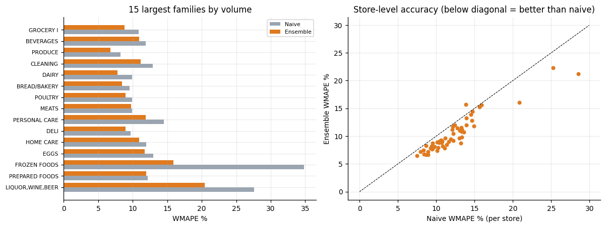
Accuracy by segment: broad, not just in the big lines
32 of 33 families beat naive; 53 of 54 stores
Store types A-E improve 11-17% relative
Bottom volume quartile: WMAPE about 49%, barely better than naive (50%)
Cold-start series (<13 weeks): damped Holt 6.6% WMAPE vs GBM 15.7% (881 rows only)
Notes:
Left: the 15 largest families; the ensemble beats naive in nearly all of them. Right: every store as a dot against its naive error; points below the diagonal are better than naive - 53 of 54 stores. Store types A to E all improve by 10 to 20 percent relative. Small-volume series are the weak spot.

Slide 9
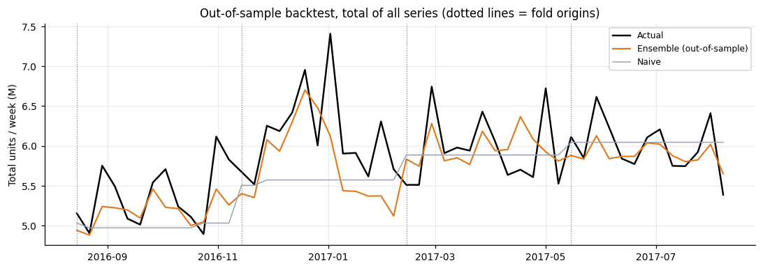
Aggregates are more accurate: coherent bottom-up totals
5.2%
WMAPE on total weekly units (naive 6.8%)
6.3% / 7.4%
family-week / store-week WMAPE (naive 8.0% / 9.1%)
Dotted lines mark the four fold origins. Forecasts are out-of-sample throughout.
Notes:
Summing the series forecasts bottom-up gives coherent totals. Total weekly units are forecast within 5.2 percent WMAPE; family-week 6.3; store-week 7.4. This matters for inventory planning, where aggregate error is what drives stock decisions.

Slide 10
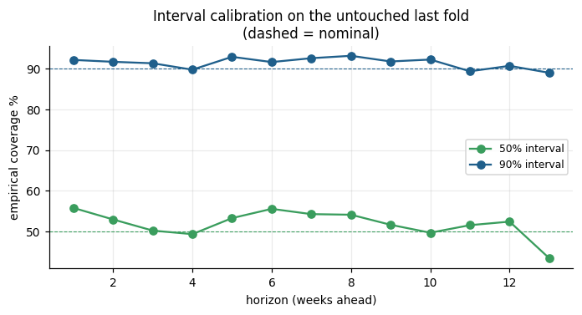
Uncertainty: conformal intervals that hold up out-of-sample
91.4%
51.8%
coverage of 90% intervals (fold 4)
coverage of 50% intervals
Calibrated on folds 1-3, scored on fold 4 only
Cells: horizon bin x series-volume tier
Every forecast row carries 50% and 90% bands
Notes:
Intervals are calibrated on folds 1 to 3 residuals, by horizon bin and volume tier, and tested on the untouched fold 4: 90 percent intervals cover 91.4 percent, 50 percent intervals 51.8 percent. Coverage is slightly low at week 13 for the 50 percent band, and the large-volume tier is mildly conservative.

Slide 11
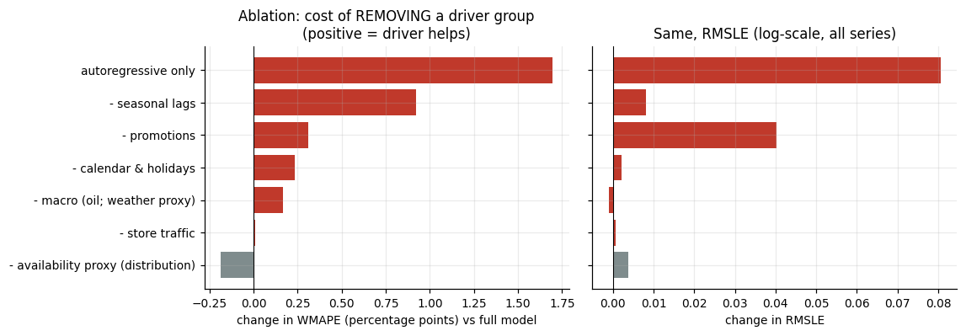
What drives accuracy: ablation across all four folds
Seasonal lags: +9.2% WMAPE if removed (all 4 folds)
Promotions: +3.1%, and RMSLE +0.04 (3 of 4 folds)
Calendar and holidays: +2.3% (3 of 4 folds)
Store traffic: about 0 - not useful beyond sales history
Availability proxy: -1.8% WMAPE but worse RMSLE - mixed
Autoregressive only: +17% - exogenous drivers do add value
Notes:
Each bar is the cost of removing one driver group and re-training. Seasonal lags matter most (9 percent relative WMAPE), then promotions and calendar. Store traffic is neutral. Oil helps WMAPE a little but not RMSLE - treat it cautiously. The availability proxy slightly hurts WMAPE but helps small series on RMSLE: a mixed result we report as is. Price and weather cannot be tested because they are not in the data.

Slide 12
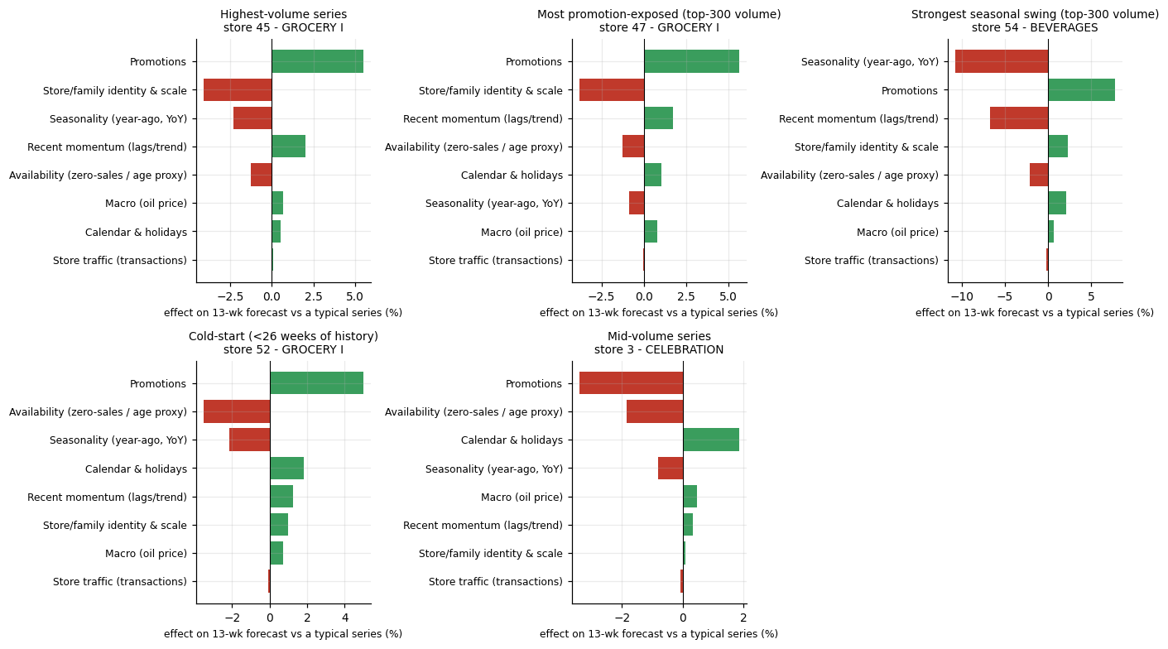
Explaining individual forecasts: exact group-Shapley drivers
Promotions add about +5% to the two largest grocery series and +8% to the seasonal beverage series
Seasonality (year-ago pattern) pulls the beverage series down about 11%
Global permutation importance: promotions, then momentum, scale, seasonality
Effects are relative to a typical series; they sum exactly to the model output
Notes:
For five automatically selected series we compute exact Shapley values over eight driver groups. Read each bar as the effect on that series' forecast relative to a typical series' average. Attributions sum exactly to the model output - verified. Permutation importance (global) ranks promotions first on RMSLE, then momentum and scale; oil shows zero by construction, so the ablation is the evidence for oil.

Slide 13
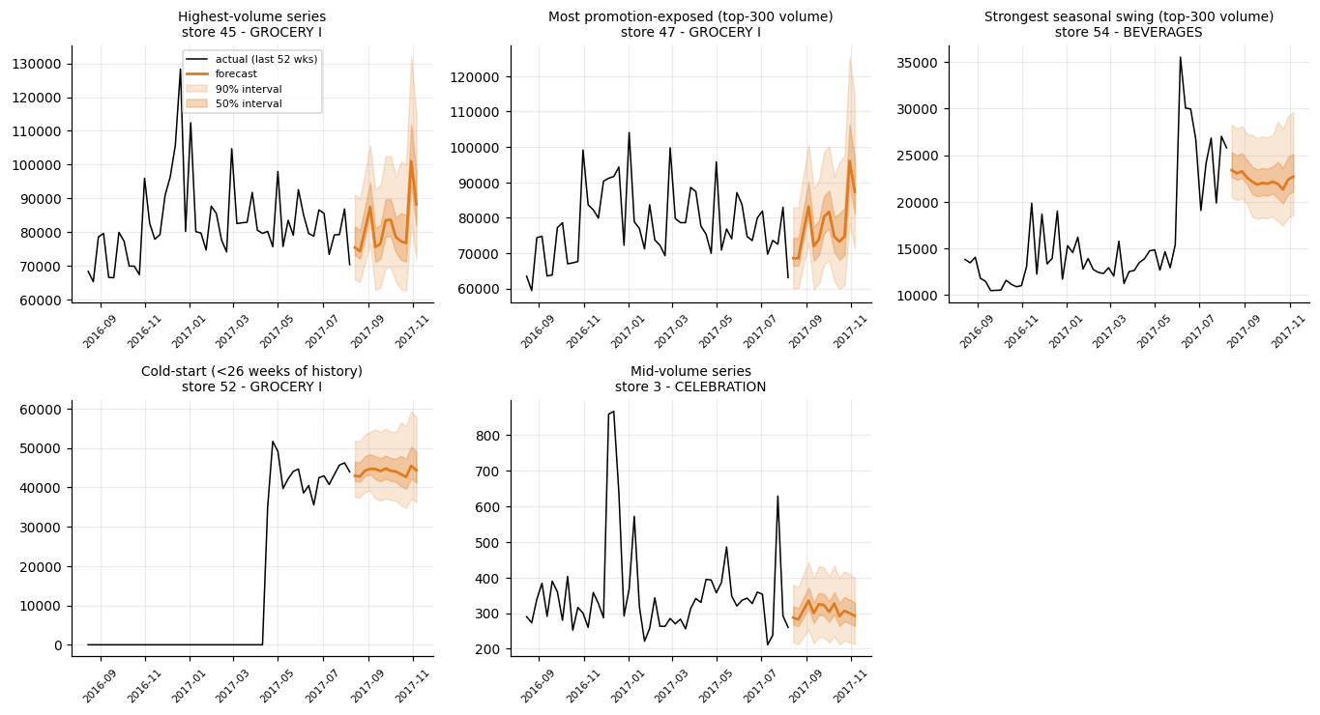
What the forecast looks like: examples with 50% / 90% bands
Total: about 77.8M units over 13 weeks (14 Aug to 12 Nov 2017), peaking the week of 30 Oct
23,166 rows with 50% and 90% intervals; flags for cold-start and delisted series
Bands widen with horizon; the cold-start series (store 52) gets a sensible level from 16 weeks of history
Notes:
Five illustrative series: the highest-volume, the most promotion-exposed, the strongest seasonal swing, a cold-start series (store 52 opened in April 2017) and a mid-volume series. Note how bands widen with horizon and how the cold-start series gets a sensible level from its short history.

Slide 14
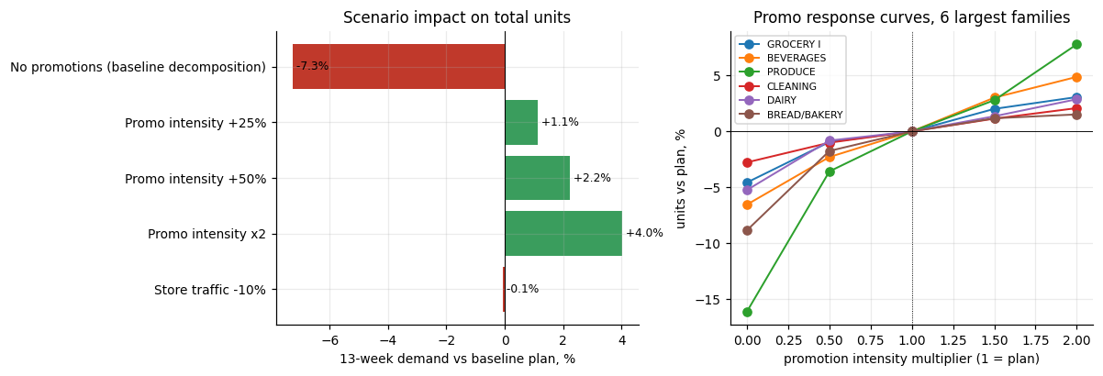
Scenarios: what changes if promotion intensity changes
Use with care
Promotions were not randomised: these are associations, not causal lift.
Extreme cases can be implausible (school supplies -96% with no promo).
Traffic -10% moves demand only -0.06%: the model barely uses traffic, so this is a sensitivity check, not insight.
No promotions: -7.3% units; +25% / +50% / x2 intensity: +1.1% / +2.2% / +4.0%
Response is roughly linear and mildly diminishing; extrapolation is capped at 1.5x each series' history
Strongest responders: Produce, Beverages, Grocery I; seasonal lines are most sensitive
Notes:
Re-running the trained model with modified known inputs. Withdrawing all promotions lowers demand about 7 percent; +25, +50 and double intensity lift demand 1.1, 2.2 and 4.0 percent - roughly linear, mildly diminishing (extrapolation is capped). Caveats: these are associations from history, not causal experiments. At extremes the model can overreach: school supplies drops 96 percent with no promotions, which is not credible. The traffic shock barely moves the forecast because the model hardly uses traffic.

Slide 15
Beyond the minimum: evidence-based extras
Global vs per-series: one model for 1,782 series, direct horizon, relative log target with volume and recency weighting
Hybrid statistical + ML ensemble, with weights chosen on earlier folds only
Reporting-gap detection that is leakage-safe (only gaps already over at each origin)
Business rules checked against data: the first delisting rule zeroed 311 forecasts that later had sales; a seasonal exception fixed RMSLE 0.417 to 0.398
Conformal intervals by horizon x volume tier, verified on an untouched fold
Exact group-Shapley local explanations (no external library) and a promo scenario simulator with response curves
A unit test that scrambles all post-origin data to prove no leakage
Notes:
Highlight what goes beyond the brief and was evidenced: the leakage test, the gap-aware training, the seasonal exception to the delisting rule which fixed a measured problem, conformal intervals checked on a held-out fold, exact Shapley, and a scenario simulator.

Slide 16
Limitations and recommendations for business use
Limitations
Recommendations
No price, weather, media or true distribution data: proxies only
Product families, not individual SKUs
Promo plan beyond week 3 is assumed (last 28 days)
Small-volume series: WMAPE about 49%, barely better than naive
Scenario effects are associations, not causal
Fold 3 margin thin; ensemble gain over GBM is small
Settings (volume weight, cold-start choice) chosen on the CV folds: results slightly optimistic
Plan inventory on the aggregate and large-line forecasts; apply the 90% band as safety-stock input
Feed the real trade-promotion calendar: with the plan unknown, RMSLE worsens from 0.40 to 0.45
Run a promo test before using lift numbers; collect price and discount depth
Retrain monthly; monitor bias (-3%) and interval coverage
Flag reporting gaps and launches at source so zeros are not read as demand
Add price, distribution and weather data to unlock the missing drivers
Notes:
Close with a clear view of what to trust. Use the forecasts for aggregate planning and for large and mid-volume lines; treat small-volume series with more caution. Provide the promotion plan to improve results. Run a controlled test before relying on scenario lifts. Retrain monthly and monitor bias and interval coverage.

Slide 17
Appendix: reproducibility and deliverables
pip install -r requirements.txt, then python run_pipeline.py (about 8-10 minutes on 1 CPU)
python tests/test_pipeline.py runs six tests including the future-leakage test
Forecast file: outputs/forecast_13w.csv (date, market_id, sku_id, forecast, 50% / 90% bounds)
Reports: data-quality and EDA, project report, this deck; all tables as CSV in outputs/tables
Seeds fixed; stages cached; synthetic-data generator included
Notes:
Everything runs end to end from one command on a single CPU. Tests use a tiny synthetic dataset so they run in about a minute.

