Slide 1
Electricity Consumption Analysis
BIG DATA ANALYTICS · MAPREDUCE ON HADOOP 3.4.2
AVERAGE CONSUMPTION BY HOUR
Four MapReduce jobs process 5,000 half-hourly electricity readings on a local HDFS and YARN cluster: overall statistics, consumption by hour, weather buckets, and normal versus abnormal readings.
Team Members:
Ansh Nandanwar - 41
Vinshi Manwatkar - 38
The 24 bars are almost level. Orange marks the lowest (01:00) and highest (02:00) hours.
5,000
0.377
0 to 1
5.0%
4 jobs
Half-hourly readings
Mean consumption
Observed range
Abnormal readings
MapReduce on HDFS
1 Jan to 14 Apr 2024
normalised, total 1,883.39
min 0.0, max 1.0
250 of 5,000
each 19 to 22 s
Notes:
Opening. The project runs four Hadoop MapReduce jobs over an electricity consumption dataset of 5,000 half-hourly readings from 1 January to 14 April 2024. The bars at the top right are the average consumption for each hour of the day; they are almost level, which previews the main result. The strip at the bottom gives the headline numbers: mean consumption 0.377 on the normalised scale, 5 percent of readings labelled abnormal, and four jobs that each ran in 19 to 22 seconds.

Slide 2
Dataset and project objectives
01 · OVERVIEW
Dataset columns
One CSV, 5,000 rows, no missing values
What each Hadoop job answers
Column | Meaning | Mean
Timestamp | 30-minute reading time | -
Electricity_Consumed | Consumption (target) | 0.377
Temperature | Normalised temperature | 0.525
Humidity | Normalised humidity | 0.498
Wind_Speed | Normalised wind speed | 0.465
Avg_Past_Consumption | Historical average for the slot | 0.459
Consumption_Difference | Consumption minus past average | -0.082
Anomaly_Label | Normal or Abnormal | 5.0%
Job | Question
ElectricityStats | What are the total, average, minimum and maximum consumption?
HourlyConsumption | Does average consumption change with the hour of day?
EnvironmentalAnalysis | Does consumption change with temperature, humidity or wind speed?
AnomalyAnalysis | How do normal and abnormal readings differ?
5,000
104 days
476,066
5.0%
readings, no missing values
1 Jan to 14 Apr 2024, every 30 minutes
bytes: size of the input CSV in HDFS
labelled abnormal (250 readings)
Source: electricity_consumption.csv, 476,066 bytes. All numeric columns are min-max normalised to 0 to 1, so values are relative units, not kWh.
Notes:
The input is a single CSV with eight columns. Consumption, temperature, humidity, wind speed and the historical average are min-max normalised to 0 to 1, so the numbers are relative units, not kilowatt-hours. There are no missing values, the data covers 104 days at 30-minute spacing, and 250 of the 5,000 readings carry an Abnormal label. The table on the right shows the question each of the four MapReduce jobs was built to answer.

Slide 3
From CSV to four result tables
02 · PIPELINE
INPUT
STORAGE
YARN · MAPREDUCE
OUTPUT
CSV
HDFS
4 jobs
part-r-00000
5,000 rows, 8 columns
/electricity/input
one map, one reduce task each
exported to output\hadoop_results
What each mapper emits and each reducer writes
Environment
Job | Mapper key | Mapper value | Reducer writes
ElectricityStats | constant "stats" | consumption | Total, average, min, max (4 lines)
HourlyConsumption | hour of day, "00" to "23" | consumption | Average per hour (24 lines)
EnvironmentalAnalysis | factor + 0.1-wide range, e.g. "WindSpeed 0.3-0.4" | consumption | Average per bucket (30 lines)
AnomalyAnalysis | "Normal" or "Abnormal" | consumption, past average, difference | Count and three averages per label (2 lines)
Hadoop | 3.4.2, Windows host
Mode | Single node: NameNode, DataNode, ResourceManager, NodeManager
HDFS input | /electricity/input
HDFS output | /electricity/output/{stats,hourly,environmental,anomaly}
Tasks per job | 1 map, 1 reduce (one input split)
Build | javac against hadoop classpath, packaged with jar -cvf
Hadoop 3.4.2 · single node · every job read the 476,066-byte input once
Notes:
The CSV is uploaded to HDFS under slash electricity slash input. Each job runs on YARN as one map task and one reduce task, because the file fits in a single input split. The mapper parses a row and emits a key and a value; the reducer aggregates all values for that key and writes a small result table. The table lists the key each mapper emits and what each reducer writes. The right-hand card records the environment: Hadoop 3.4.2 on a Windows host in single-node mode, built with javac against the Hadoop classpath and packaged with jar.

Slide 4
How the cluster run went
02 · PIPELINE
✓
Start the cluster
Job runtimes
Start HDFS and YARN, then confirm the four daemons with jps.
Seconds, submission to completion
✓
Load the dataset into HDFS
Create the input folder and upload the 476,066-byte CSV. Header and rows verified with hdfs dfs -cat.
✓
Job 1 · ElectricityStats
Compiled, packaged and run in 22 seconds. Output confirms total 1883.39 and average 0.3767.
!
Job 2 · HourlyConsumption Fixed after 3 runs
First runs produced malformed hour keys. The mapper and jar were rebuilt and the job re-run until the output showed clean hours 00 to 23.
✓
Job 3 · EnvironmentalAnalysis
Ran first time in 20 seconds and wrote 30 bucket averages (10 each for temperature, humidity, wind speed).
4 of 4
19–22 s
!
Job 4 · AnomalyAnalysis Fixed compile error
The first compile failed because a double was passed to Text.set(). Converting the value to a string fixed it; the job then ran in 19 seconds.
Succeeded
Per job
jobs, final status in YARN
1 map + 1 reduce task
!
Export and verify Path errors resolved
Results copied out of HDFS to output\hadoop_results. Relative paths failed at first; quoted absolute paths worked.
Reconstructed from the 17 terminal screenshots. Runtimes are wall-clock seconds from submission to completion.
Notes:
This timeline is reconstructed from the 17 terminal screenshots. The cluster is started and the dataset is loaded into HDFS, then each of the four jobs is compiled, packaged and run. Two steps carry an amber marker because they needed fixes: the hourly job was re-run until its keys were clean, and the anomaly job failed to compile first. The results were then exported from HDFS to a local folder. All four jobs finished with status SUCCEEDED in 19 to 22 seconds each; with a file this small the single node is a demonstration of the pattern, not a performance test.

Slide 5
Three problems on the way, all fixed
02 · PIPELINE
JOB 2 · HOURLYCONSUMPTION
JOB 4 · ANOMALYANALYSIS
EXPORT FROM HDFS
Malformed hour keys
Compile error
Relative paths failed
PROBLEM
PROBLEM
PROBLEM
The first hourly runs wrote keys such as 0:, 1:, 30 and :0 instead of the hours 00 to 23.
AnomalyAnalysis.java failed at line 65: Text.set(double) is not applicable, because a double was passed where a string is expected.
hdfs dfs -get could not resolve relative local paths, so the first export attempts failed and folders had to be recreated.
FIX
FIX
FIX
The mapper and jar were rebuilt and the job re-run (job 0002, 0005, 0006) until the output showed 24 clean rows, 00 to 23.
The value was converted to a string, the class recompiled and the jar built. Job 0004 then completed in 19 seconds.
Absolute, quoted Windows paths worked. All four result files were saved to output\hadoop_results.
Screenshots 6, 12, 13, 14, 15
Screenshots 8, 9
Screenshots 10, 11, 16, 17
3
problems found
3
fixed and re-run
3
hourly runs before clean keys (jobs 0002, 0005, 0006)
4 of 4
jobs ended SUCCEEDED
Source: terminal screenshots 5 to 16
Notes:
Three things went wrong along the way. The hourly job first wrote malformed keys such as 0 colon and 30 instead of the hours 00 to 23; the code was rebuilt and the job re-run until the output was clean. The anomaly job failed to compile because a double was passed where Text.set expects a string. The first attempts to copy results out of HDFS failed on relative paths, which quoted absolute Windows paths solved. Every problem was fixed and all four jobs ended with status SUCCEEDED.

Slide 6
The headline numbers
03 · HADOOP RESULTS · JOB 1 · ELECTRICITYSTATS
1,883.39
0.3767
0.0
1.0
Job 1 output
Verbatim from stats.txt
Total consumption
Average per reading
Minimum
Maximum
Total consumption | 1883.3873
Average | 0.376677
Minimum | 0.0
Maximum | 1.0
Where readings fall
Normal
Abnormal
Centre. Readings centre on 0.38 and cluster between 0.27 and 0.49 (the middle half). 55 readings hit exactly 0 and 2 hit exactly 1, the clipped ends of the normalised scale.
History. Against the historical average (Avg_Past_Consumption = 0.459), usage in this window ran 17.9% lower.
Source: Hadoop output stats.txt; histogram and historical average from the CSV. Values are normalised 0 to 1.
Notes:
Job 1 reads every consumption value and reduces them to four numbers: a total of 1,883.39, an average of 0.3767, a minimum of 0 and a maximum of 1. The histogram shows where the 5,000 readings fall, split by anomaly label: they centre on 0.38 and the middle half sits between 0.27 and 0.49. 55 readings sit exactly at zero and 2 exactly at one, which are the clipped limits of the normalised scale. Compared with the historical average of 0.459, usage in this window ran about 17.9 percent lower.

Slide 7
Demand is flat across the day
03 · HADOOP RESULTS · JOB 2 · HOURLYCONSUMPTION
Average consumption by hour of day
Hourly mean
Lowest / highest
0.357
Quietest hour
01:00
0.398
Busiest hour
02:00
0.04
Gap between them
all 24 means in 0.357 to 0.398
00 | 01 | 02 | 03 | 04 | 05 | 06 | 07 | 08 | 09 | 10 | 11
0.369515 | 0.356704 | 0.398156 | 0.371474 | 0.382518 | 0.370012 | 0.388886 | 0.376198 | 0.386087 | 0.375318 | 0.365155 | 0.390231
12 | 13 | 14 | 15 | 16 | 17 | 18 | 19 | 20 | 21 | 22 | 23
0.376111 | 0.374668 | 0.373195 | 0.376403 | 0.373446 | 0.363929 | 0.382042 | 0.383647 | 0.380955 | 0.380176 | 0.370934 | 0.374601
Source: Hadoop output hourly.txt (mean over all 5,000 readings, keyed by hour 00 to 23). Bars start at zero.
Notes:
Job 2 averages consumption for each hour of the day. All 24 averages sit between 0.357 and 0.398, around an overall mean of 0.377. The quietest hour is 01:00 at 0.357 and the busiest is 02:00 at 0.398, a gap of only 0.04. The bars start at zero on purpose, so a gap this small is not exaggerated. The table under the chart reproduces the 24 rows of hourly.txt exactly as the reducer wrote them.

Slide 8
Weather buckets show no consistent trend
03 · HADOOP RESULTS · JOB 3 · ENVIRONMENTALANALYSIS
Temperature
dashed line: mean 0.377
Humidity
dashed line: mean 0.377
Wind speed
dashed line: mean 0.377
Factor | 0.0–0.1 | 0.1–0.2 | 0.2–0.3 | 0.3–0.4 | 0.4–0.5 | 0.5–0.6 | 0.6–0.7 | 0.7–0.8 | 0.8–0.9 | 0.9–1.0
Temperature | 0.337251 | 0.396837 | 0.365320 | 0.382297 | 0.374099 | 0.380390 | 0.372040 | 0.379784 | 0.377055 | 0.359434
Humidity | 0.427177 | 0.396517 | 0.383490 | 0.372777 | 0.372128 | 0.381307 | 0.372512 | 0.377839 | 0.388700 | 0.370948
Wind speed | 0.491377 | 0.367739 | 0.368889 | 0.376132 | 0.379628 | 0.377722 | 0.372945 | 0.372071 | 0.322599 | 0.448005
Reading. Bucket averages show no consistent rise or fall for any of the three factors, so none appears to drive consumption.
Source: Hadoop output environmental.txt. Each reading is placed in one of ten 0.1-wide buckets per factor; bars start at zero.
Notes:
Job 3 sorts each reading into ten buckets of width 0.1 for temperature, humidity and wind speed, and averages consumption in each bucket, producing 30 averages. The three charts plot those averages against the overall mean of 0.377. The table below reproduces the 30 values from environmental.txt. Across all three factors the bucket averages show no consistent rise or fall, so none of the three appears to drive consumption.

Slide 9
Normal versus abnormal readings
03 · HADOOP RESULTS · JOB 4 · ANOMALYANALYSIS
Job 4 output
Verbatim from anomaly.txt
0.379 vs 0.377
Label | Count | Avg consumption | Avg past | Avg difference
Abnormal | 250 | 0.379039 | 0.435187 | -0.056148
Normal | 4,750 | 0.376553 | 0.459978 | -0.083424
Average consumption
abnormal vs normal: nearly identical
0.435 vs 0.460
Abnormal readings are 5.0% of the 5,000 rows (250); the other 4,750 are normal.
Average past consumption
abnormal vs normal
Averages by label
Normal (4,750)
Abnormal (250)
-0.056 vs -0.083
Average difference
consumption minus past average
Reading. The mean alone cannot separate normal readings from abnormal ones.
Source: Hadoop output anomaly.txt. AnomalyAnalysis groups readings by Anomaly_Label and averages three columns.
Notes:
Job 4 groups readings by their Anomaly label and averages three columns. The result: average consumption is 0.3766 for normal readings and 0.3790 for abnormal ones, essentially identical. Average past consumption is 0.460 for normal and 0.435 for abnormal, and the average difference is minus 0.083 versus minus 0.056. The mean alone cannot separate normal readings from abnormal ones.

Slide 10
Jobs 1 and 2: statistics and hourly mean
04 · SOURCE CODE
JOB 1 · STATS
JOB 2 · HOURLY
ElectricityStats
HourlyConsumption
MAPPER KEY
MAPPER VALUE
REDUCER WRITES
MAPPER KEY
MAPPER VALUE
REDUCER WRITES
constant "stats"
consumption (double)
Total, average, min, max (4 lines)
hour of day, "00" to "23"
consumption (double)
Average consumption per hour (24 lines)
// Mapper: key "stats", value = consumption
if (line.startsWith("Timestamp")) return; // skip header
String[] fields = line.split(",");
double consumption = Double.parseDouble(fields[1].trim());
context.write(new Text("stats"),
new DoubleWritable(consumption));
// Reducer: one pass over all values
for (DoubleWritable v : values) {
sum += v.get(); count++;
if (v.get() < min) min = v.get();
if (v.get() > max) max = v.get();
}
write("Total Consumption", sum);
write("Average Consumption", sum / count);
write("Minimum Consumption", min);
write("Maximum Consumption", max);
// Mapper: key = hour of day, value = consumption
String time = timestamp.split("\\s+")[1]; // "13:30"
int hourNumber =
Integer.parseInt(time.split(":")[0]);
String hour = String.format("%02d", hourNumber);
context.write(new Text(hour),
new DoubleWritable(consumption));
// Reducer: mean per hour
for (DoubleWritable v : values) {
sum += v.get(); count++;
}
double average = sum / count;
context.write(key,
new Text(String.format("%.6f", average)));
Condensed excerpts of each mapper and reducer; every job also has a driver that sets the paths.
Notes:
Each job follows the same pattern: the mapper parses a CSV row and emits a key and a value, and the reducer aggregates all values per key. Job 1 emits a single constant key so one reducer sees every consumption value and computes total, average, minimum and maximum. Job 2 extracts the hour from the timestamp, formats it as 00 to 23 with String.format, and averages consumption per hour. The formatted key is what fixed the malformed hour keys seen in the first runs.

Slide 11
Jobs 3 and 4: buckets and anomaly labels
04 · SOURCE CODE
JOB 3 · ENVIRONMENTAL
JOB 4 · ANOMALY
EnvironmentalAnalysis
AnomalyAnalysis
MAPPER KEY
MAPPER VALUE
REDUCER WRITES
MAPPER KEY
MAPPER VALUE
REDUCER WRITES
factor + 0.1-wide range, e.g. "WindSpeed 0.3-0.4"
consumption (double)
Average consumption per bucket (30 lines)
"Normal" or "Abnormal"
consumption, past average, difference
Count and three averages per label (2 lines)
// Mapper: one row emits three keys, one per factor
outputValue.set(consumption);
outputKey.set("Temperature " + getRange(temperature));
context.write(outputKey, outputValue);
outputKey.set("Humidity " + getRange(humidity));
context.write(outputKey, outputValue);
outputKey.set("WindSpeed " + getRange(windSpeed));
context.write(outputKey, outputValue);
// getRange: 0.1-wide bucket such as "0.3-0.4"
if (value >= 1.0) return "0.9-1.0";
int lower = (int) (value * 10);
return String.format("%.1f-%.1f",
lower / 10.0, (lower + 1) / 10.0);
// Reducer: average per bucket
for (DoubleWritable v : values) { sum += v.get(); count++; }
context.write(key, new Text(
String.format("%.6f", sum / count)));
// Mapper: key = label, value = "consumption,past,diff"
String label = fields[7].trim().equalsIgnoreCase("Abnormal")
? "Abnormal" : "Normal";
outputValue.set(consumption + "," + pastConsumption
+ "," + difference);
context.write(new Text(label), outputValue);
// Reducer: three sums and a count per label
for (Text v : values) {
String[] p = v.toString().split(",");
sumConsumption += Double.parseDouble(p[0]);
sumPast += Double.parseDouble(p[1]);
sumDifference += Double.parseDouble(p[2]);
count++;
}
outputValue.set("Count=" + count
+ ", Avg_Consumption=" + fmt(sumConsumption / count)
+ ", Avg_Past_Consumption=" + fmt(sumPast / count)
+ ", Avg_Difference=" + fmt(sumDifference / count));
Condensed excerpts of each mapper and reducer; every job also has a driver that sets the paths.
Notes:
Job 3 emits three records per row, one each for temperature, humidity and wind speed, keyed by factor and a 0.1-wide range such as WindSpeed 0.3-0.4; the reducer averages consumption per key, giving 30 lines. Job 4 keys on the Normal or Abnormal label and passes consumption, past consumption and difference as a comma-separated string; the reducer splits it, sums the three values and writes the count and three averages.

Slide 12
What this project shows
05 · CONCLUSION
BOTTOM LINE
All four MapReduce jobs ran successfully on HDFS and YARN. Consumption is steady across the day and shows no clear link to weather.
4 of 4
5,000
0.377
MapReduce jobs finished with status SUCCEEDED, each in 19 to 22 seconds.
Half-hourly readings processed from a single CSV stored in HDFS.
Average consumption on the normalised scale (total 1,883.39, min 0.0, max 1.0).
0.357 to 0.398
30
250 / 4,750
Range of the 24 hourly averages produced by Job 2.
Environmental bucket averages from Job 3: 10 each for temperature, humidity and wind speed.
Abnormal and normal readings counted by Job 4, with almost identical average consumption.
Source: Hadoop outputs stats.txt, hourly.txt, environmental.txt and anomaly.txt; YARN job status
Notes:
The conclusion in one line: all four MapReduce jobs ran successfully, and in this dataset consumption is steady across the day with no clear link to weather. Job 1 gives a mean of 0.377 over 5,000 readings. Job 2 shows the 24 hourly averages inside a narrow 0.357 to 0.398 band. Job 3 produced 30 bucket averages with no consistent trend. Job 4 counted 250 abnormal and 4,750 normal readings, whose average consumption is almost identical.

Slide 13
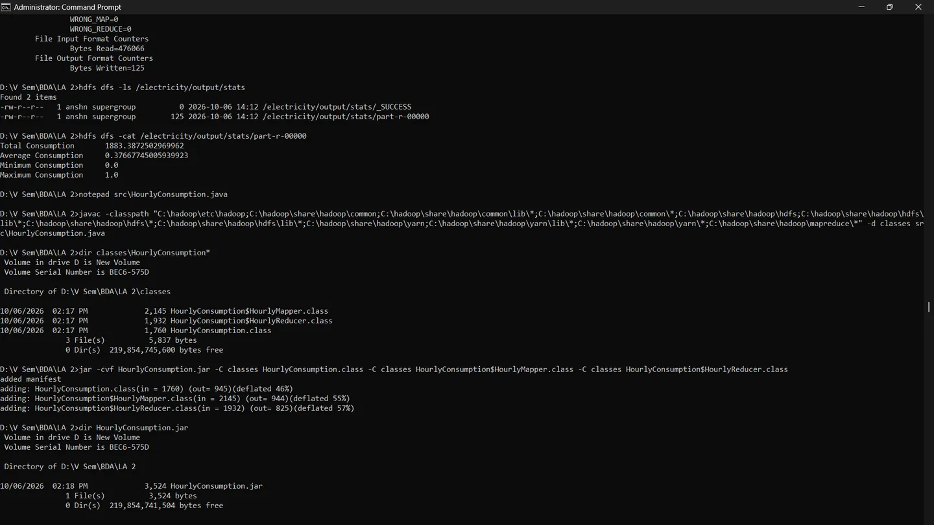
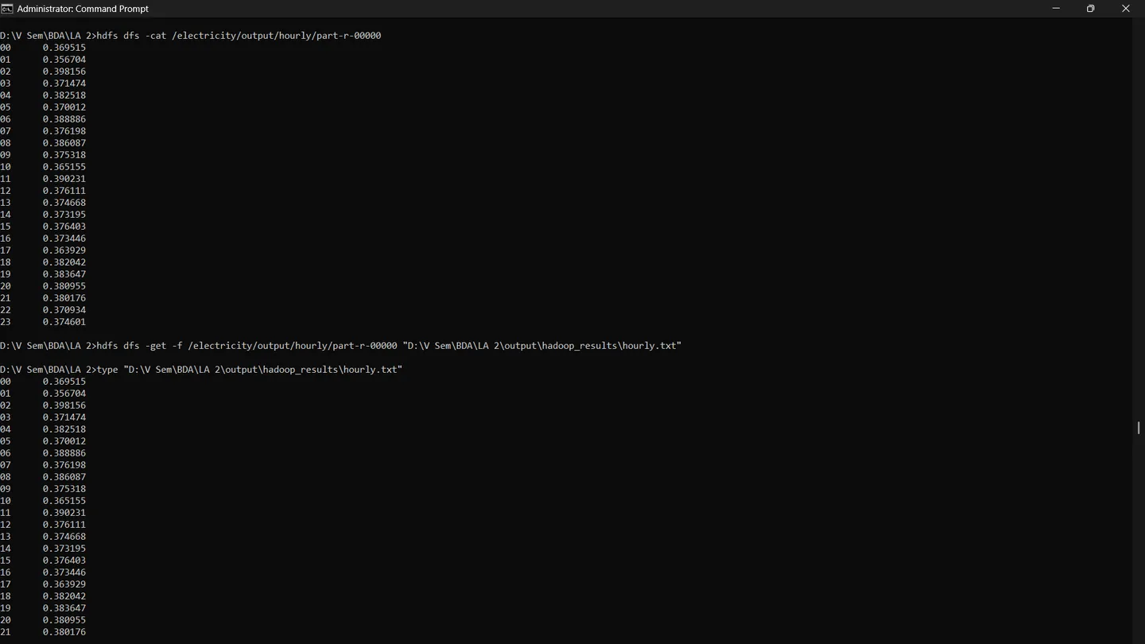
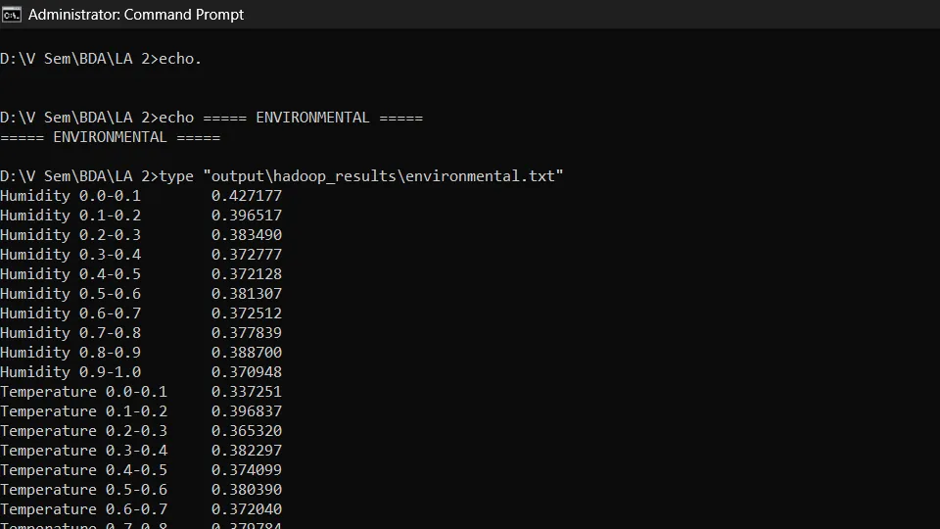
Outputs confirmed in the terminal
06 · EVIDENCE
SCREENSHOT 4
SCREENSHOT 15
SCREENSHOT 17
Stats result
Hourly result
Final result files
ElectricityStats job completes; part-r-00000 shows total 1883.39, average 0.3767, min 0.0, max 1.0.
Final hourly run is clean: 24 rows, keys 00 to 23, exported to hourly.txt.
Final check: all four result files confirmed on disk in output\hadoop_results.
17
terminal screenshots captured
4
result files saved locally
6
phases: setup, stats, hourly, environmental, anomaly, export
Source: terminal screenshots 4, 15 and 17 of the 17 captured during the run
Notes:
These are three of the 17 terminal screenshots from the run: the Stats result, the clean hourly output after the fix, and the final check that the environmental and anomaly files were saved. The next slide lists all 17 captures in order.

Slide 14
All 17 terminal captures, in order
06 · EVIDENCE
# | Phase | Capture
1 | Setup | Start HDFS and YARN, upload data
2 | Setup | Hadoop version and first compile
3 | Stats | Package and submit ElectricityStats
4 | Stats | Stats job result, start Hourly build
5 | Hourly | First Hourly run
6 | Hourly | First Hourly output looks wrong
7 | Environmental | Environmental job runs
8 | Environmental | Environmental output, Anomaly compile error
9 | Anomaly | Anomaly fix and run
# | Phase | Capture
10 | Export | Anomaly output, first export attempts fail
11 | Export | Export succeeds, hourly still malformed
12 | Hourly | Hourly recompiled and re-run (job 0005)
13 | Hourly | Hourly output still not clean
14 | Hourly | Hourly re-run (job 0006)
15 | Hourly | Hourly output is clean
16 | Export | Final check of all results
17 | Export | Environmental and anomaly final
Source: terminal screenshots 1 to 17
Notes:
All 17 captures in order. Setup covers starting HDFS and YARN and uploading the CSV. Stats, Hourly, Environmental and Anomaly each show a job being compiled, packaged and run, including the hourly re-runs and the anomaly compile fix. Export covers copying the four result files out of HDFS, including the failed relative-path attempts and the final confirmation.

