Slide 1
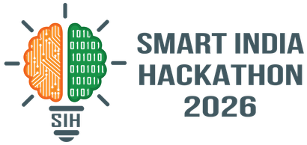


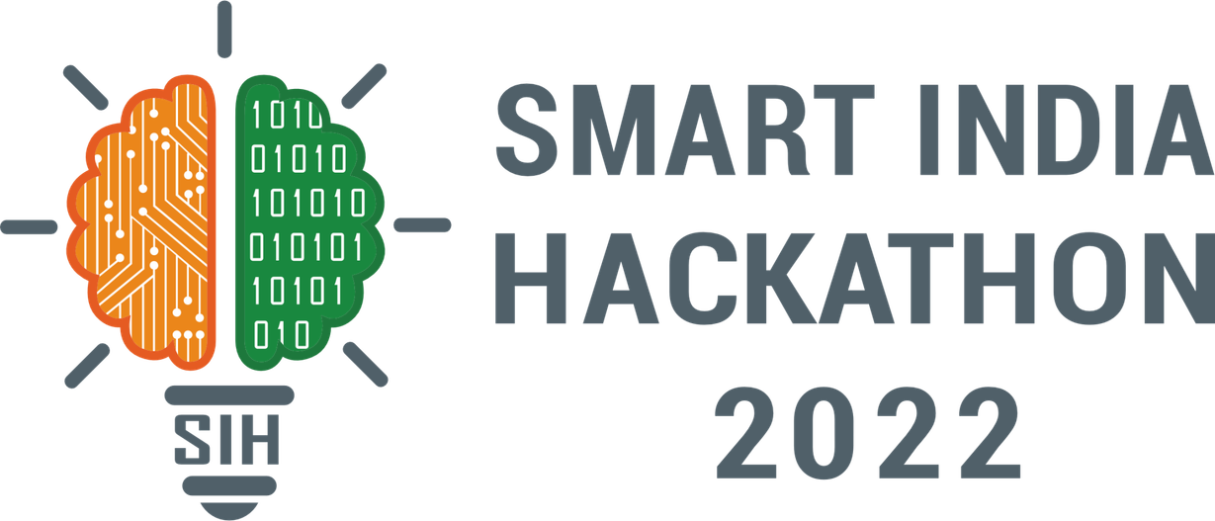
SMART INDIA HACKATHON 2026
EPAG
Problem Statement ID – SIH26093
Problem Statement Title – AI-Based Real-Time Stress and Trauma Assessment Module for Victims/Complainants Accessing NHAA (14566) and Integrated Portal
Theme – MedTech/BioTech/HealthTech
PS Category – Software
Team ID –
Team Name – NeuroNex

Slide 2

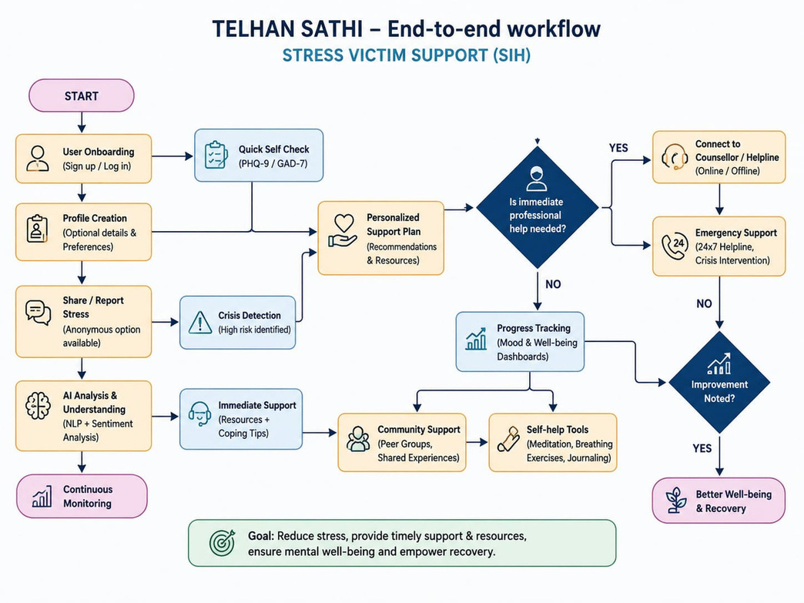










SAATHI
Safety-First AI TriageforNHAA(14566)
— SIH26093
SAATHI end-to-end workflow
Proposed Solution / Approach
Proposed Solution
SAATHI sits beside NHAA’s existing workflow — before
Registration — and runs areal-time Safety Check + Priority Assessment on every voice/text interaction, then hands operators an evidence-backed recommendation. It never diagnoses and never decides on its own.
How it addresses the problem
Two complaints can read identically on
paper while callers are in very different states. SAATHI flags urgency at first contact from what was said, how it was said, and an optional check-in — routing any explicit danger signal straight to a human, with no scoring step in between.
Architecture
Innovation & uniqueness
A twin-path architecture — a deterministic Safety Engine that can bypass scoring entirely, paired with a transparent, confidence-weighted Priority Score for everything else. Every recommendation shows its evidence; a human always has the final call.
Architecture
ASR
SCORE
OPS
CO-P
SAFE
CO-P
Real-time ASR
(Hindi/English,
code-mixed)
Template-
constrained
Co-Pilot
(reword only)
SAFE
OPS
Independent
Safety Engine
— bypasses
scoring.
SCORE
Operator
Dashboard
— evidence
+ override
Confidence-
aware
Priority Score
(Low→Urgent)
@SIH Idea Submission—NeuroNex
2

Slide 3
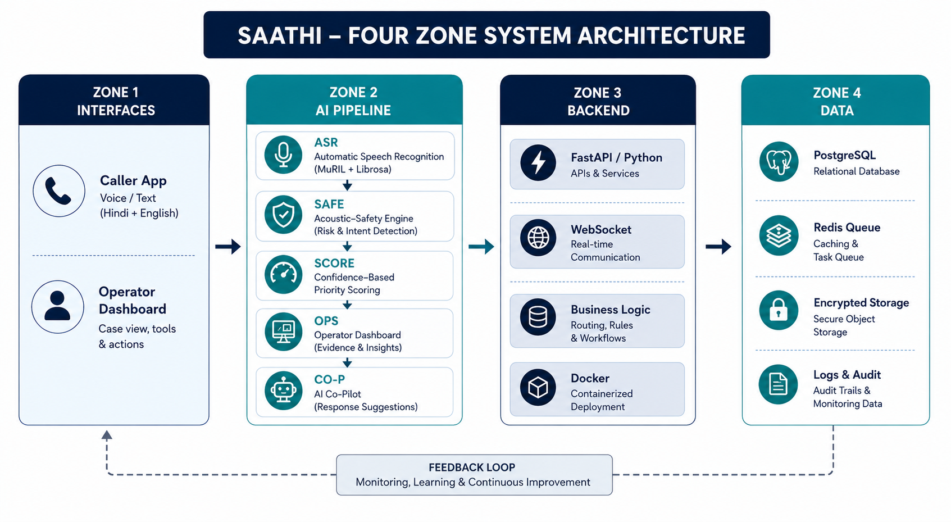
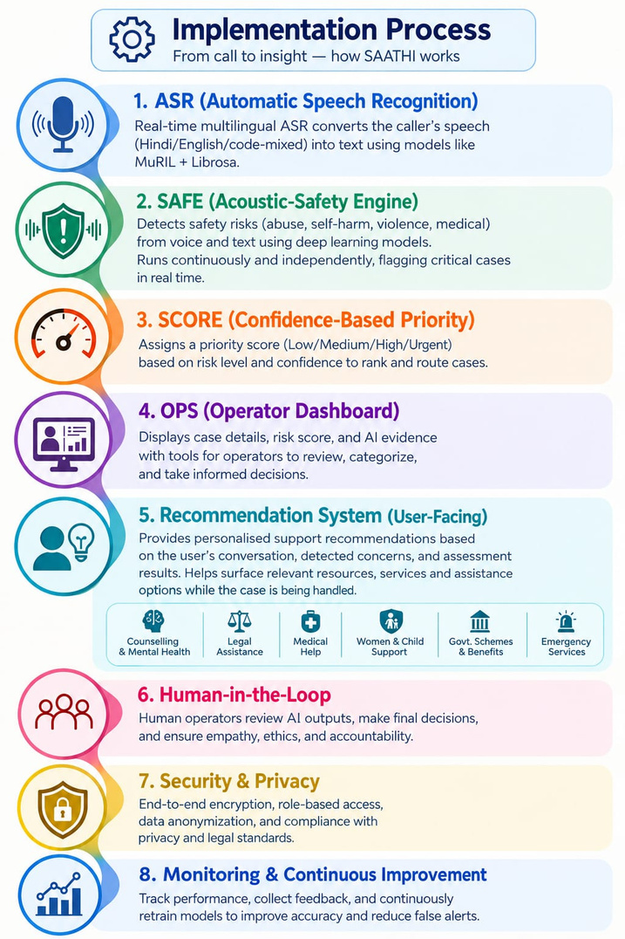
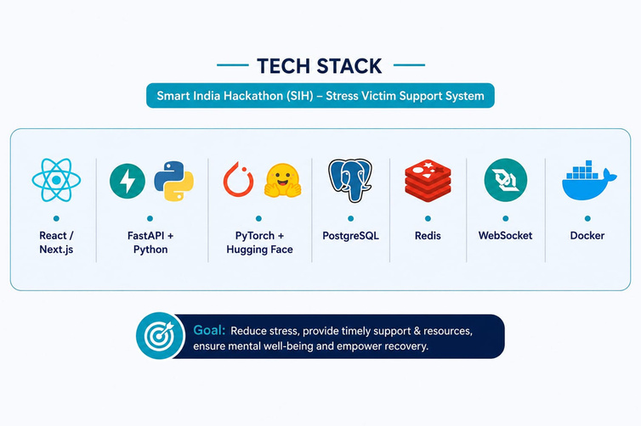
TECHNICAL APPROACH
SMART INDIA HACKATHON 2025
3
@SIH Idea Submission—NeuroNex
3

Slide 4
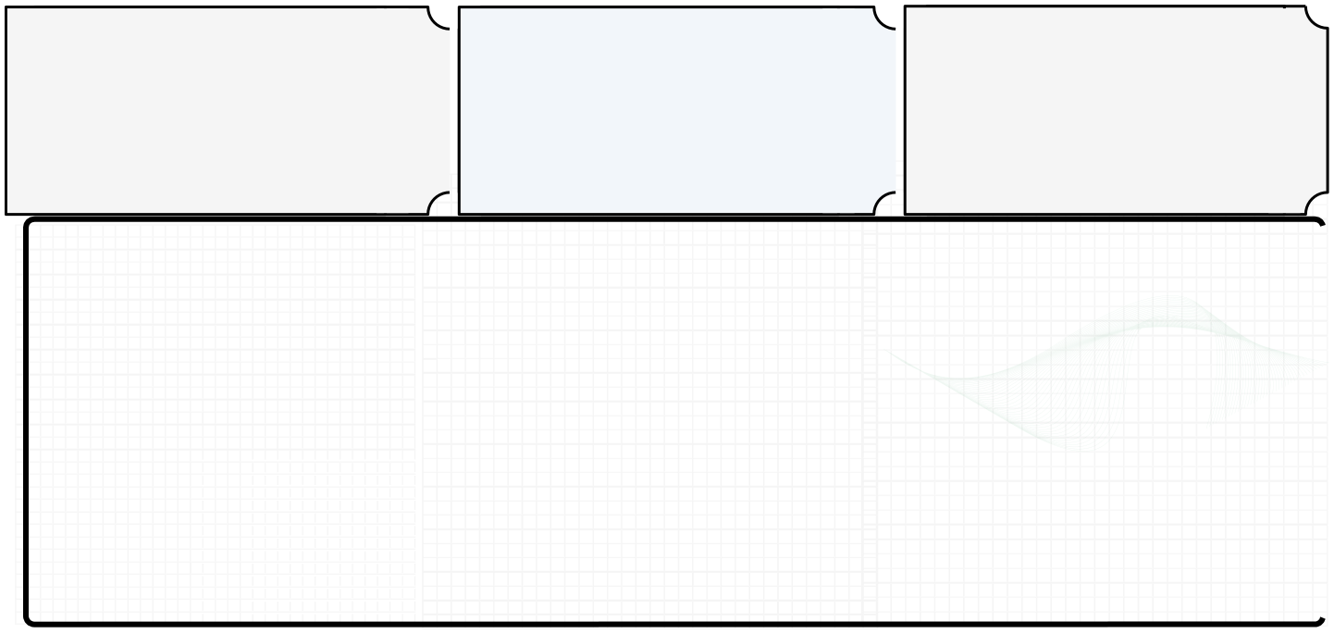

















FEASIBILITY AND VIABILITY
Feasibility
Viability
Practical Implementation
Builds on proven open Indian-language models
(AI4Bharat, MuRIL) — no ground-up training
needed. Rule-based safety engine is
deterministic and testable.
A clear four-band priority system
operators can act on at a glance —
fits into NHAA's existing 14566 / portal flow
without replacing it.
Hackathon build simulates the 14566 integration
(mock call stream); an authorised telephony
integration is the honest, stated next step for
production.
.
Proxy data used only for pretraining /
proof-of-concept; honest about limits —
real deployment needs consented clinical data.
Proxy data used only for pretraining /
proof-of-concept; honest about limits —
real deployment needs consented clinical data.
01
01
02
MuRIL / IndicBERT are built for code-mixed
Indian text; ASR defaults to
Indian-language-first models.
MuRIL / IndicBERT are built for code-mixed Indian text;
ASR defaults to Indian-language-first models.
02
Fusion re-weights dynamically
instead of treating a missing signal as neutral.
Fusion re-weights dynamically
instead of treating a missing signal as neutral.
03
Potential Challenges and Risks
03
Strategies For Overcoming Challenges
Rule-based engine chosen over an
LLM specifically for predictable, testable recall.
Rule-based engine chosen over an LLM specifically for predictable, testable recall.
04
04
Explicitly scoped as a hackathon prototype
needing clinical / legal / security review
before reaching a real caller.
Explicitly scoped as a hackathon prototype needing
clinical / legal / security review before reaching a real caller.
05
05
@SIH Idea Submission—NeuroNex
4

Slide 5























IMPACT AND BENEFITS
Consistent & Data-Driven Decision Support
Benefits of the solution
Provides a standardised assessment framework across interactions,
reducing reliance on subjective judgement while keeping the final decision
with the human operator._
A human stays in the loop
throughout — the co-pilot assists,
never replaces, and never sends
anything without a human's decision.
Victims / Complainants
NHAA Operators
Fewer people in real danger fall
through the cracks — urgency is
caught at first contact, not buried in
a transcript.
Evidence-backed triage with
confidence scores, so
limited attention goes to the most
urgent cases first.
Social
Potential
An evidence-backed, confidence-
aware priority signal beats a black-
box label an operator has to just trust.
Impact on Targeted Audience
Operational
MoSJE / State Authorities
SC/ST Community & Society
A transparent, auditable trail
of how each case
was prioritised —
supports oversight, not just
automation.
Immediate emotional and
psychological support for
SC/ST victims facing caste-
based atrocities and trauma.
A live danger / self-harm flag
always wins over the score,
architecturally — not a policy that
can be quietly deprioritised under load.
Safety-specific
“AI That Listens. Humans Who Help Human-Centred AI for Safer Support. Turning Signals into Safer Support”
@SIH Idea Submission—NeuroNex
5

Slide 6



RESEARCH AND REFERENCES
FIELD & APPLIED RESEARCH
ACADEMIC & GOVERNMENT SOURCES
Reviewed the existing NHAA (14566) grievance journey end to end —
Complaint → Registration → Routing → Investigation → Relief → Monitoring —
to locate where caller distress goes uncaptured at first contact.
Benchmarked proxy emotion/speech datasets (RAVDESS, CREMA-D, GoEmotions)
for pipeline proof-of-concept only — none represent real Indian atrocity victims, and
that limit is stated explicitly.
Set component-level validation targets ahead of the pilot — ASR by WER/CER
per language, text classifier by macro-F1 and recall, safety engine recall on explicit
danger phrases pushed as close to 100% as achievable, since a missed flag costs
more than a false alarm.The entire demo runs on a synthetic, consented
conversation — never a real NHAA case or recording, stated plainly rather than implied.
NHAA Official Portal: nhapoa.gov.in
PIB — NHAA 14566 Launch: pib.gov.in (PRID 1780864)
MoSJE Annual Report 2025–26: socialjustice.gov.in
SIH26093 Problem Statement: https://www.sih.gov.in/sih2026PS
Tele-MANAS — DGHS: dghs.mohfw.gov.in
Mental Healthcare Act — NHSRC: qps.nhsrcindia.org
DPDP Act 2023 — MeitY: meity.gov.in
AI4Bharat Models: models.ai4bharat.org
RAVDESS Dataset: zenodo.org/records/1188976
CREMA-D Dataset: github.com/CheyneyComputerScience/CREMA-D
GoEmotions Dataset: github.com/google-research/google-research
@SIH Idea Submission—NeuroNex
6

