Slide 1


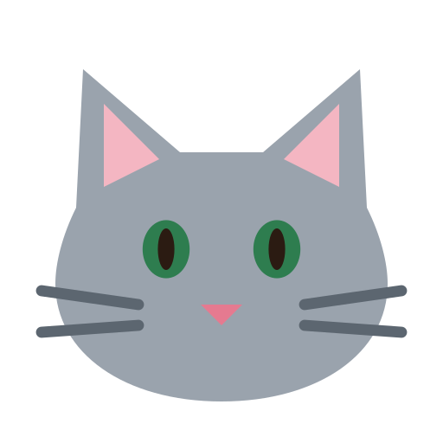
Case file #001
Top secret
A family wellness game
Find it
at home!
Find it. Click it. Upload it. Win it!
Hybrid game design · Assignment 1 · Theme: wellness
Name: add your name here
Course: Game design fundamentals

Slide 2
What we were asked to make
Case file 01 · The brief
The brief in short
How we answered it
Theme: wellness
Split: 50% physical activity, 50% social media
Emojis: 10 at most, as a special way to talk
Elements: players, goals, rules, space, time, resources, conflict
Deliver: a rule book and the design story
Keep it: simple, small group, no violence, original media
Walk and find healthy things at home, then post a photo
React to each other's posts with exactly 10 emojis
2 to 6 players, 5 rounds, about 15 minutes
A wellness break after every round: stretch, breathe, drink water
Own artwork, music and sounds, all made for this game
Brief met

Slide 3
How we got here: design thinking
Case file 02 · Our process
1
2
3
4
5
Empathise
Define
Ideate
Prototype
Test
Who plays, and what do they need?
Turn that into one clear problem
Many game ideas, then pick one
A working web game on phones
Play it with real families
Refine: what we learn from testing goes back to the start. We went round this loop five times so far.

Slide 4
Empathise and define
Part 1
Before making anything, we looked at who would play and what gets in their way.

Slide 5
Who we are designing for
Case file 03 · Empathise
Our audience: families who play together
Add your research
Children from about 7 years old, their parents and their grandparents, playing at home or across homes on a video call.
Paste two or three real quotes from the families you spoke to, and how you met them.
What we noticed going in
Quote 1: "…"
Screen time worries: parents want kids off the sofa, not more scrolling
Mixed phone skills: grandparents find small text and busy screens hard
Different energy: kids want speed, grandparents need it gentle and safe
Social media is already shared: families send photos and reactions every day
Quote 2: "…"
Quote 3: "…"

Slide 6
Persona: Aarav
Case file 04 · Persona 1
About
Goals
Year 4 student, loves races
Plays on his mum's old phone
Gets bored if he has to wait
Win, and win fast
Beat his big sister
Show off his finds
Aarav
Frustrations
What the game must do
9 years old
the speedy finder
Long instructions
Waiting for others
Games that feel like homework
Start in seconds
Big, fun feedback
A fair shot at winning
"Can we play again? I was so close!"
Player type: Achiever (points, leaderboard) with a bit of Killer (wants to beat others)

Slide 7
Persona: Kamla Nani
Case file 05 · Persona 2
About
Goals
Retired teacher
Uses WhatsApp video calls
Has sore knees
Play with her grandkids
Move a little every day
Feel included, not left behind
Kamla Nani
Frustrations
What the game must do
67 years old
the caring grandmother
Tiny text and busy screens
Fear of pressing the wrong button
Anything that needs running
Large text, few buttons
Gentle walking only
A role even if she is slower
"I just want to spend time with the children."
Player type: Socializer (here for the family time, the chat and the reactions)

Slide 8
Persona: Meera
Case file 06 · Persona 3
About
Goals
Works full time
Sets up family activities
Shares photos in the family group
Less screen time for the kids
A quick activity for all ages
Everyone safe at home
Meera
Frustrations
What the game must do
38 years old
the busy mum and host
Setups that take forever
Games that never end
Kids fighting over rules
Set up in 2 minutes
A clear end point
Rules the app enforces
"Fifteen minutes, everyone off the sofa. That is the dream."
Player type: Planner (Achiever, explicit) who also acts as the Networker for the family

Slide 9
The problem we chose to solve
Case file 07 · Define
Problem statement
Families want to move and laugh together, but most phone games keep everyone sitting still, and they are often too fast or too fiddly for grandparents.
How might we…
1
2
3
make the phone the reason to get up and walk, not the reason to sit?
give a 9-year-old and a 67-year-old an equal chance to win?
use social media habits (posts and reactions) in a kind, safe way?

Slide 10
Ideate
Part 2
We came up with several game ideas, compared them against the brief, and picked one.

Slide 11
Four ideas we tried on paper
Case file 08 · Ideate
Idea A
Idea B
Idea C
Idea D
Stretch charades
Step streak
Water quest
Find It at Home!
Act out a stretch, others guess it with emojis.
Phones count steps, a family feed shows who walked most.
Drink-water reminders and selfies with your glass.
Walk to find healthy things, post a photo, others react.
Problem: Fun, but little to post on social media.
Problem: Unfair for grandparents, needs fitness apps.
Problem: Very little physical activity.
Verdict: Balanced, works for every age.
Chosen
Faculty discussion: add what your faculty said about these ideas, and how it changed your choice.

Slide 12
How the ideas scored against the brief
Case file 09 · Choosing
What the brief asks | Stretch charades | Step streak | Water quest | Find It at Home!
Wellness theme | Strong | Strong | Strong | Strong
50% physical | Okay | Strong | Weak | Strong
50% social media | Weak | Okay | Okay | Strong
Fair for ages 7 to 70 | Okay | Weak | Strong | Strong
Simple rules | Strong | Okay | Strong | Strong
Why Find It at Home! won: it is the only idea that is strong on every line. Walking is gentle enough for Nani and still a race for Aarav, and photos plus reactions are the social media people already use.

Slide 13
One round of Find It at Home!
Case file 10 · The concept
The core loop is what players do again and again. Each round takes about 2 to 3 minutes, and a game is 5 rounds.
1
2
3
4
5
6
Read the clue
Walk and find
Snap and post
React
Win a point
Wellness break
Same clue on every phone
Search the home, never run
Take a photo and post it
Others tap one of 10 emojis
More than half say yes
Stretch, breathe or sip water
Digital
Physical
Digital
Social
Digital
Physical
Next round, with a harder clue

Slide 14
The game design
Part 3
The seven core elements from our lectures, and how each one works in Find It at Home!

Slide 15
Players, goals, rules and resources
Case file 11 · Game elements
1
Players
2
Goals
2 to 6 players, each on their own phone. Everyone is a finder and a judge. One person is the host who starts the game.
Each round: be first to post the right object and have it approved. The whole game: most points after 5 rounds. Plus five walks and five wellness breaks.
Design term: small group, no teams; the host is a light role
Design term: primary goal and sub-goals (short milestones)
3
Rules
4
Resources
Find the object and post a photo. Others react. More than half yes wins 1 point. You cannot react to your own post. A tie is a shared win.
A phone with a camera, the everyday things in your home, 2 minutes per round, and the 10 reaction emojis, the only way to judge a post.
Design term: operational rules on one card; the app enforces them
Design term: time and emojis are the limited assets players manage

Slide 16
Space, time and conflict
Case file 12 · Game elements
5
Space
6
Time
7
Conflict
Two spaces at once. The physical space is your own home, safe rooms only: no climbing, nothing hot or sharp. The digital space is the shared game room: clue, feed, reactions and leaderboard.
Real time, not turns. Everyone searches at once against a 2-minute clock. The clock pauses while people react, so judging never costs search time. 5 rounds is about 15 minutes, then the game ends.
A friendly race. Everyone chases the same object at the same time. A second, social friction: a post only counts when the others agree. Nobody attacks or loses anything.
Design term: the magic circle stretches across the home and the phone
Design term: real-time pacing with a natural stopping point
Design term: agon (competition) without violence

Slide 17
Why it is fun for different players
Case file 13 · Player psychology
Caillois' forms of play
Bartle player types
Agon (competition): the race to find the object first
Alea (chance): the clue is random, so a beginner can get an easy one and win
Mimicry (role-play): everyone plays a detective cracking a case
Achievers get points, a leaderboard and a podium
Socializers get the feed, reactions and the shared wellness break
Explorers get riddles and a reason to poke around the house
Killers are not fed on purpose: there is no way to hurt or block another player
Flow
Clues get harder each round, from Word Hunt to Riddle Hunt to Learn & Find, so the challenge grows as players warm up.
Self-determination: autonomy (you choose where to search), competence (you find it), relatedness (you play as a family).

Slide 18
Fair for a 9-year-old and a 67-year-old
Case file 14 · Balance
1
Controlled luck
2
Fresh start every round
The random clue is input randomness. Sometimes the easy item is right next to Nani, so the fastest runner does not always win.
Each round is worth only 1 point and gives no advantage in the next one. No snowballing, so nobody is out of it early.
3
Constructive failure
4
Fair judging
A post that is not approved is not the end. You keep searching and can post again in the same round.
You cannot react to your own post, the clock pauses while people react, and a tie is shared instead of decided by a sprint.

Slide 19
The 10 emojis: our special language
Case file 15 · Communication
These are the only emojis in the game, and the only way to judge a post. Five say yes, five say no.
Counts as yes
✅
👍
💯
🎯
👏
Correct object
This matches
Perfect match
Exact match
Approved
Counts as no
❌
🔄
🔍
👎
🤔
Wrong object
Please retake
Photo is unclear
Does not match
Not sure

Slide 20
Half physical, half social media
Case file 16 · Hybrid
50% physical
50% social media
Walk around the home to find each object
Bend, reach, look in different rooms
Wellness break after every round: stretch, march, breathe
Five walks in a 15-minute game
Post a photo, like a social media post
React with emojis and see the reaction count
Round feed of everyone's posts
Leaderboard and game feed of every winning photo

Slide 21
The rule book
Part 4
Everything a family needs to play, on two pages.

Slide 22
Setting up and playing a round
Rule book · Page 1
What you need
How a round works
2 to 6 players
A phone with a camera each
An internet connection
A home with everyday things
1
The clue appears on every phone at the same time.
2
Walk (never run) and find the object before 2 minutes are up.
3
Take a photo. Tap Retake if it is blurry, or Save to post it.
Setting up
4
Everyone else reacts with one of the 10 emojis.
Host taps Play Game, adds a name and animal
Host shares the 4-letter code
Others tap Join a game and type it
Host taps Start the hunt
5
More than half say yes? The post wins 1 point. If not, keep searching.
6
Wellness break: do the short activity on screen together.

Slide 23
Scoring, safety and practice
Rule book · Page 2
Scoring
Safety rules
Practice mode
First approved post: 1 point
Posting first is not enough, it must be approved
No approved post: nobody scores
After 5 rounds, most points wins
Equal points share the win
Walk carefully, never run or climb
Nothing hot, sharp, fragile or electrical
No heavy lifting or high cupboards
Children play with an adult at home
Fresh photos only, taken during the round
Pick Practice instead of a number of players to play alone. You check your own photos honestly, and the game remembers your best score so you can try to beat it.
Be fair and kind: react to what the photo shows, not to who posted it.

Slide 24
The prototype
Part 5
A working web game. Everyone plays on their own phone at
find-it-at-home.onrender.com

Slide 25
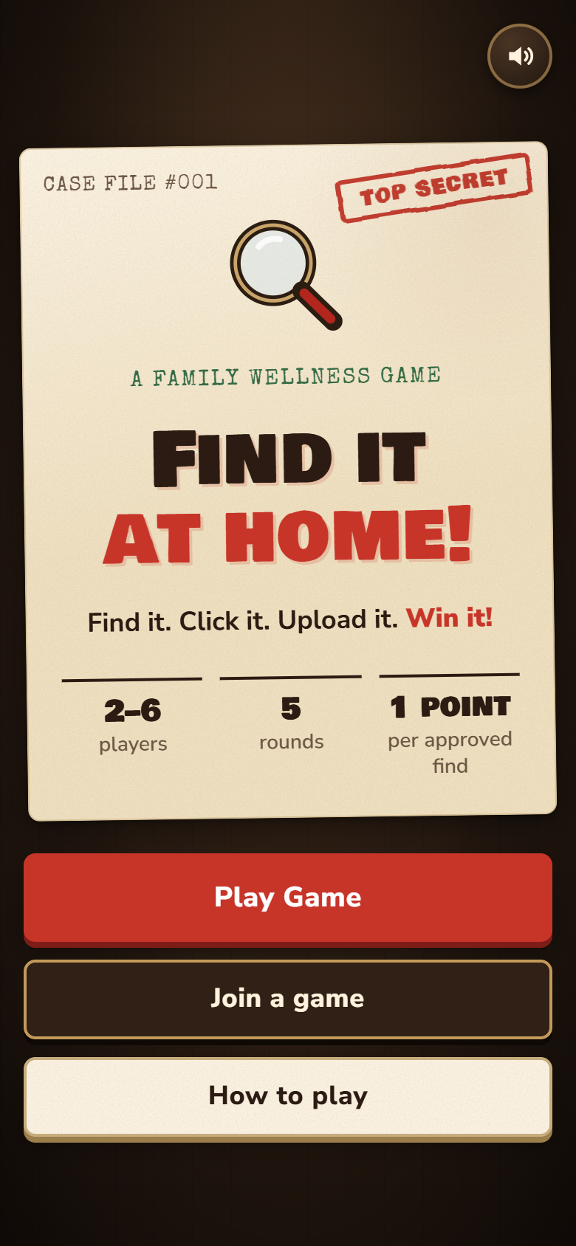
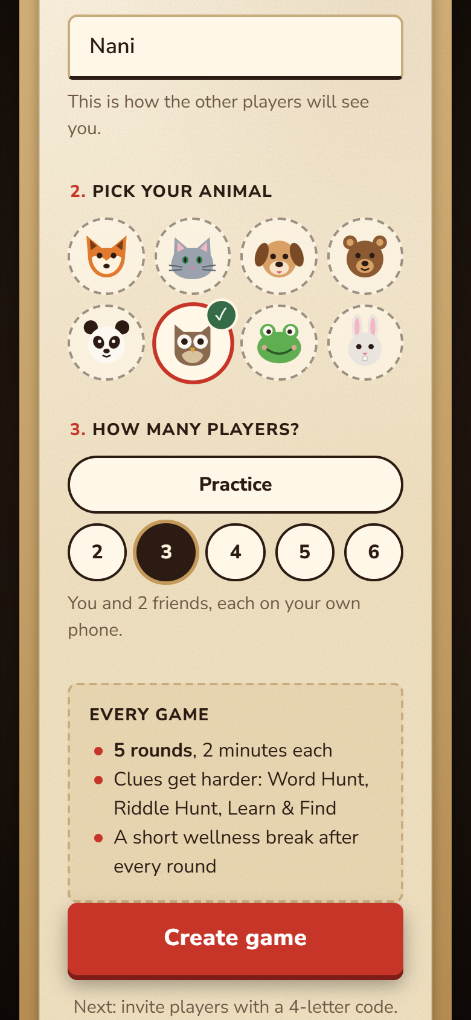
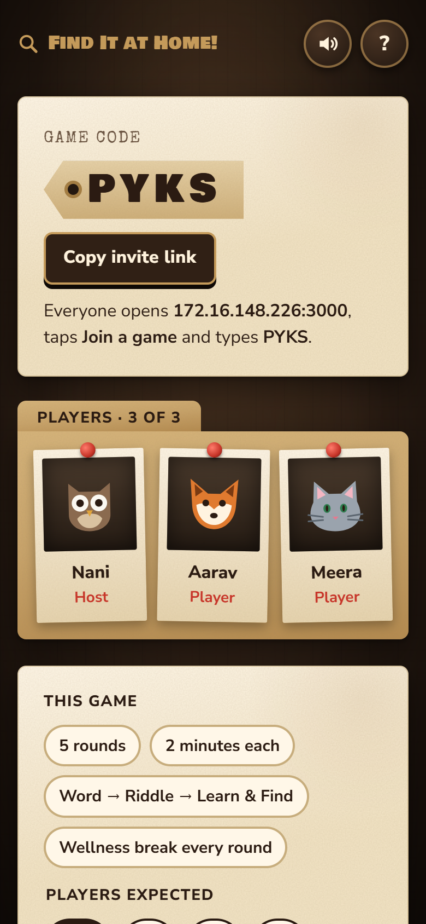
Getting started
Case file 17 · Prototype
Big title, one main button
Name, animal, number of players
Share the 4-letter code

Slide 26
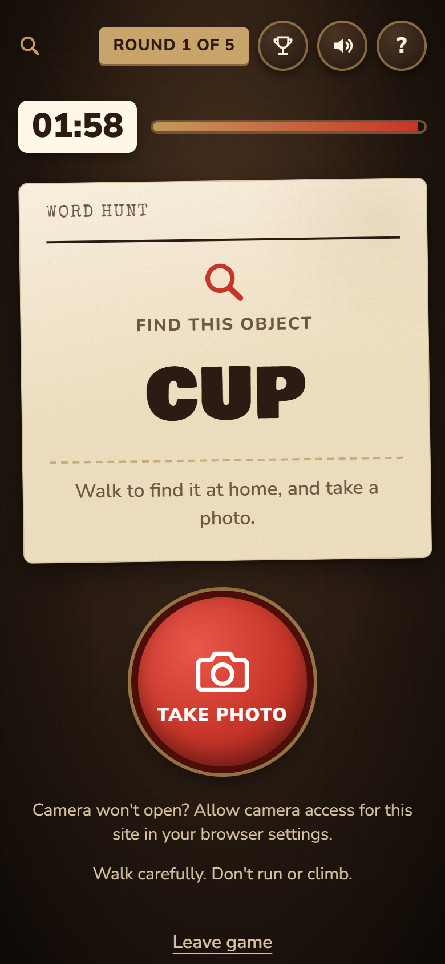
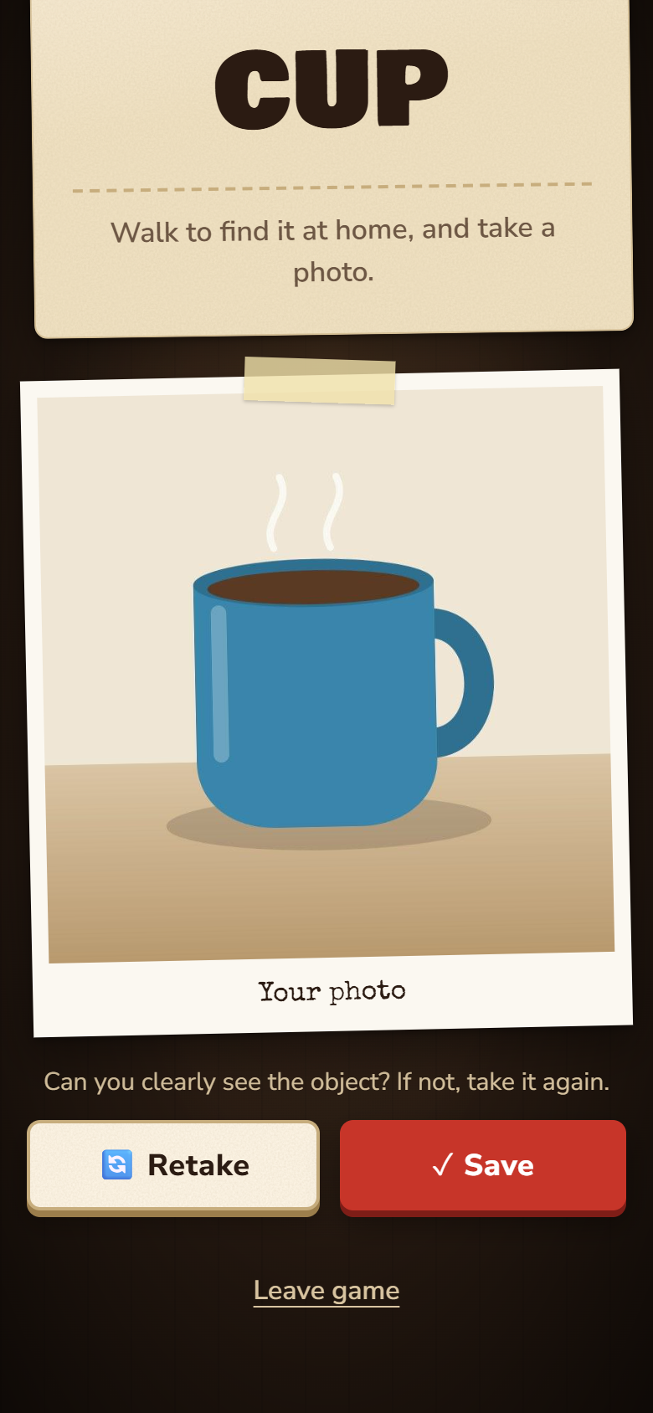
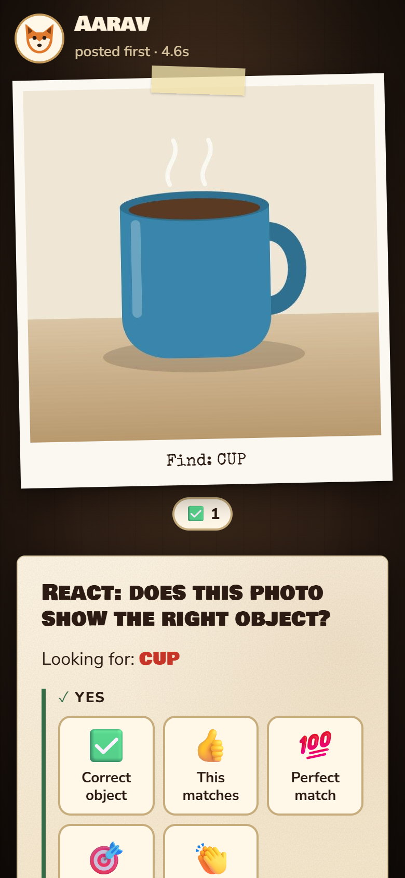
Playing a round
Case file 18 · Prototype
The clue, as big as possible
Check the photo, then Save
Others react to the post

Slide 27
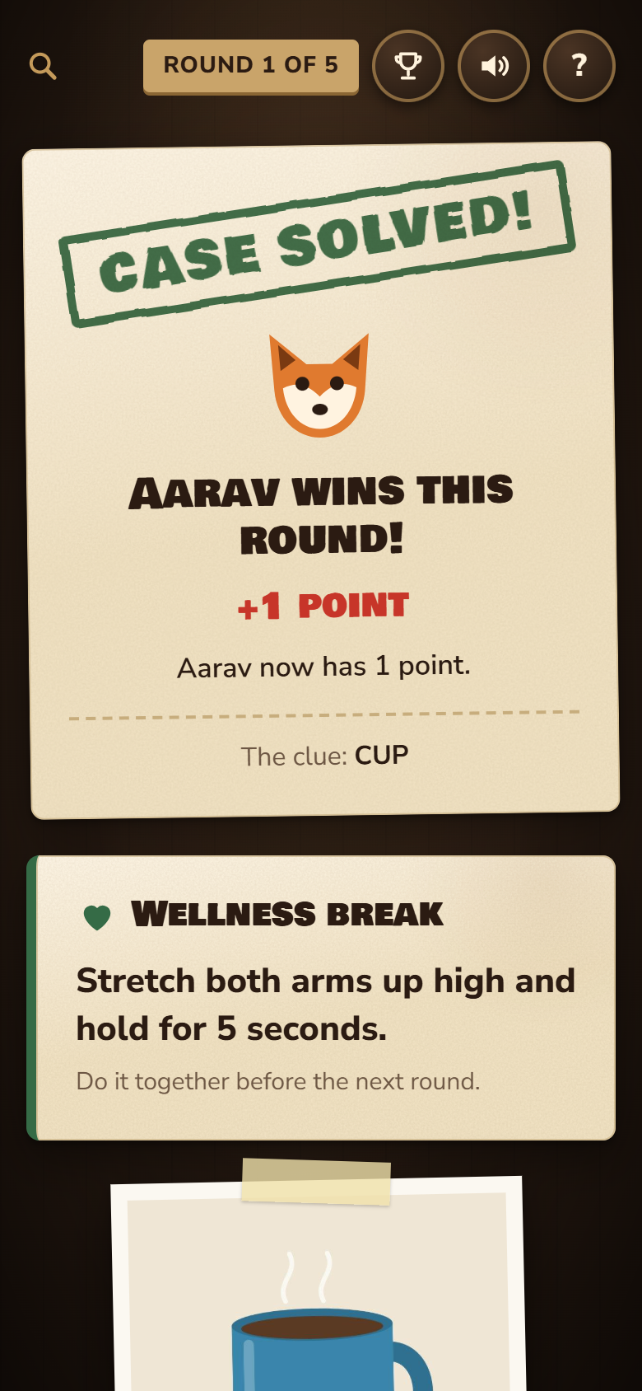
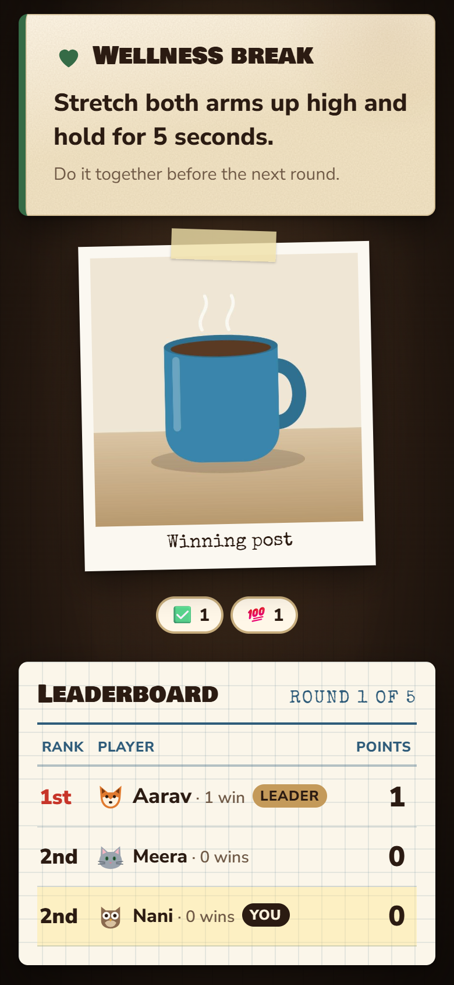
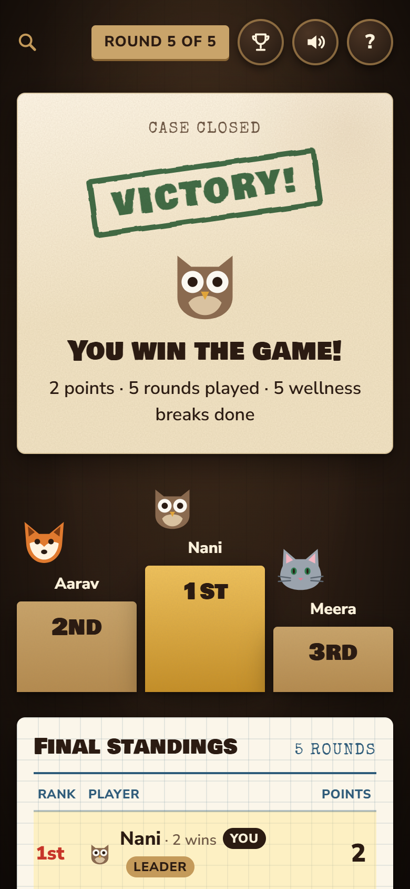
Results and the wellness break
Case file 19 · Prototype
Case solved, +1 point
Wellness break together
Podium and final standings

Slide 28
A detective case file, made easy to read
Case file 20 · Look and feel
Colours
Made for grandparents too
Big text: nothing smaller than 15px on a phone
Big buttons: at least 44px, easy to tap
Not just colour: every choice also shows a tick
Clear words: "Save", not "Upload to server"
Motion you can turn off: respects reduce-motion settings
Checked on 7 screen sizes, with no overlapping text
Desk
Parchment
Stamp red
Gold
Success
Fonts
Bowlby One for big moments
Nunito Sans in the game, Inter here, for reading
Special Elite for case-file labels

Slide 29
All our own media, copyright-free
Case file 21 · Media
Music
Sound effects
"The Chase", an upbeat detective groove we composed. The browser plays it from code, no recordings.
Stamp, camera click, chimes, drumroll. All made in code while you play, no sound files.
Animal avatars
Icons and art
8 animals (fox, cat, dog, bear, panda, owl, frog, rabbit) drawn by us as vector art.
Magnifying glass, case files, stamps, podium and confetti, all drawn for this game.
Fonts
Emojis
Bowlby One SC, Nunito Sans and Special Elite, all under the free SIL Open Font License.
The 10 reactions are standard Unicode characters, drawn by each phone's own emoji font.

Slide 30
Ethics, safety and kindness
Case file 22 · Responsible design
No dark patterns
A natural stopping point
Safe movement
No ads, no in-app purchases, no fake urgency, no endless loops.
The game ends after 5 rounds. It is a healthy break, not a habit trap.
Walk, never run. No climbing, nothing hot, sharp or fragile.
Kind by design
No violence
Privacy
Only 10 set emojis, so no rude comments. You cannot judge your own post.
Detectives here find and solve. Nobody attacks, blocks or loses anything.
Photos stay in the game room's memory for the round and are never saved to disk.

Slide 31
Refine
Part 6
We reviewed the game against the brief after every version and changed what did not work.

Slide 32
How the design changed, version by version
Case file 23 · Iterations
1
2
3
4
5
Version 1
Version 2
Version 3
Version 4
Version 5
First prototype
Practice mode
Sound and motion
Easier to read
Fits the brief
Two game modes, many settings, emoji voting and a scoreboard.
One person can play alone and beat their best time.
Stamps, confetti, music and sounds as feedback.
Bigger text and buttons for grandparents, clearer errors.
Wellness clues and breaks, a social feed, only 10 emojis, simpler rules.
Biggest lesson: our first version did too much. Cutting it down to one mode and five rounds made it easier for every age, and closer to the brief.

Slide 33
User testing
Part 7
The most important part: real families playing the real game. These slides are ready for your results.

Slide 34
How we will test the game
Case file 24 · Test plan
Who
How
2 families, 3 to 4 players each
At least one child (7 to 10) and one grandparent
Played at home on their own phones
Explain nothing, hand them the rule book
Watch quietly and take notes (a blind playtest)
Play one full game, about 15 minutes
What we watch
What we ask after
Can they set up without help?
Do they understand the 10 emojis?
Does anyone run, or get left out?
What was the best moment?
What confused you?
Would you play again tomorrow?

Slide 35
Playtest 1: what happened
Case file 25 · Playtest 1
The session
What went well
What confused them
Date: …
…
…
Who played: …
Ages: …
Where: …
Game length: …
Best quote
What we will change
…
…
Add a photo of the playtest here

Slide 36
Playtest 2: what happened
Case file 26 · Playtest 2
The session
What went well
What confused them
Date: …
…
…
Who played: …
Ages: …
Where: …
Game length: …
Best quote
What we will change
…
…
Add a photo of the playtest here

Slide 37
What we changed after testing
Case file 27 · Results
What we saw in testing | Why it mattered | What we changed
… | … | …
… | … | …
… | … | …
… | … | …
Before and after: add a screenshot of a screen you changed because of a playtest, next to the old one.

Slide 38
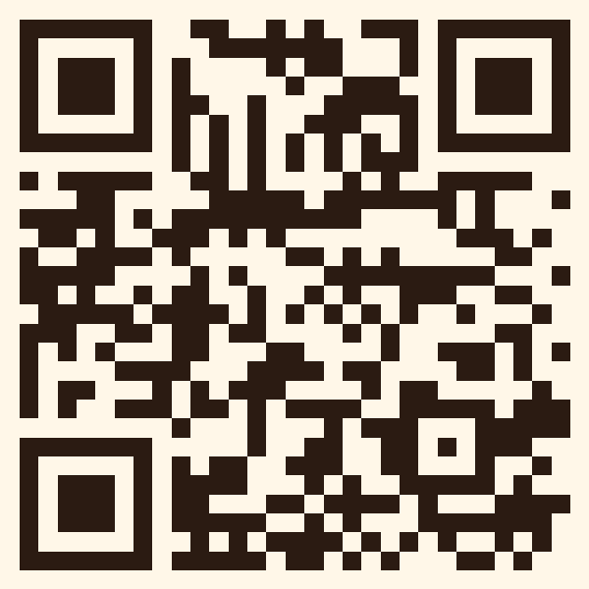

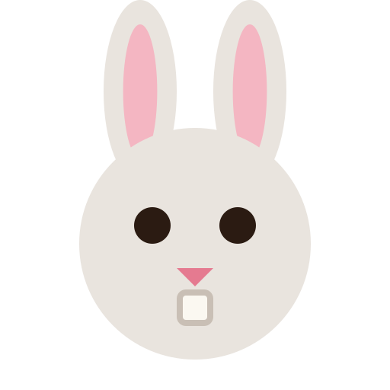

Case closed
Solved!
Thank you!
"Games are a series of interesting choices." Sid Meier
Ours asks just one, every round: where in your home would you look?
Scan to play on your phone
Play it: find-it-at-home.onrender.com

