Slide 1
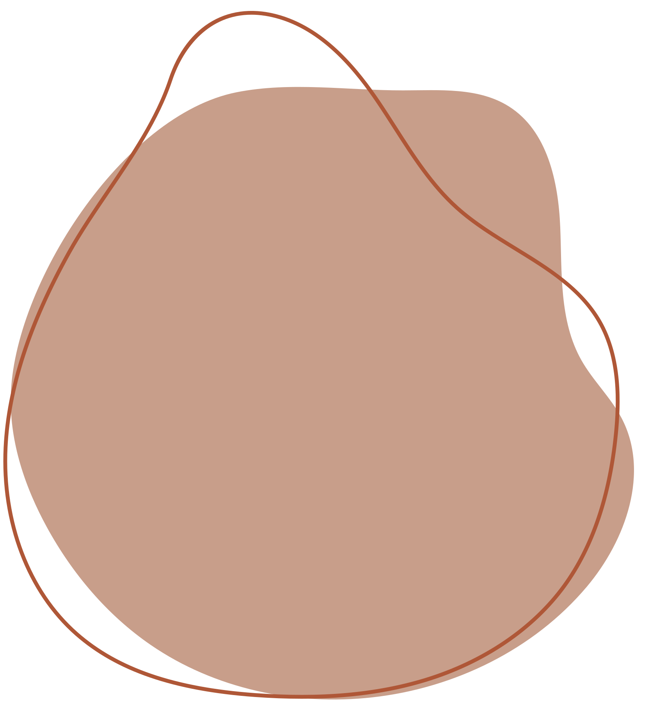

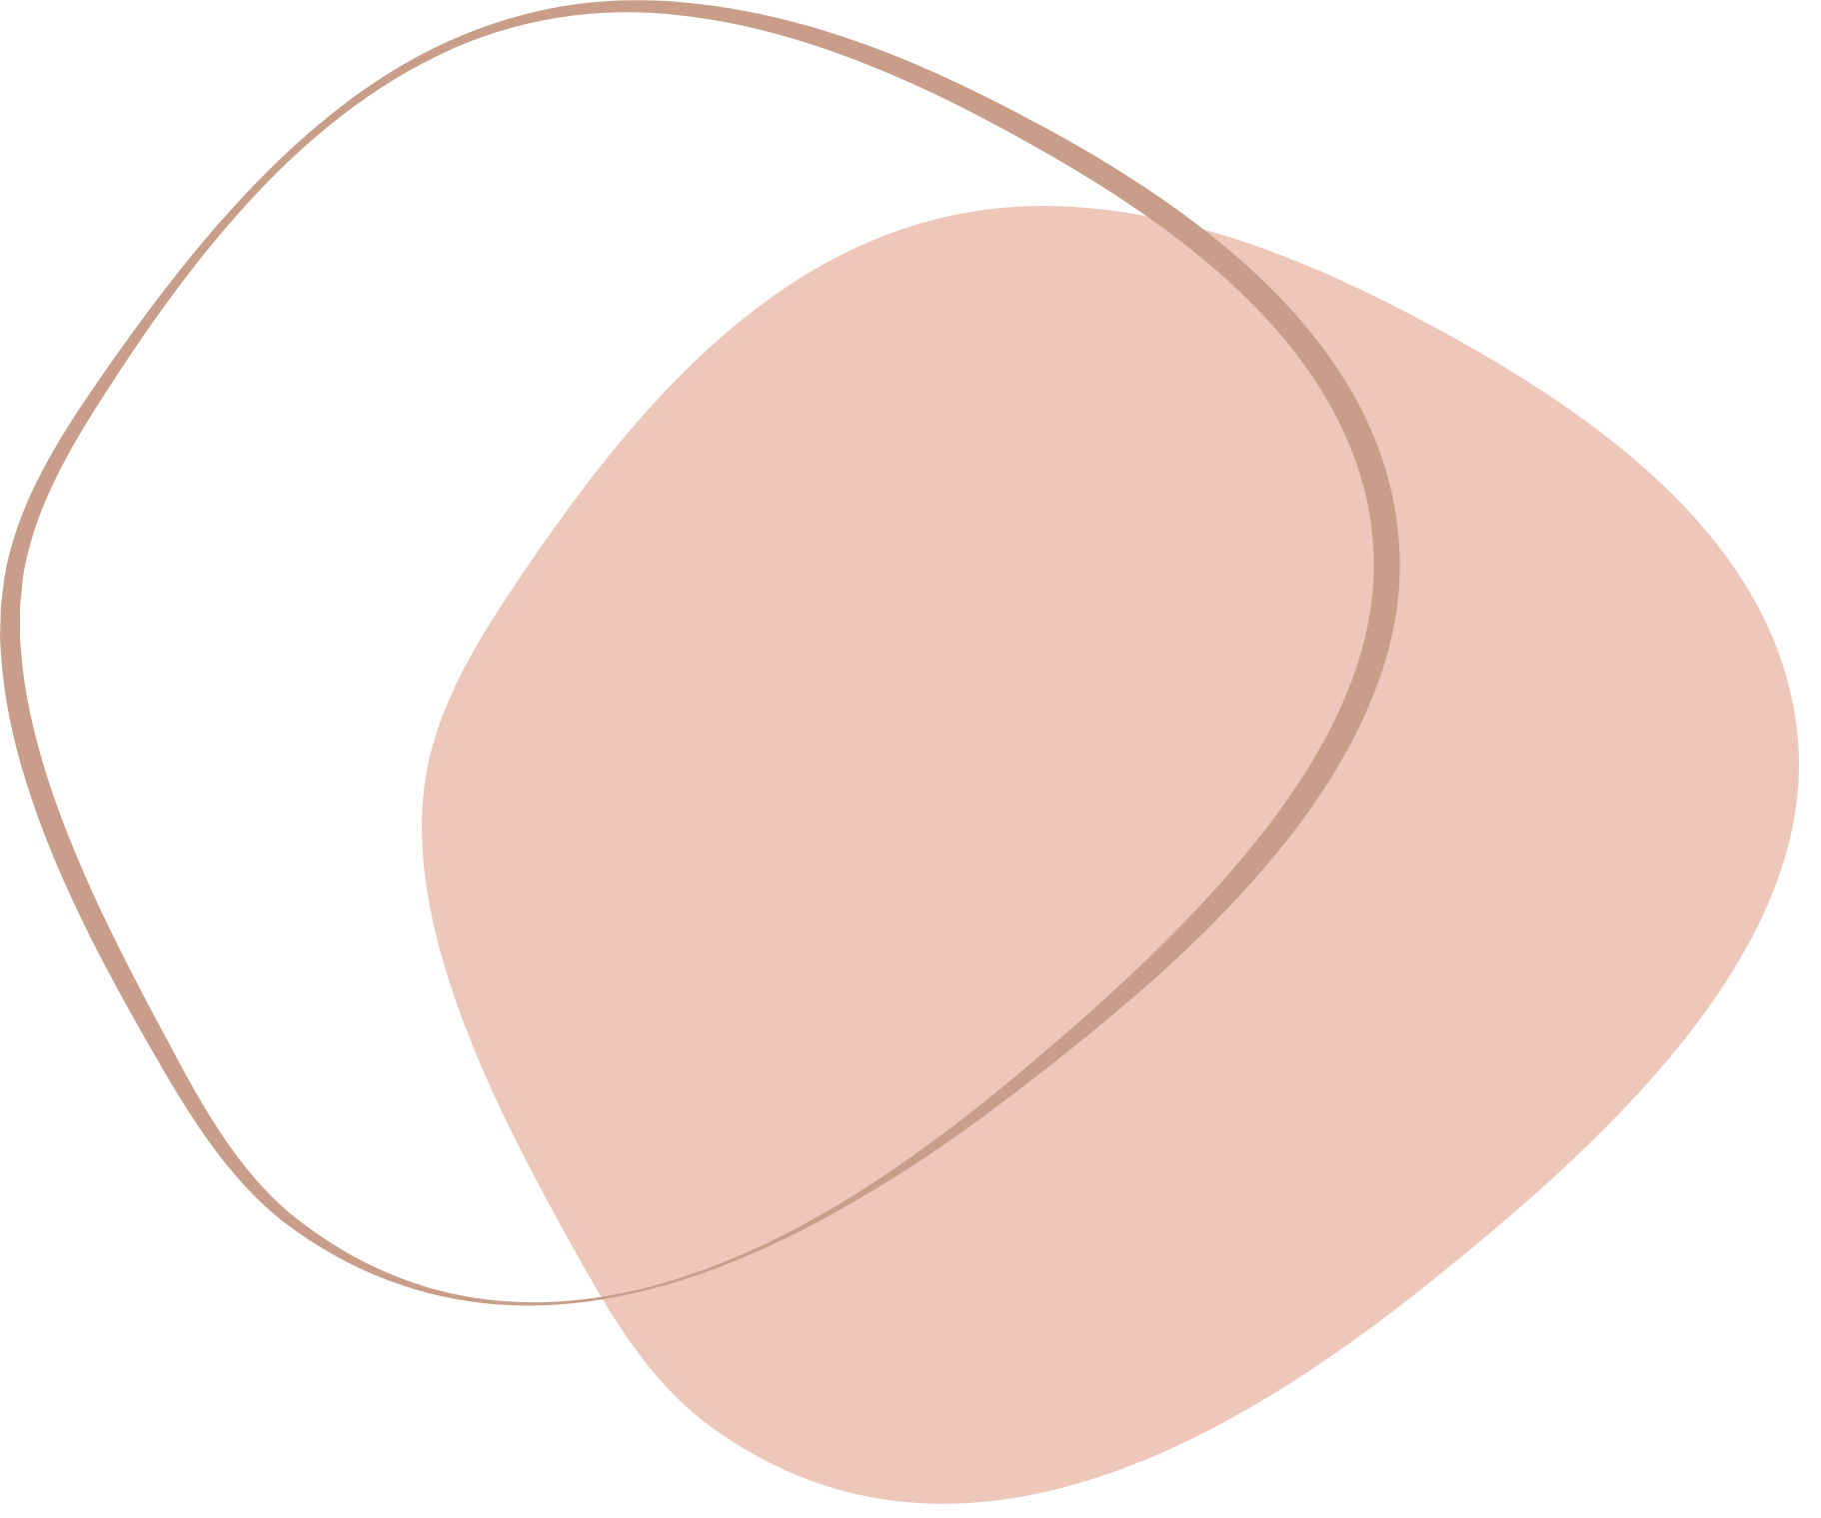

CSE523: Machine Learning
Mentor : Prof. Mehul Raval
Wine Quality Prediction
Group 3: Good Pointsss
Anshi Shah
AU2040087
Rahi Shah
AU2040070
Yesha Dhivar
AU2040215
Kenil Shah
AU2040111

Slide 2
The quality of wine is important for consumers and producers. Historically, wine quality was determined at the end of production, but with the development of technology and the availability of data, machine
learning techniques have been used to determine wine quality in the development phase.
This saves time and money and allows
for the tuning of parameters that
control wine quality.
Introduction

Slide 3
Machine learning techniques can help wine manufacturers analyze basic parameters that determine wine quality, enabling them to fine tune the wine's taste during the development process.
The goal of this work is to use machine learning to identify the most significant parameters that control wine quality and predict wine quality based on those parameters.
Problem
Statement

Slide 4
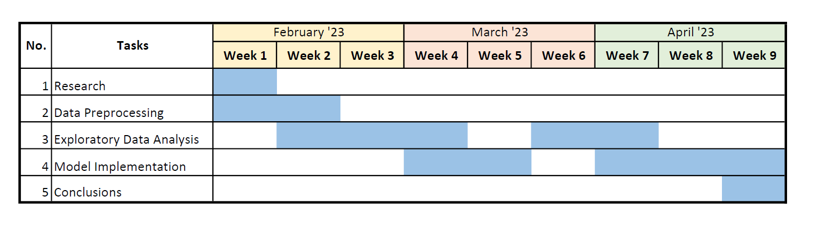
GNATT CHART

Slide 5
Existing Body of Work
Red Wine Quality Prediction Using
Machine Learning Techniques
By IEEE
S. Kumar, K. Agrawal and N. Mandan, "Red Wine Quality Prediction Using Machine Learning Techniques," 2020 International Conference on Computer Communication and Informatics (ICCCI), Coimbatore, India, 2020, pp. 1 6,
doi : 10.1109/ICCCI48352.2020.9104095.
Three regression techniques were applied, under a computationally efficient procedure that performs simultaneous variable and model selection. The support vector machine achieved promising results, outperforming the multiple regression and neural network methods.
Three regression techniques were applied, under a computationally efficient procedure that performs simultaneous variable and model selection. The support vector machine achieved promising results, outperforming the multiple regression and neural network methods.
Modeling wine preferences by data
mining from physicochemical properties
Paulo Cortez, António Cerdeira , Fernando Almeida, Telmo Matos, José Reis,
Modeling wine preferences by data mining from physicochemical properties,
Decision Support Systems,
Volume 47, Issue 4, 2009, Pages 547-553, ISSN 0167 9236,
https://doi.org/10.1016/j.dss.2009.05.016.

Slide 6
Dataset and Wine Parameters
Dataset
Factors contributing to wine quality:
Climate and Weather
Temperature and Sunlight
Growing Practices
Winemaking Practices
Retrieved from: UCI Machine Learning Repository
Details:
The two datasets are related to red and white variants of the Portuguese "Vinho Verde" wine.
No. of instances: 4898
No. of attributes: 12
Attributes: fixed acidity, volatile acidity, citric acid, residual sugar, chlorides, free sulfur dioxide, total sulfur dioxide, density, pH, sulphates, alcohol, quality
Indicators of wine quality:
Complexity - flavour profile
Balance - sweetness, acidity, alcohol, fruit
Typicity - looks and tastes
Intensity and finish - intense flavors
Dataset: https://archive.ics.uci.edu/ml/datasets/Wine+Quality
Wine quality factors from : https://www.jjbuckley.com/wine-knowledge/blog/the-4-factors-and-4-indicators-of-wine-quality/1009

Slide 7
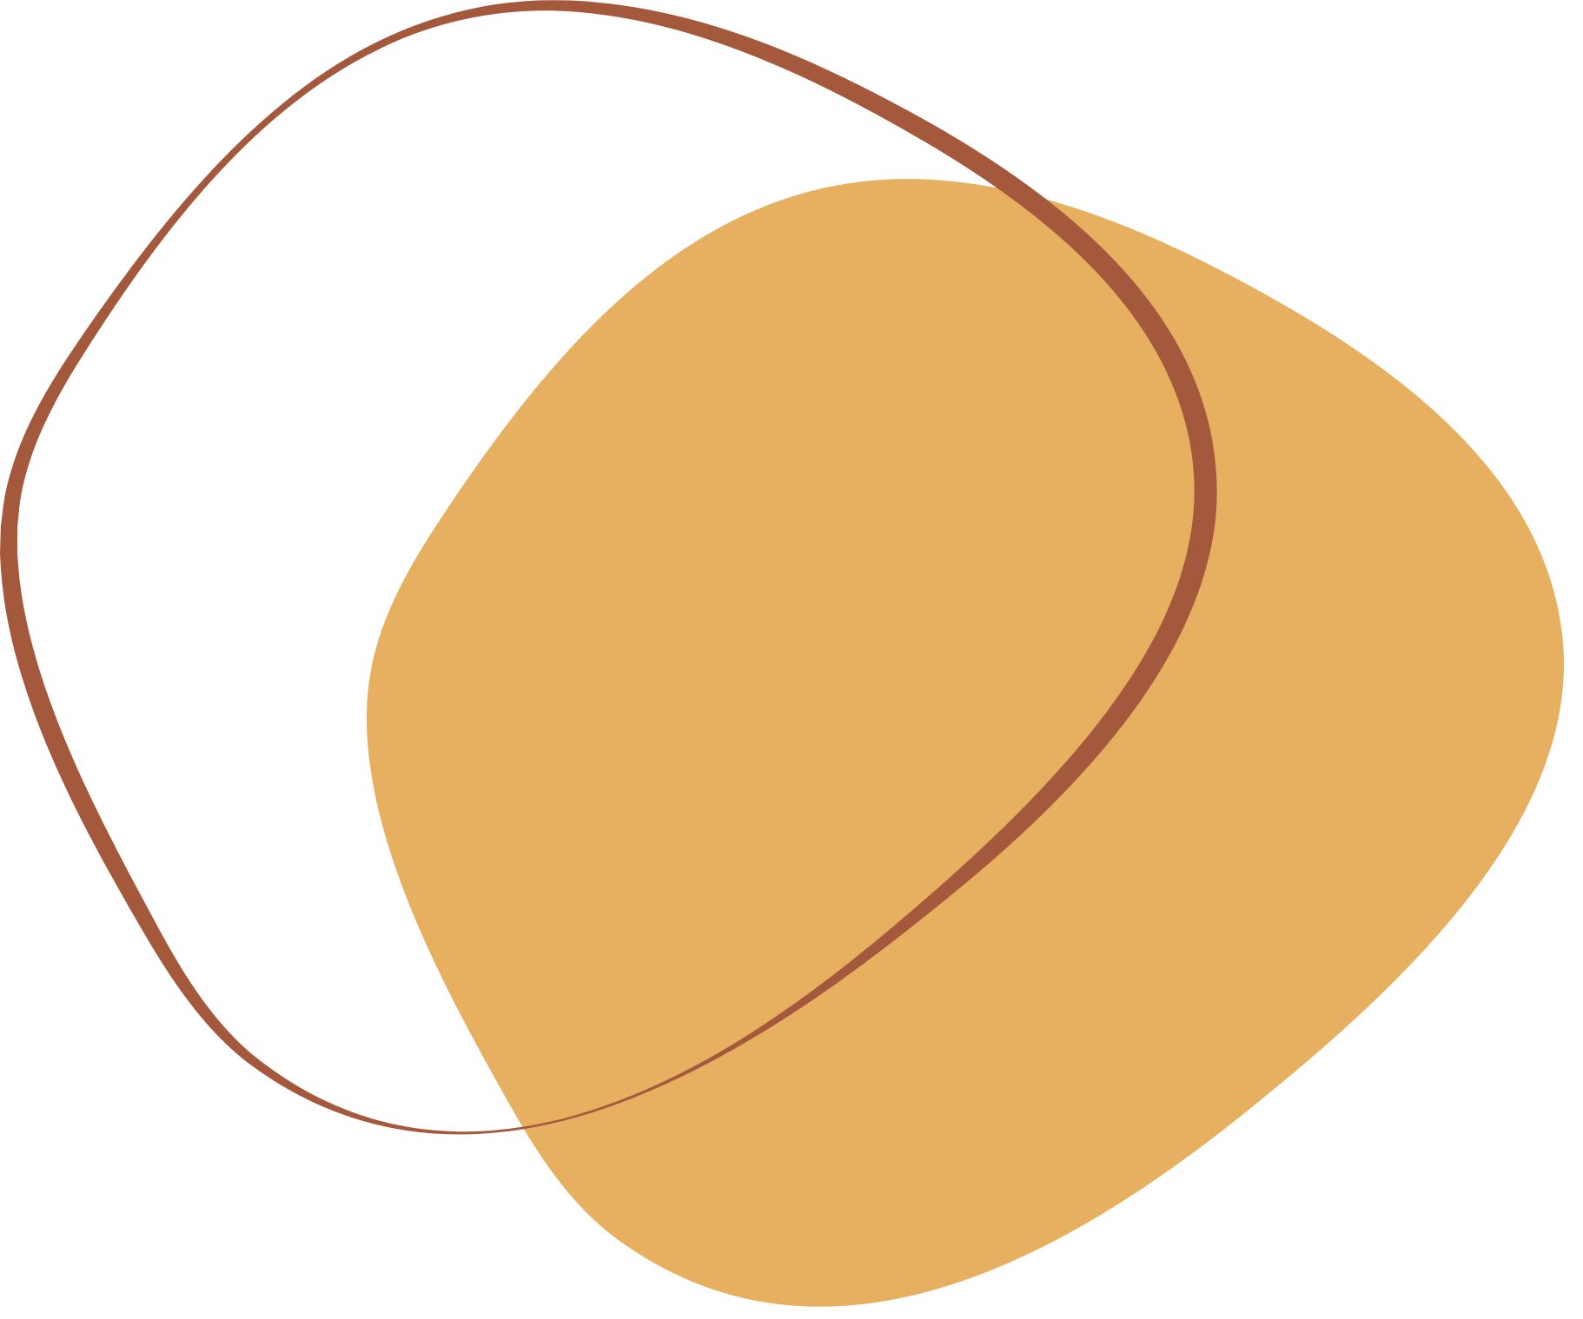
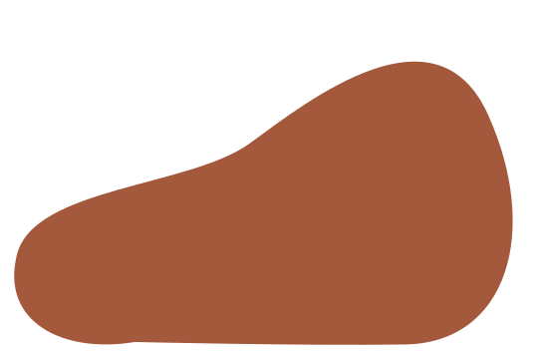
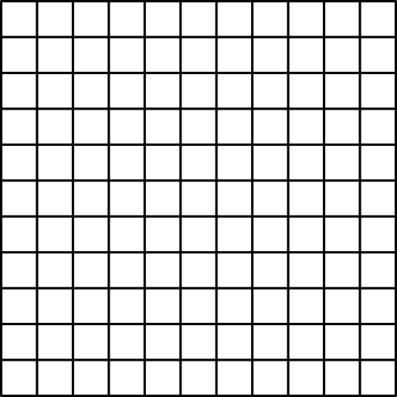


Approach
Preprocessing
Data Cleaning
Normalization
(MinMax Scaler)
Model Building
Recoding the target column - quality
It changes the multi-class classification to binary-class classification.
3
4
5
6
7
8
9
EDA and Data Analysis
Catplots and Factorplots
Pairplot
Covariance Matrix
0
1
Models are trained on the recoded quality target column.

Slide 8
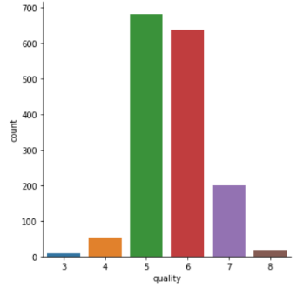
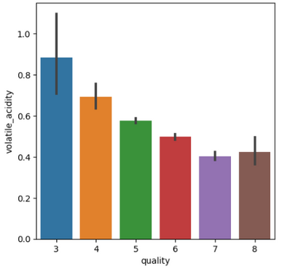
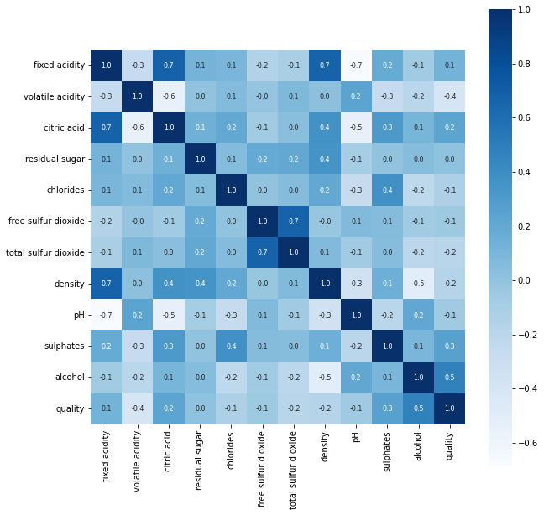
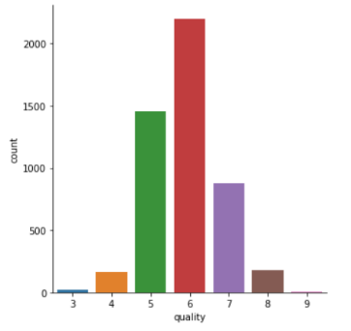
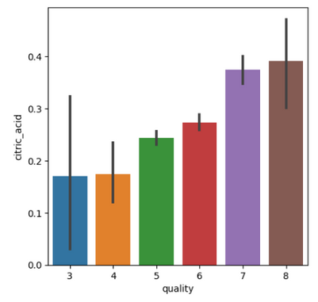
Exploratory Data Analysis
Catplots, Factorplots and Covariance Matrix

Slide 9
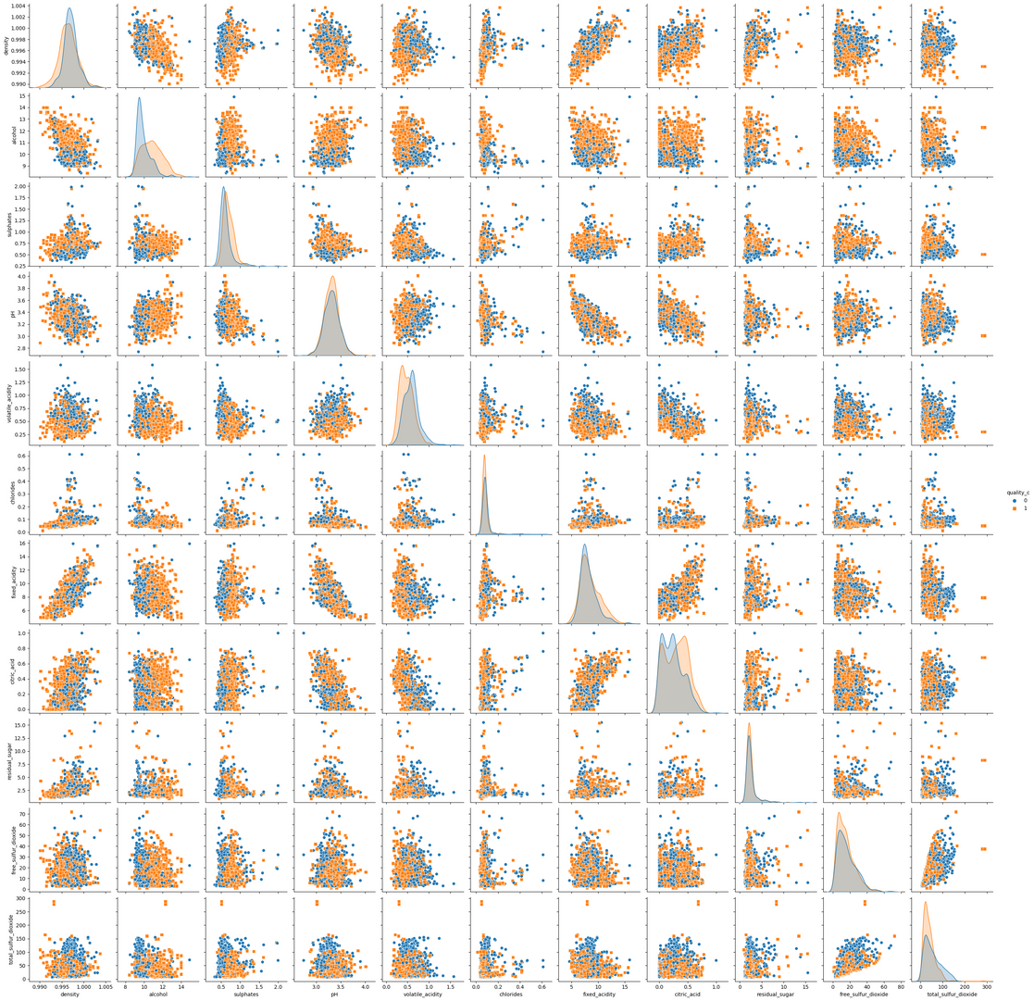
Exploratory Data Analysis
The diagonal of the grid shows the distribution of each individual feature.
The scatter plots in the upper triangle of the grid show the scatter plots for pairs of features, with different colors indicating the two classes.
Pair Plot

Slide 10
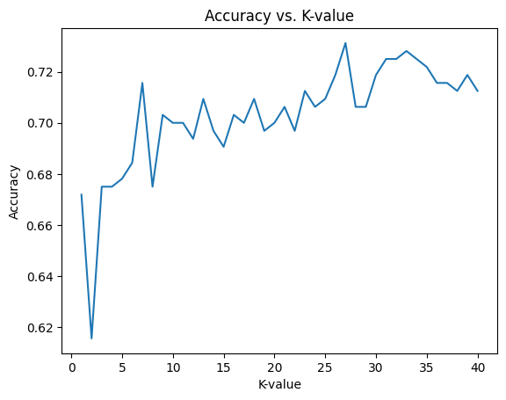
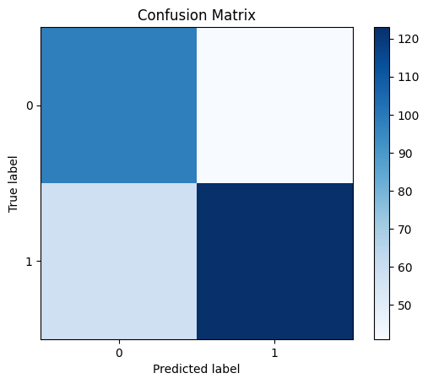
Results
Accuracy - 70%
K-Nearest Neighbour

Slide 11
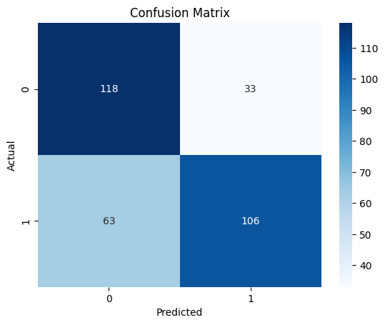
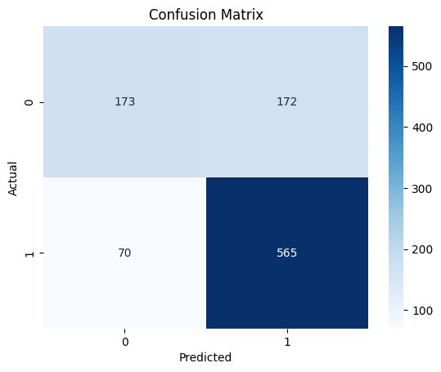
Results
Red Wine
Accuracy - 71%
White Wine
Accuracy - 73%
Support Vector Machine

Slide 12
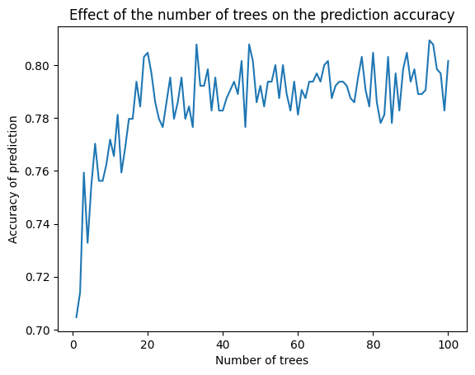
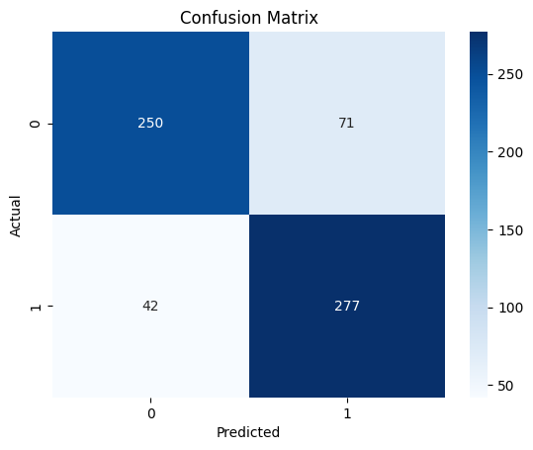
Results
Red Wine
Accuracy - 80%
Random Forest

Slide 13
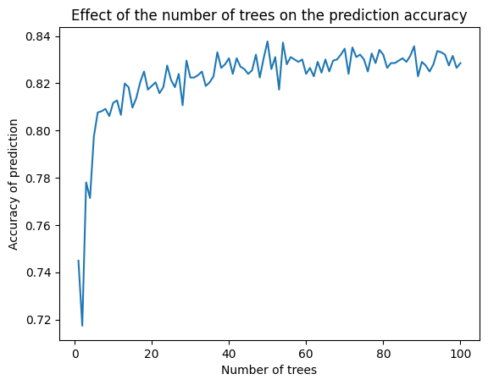
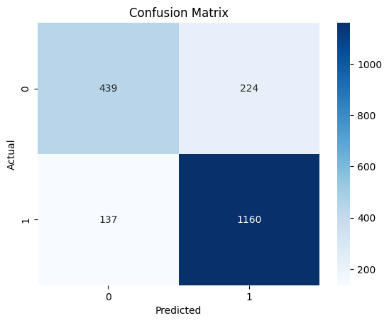
Results
White Wine
Accuracy - 82%
Random Forest

Slide 14
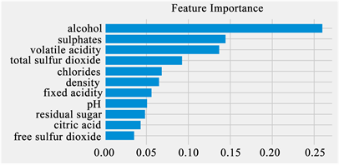
Conclusions
When we plot the feature importance of all features for our we see that the most important feature to control the wine quality is turn out to be an alcohol. Which perfectly make sense because it is not only about the feelings after drinking in fact it effects the teste, texture and structure of the wine itself.
Prior to production, it is possible to forecast the wine's quality using several analyses. Our research demonstrates that Random Forest, when compared to other ML models, predicts wine quality the best.

Slide 15
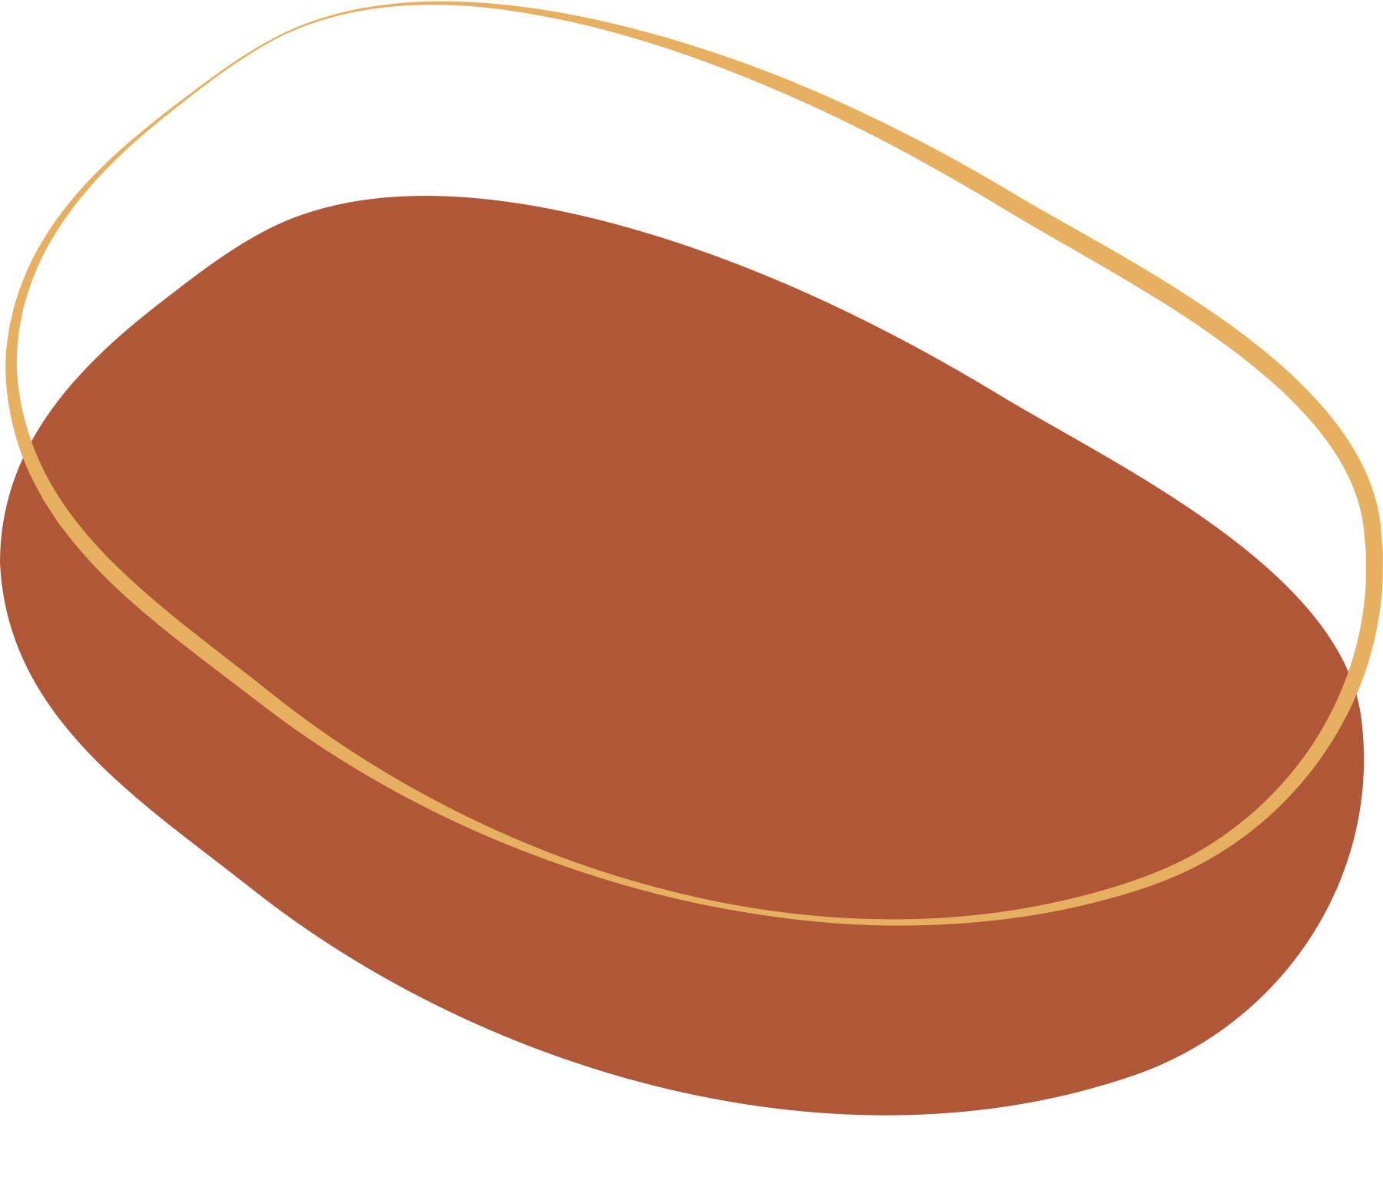

Distribution of Work
Anshi Shah
AU2040087
Rahi Shah
AU2040070
Yesha Dhivar
AU2040215
Kenil Shah
AU2040111
Model Building
Literature Review
Feature Selection
EDA
Model Building
Data Analysis
EDA
Feature Selection
Model Building
Literature Review
Preprocessing
EDA
Model Building
Data Exploration
EDA
Data Visualisation

Slide 16
References
[1] U. o. M. G. P. Paulo Cortez, "UCI Machine Learning Repository," 2009. [Online]. Available:
https://archive.ics.uci.edu/ml/datasets/Wine+Quality.
[2] A. C. F. A. T. M. J. R. Paulo Cortez, "Science Direct," November 2009. [Online]. Available: https://www.sciencedirect.com/science/article/abs/pii/S0167923609001377?via%3Dihub#preview-section-references.
[3] K. A. N. Sunny Kumar, "IEEE Xplore," June 2020. [Online]. Available: https://ieeexplore.ieee.org/abstract/document/9104095.
[4] Wine quality factors from : https://www.jjbuckley.com/wine-knowledge/blog/the-4-factors-and-4-indicators-of-wine-quality/1009

Slide 17


Thank You!

