Slide 1
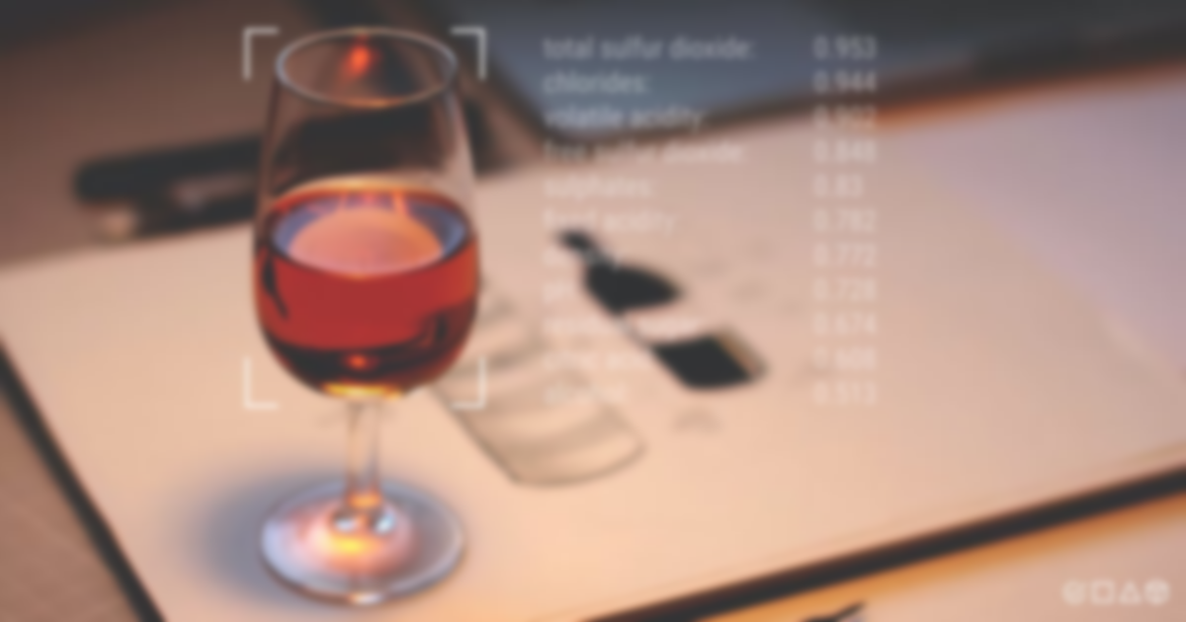
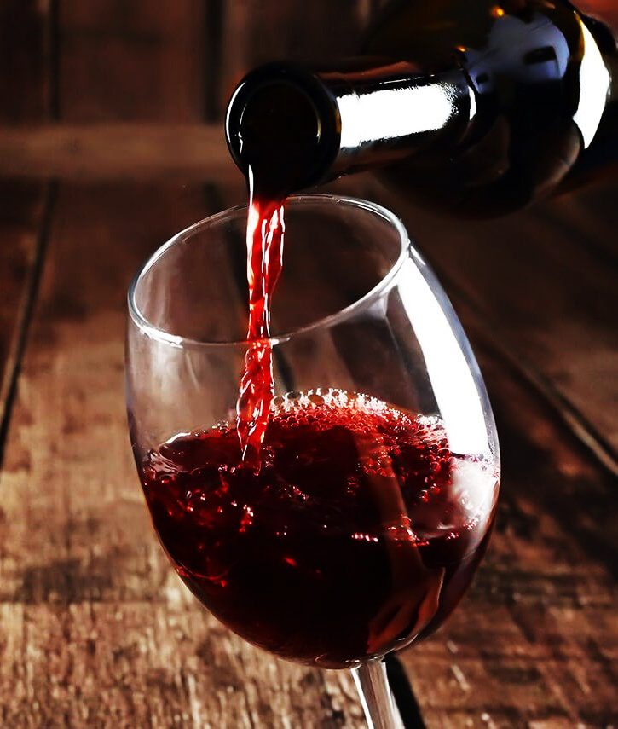
Wine Quality Prediction
Group 3: Good Pointsss
Anshi Shah | AU2040087
Rahi Shah | AU2040070
Kenil Shah | AU2040111
Yesha Dhivar | AU2040215

Slide 2
Introduction
The quality of wine is important for consumers and producers.
Historically, wine quality was determined at the end of production, but with the development of technology and the availability of data, machine learning techniques have been used to determine wine quality in the development phase.
This saves time and money and allows for the tuning of parameters that control wine quality.

Slide 3
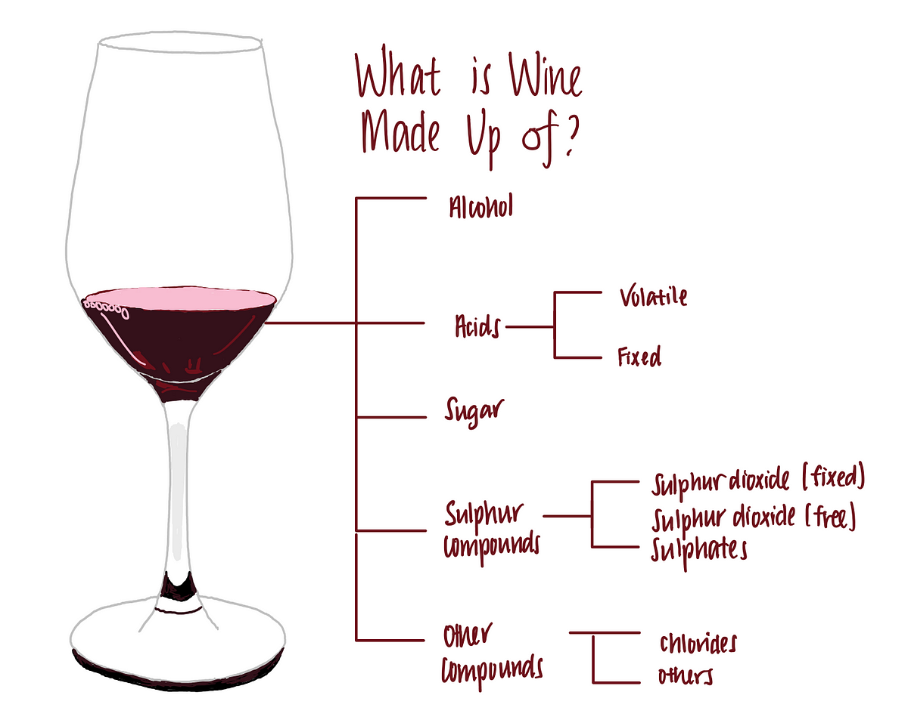
Problem Statement
Machine learning techniques can help wine manufacturers analyze basic parameters that determine wine quality, enabling them to fine-tune the wine's taste during the development process.
The goal of this work is to use machine learning to identify the most significant parameters that control wine quality and predict wine quality based on those parameters.

Slide 4
Existing Body of Work
Red Wine Quality Prediction Using Machine Learning Techniques
By IEEE
Three regression techniques were applied, under a computationally efficient procedure that performs simultaneous variable and model selection. The support vector machine achieved promising results, outperforming the multiple regression and neural network methods.
S. Kumar, K. Agrawal and N. Mandan, "Red Wine Quality Prediction Using Machine Learning Techniques," 2020 International Conference on Computer Communication and Informatics (ICCCI), Coimbatore, India, 2020, pp. 1-6, doi: 10.1109/ICCCI48352.2020.9104095.
Modeling wine preferences by data mining from physicochemical properties
The techniques such as Random Forest, Support Vector Machine and Naïve Bayes are applied. Various measures are calculated and the results are compared among training set and testing set and accordingly the best out of the three techniques depending on the training set results is predicted.
Paulo Cortez, António Cerdeira, Fernando Almeida, Telmo Matos, José Reis,
Modeling wine preferences by data mining from physicochemical properties,
Decision Support Systems,
Volume 47, Issue 4, 2009, Pages 547-553, ISSN 0167-9236,
https://doi.org/10.1016/j.dss.2009.05.016.

Slide 5
Our Approach
Data Exploration
Knowing the features
Null values check
Understanding the nature of the dataset by various statistical analysis
Checking for outliers in the datasets
Data Analysis and Visualisation
Knowing statistical measures
The spread of the ‘Quality Column’
Checking the proportionality of other features w.r.t. ‘Quality’
Correlation Matrix (for feature selection) and checking dependent and independent features
Using catplots and factorplots on various features of the data

Slide 6
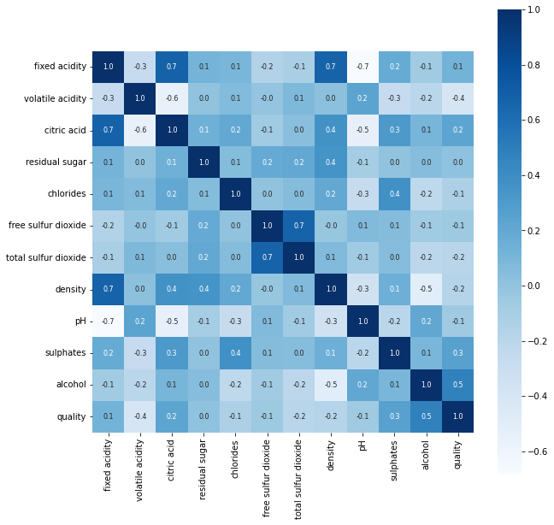
Our Approach
Model Building
Logistic Regression
Feature selection is performed by taking conclusions from the correlation matrix and other plots
The quality values are recoded from 3-9 to ‘0’ or ‘1’ for predicting either good or bad quality
Decision Tree
Here too, the quality column is recoded to ‘0’ or ‘1’ for better and easy results
The predictors again are selected by feature engineering and feature selection
Correlation Matrix of Red Wine

Slide 7
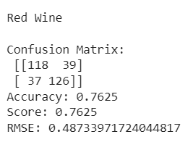
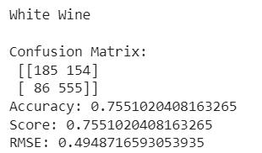
Initial Results
Outputs
Model Building
Logistic Regression
Results:
For Red Wine,
Accuracy = 76% (max)
For White Wine,
Accuracy = 75% (max)

Slide 8
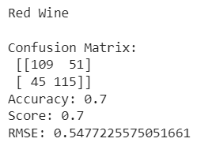
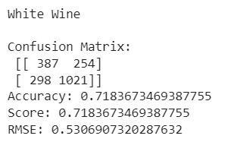
Initial Results
Model Building
Decision Tree
Results:
For Red Wine,
Accuracy = 70% (max)
For White Wine,
Accuracy = 72% (max)
Outputs

Slide 9

Future Work
Distribution of Work:
Anshi
Literature Review, Feature Engineering, Model Building
Yesha
Literature Review, Data Analysis, Model Building
Kenil
Data Exploration, Data Analysis and Visualisation
Rahi
Data Exploration, Preprocessing, Feature selection
For improved performance and results:
Better feature selection (using more hypothesis testing and ANOVA)
Try to measure linear correlation by Pearson correlation coefficient
Feature Scaling
Try to fit and train more models based on K-NN, Random Forest Classifier, and SVM

Slide 10
References
Red Wine Quality Prediction Using Machine Learning Techniques
By IEEE
https://ieeexplore.ieee.org/abstract/document/9104095
Modeling wine preferences by data mining from physicochemical properties
https://www.sciencedirect.com/science/article/abs/pii/S0167923609001377?via%3Dihub#preview-section-references
Prediction of Wine Quality Using Machine Learning Algorithms
https://www.scirp.org/journal/paperinformation.aspx?paperid=107796#ref10
Thank You!

