Slide 1
Restaurant bill management system
Anshika Gupta, Shivansh Sharma
B.Tech 1st year

Slide 2
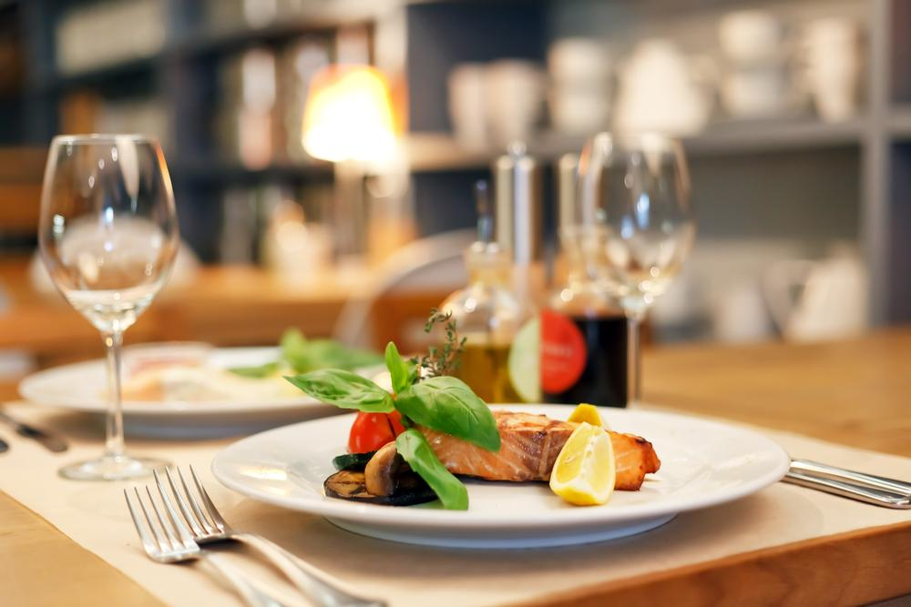
TABLE OF CONTENT
INTRODUCTION
PURPOSE
PROBLEM STATEMENT
SYSTEM REQUIREMENT
TECHNIQUES USED
PROPOSED MODEL
RESULT
COCLUSION AND FUTURE SCOPE

Slide 3
INTRODUCTION
While using this restaurant bill management system, one can easily calculate total bill of the customer.
All you need to do is just fill up the blank boxes with item quantities, some detail of customer and the table number at which they want to eat in restaurant. The program will display your total bill.
This simple program can be used in restaurants, cafe and food truck for calculating bills in a short period of time and it’s not time consuming.
The user of On the Go is now able to Order from listed items on menu. Once the user has ordered the item, the bill is automatically shown to the user.
He/she may pay the amount and the food will be delivered to him/her on their respective tables.

Slide 4
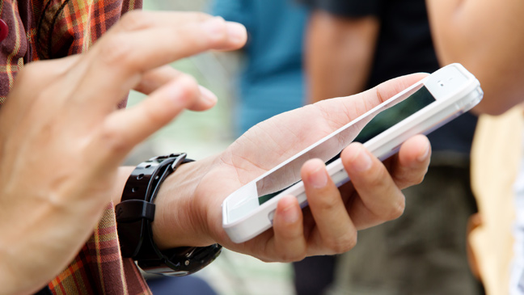
PURPOSE
The main purpose of the online Restaurant Bill Management System is to reach wider range of customers and to educate them about existing and new packages and discounts offered.
One more purpose is to allow user order online and interact direct with every user.
This system reduce time consumption
This System helps the management to know customers order details in few seconds

Slide 5
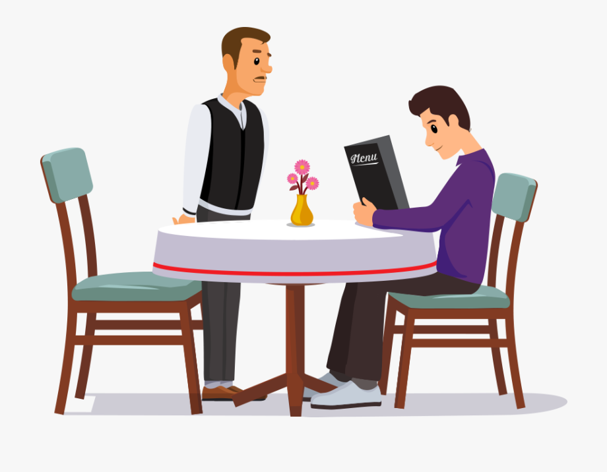
PROBLEM STATEMENT
Over the past years we have been going to the restaurant, waited for the waiter and ordered in a conventional manner and have wasted a lot of time.
There is also limited number of waiters to take the order in a restaurant so the time is wasted there also.
No more waiting for the waiter. It has a functionality to show you the bill after ordering and you can pay the amount.

Slide 6
SYSTEM REQUIREMENT
HARDWARE REQUIREMENT:
Processor intel i5 core generation 8th
SOFTWARE REQUIREMENT:
Python 3.7
Tkinter for GUI (Graphic user inter face) development
OS Module
Random and Math library

Slide 7
TECHNIQUE USED
PYTHON:
Python is an interpreted, high-level and general-purpose programming language. Python's design philosophy emphasizes code readability with its notable use of significant whitespace. Its language constructs and object-oriented approach aim to help programmers write clear, logical code for small and large-scale projects.
TKINTER:
Tkinter is the standard GUI library for Python. Python when combined with Tkinter provides a fast and easy way to create GUI applications. Tkinter provides a powerful object-oriented interface to the Tk GUI toolkit.

Slide 8
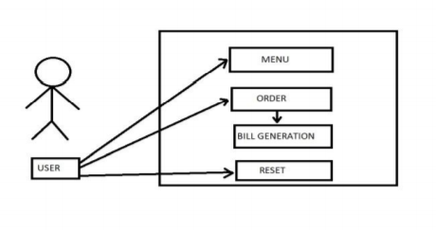
PROPOSED MODEL

Slide 9
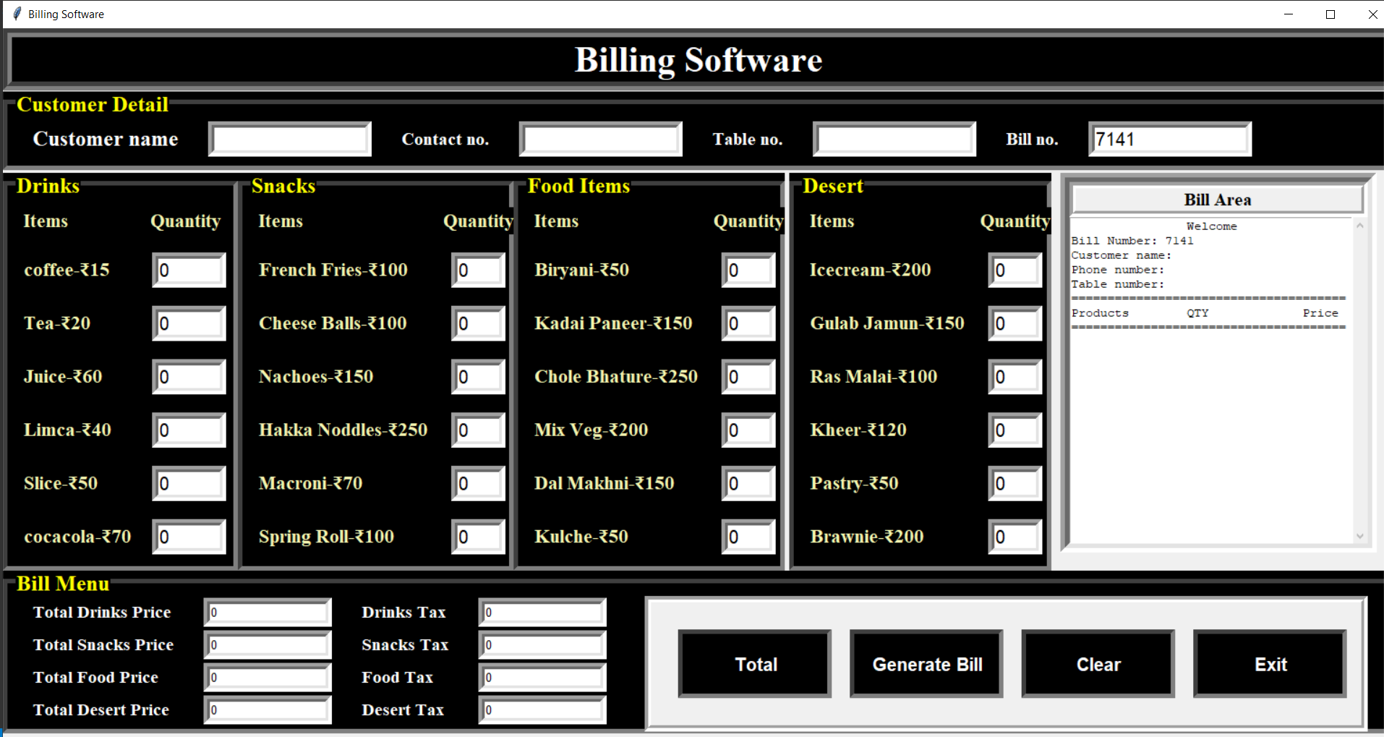
FINAL MODEL

Slide 10
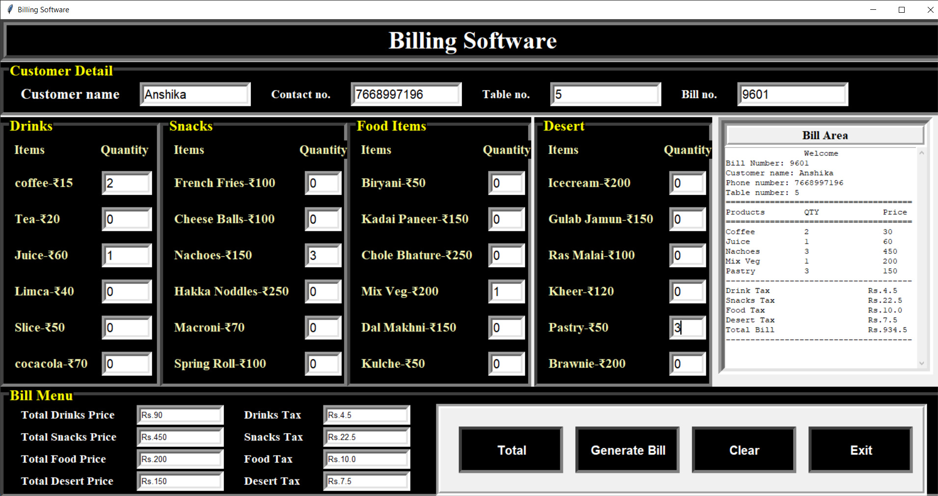

Slide 11
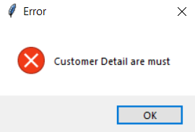
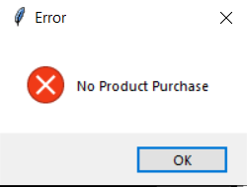
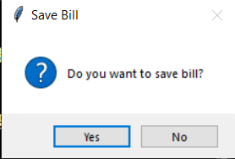
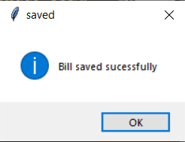
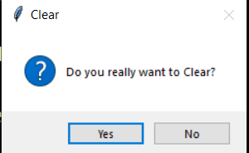
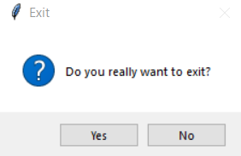
SOME POP UPS
Generate bill
Clear Button
Exit Button

Slide 12
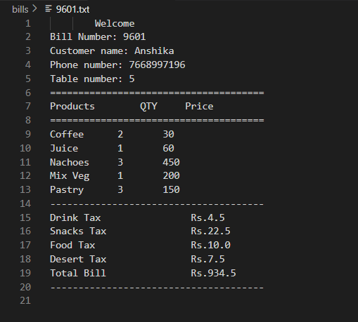
Data Save in internal database

Slide 13
CONCLUSION AND FUTURE SCOPE
By this we can directly place the order from our mobile phones and hence save a lot of time.
Also, the software used in this project, python is a flexible language which can run in any type of system.
It is user friendly and very easy to use. We are further going to implement this program in android platform so that this program can be installed in mobile phones. Majority of people use phones so this would be beneficial.
We can use more features in it according to the need of the restaurants in future.

Slide 14
THANK YOU…

