Slide 1


SMART INDIA HACKATHON 2025
TITLE PAGE
Problem Statement ID - SIH25020
Problem Statement Title- Development of indigenous contactless Integrated Track Monitoring Systems (ITMS) for Track Recording on Indian Railways
Theme- Smart Automation
PS Category- Hardware
Team ID-
Team Name - IronLogic

Slide 2
Development of indigenous contactless Integrated Track Monitoring Systems (ITMS) for Track Recording on Indian Railways
IRONLOGIC
Proposed Solution:
A contactless system to check railway tracks using LiDAR, cameras, and sensors.
Can be mounted on normal trains for continuous monitoring.
Uses AI + IoT to analyze data and detect problems early.
GPS mapping gives the exact location of faults.
Provides real-time alerts on a dashboard and mobile app.

Slide 3
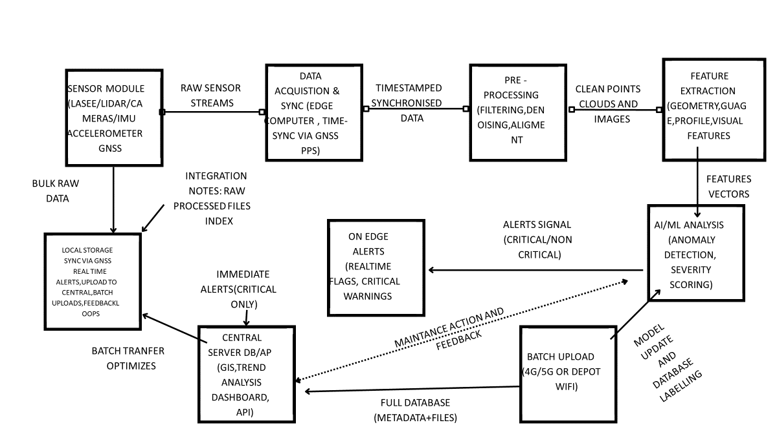
TECHNICAL APPROACH
IRONLOGIC

Slide 4
FEASIBILITY AND VIABILITY
IRONLOGIC
Feasibility:
Sensor Integration:
LiDAR for high-resolution, contactless rail profile, wear, and infringement measurement (accuracy ≤1 mm).
IMU & Accelerometers for real-time vertical and lateral acceleration monitoring, ensuring compliance with EN 13848 ride comfort parameters.
GPS + Axle Encoder for precise chainage mapping, location referencing, and synchronization of measurement data.
Real-time Data Acquisition:
Sampling at 25 cm intervals, operable up to 200 km/h under dynamic conditions.
Onboard server for noise filtering, data fusion, and real-time analysis.
Viability:
Cost-effective alternative to imported systems by using indigenous hardware & modular open-source software.
Scalable & Upgradable: Modular subsystems (track geometry, rail wear, video monitoring) allow phased implementation.
Maintainability: Standard off-the-shelf components with easy calibration and servicing.

Slide 5
IMPACT AND BENEFITS
IRONLOGIC
Impacts:
Contactless track monitoring for safer & efficient operations
Safer journeys with reduced risk of derailments & delays
Indigenous solution reducing reliance on costly foreign systems, supporting Atmanirbhar Bharat
Benefits:
Reduced maintenance costs, fewer delays, reduced imports
Helps to boost the local innovation & employment

Slide 6
RESEARCH AND REFERENCES
IRONLOGIC
EN 13848-1 & 2: Railway applications – Track geometry quality.
RDSO Specification TM/IM/448, Rev. 1: 2023.
Xu et al., “Railway track inspection using LiDAR and IMU sensor fusion,” IEEE Trans. Intell. Transp. Syst., 2021.
Indian Railways, R&D initiatives on Track Monitoring Systems, RDSO, 2023 write the main title and one line for each point
The New Indian Express
MillenniumPost

