Slide 1

MSc. Project Presentation
MACHINE LEARNING FOR BIG MART SALES PREDICTION
Machine learning for digital Humanities
By:- Anshika Kashyap Roll no.:- M23ID1012
MSc:- Digital Humanities (DH)
Date:- 05-03-2025

Slide 2
Introduction
Problem Statement: Why is sales prediction important?
Retailers need to optimize inventory and pricing strategies.
Accurate forecasts help in better resource allocation.
Dataset Overview:
Number of records: 8,523 rows
Features available: 12 columns including item attributes and outlet characteristics.
Target variable: Item Outlet Sales
Business Use Case:
Helps stores understand which products will sell more.
Reduces wastage by optimizing stock.
Enhances profit margins by identifying trends.

Slide 3
Data Exploration & Preprocessing :Fit the data
Initial Data Insights:
Exploratory Data Analysis (EDA) to find missing values, outliers, and distributions.
Key observations:
Item visibility contains zero values (which is unrealistic).
Some outlet sizes are missing.
Handling Missing Data:
Item Visibility Correction: Replacing zeros with the mean visibility per item.
Filling Missing Outlet Sizes: Using mode based on outlet type.
Feature Engineering:
Created "Outlet Age" by subtracting the establishment year from the current year.
Derived "Item Type Combined" by grouping similar categories.
Categorical Encoding:
Used One-Hot Encoding for nominal variables.
Used Label Encoding for ordinal variables.
Data Normalization/Scaling (if used):
Applied Min-Max Scaling to normalize price-related features.

Slide 4
Model Training & Code Walkthrough
Data Splitting:
Used an 80-20 split for training and testing.
Stratified sampling was used to maintain class balance.
Model Implementation in Python:
Library used: Scikit-learn, XGBoost, Pandas, NumPy
Steps:
Data preprocessing pipeline
Feature selection
Model training with hyperparameter tuning
Performance evaluation
Hyperparameter Tuning:
Used GridSearchCV to optimize XGBoost parameters like:
Learning rate
Number of estimators
Max depth
Achieved a 10% improvement in RMSE after tuning.

Slide 5
Algorithms Tested:
Neural Network
Support Vector Machine
Decision Tree Regressor
Random Forest Regression
XGBoost Regressor (Gradient Boosting)
AdaBoost Regressor
Linear Regression

Slide 6
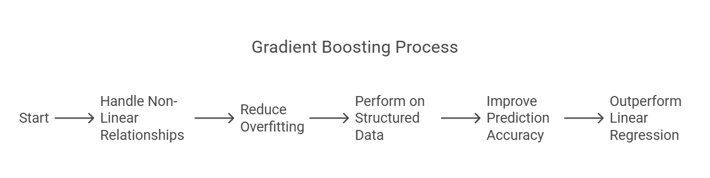
ALGORITHM USED? : GRADIENT BOOSTING REGRESSOR

Slide 7
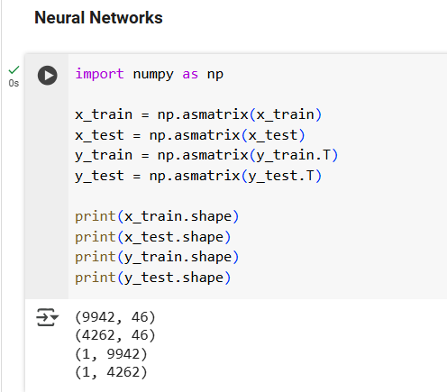
1. Neural Network

Slide 8
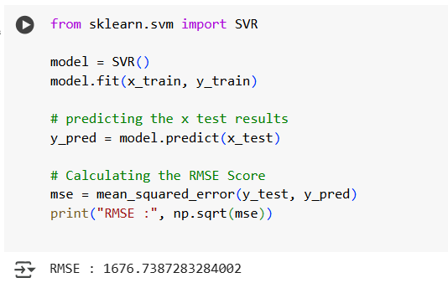
2. Support Vector machine

Slide 9
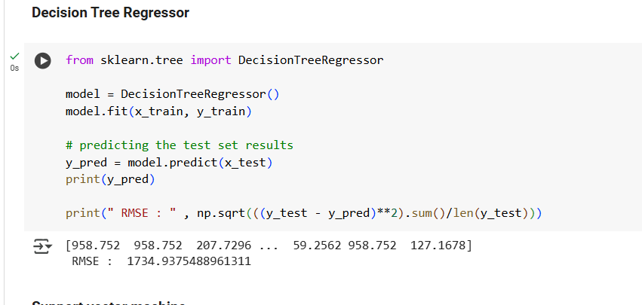
3. Decision tree regressor

Slide 10
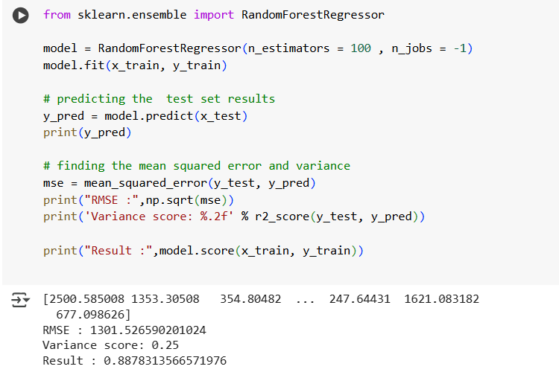
4. Random Forest Regression

Slide 11
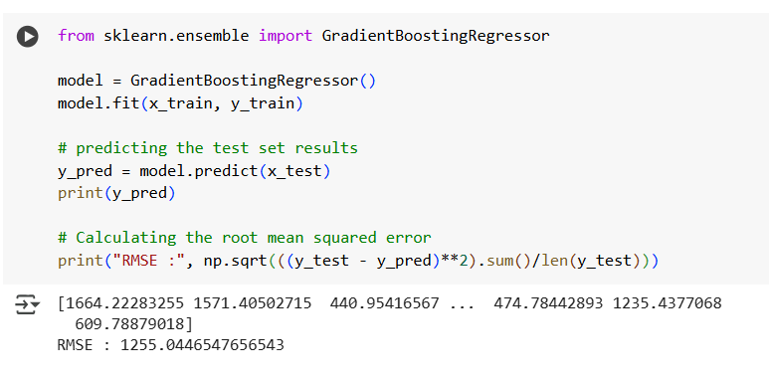
5. XgBoost Regressor

Slide 12
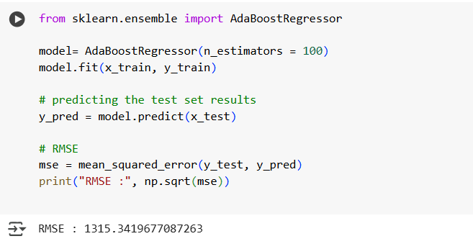
6. AdaBoost Regressor

Slide 13
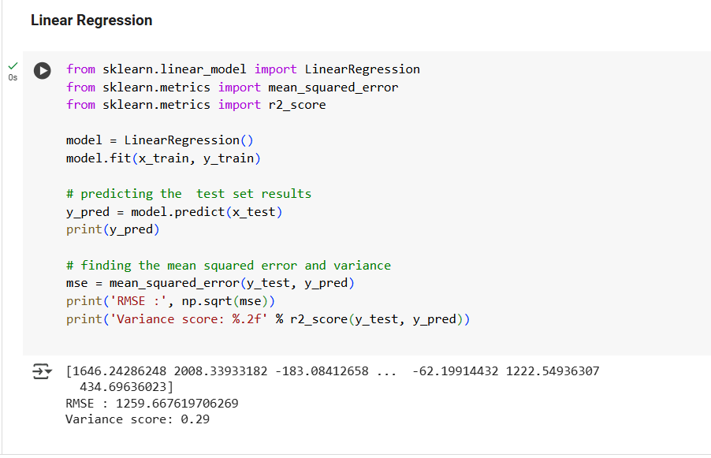
7. Linear Regression

Slide 14
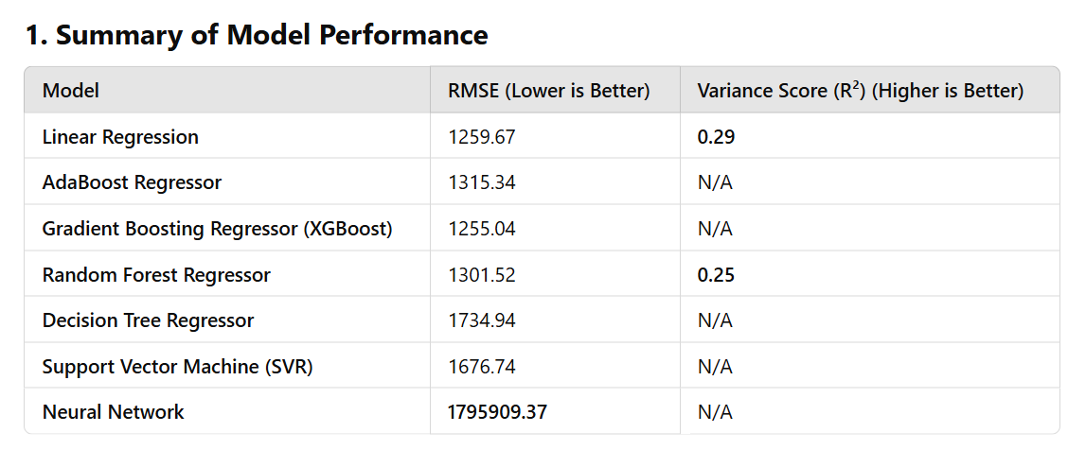
Model Performance & Evaluation
Evaluation Metrics:
(RMSE)
R-Squared Score

Slide 15
Algorithm Selection
Why XGBoost?
Achieved the lowest RMSE score (1255.04), indicating better accuracy.
Handles missing values effectively.
Works well with tabular data.
Feature importance analysis shows it captures key patterns.
Why not other models?
Decision Tree: Overfits the training data.
Neural Network: Requires a large dataset for effective training.
Linear Regression: Assumes linearity, which isn't always the case for sales.
Random Forest: Performed well but slightly worse than XGBoost

Slide 16
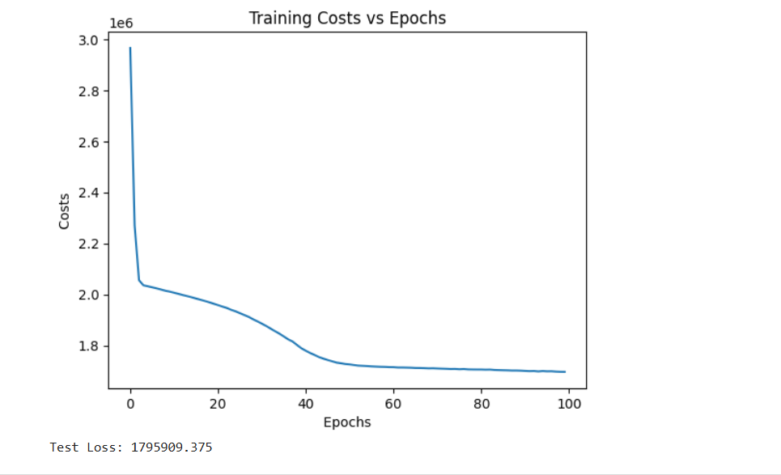
RESULT VISUALIZATION

Slide 17
Business Insights & Future Work
Key Business Findings:
Outlet type affects sales: Supermarkets have higher sales than grocery stores.
Item visibility matters: Products with lower visibility tend to be undersold.
Outlet location type has an impact: Urban outlets show higher revenue.
Future Improvements:
Deep Learning Approaches: Try LSTM or CNN for time-series forecasting.
Real-Time Data Integration: Incorporate live sales data for dynamic predictions.
External Factors: Consider holidays, inflation, and weather impact on sales.
Automate Hyperparameter Optimization: Use Bayesian Optimization instead of Grid Search.

