Slide 1
Java Beans

Slide 2
Contents
What is a Java Bean?
Advantages
Properties
Bean Developers Kit (BDK)
What makes Bean possible?
Support for Java Bean

Slide 3
What is Java Bean? ...
“A Java Bean is a reusable software component that can be manipulated visually in a builder tool.”
JavaBeans is a portable, platform-independent component model written in the Java programming language, developed in collaboration with industry leaders.
It enables developers to write reusable components once and run them anywhere -- benefiting from the platform-independent power of Java technology.
The goal of JavaBeans is to create a system whereby application developers can take a set of beans from a stock library and wire them together to make a full application
The JavaBeans Specs are available at http://java.sun.com/products/javabeans/docs/

Slide 4
Advantages of Java Beans
It obtains all the benefits of Java “write-once, run-anywhere (WORA)” paradigm.
The properties, events and methods of a bean that are exposed to an application builder tool can be controlled.
A Bean may be designed to operate correctly in different environment, which makes it useful in global market.
The configuration settings of a Bean can be saved in persistent storage and restored at a later time.
A Bean may register to receive events from other objects and can generate events that are sent to other objects.

Slide 5
Features of JavaBeans
Support for introspection
so that a builder tool can analyze how a bean works
Support for customization
so that when using an application builder a user can customize the appearance and behavior of a bean
Support for events
as a simple communicator than can be used to connect up beans
Support for properties
both for customization and for programmatic use
Support for persistence
so that a bean can be customized in an application builder and then have its customized state saved away and reloaded later

Slide 6
Types of Bean application builder tools
Sun provides two Bean application builder tools:-
Bean Developer Kit (BDK)-BeanBox compatible with ealier version of Java 2, version 1.4.
Bean Builder- compatible with Java 2, version 1.4 or later.

Slide 7
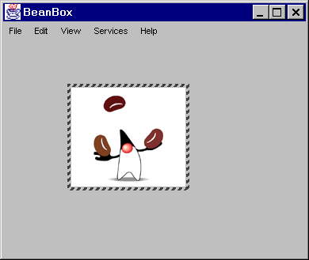
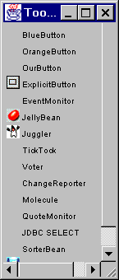
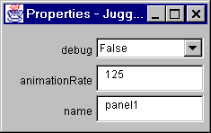
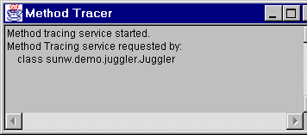
Bean Developer Kit (BDK) Visually Manipulated, Builder Tools
ToolBox
BeanBox
Property Sheet
Method Tracer

Slide 8
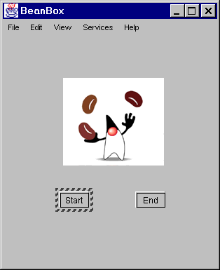
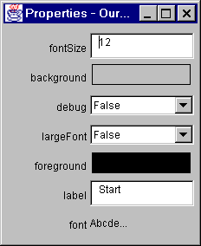
Bean Developer Kit (BDK)...

Slide 9
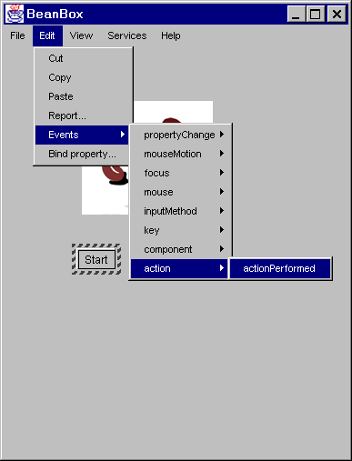
Selecting the events

Slide 10
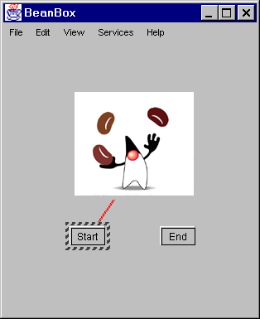
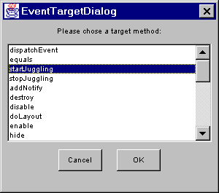
Attaching Events

Slide 11
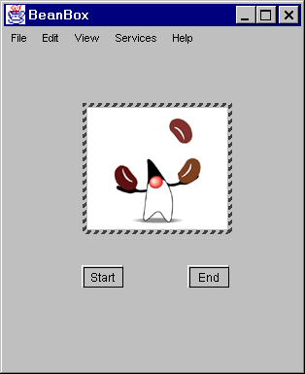
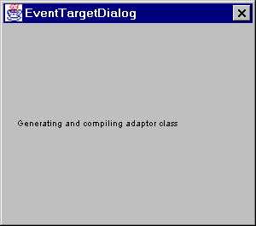
Generating Adapter...

Slide 12
Types of files use
Java Archive(JAR) files:- A JAR files allows us to efficiently deploy a set of classes and their associated resources.
Manifest files:- A developer must provide a manifest file to indicate which components in a JAR file are Java Beans.

Slide 13
What makes this possible?
Properties
Persistence
Introspection
Customization
Events.

Slide 14
Properties
Attributes.
Can be read/write, read-only or write-only.
Several types of properties:
Simple
Boolean
Indexed.

Slide 15
Constructors
Simple Properties public T getN() public void setN( T value)
Boolean Properties public boolean isN() public boolean getN() public void setN(boolean value)
Indexed Properties public T getN(int index) public T[] getN() public void setN(int index, T value) public void setN(T[] values)
Here N is the name of the property
and T is its type.

Slide 16
Introspection
A mechanism that allows the builder tool to analyze a bean to determine its capacities.
Two ways to analyze a bean:
low-level reflection APIs.
vendor provided explicit information (Customization).
Application builder will provide default BeanInfo class.

Slide 17
Persistence
Allows the graphical builder to recall the state of a bean.
writeObject and readObject
Allows the customization of objects.
Appearance and behavior can be stored and recalled.

Slide 18
Customization
Similar to Introspection.
Develop your own <classname>BeanInfo class which extends SimpleBeanInfo.
Develop your own <classname>Editor class which extends PropertyEditorSupport to custom build your property editor.

Slide 19
Events
Two types of objects are involved:
“Source” objects.
“Listener” objects.
Based on registration.
Makes use of parametric polymorphism.

Slide 20
Events
Message sent from one object to another.
Sender fires event, recipient (listener) handles the event
There may be many listeners.
Event
source
Register listener
Fire event
Event
listener
Event
Object

Slide 21
Support
BDK & Bean Builder - Sun
NetBeans – www.netbeans.org
Jbuilder - Inprise
Visual Age for Java - IBM
Visual Cafe - Symantec Corporation
JDeveloper Suite - Oracle

Slide 22
Conclusion
Easy to use.
Difficult to build.
Like all OO design, needs careful planning.
Similar to the String library in C++.
Wide selection of JavaBeans in the future.

Slide 23
THANKS

