Slide 1
SERVLET

Slide 2
SERVLET
Java Servlets are the programs that run on a web Application Server.
It acts as a middle layer between a request from web browser /client and database/application on HTTP Server

Slide 3
SERVLET
Servlets are generic extensions to Java-enabled servers
Servlets are secure, portable, and easy to use.
Servlet is a dynamically loaded module that services requests from a Web server
Because the servlet is running on the server side, it does not depend on browser compatibility.

Slide 4
SERVLET
Servlet can be described in many ways, depending on the context.
Servlet is a technology which is used to create a web application.
Servlet is an API that provides many interfaces and classes including documentation.
Servlet is an interface that must be implemented for creating any Servlet.
Servlet is a class that extends the capabilities of the servers and responds to the incoming requests. It can respond to any requests.
Servlet is a web component that is deployed on the server to create a dynamic web page.

Slide 5
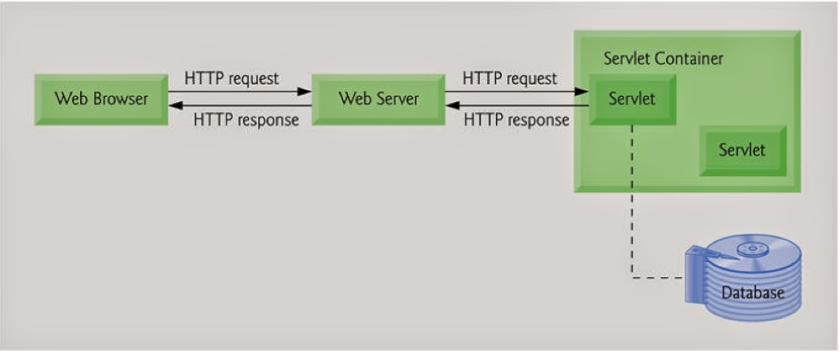
Servlet Architecture

Slide 6
Servlet Architecture
Read explicit data sent by client (form data)
Read implicit data sent by client (request headers)
Generate the results
Send the explicit data back to client (HTML)
Send the implicit data to client (status codes and response headers)

Slide 7
Servlet Architecture
In servlet for a session if multiple request are there, then a single process is created and inside that process different threads are created.
Whenever a servlet container calls a servlet, a thread is created.
Init() and destroy() methods are directly called by the servlet container, whereas service() is called by threads.

Slide 8
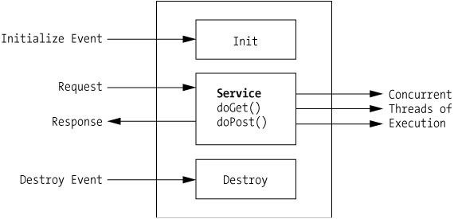
Servlet Life Cycle

Slide 9
Init( )
Contains all information code for servlet and is invoked when the servlet is first loaded.
The init( ) does not require any argument , returns a void and throws Servlet Exception.

Slide 10
Init( )
Called once
Public void init() throws ServletException

Slide 11
Service( )
It is called by the Servlet container after the init method to allow the servlet to respond to a request.
Receives the request from the client and identifies the type of request and deligates them to doGet( ) or doPost( ) for processing.
Public void service(ServletRequest request,ServletResponce response) throws ServletException, IOException

Slide 12
doGet() and doPost()
Based on HTTP request type(Get or Post) following methods are called:
Public void doGet(ServletRequest request,ServletResponce response) throws ServletException, IOException
Public void doPost(ServletRequest request,ServletResponce response) throws ServletException, IOException

Slide 13
Service( )
If services() are both for get and post methods.
So if u want to use post method in html page, we use doPost() or services() in servlet class.
if want to use get methods in html page,we can use doGet() or services() in servlet calss.
Finally destory() is used to free the object.

Slide 14
Destroy( )
The Servlet Container calls the destroy( ) before removing a Servlet Instance from Service.
Executes only once when the Servlet is removed from Server.
Called once
Public void destroy( )

Slide 15
Types of Servlets
Generic Servlets
– Must extend javax.servlet.Servlet
– Protocol-independent
• HTTP Servlets
– Must extend javax.servlet.http.HttpServlet
– Handling HTTP request/reply

Slide 16
Example
import java.io.*;
import javax.servlet.*;
import javax.servlet.http.*;
public class HelloWorld extends HttpServlet
{
private String message;
public void init() throws ServletException
{
// Do required initialization
message = "Hello World";
}

Slide 17
Example
public void doGet(HttpServletRequest request, HttpServletResponse response) throws ServletException, IOException
{
// Set response content type
response.setContentType("text/html");
// Actual logic goes here
PrintWriter out = response.getWriter();
out.println("<h1>" + message + "</h1>");
}

Slide 18
Example
public void destroy() {
// do nothing.
}
}

Slide 19
Compiling a Servlet
javac HelloWorld.java
If everything goes fine, above compilation would produce HelloWorld.class file in the same directory

Slide 20
Servlet Deployment
Copy your Java program in <Tomcat-installationdirectory>/webapps/ROOT directory
And copy .class file in <Tomcat-installationdirectory>/webapps/ROOT/WEB-INF/classes

Slide 21
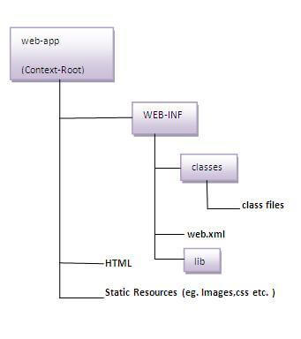
Deployment Descriptor (web.xml)
The deployment descriptor is an xml file, from which Web Container gets the information about the servlet to be invoked.
The web container uses the Parser to get the information from the web.xml file. There are many xml parsers such as SAX, DOM etc.
Type to enter a caption.

Slide 22
Deployment Descriptor (web.xml)
<servlet>
<servlet-name>Hello</servlet-name>
(Internal alias name)
<servlet-class>HelloServlet</servlet-class>
(Actual Servlet name)
</servlet>
<servlet-mapping>
<servlet-name>Hello</servlet-name>
(Internal alias name)
<url-pattern>/HelloWorld</url-pattern>
(External alias name)
</servlet-mapping>

Slide 23
web.xml
Entries shown in previous slide are to be created inside <web-app>...</web-app> tags available in web.xml file.
Finally,
type http://localhost:8080/HelloWorld in the browser's address box

Slide 24
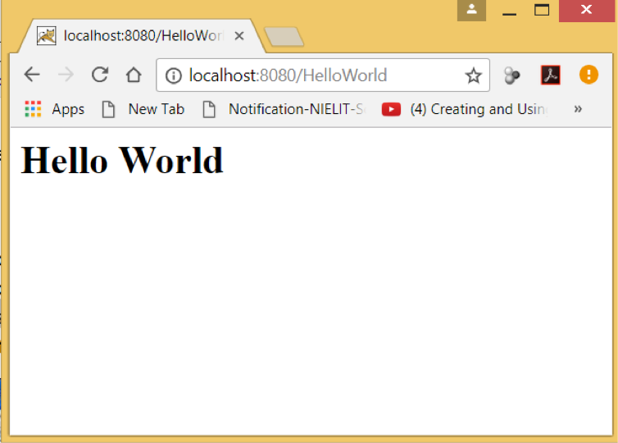
OUTPUT

Slide 25
Reading Form Data using Servlet
Servlets handles form data parsing automatically using the following methods depending on the situation −
getParameter() − You call request.getParameter() method to get the value of a form parameter.
getParameterValues() − Call this method if the parameter appears more than once and returns multiple values, for example checkbox.
getParameterNames() − Call this method if you want a complete list of all parameters in the current request.

Slide 26
HelloForm.java
// Import required java libraries
import java.io.*;
import javax.servlet.*;
import javax.servlet.http.*;
public class HelloForm extends HttpServlet {
public void doGet(HttpServletRequest request, HttpServletResponse response)
throws ServletException, IOException {
// Set response content type
response.setContentType("text/html");
PrintWriter out = response.getWriter();
String title = "Using GET Method to Read Form Data";

Slide 27
HelloForm.java
out.println( "<html>\n" +
"<head><title>" + title + "</title></head>\n" +
"<body bgcolor = \"#f0f0f0\">\n" +
"<h1 align = \"center\">" + title + "</h1>\n" +
"<ul>\n" +
" <li><b>First Name</b>: "
+ request.getParameter("first_name") + "\n" +
" <li><b>Last Name</b>: "
+ request.getParameter("last_name") + "\n" +
"</ul>\n" +
"</body>
</html>"
);
}
}

Slide 28
Hello.html
<html>
<body>
<form action = "HelloForm" method = "GET">
First Name: <input type = "text" name = "first_name">
<br />
Last Name: <input type = "text" name = "last_name" />
<input type = "submit" value = "Submit" />
</form>
</body>
</html>

Slide 29
Web.xml
<servlet>
<servlet-name>HelloForm</servlet-name>
<servlet-class>HelloForm</servlet-class>
</servlet>
<servlet-mapping>
<servlet-name>HelloForm</servlet-name>
<url-pattern>/HelloForm</url-pattern>
</servlet-mapping>

Slide 30
Advantages of Servlets
Efficiency
More efficient – uses lightweight java threads as opposed to individual processes
Portability
Since servlets are written in Java, they are platform independent
Robustness
Error handling, Garbage collector to prevent problems with memory leaks
Large class library – network, file, database, distributed object components, security, etc.

Slide 31
Advantages of Servlets
Extensibility
Creating new subclasses that suite your needs
Inheritance, polymorphism, etc.
Powerful
Servlets can directly talk to web server
Facilitates database connection pooling, session tracking etc.

Slide 32
Servlets Packages
The javax.servlet package contains many interfaces and classes that are used by the servlet or web container. These are not specific to any protocol.
The javax.servlet.http package contains interfaces and classes that are responsible for http requests only.

Slide 33
Interfaces in javax.servlet package
Servlet
ServletRequest
ServletResponse
RequestDispatcher
ServletConfig
ServletContext
SingleThreadModel
Filter
FilterConfig
FilterChain
ServletRequestListener
ServletRequestAttributeListener
ServletContextListener
ServletContextAttributeListener

Slide 34
Classes in javax.servlet package
GenericServlet
ServletInputStream
ServletOutputStream
ServletRequestWrapper
ServletResponseWrapper
ServletRequestEvent
ServletContextEvent
ServletRequestAttributeEvent
ServletContextAttributeEvent
ServletException
UnavailableException

Slide 35
Interfaces in javax.servlet.http package
HttpServletRequest
HttpServletResponse
HttpSession
HttpSessionListener
HttpSessionAttributeListener
HttpSessionBindingListener
HttpSessionActivationListener
HttpSessionContext (deprecated now)

Slide 36
Classes in javax.servlet.http package
HttpServlet
Cookie
HttpServletRequestWrapper
HttpServletResponseWrapper
HttpSessionEvent
HttpSessionBindingEvent
HttpUtils (deprecated now)

Slide 37
Servlet API
All interfaces and classes mentioned in previous slide also known as Servlet APIs

Slide 38
Example (login.html)
<form action="login" method="post">
<table>
<tr>
<td><font face="verdana" size="2px">Name:</font></td>
<td><input type="text" name="userName"></td>
</tr>
<tr>
<td><font face="verdana" size="2px">Password:</font></td>
<td><input type="password" name="userPassword"></td>
</tr>
</table>
<input type="submit" value="Login">
</form>

Slide 39
OnServletLogin.java
import java.io.*;
import javax.servlet.*;
import javax.servlet.http.*;
public class OnServletLogin extends HttpServlet
{
protected void doPost(HttpServletRequest req,HttpServletResponse res)throws ServletException,IOException
{
PrintWriter pw=res.getWriter();
res.setContentType("text/html");
String user=req.getParameter("userName");
String pass=req.getParameter("userPassword");
if(user.equals("om")&&pass.equals("123456"))
pw.println("Login Success...!");
else
pw.println("Login Failed...!");
pw.close();
}
}

Slide 40
web.xml
<?xml version="1.0" encoding="UTF-8"?>
<web-app xmlns:web="http://java.sun.com/xml/ns/javaee/web-app_2_5.xsd">
<servlet>
<servlet-name>loginServlet</servlet-name>
<servlet-class>java4s.OnServletLogin</servlet-class>
</servlet>
<servlet-mapping>
<servlet-name>loginServlet</servlet-name>
<url-pattern>/login</url-pattern>
</servlet-mapping>
<welcome-file-list>
<welcome-file>index.html</welcome-file>
</welcome-file-list>
</web-app>

Slide 41
Session Tracking in Servlets
Session simply means a particular interval of time.
Session Tracking is a way to maintain state (data) of an user. It is also known as session management in servlet.
Http protocol is a stateless so we need to maintain state using session tracking techniques. Each time user requests to the server, server treats the request as the new request. So we need to maintain the state of an user to recognize to particular user.

Slide 42
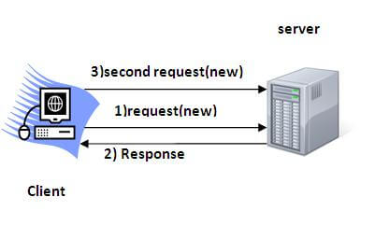
Session Tracking in Servlets
HTTP is stateless that means each request is considered as the new request. It is shown in the figure given below:
Why use Session Tracking?
To recognize the user It is used to recognize the particular user.

Slide 43
Session Tracking Technique
There are four techniques used in Session tracking:
Cookies
Hidden Form Field
URL Rewriting
HttpSession

Slide 44
1)Cookies in Servlet
A cookie is a small piece of information that is persisted between the multiple client requests.
A cookie has a name, a single value, and optional attributes such as a comment, path and domain qualifiers, a maximum age, and a version number.

Slide 45
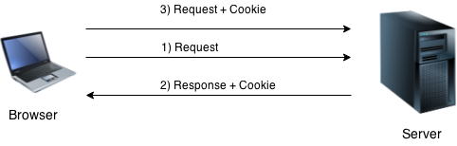
How Cookie works
By default, each request is considered as a new request. In cookies technique, we add cookie with response from the servlet. So cookie is stored in the cache of the browser. After that if request is sent by the user, cookie is added with request by default. Thus, we recognize the user as the old user.
Type to enter a caption.

Slide 46
Types of Cookie
There are 2 types of cookies in servlets.
Non-persistent cookie
Persistent cookie
Non-persistent cookie
It is valid for single session only. It is removed each time
when user closes the browser.
Persistent cookie
It is valid for multiple session . It is not removed each time when user closes the browser. It is removed only if user logout or signout.

Slide 47
Cookie class
javax.servlet.http.Cookie class provides the functionality of using cookies. It provides a lot of useful methods for cookies.
Constructor of Cookie class
Constructor & Description:-
Cookie()-constructs a cookie.
Cookie(String name, String value)-constructs a cookie with a specified name and value.
Useful Methods of Cookie class-There are given some commonly used methods of the Cookie class.
Method & Description
public void setMaxAge(int expiry)-Sets the maximum age of the cookie in seconds.
public String getName()-Returns the name of the cookie. The name cannot be changed after creation.
public String getValue()-Returns the value of the cookie.
public void setName(String name)-changes the name of the cookie.
public void setValue(String value)-changes the value of the cookie.

Slide 48
Advantages and Disadvantages of Cookies
Advantage of Cookies
Simplest technique of maintaining the state.
Cookies are maintained at client side.
Disadvantage of Cookies
It will not work if cookie is disabled from the browser.
Only textual information can be set in Cookie object.

Slide 49
SERVLET COOKIES
<html>
<body>
<form action = "HelloForm" method = "GET">
First Name: <input type = "text" name = "first_name">
<br />
Last Name: <input type = "text" name = "last_name" />
<input type = "submit" value = "Submit" />
</form>
</body>
</html>

Slide 50
Setting Cookies with Servlet
// Import required java libraries
import java.io.*;
import javax.servlet.*;
import javax.servlet.http.*;
// Extend HttpServlet class
public class HelloForm extends HttpServlet {
public void doGet(HttpServletRequest request, HttpServletResponse response)
throws ServletException, IOException {

Slide 51
Setting Cookies with Servlet
// Create cookies for first and last names.
Cookie firstName = new Cookie("first_name", request.getParameter("first_name"));
Cookie lastName = new Cookie("last_name", request.getParameter("last_name"));
// Set expiry date after 24 Hrs for both the cookies.
firstName.setMaxAge(60*60*24);
lastName.setMaxAge(60*60*24);
// Add both the cookies in the response header.
response.addCookie( firstName );
response.addCookie( lastName );

Slide 52
Setting Cookies with Servlet
PrintWriter out = response.getWriter();
String title = "Setting Cookies Example";

Slide 53
Setting Cookies with Servlet
out.println(
"<html>\n" +
"<head>
<title>" + title + "</title>
</head>\n" +
"<body bgcolor = \"#f0f0f0\">\n" +
"<h1 align = \"center\">" + title + "</h1>\n" +
"<ul>\n" +
" <li><b>First Name</b>: "
+ request.getParameter("first_name") + "\n" +
" <li><b>Last Name</b>: "
+ request.getParameter("last_name") + "\n" +
"</ul>\n" +
"</body>
</html>"
);
}
}

Slide 54
Reading Cookies with Servlet
// Import required java libraries
import java.io.*;
import javax.servlet.*;
import javax.servlet.http.*;
// Extend HttpServlet class
public class ReadCookies extends HttpServlet {
public void doGet(HttpServletRequest request, HttpServletResponse response) throws ServletException, IOException {

Slide 55
Reading Cookies with Servlet
Cookie cookie;
Cookie cookies[] = null;
// Get an array of Cookies associated with this domain
cookies = request.getCookies();
PrintWriter out = response.getWriter();
String title = "Reading Cookies Example";

Slide 56
Reading Cookies with Servlet
out.println("<html>\n" +
"<head><title>" + title + "</title></head>\n" +
"<body bgcolor = \"#f0f0f0\">\n" );
if( cookies != null ) {
out.println("<h2> Found Cookies Name and Value</h2>");
for (int i = 0; i < cookies.length; i++) {
cookie = cookies[i];
out.print("Name : " + cookie.getName( ) + ", ");
out.print("Value: " + cookie.getValue( ) + " <br/>");
}
}

Slide 57
Reading Cookies with Servlet
else {
out.println("<h2>No cookies founds</h2>");
}
out.println("</body>");
out.println("</html>");
}
}

Slide 58
OUTPUT
Found Cookies Name and Value
Name : first_name, Value: John
Name : last_name, Value: Player

Slide 59
2) Hidden Form Field
In case of Hidden Form Field a hidden (invisible) textfield is used for maintaining the state of an user.
In such case, we store the information in the hidden field and get it from another servlet. This approach is better if we have to submit form in all the pages and we don't want to depend on the browser.
Let's see the code to store value in hidden field.
<input type="hidden" name="uname" value="om">
Here, uname is the hidden field name and om is the hidden field value.
Real application of hidden form field
It is widely used in comment form of a website. In such case, we store page id or page name in the hidden field so that each page can be uniquely identified.

Slide 60
Advantage & Disadvantage of Hidden Form Field
Advantage of Hidden Form Field:
It will always work whether cookie is disabled or not.
Disadvantage of Hidden Form Field:
It is maintained at server side.
Extra form submission is required on each pages.
Only textual information can be used.

Slide 61
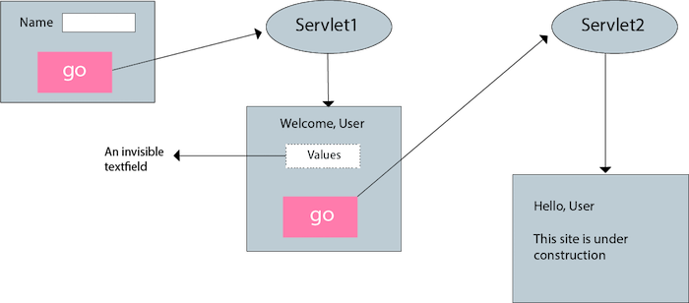
Example of using Hidden Form Field
Type to enter a caption.

Slide 62
3)URL Rewriting
In URL rewriting, we append a token or identifier to the URL of the next Servlet or the next resource. We can send parameter name/value pairs using the following format:
url?name1=value1&name2=value2&??
A name and a value is separated using an equal = sign, a parameter name/value pair is separated from another parameter using the ampersand(&).
When the user clicks the hyperlink, the parameter name/value pairs will be passed to the server. From a Servlet, we can use getParameter() method to obtain a parameter value.

Slide 63
Advantage & Disadvantage of URL Rewriting
Advantage of URL Rewriting
It will always work whether cookie is disabled or not (browser independent).
Extra form submission is not required on each pages.
Disadvantage of URL Rewriting
It will work only with links.
It can send Only textual information.

Slide 64
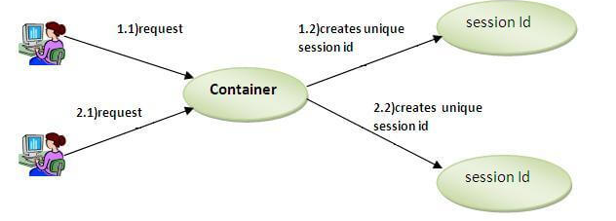
4) HttpSession interface
In such case, container creates a session id for each user.The container uses this id to identify the particular user.An object of HttpSession can be used to perform two tasks:
bind objects
view and manipulate information about a session, such as the session identifier, creation time, and last accessed time.
Type to enter a caption.

Slide 65
How to get the HttpSession object ?
The HttpServletRequest interface provides two methods to get the object of HttpSession:
public HttpSession getSession():Returns the current session associated with this request, or if the request does not have a session, creates one.
public HttpSession getSession(boolean create):Returns the current HttpSession associated with this request or, if there is no current session and create is true, returns a new session. If create is false and the request has no valid HttpSession, this method returns null.
Commonly used methods of HttpSession interface:-
public String getId():Returns a string containing the unique identifier value.
public long getCreationTime():Returns the time when this session was created, measured in milliseconds since midnight January 1, 1970 GMT.
public long getLastAccessedTime():Returns the last time the client sent a request associated with this session, as the number of milliseconds since midnight January 1, 1970 GMT.
public void invalidate():Invalidates this session then unbinds any objects bound to it.

Slide 66
Example of using HttpSession
In this example, we are setting the attribute in the session scope in one servlet and getting that value from the session scope in another servlet. To set the attribute in the session scope, we have used the setAttribute() method of HttpSession interface and to get the attribute, we have used the getAttribute() method.
index.html
<form action="servlet1">
Name:<input type="text" name="userName"/><br/>
<input type="submit" value="go"/>
</form>

Slide 67
Example of using HttpSession (cont..)
FirstServlet.java
import java.io.*;
import javax.servlet.*;
import javax.servlet.http.*;
public class FirstServlet extends HttpServlet {
public void doGet(HttpServletRequest request, HttpServletResponse response){
try{
response.setContentType("text/html");
PrintWriter out = response.getWriter();
String n=request.getParameter("userName");
out.print("Welcome "+n);
HttpSession session=request.getSession();
session.setAttribute("uname",n);
out.print("<a href='servlet2'>visit</a>");
out.close();
}catch(Exception e){System.out.println(e);}
} }

Slide 68
Example of using HttpSession (cont..)
SecondServlet.java
import java.io.*;
import javax.servlet.*;
import javax.servlet.http.*;
public class SecondServlet extends HttpServlet {
public void doGet(HttpServletRequest request, HttpServletResponse response)
try{
response.setContentType("text/html");
PrintWriter out = response.getWriter();
HttpSession session=request.getSession(false);
String n=(String)session.getAttribute("uname");
out.print("Hello "+n);
out.close();
}catch(Exception e){System.out.println(e);}
}
}

Slide 69
Example of using HttpSession (cont..)
web.xml
<web-app>
<servlet>
<servlet-name>s1</servlet-name>
<servlet-class>FirstServlet</servlet-class>
</servlet>
<servlet-mapping>
<servlet-name>s1</servlet-name>
<url-pattern>/servlet1</url-pattern>
</servlet-mapping>
<servlet>
<servlet-name>s2</servlet-name>
<servlet-class>SecondServlet</servlet-class>
</servlet>
<servlet-mapping>
<servlet-name>s2</servlet-name>
<url-pattern>/servlet2</url-pattern>
</servlet-mapping>
</web-app>

Slide 70
Thanks

