Slide 1




INTRODUCTION TO
TDD & JUNIT
DURGA ADIMULAM
June 10, 2019

Slide 2

PURPOSE OF THE SESSION
The purpose of this TDD & Junit session is to make you understand how Junit works. Therefore this tutorial focuses on the core concepts of TDD & Junit.
Once you understand the core concepts, it is much easier to lookup detailed information in the respective documentation, or search for it on the internet.

Slide 3
WHAT IS TDD?
TDD means “Test Driven Development”
TDD can be defined as a programming practice/approach that instructs developers to write new code only if a test case has failed.
Primary goal of TDD is to make the code clearer, simple and bug-free.
This avoids duplication of code.
Test-Driven Development starts with designing and developing tests for every small functionality of an application.
In this approach, testing is done first, and then, the code is written.

Slide 4
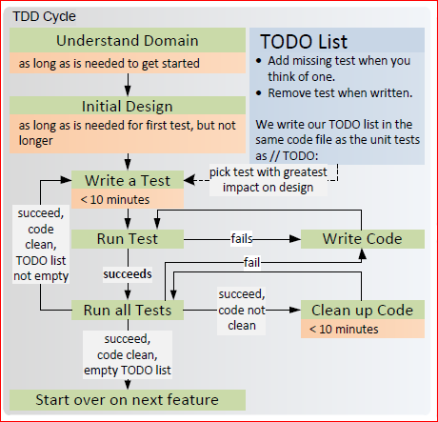
TDD Cycle

Slide 5
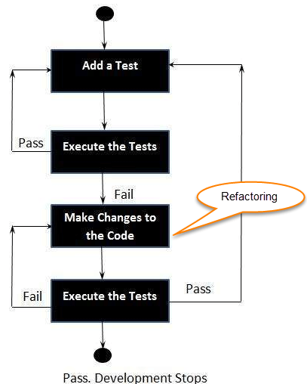
TDD Cycle
Add a test.
Run all tests and see if any new test fails.
Write some code.
Run tests and Refactor code.
Repeat.

Slide 6
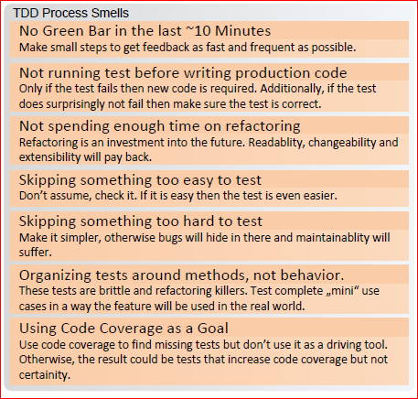
TDD Process Smells

Slide 7
QUIZ

Slide 8
JUNIT
DURGA ADIMULAM
June 10, 2019

Slide 9
What is Unit Testing?
Unit testing is a form of white-box testing, in which test cases are based on an internal structure/design/implementation of the item being tested.
The tester chooses inputs to explore particular paths and determines the appropriate output.
The purpose of unit testing is to examine the individual components or piece of methods/classes to verify functionality, ensuring the behavior is as expected.

Slide 10
What is Junit?
JUnit is a unit testing framework for Java programming language. It plays a crucial role in test-driven development.
JUnit promotes the idea of "first testing then coding", which emphasizes on setting up the test data for a piece of code that can be tested first and then implemented. This approach is like "test a little, code a little, test a little, code a little."

Slide 11
Features of JUnit
JUnit is an open source framework, which is used for writing and running tests.
Provides annotations to identify test methods.
Provides assertions for testing expected results.
Provides test runners for running tests.
JUnit tests allow you to write codes faster, which increases quality.
JUnit is elegantly simple. It is less complex and takes less time.

Slide 12
Annotations
Annotation | Description
@Test | The most basic JUnit annotation is @Test, which marks methods that are to be run as tests.
@BeforeEach | Denotes that the annotated method should be executed before each @Test, @RepeatedTest, @ParameterizedTest, or @TestFactory method in the current class
@AfterEach | Denotes that the annotated method should be executed after each @Test
@BeforeAll | Denotes that the annotated method should be executed before all @Test
@AfterAll | Denotes that the annotated method should be executed after all @Test (A new instance is created for each test, there is no obvious instance on which to call the @BeforeAll/@AfterAll methods, so they have to be static.)
@DisplayName | Declares a custom display name for the test class or test method
@Disabled | Used to disable a test class or test method;

Slide 13
Assertions
For assertions we have to use org.junit.jupiter.api.Assertions class. It provides static factory methods that we can use for writing assertions.
public static void assertEquals(int expected, int actual)
public static void assertEquals(int expected, int actual, String message)
public static void assertNotEquals(Object expected, Object actual)
public static void assertNotEquals(Object expected, Object actual, String message)
public static void assertArrayEquals(int[] expected, int[] actual)
public static void assertArrayEquals(int[] expected, int[] actual, String message)
public static void assertNotNull(Object actual)
public static void assertNotNull(Object actual, String message)
public static void assertNull(Object actual)
public static void assertNull(Object actual, String message)
public static void assertNotSame(Object actual)
public static void assertNotSame(Object actual, String message)
public static void assertSame(Object actual)
public static void assertSame(Object actual, String message)
public static <T extends Throwable> T assertThrows(Class<T> expectedType, Executable executable)

Slide 14
QUIZ

Slide 15
DEMO

Slide 16
Problem Statements
Given a string swap the last two characters of the string.
Hint : str.charAt(i) will gives the character at i+1th position.
Ex: “AB” => “BA”
“RAIN” => “RANI”
“A” => “A”
“” => “”

Slide 17
Task
https://epa.ms/PEP2019-TDD
(Last date for task submission is 25th June 2019)
Remove ‘A’ if it is present in first 2 characters of the string.
if ‘A’ is present after 2 characters, it should not be removed.
Ex: “ABCD” => “BCD”
“AACD” => “CD”
“BACD” => “BCD”
“BBAA” => “BBAA”
“AABAA” => “BAA”

Slide 18
QUIZ

Slide 19
References
Junit : https://junit.org/junit5/docs/current/user-guide/
TDD : https://www.guru99.com/test-driven-development.html
https://dzone.com/articles/get-started-with-test-driven-development-a-beginne

Slide 20
Q & A

