Slide 1
INDIA AIR QUALITY
Project by: Drishti & Anshika Patel

Slide 2
AGENDA
Problem Statement
Project Overview
Who are the End Users
Your Solution and its Value Proposition
The Wow in Your Solution
Modelling
Results

Slide 3

PROBLEM STATEMENT
Air pollution is a significant problem in India, with air pollution being responsible for 1.1 million deaths in 2018.
The main sources of air pollution in India are due to the energy production industry, vehicle traffic on roads, soil and road dust, waste incineration, power plants, and open waste burning.
To analyze the air quality data of India and develop a model to predict air quality levels in different regions of the country, in order to identify the major sources of air pollution

Slide 4
PROJECT OVERVIEW
Data gathering from Kaggle.
Data cleaning to ensure accuracy and consistency in the analysis.
Model prediction to forecast air quality levels in different regions of India based on the available data.
Development of a user-friendly dashboard using Power BI to present the findings and insights in an accessible manner

Slide 5

WHO ARE THE END USERS?
The end users for the India Air Quality Data Analysis project could include:
Government Agencies
Environmental Organizations
General Public
Industry Stakeholders

Slide 6

YOUR SOLUTION AND ITS VALUE PROPOSITION
Solution:
provide a comprehensive analysis of air quality data in India.
to address air pollution and its adverse effects on public health and the environment.
Value Proposition:
Provide Accurate and Reliable Air Quality Data.
Raise Awareness and Empower Individuals.
Improved Decision-Making.

Slide 7

THE WOW IN YOUR SOLUTION
The wow factor in the India Air Quality Data Analysis project is its potential to provide accurate and reliable air quality data, enabling stakeholders to make informed decisions and take appropriate actions to protect public health and the environment.
The project leverages advanced data analysis tools like Power BI to conduct a comprehensive analysis of air quality data in India, including data gathering, cleaning, visualization, and model prediction.

Slide 8
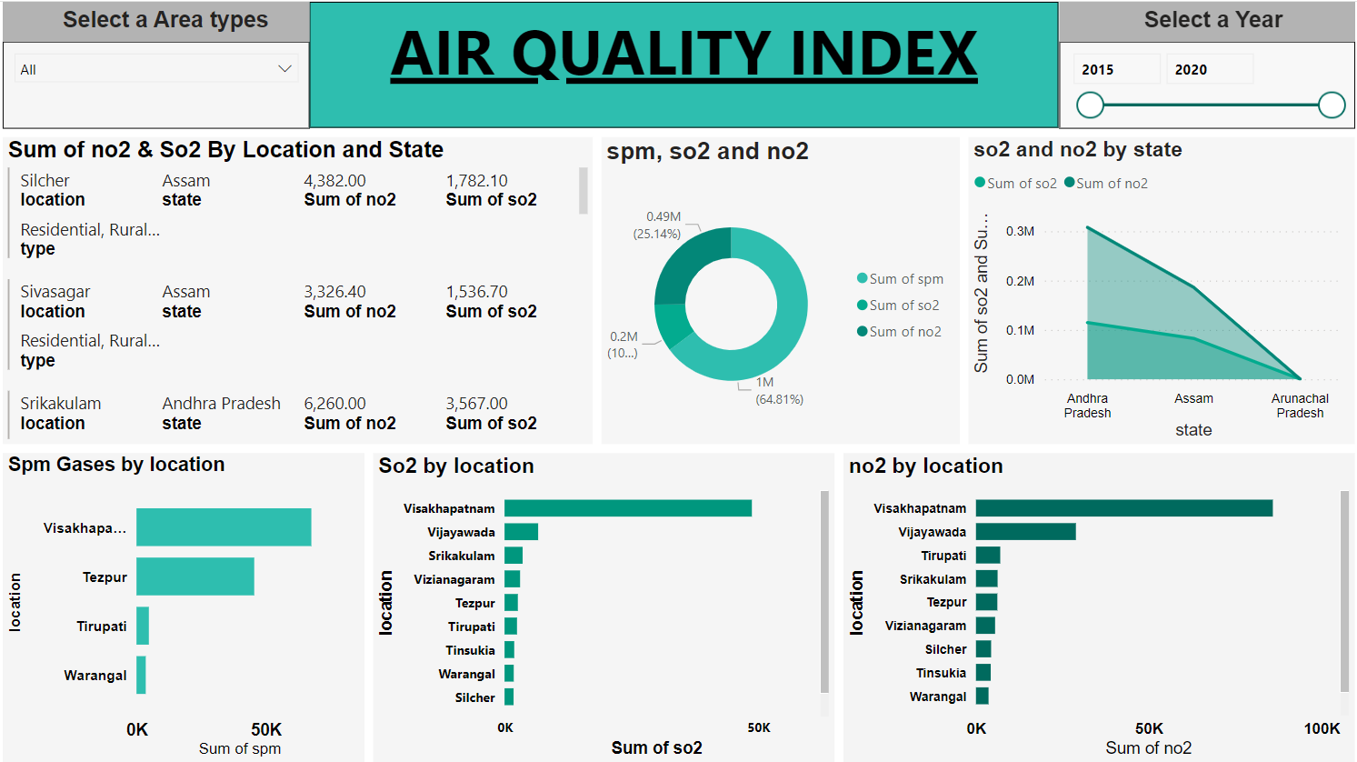
MODELLING

Slide 9
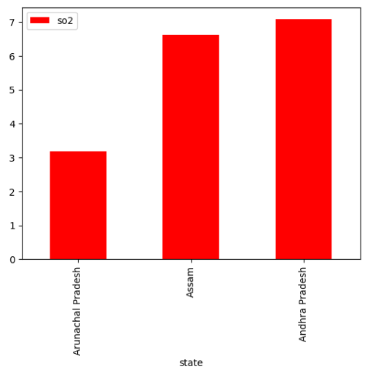
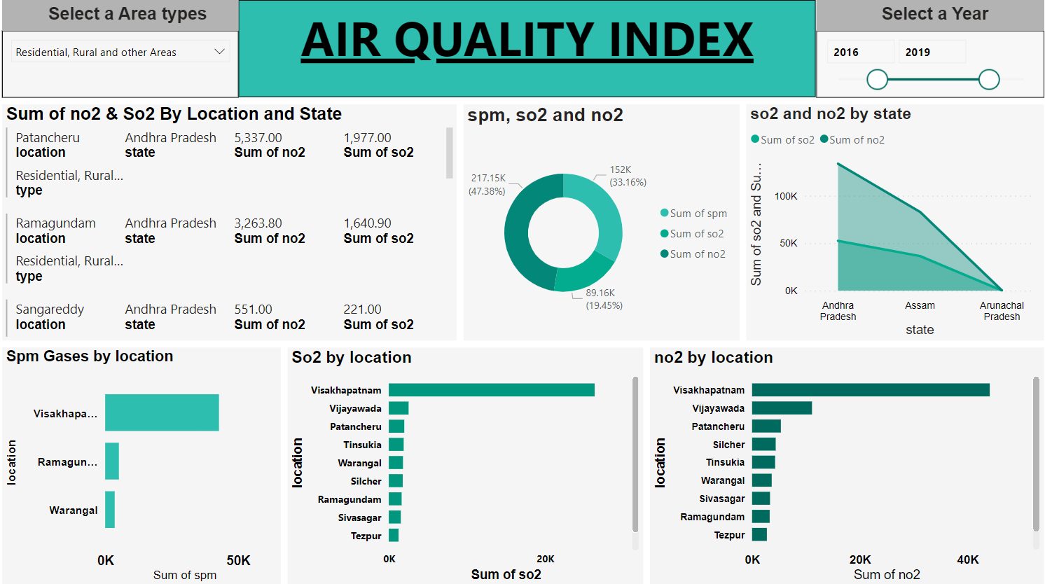
RESULTS
This analysis could also provide insights into the most affected cities and states, potentially leading to the formulation of targeted strategies to reduce emissions and improve air quality.

Slide 10
THANKYOU

