Slide 1



Goodcabs Insights Project: Driving Data-Driven Decisions for Growth in Tier-2 Cities
By Anshika | Data Analyst | 2024

Slide 2
Problem Statement
Domain & Function: Transportation & Mobility | Operations
Problem Statement: Goodcabs operates in tier-2 cities and aims to boost trip volume, passenger satisfaction, and repeat passenger rates while achieving ambitious 2024 targets.
Task Assigned: Analyze company performance metrics, answer business questions, and design a Power BI dashboard for actionable insights.
📈
🔁
📊
Growth
Customer Retention
Performance Metrics
Slow growth in trip volume and revenue across target cities.
Declining repeat passenger rates and engagement.
Difficulty meeting key performance metrics like trip volume and ratings.

Slide 3
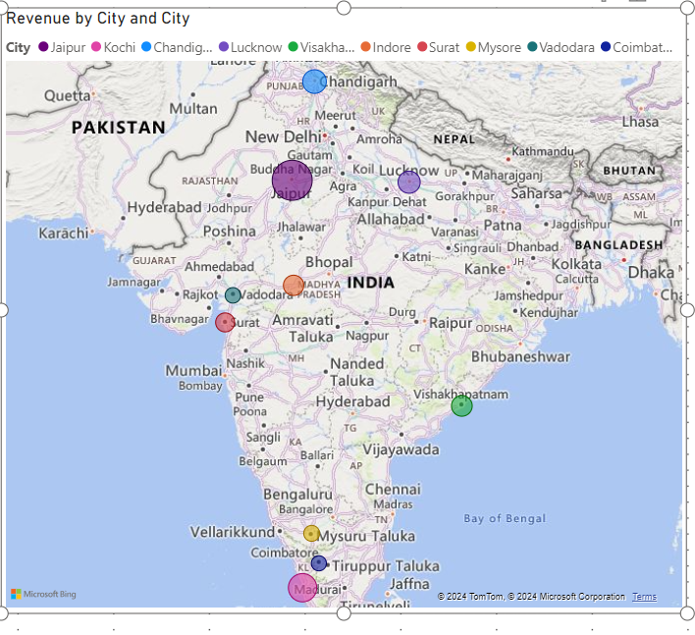

Slide 4


Project Objectives and Goals
Objective: Deliver actionable insights for operational efficiency, customer satisfaction, and revenue growth.
Key Goals:
Analysis: Evaluate trip data, passenger behavior, and .. performance.
Optimization: Identify areas to improve revenue and …..satisfaction.
Recommendations: Actionable steps to achieve business goals.

Slide 5
Data Overview
Data Sources: CSV files from operational databases.
Storage Location: Data stored in a local/SQL database integrated into Power BI.
Update Frequency: Monthly data refresh cycle.
ETL Tool: Power Query used for data cleaning and transformation.
Challenges: Missing values, duplicate entries, and data inconsistencies resolved with Power Query.

Slide 6
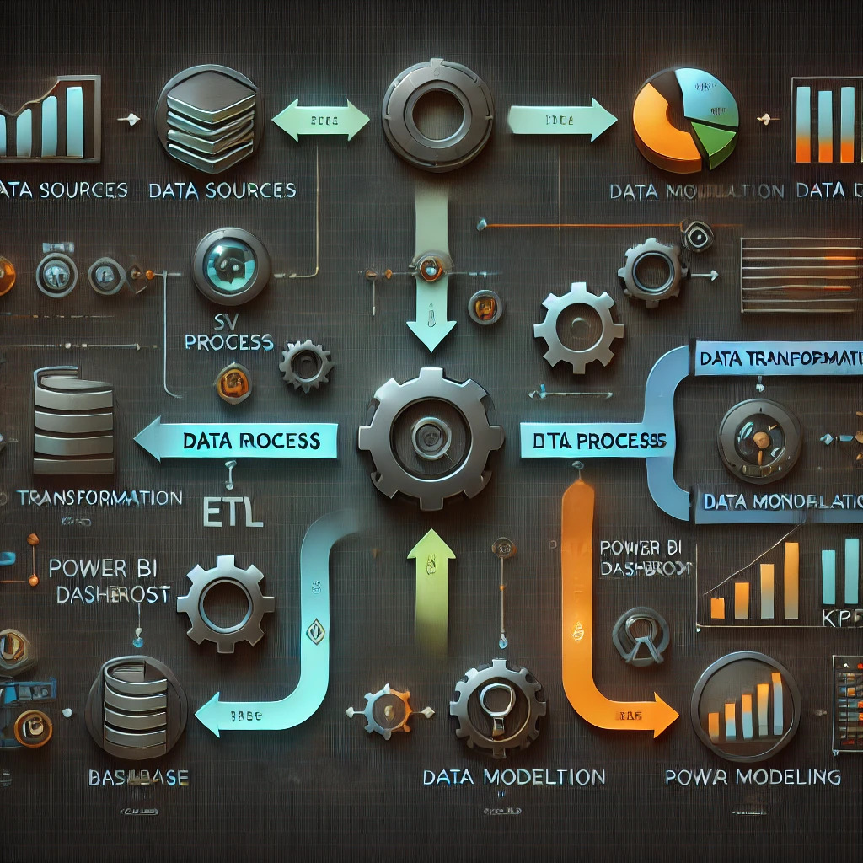

Slide 7
Data Transformation
Transformation Steps:
- Handled missing data (e.g., passenger ratings).
- Resolved cardinality issues in Power BI relationships.
- Created calculated columns (e.g., Revenue per Trip).
Challenges:
- Complex relationships requiring adjustments to Many-to-Many joins.
- Handling large datasets with efficient measures.
Tools Used: Power Query, Python numpy for preprocessing, SQL for ad-hoc queries.

Slide 8
Data Modeling
Approach:
- Star schema for optimized data modeling.
- Relationships: fact_trips linked to dimension tables like dim_city, dim_date, etc.
Best Practices:
- Avoided circular references.
- Used surrogate keys for cleaner joins.
- Managed Many-to-Many relationships with bridge tables.
Challenges:
- Addressing high cardinality in city and date relationships.

Slide 9
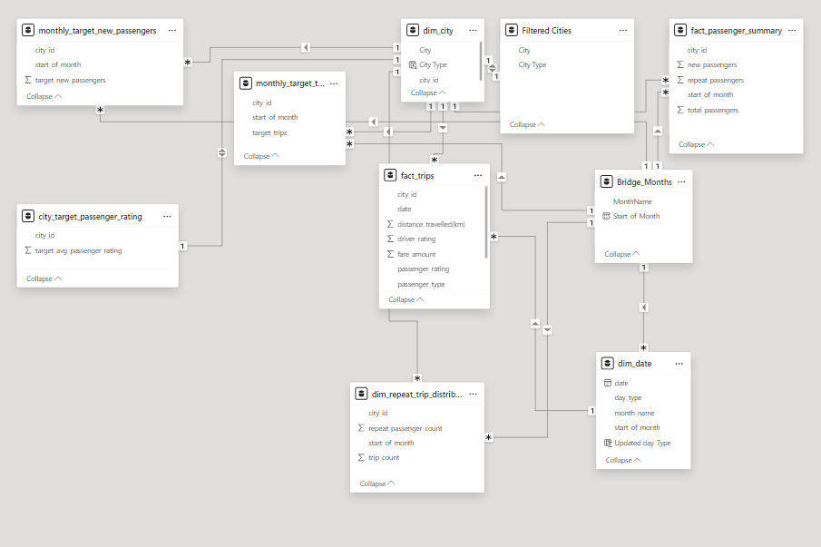

Slide 10
Key Metrics and DAX Functions
Key Metrics:
- Total Trips, Revenue, RPR%, Average Ratings, Revenue per Trip, and Monthly Target Achievement.
DAX Functions Used:
- CALCULATE, SUMX, DISTINCTCOUNT, and Time Intelligence functions like SAMEPERIODLASTYEAR.

Slide 11
Dashboard Design
Design Philosophy:
- Dark-themed, futuristic visuals for a professional look.
- Interactive slicers, tooltips, and drill-throughs for better exploration.
Components:
- KPIs: Total Revenue, RPR%, Average Ratings.
- Charts: Revenue by Passenger Type, Ratings by Month, and City Performance.
- Filters: City, Passenger Type, Month.

Slide 12
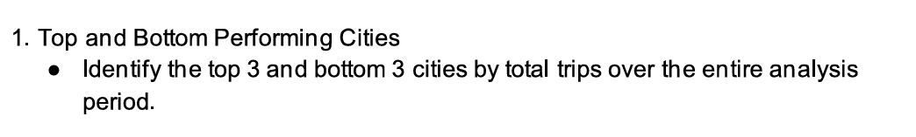

Slide 13
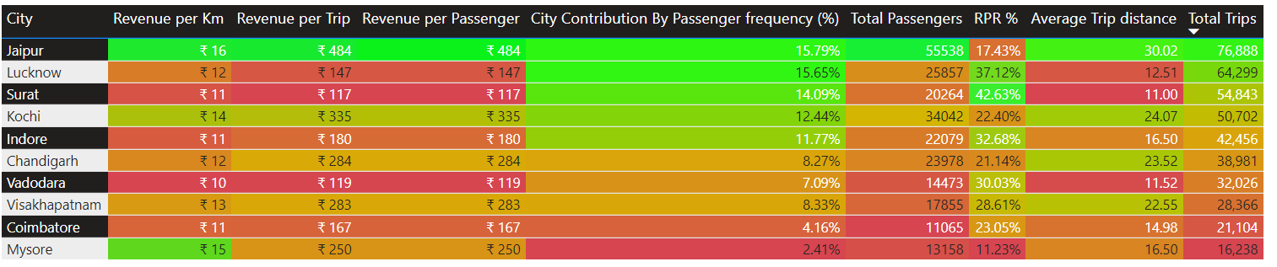

Slide 14
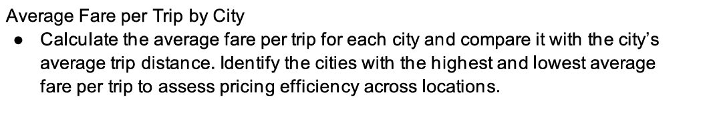

Slide 15
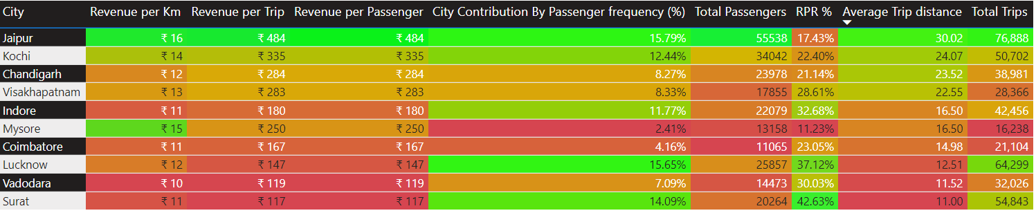

Slide 16
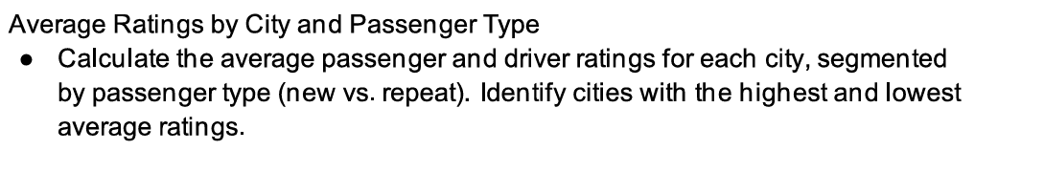

Slide 17
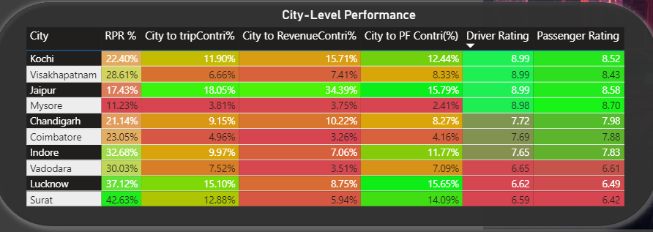

Slide 18
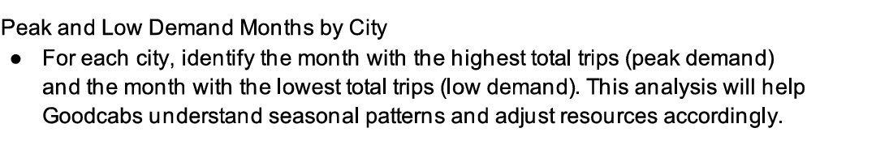

Slide 19
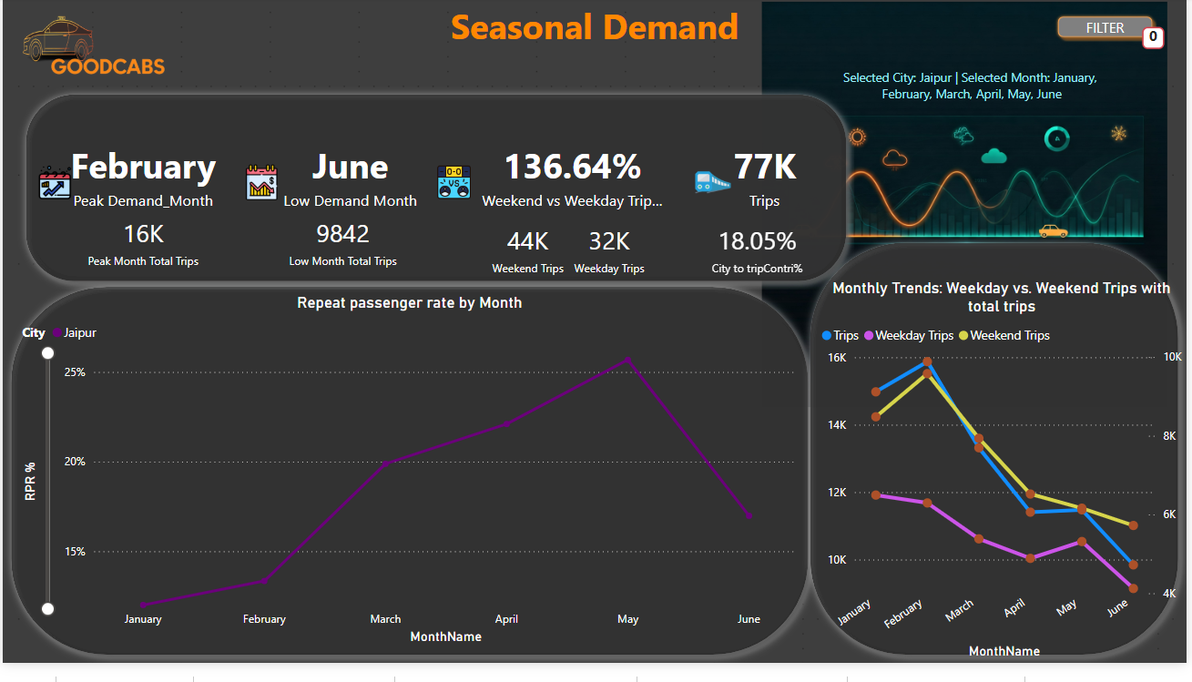

Slide 20
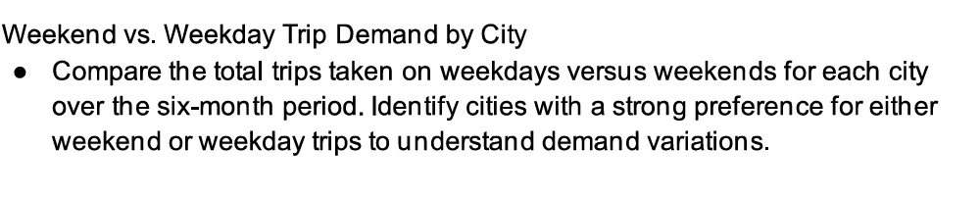

Slide 21
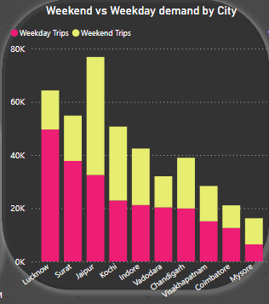

Slide 22
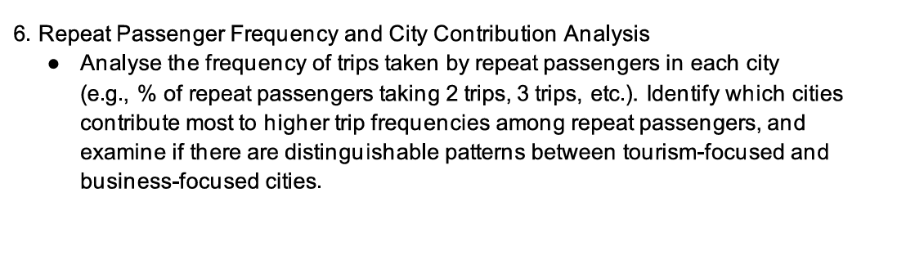

Slide 23
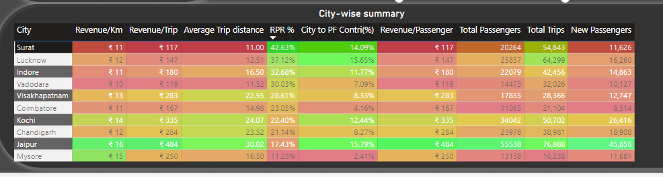
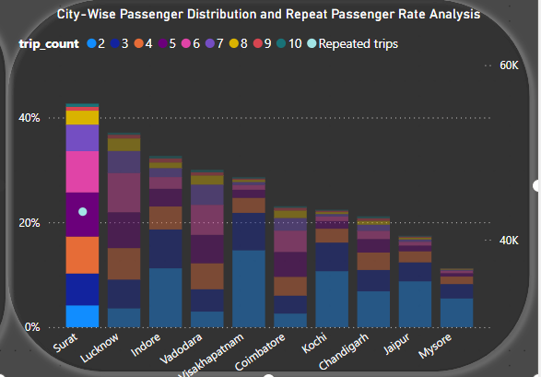

Slide 24
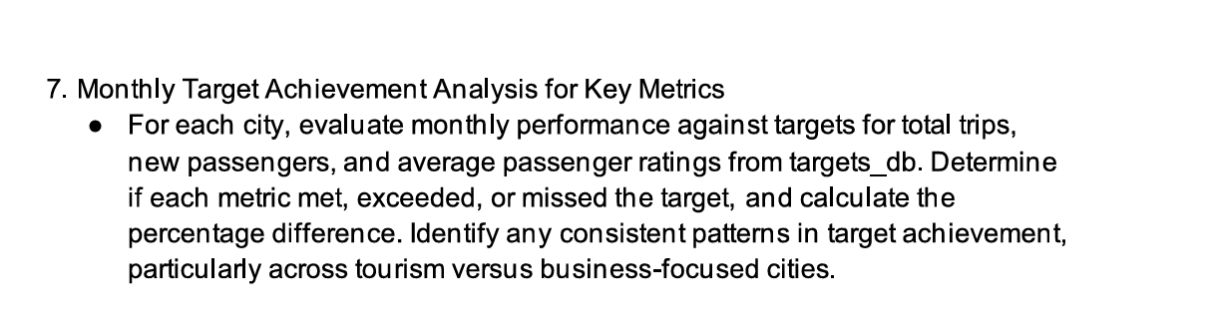

Slide 25
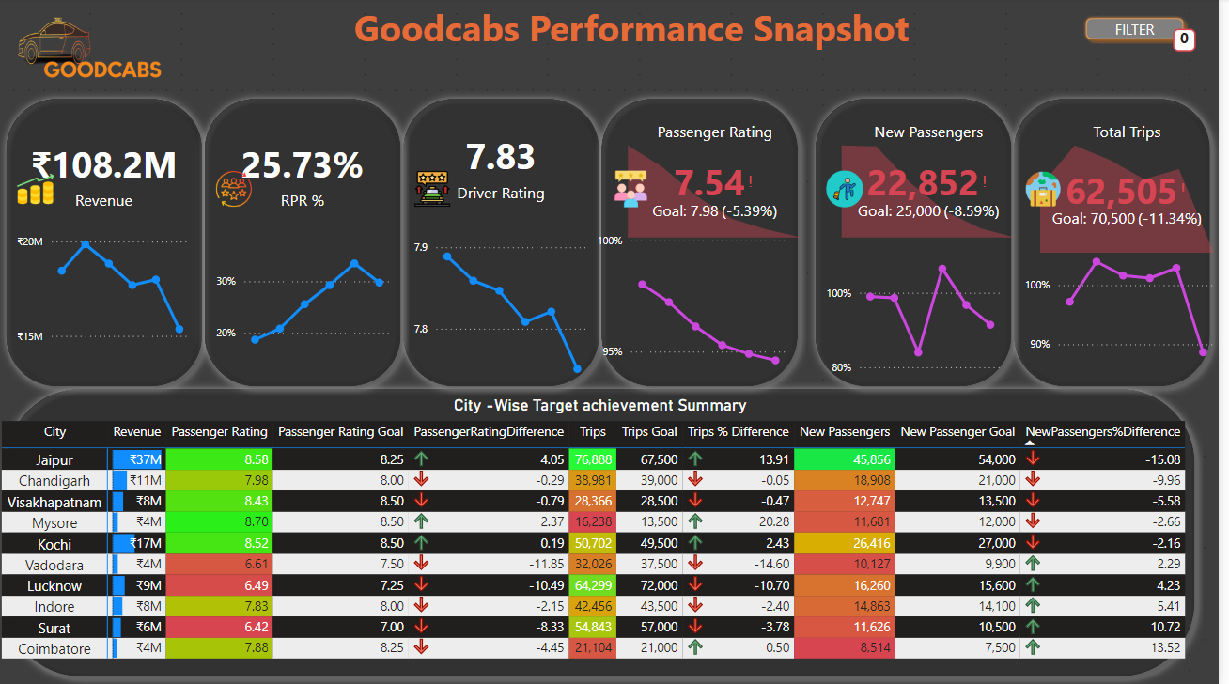

Slide 26
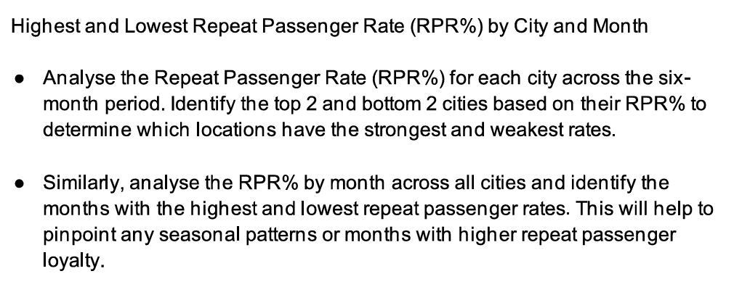

Slide 27
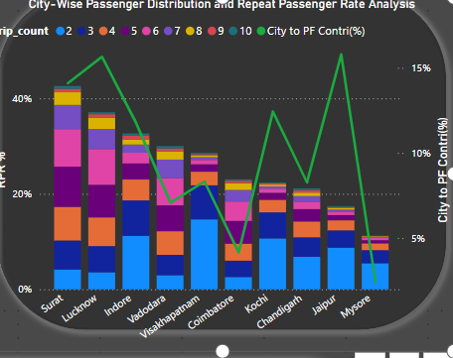
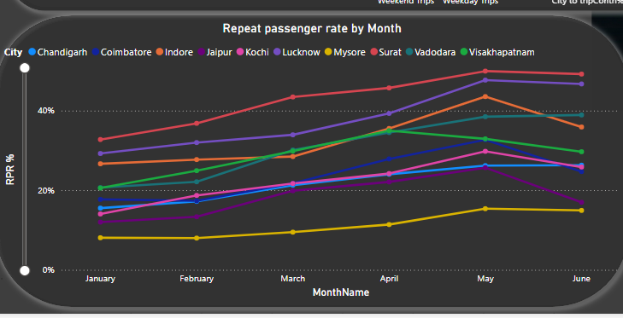

Slide 28
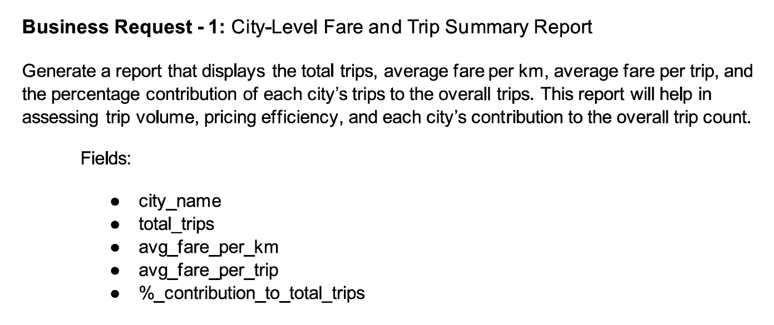

Slide 29
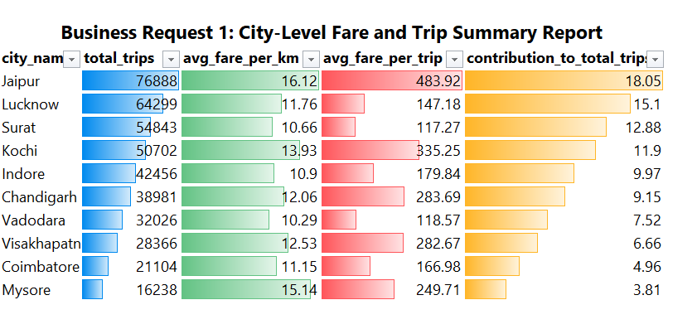

Slide 30
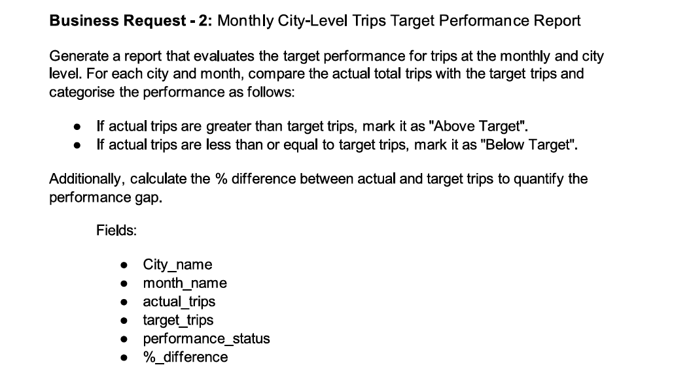

Slide 31
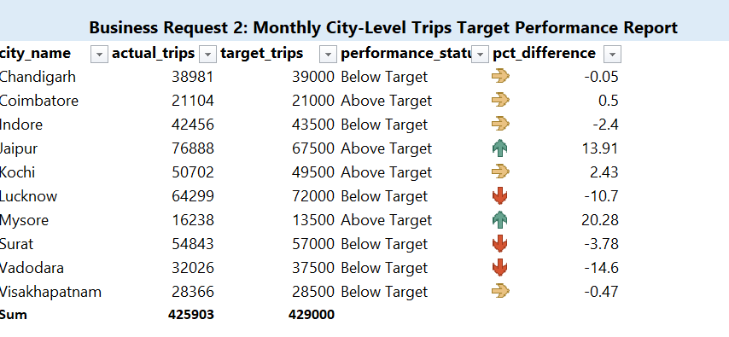

Slide 32
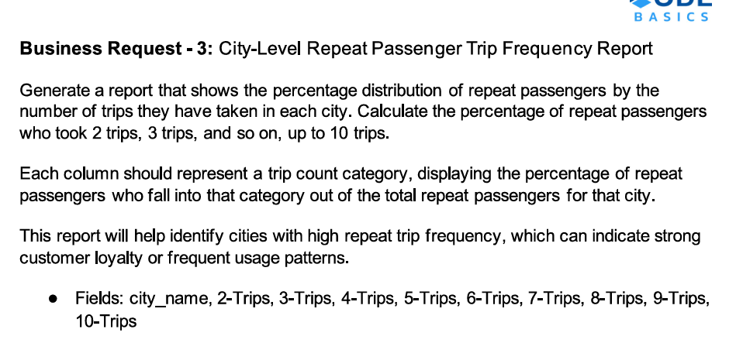

Slide 33
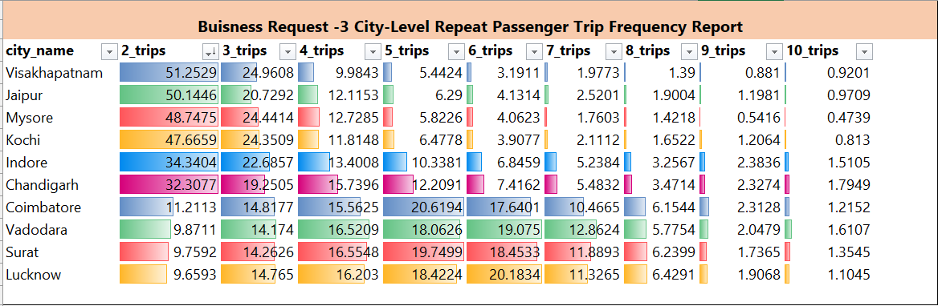

Slide 34
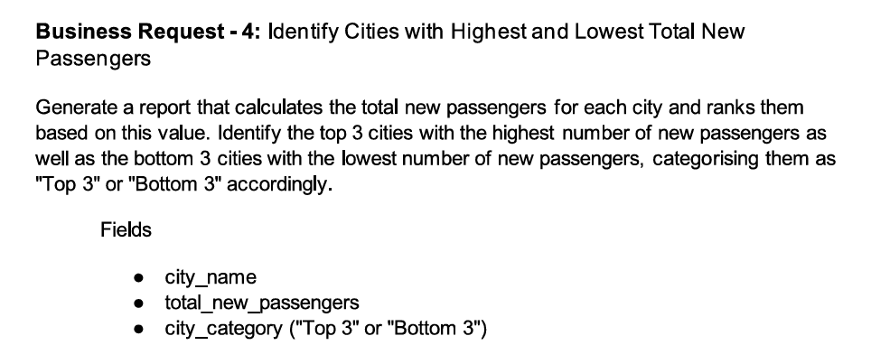

Slide 35
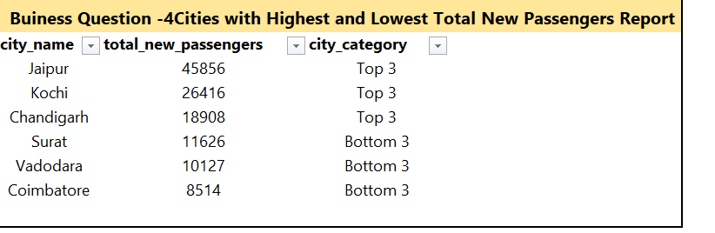

Slide 36
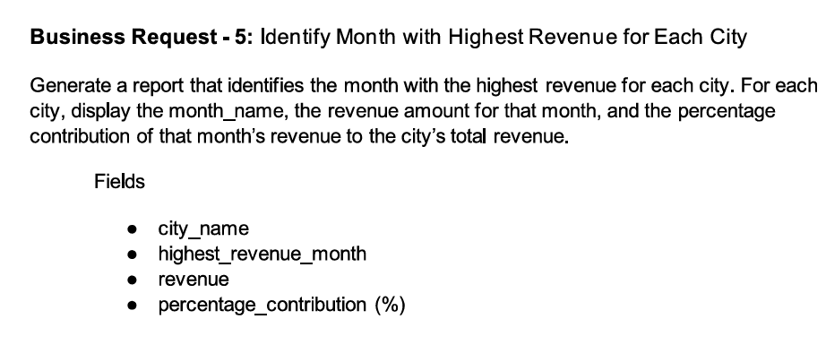

Slide 37
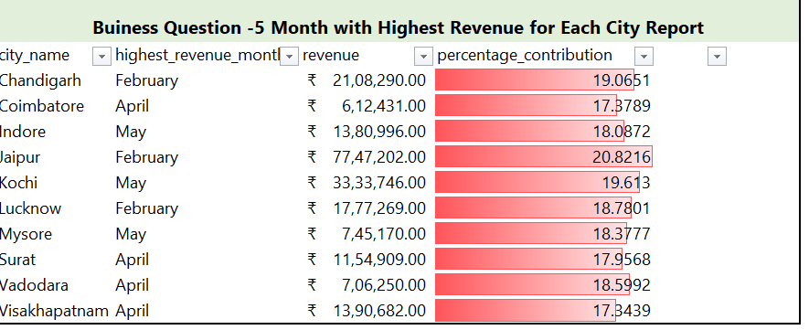

Slide 38
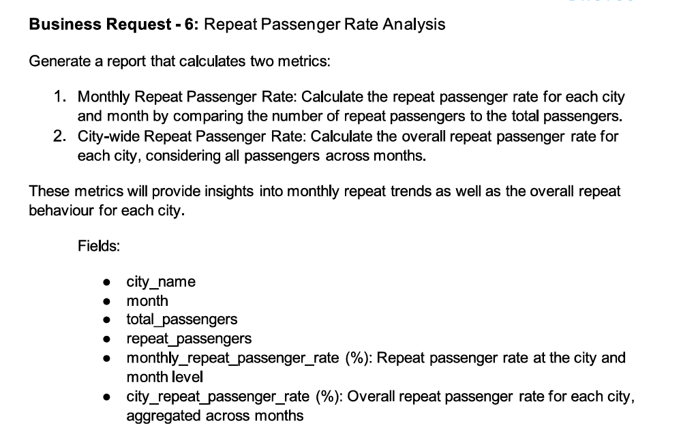

Slide 39
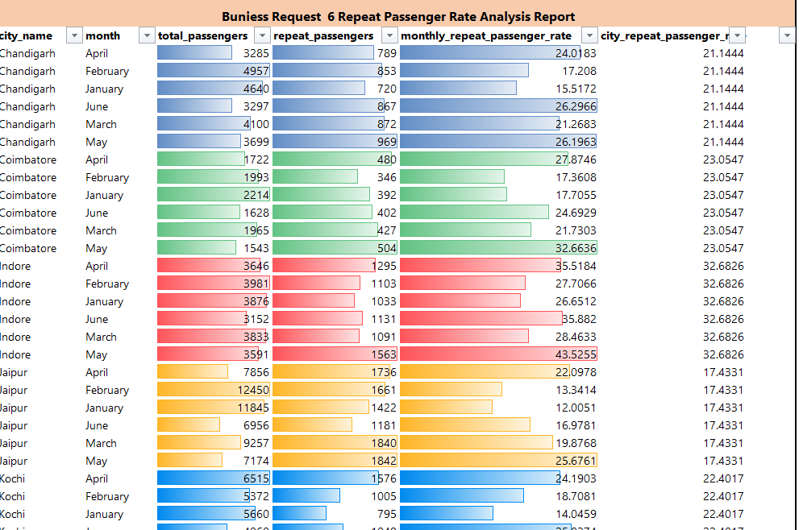

Slide 40
Analysis and Insights
Primary Analysis:
- Top 3 Cities: Highest Revenue and RPR%.
- Seasonal Trends: Demand peaks in May and December.
- Weekend vs. Weekday Trends: 40% higher weekend demand.
Secondary Analysis:
- Factors influencing RPR%: Service quality, pricing, and city demographics.
- Tourism vs. Business Impact: Higher demand during festivals in tourism-heavy cities.

Slide 41
Recommendations
Actionable Steps:
• Optimize Resource Allocation: Based on seasonal and city-level demand patterns.
• Target High-Potential Cities: Focus on cities with high repeat passenger rates and growth potential.
• Tailor Marketing Strategies: Segment customers by behavior to boost loyalty.
• Improve Pricing Strategy: Focus on pricing efficiency across cities to enhance profitability.
• Enhance Customer Retention: Improve service quality to increase repeat passenger rates.
Future Strategies:
- Partner with local businesses for cross-promotions with Exclusive partnerships with hotels , malls, Corporate offices with eye- catching discounts
- Explore emerging trends like EV adoption with pilot program in selected cities
-Introduction of Eco –friendly initiatives like electric- car sharing program and eco- friendly materials.
-Data collection upon customer behaviour like ride frequency, peak hours, popular routes, and customer feedback. • Operational Efficiency Data: Track driver performance, vehicle utilization rates, and maintenance schedule. • Market Trends Data: Monitor competitor performance, customer preferences, and regional demand shifts to stay ahead of the market curve.

