Slide 1

Mediversal Hospital KPI Report: Data-Driven Insights
2011-2022 Patient Data Analysis
Anshika Porwal
Analyst

Slide 2

Mediversal Hospital KPI Report Introduction
Data Analysis
Utilize data to identify trends in hospital performance admissions, and patient care metrics for improved operations.
Operational Insights
Examine admission trends and patient demographics to optimize service offerings and resource allocation.
.
01
04
Strategic Decision-Making
Leverage insights from KPIs to guide strategic initiatives aimed at enhancing patient care and operational efficiency
02
Financial Assessment
Evaluate financial risks related to procedure costs and insurance coverage for sustainable hospital management.
03

Slide 3
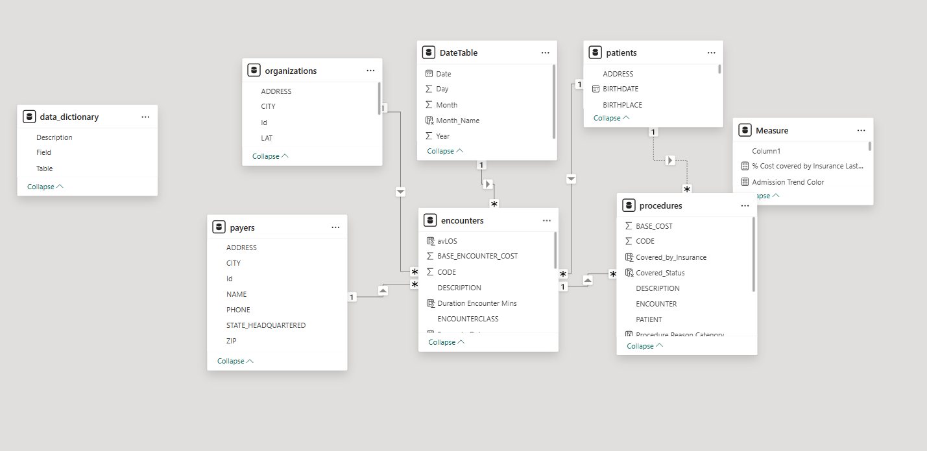

Slide 4
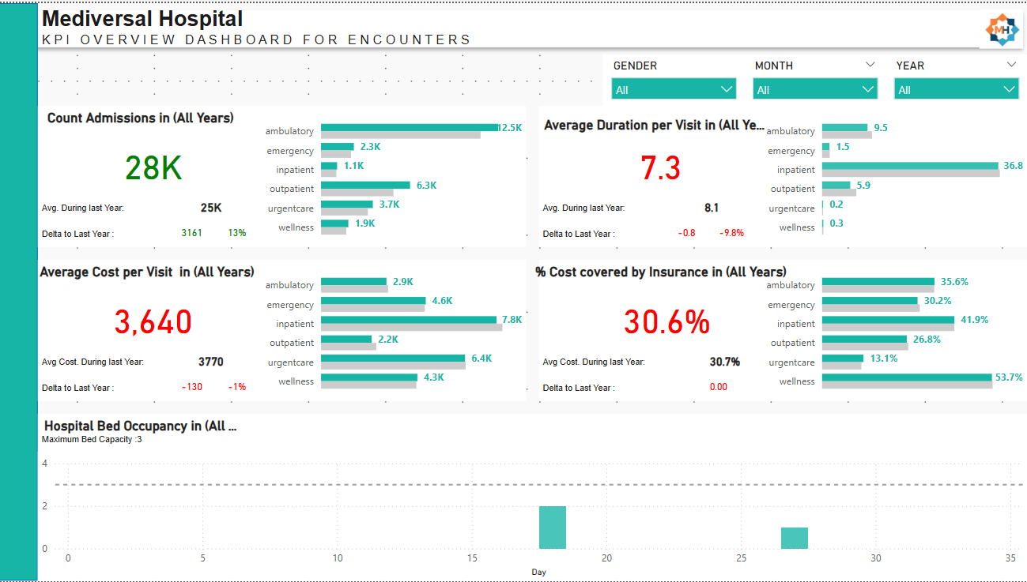

Slide 5
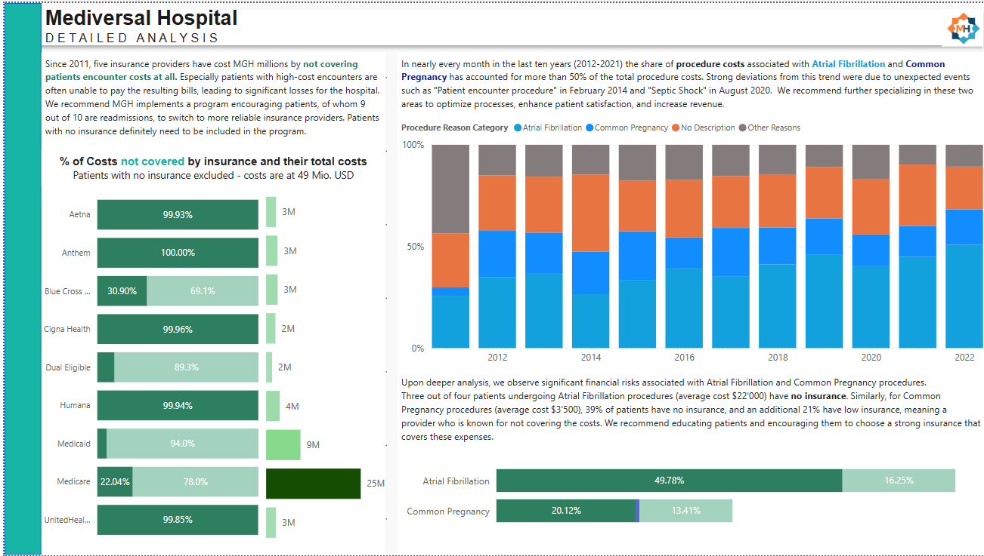

Slide 6

Key Findings from Admission Data Overview
Increase in Admissions
The hospital experienced a significant increase of 28,000 admissions, reflecting a 13% growth year-over-year, indicating a rising demand for healthcare services and the need for resource planning.
High Readmission Rate
With 88% of the analyzed 974 patients being readmitted, this highlights concerns about chronic condition management and the necessity for developing effective discharge planning and follow-up care initiatives.
Growth by Encounter Type
Ambulatory and outpatient care segments grew notably, representing opportunities to enhance service offerings and invest in related healthcare programs to address patient needs and boost satisfaction.
01
02
03

Slide 7
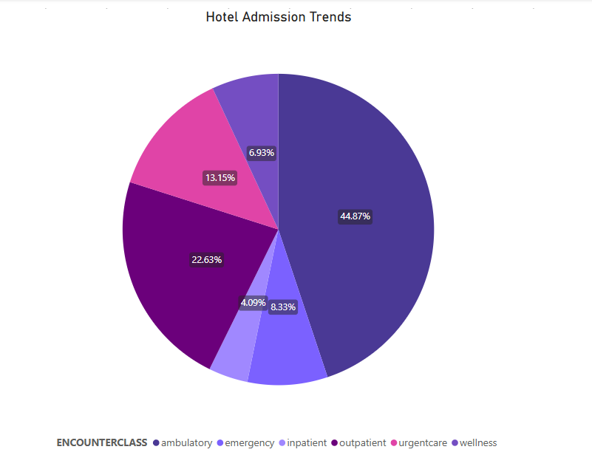
Admission Trends By Encounter Types

Slide 8
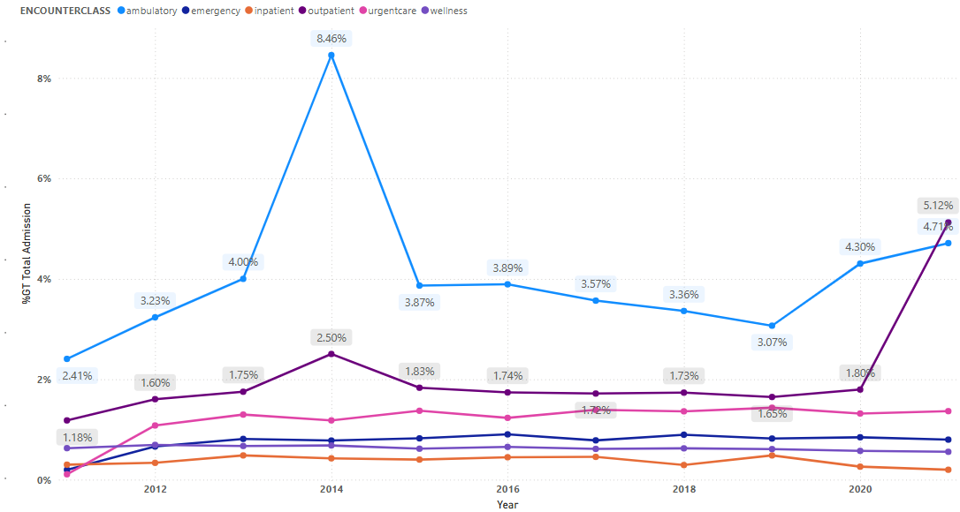
Growth In Patient Admission Analysis

Slide 9
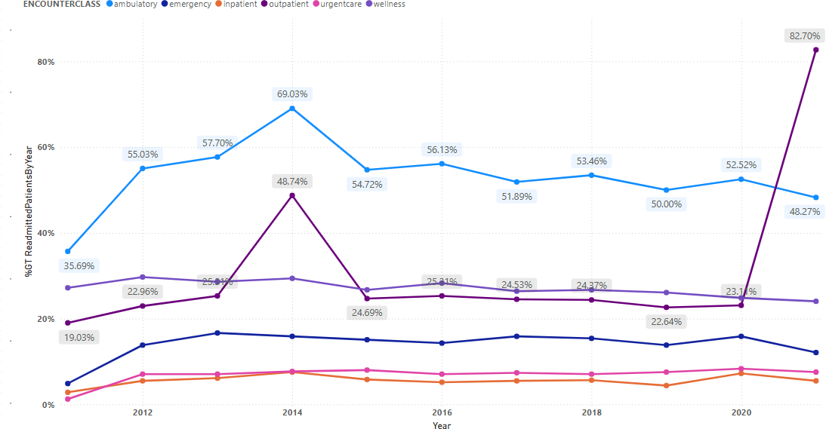

Slide 10




High Readmission Rates And Implications
Problem 1
Problem 2
Problem 3
Problem 4
Increased Financial Strain on Hospital Resources
Impact on Patient Satisfaction and Care Quality
Regulatory Scrutiny and Potential Penalties
High Readmission Rates Indicate Treatment Issues
Potential inadequacies in initial treatments noted
Readmissions contribute to higher operational costs
Frequent readmissions may lower satisfaction scores
High rates can lead to penalties from insurers
Chronic conditions may not be appropriately managed
Limited resources stretched due to repeated visits
Patients may perceive care quality as inadequate
Increased scrutiny from regulatory bodies expected

Slide 11
Strategic Recommendations for Admissions Growth
Community Health
Strengthen initiatives to manage emergency room traffic effectively.
04
Readmission Programs
Implement follow-up care to reduce high readmission rates.
Preventive Health
Expand wellness programs to promote preventive healthcare services.
01
05
Ambulatory Care
Invest in expanding outpatient clinics to accommodate growth.
02
Resource Management
Utilize predictive analytics for efficient resource allocation.
06
Telehealth Services
Enhance telehealth offerings to meet increased service demand.
Patient Education
Develop programs to inform patients about services and options.
03
07

Slide 12
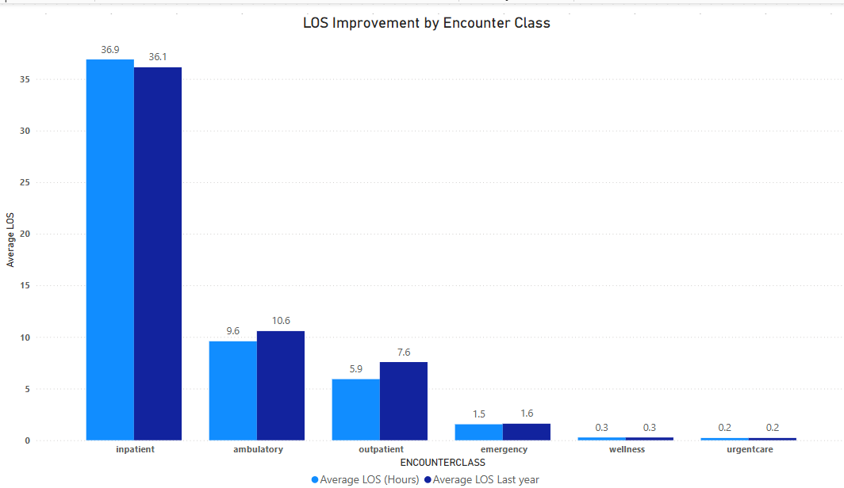
Length of Stay(LOS) Highlights

Slide 13
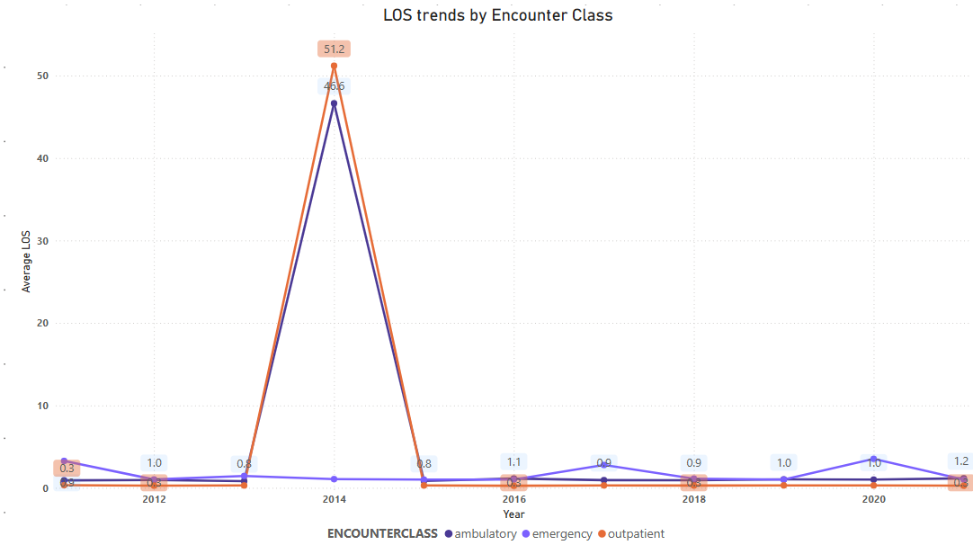
Length of Stay(LOS) Highlights

Slide 14
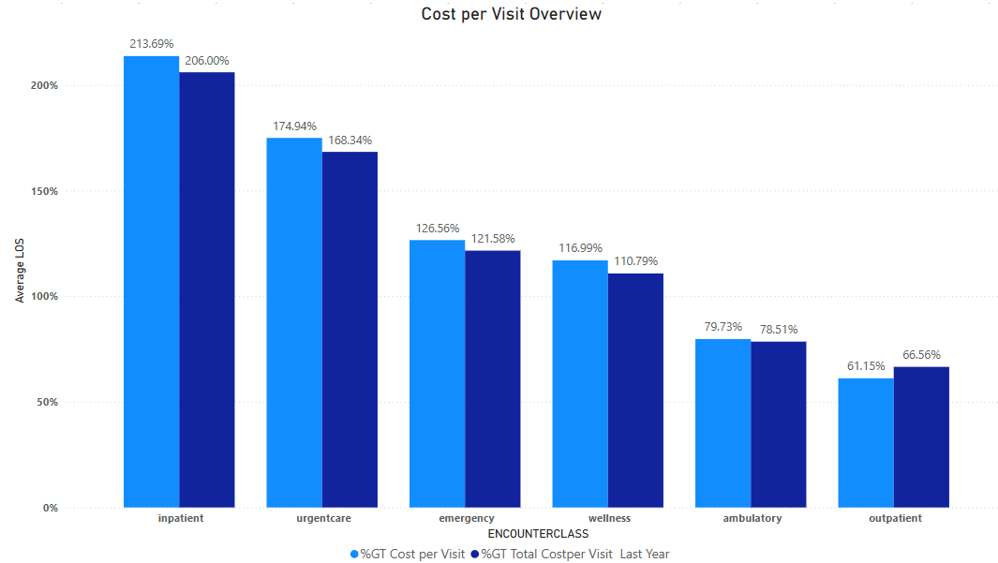
Cost per Visit Analysis and Trends

Slide 15

General Recommendations for Cost Efficiency
Monitor
Regularly review financial reports to identify cost –saving opportunities.
04
Optimize
Streamline procedures to cut unnecessary expenses significantly.
Preventive Health
Expand wellness programs to promote preventive healthcare services.
01
05
Negotiate
Ensure insurers for better reimbursement rates on high-cost services.
02
Resource Management
Utilize predictive analytics for efficient resource allocation.
06
Invest
.Allocate resources to enhance technology for operational efficiencies.
03

Slide 16

Insurance Coverage for Procedures Overview
Higher Reimbursement
Negotiate for improved reimbursement rates with insurers, particularly for outpatient and urgent care services to alleviate financial pressures on both the hospital and patients.
Financial Support Programs
Enhance patient financial assistance initiatives to reduce out-of-pocket expenses, providing transparency and support for patients facing high costs from low insurance coverage.
01
02

Slide 17












Impact of Insurance Coverage on Patient Cost
Reduces Financial Burden on Patients
Insurance significantly lowers out-of-pocket costs for patients, making healthcare services more affordable
High Cost for Uninsured & Underinsured Patients
A large percentage of Atrial Fibrillation (75%) and Common Pregnancy (39%) patients have no insurance, leading to significant out-of-pocket expenses.
Encourages Preventive & Timely Care
Patients with strong insurance coverage are more likely to seek early medical intervention instead of delaying care due to cost concerns
Administrative & Billing Complexities
Hospitals must navigate complex insurance policies, claim denials, and reimbursement delays that increase administrative burdens..
Improves Hospital Revenue & Cash Flow
Hospitals receive timely payments from insurers, ensuring a steady financial inflow rather than relying on delayed or unpaid patient bills.
Coverage Limitations & Hidden Costs
Some insurance plans provide limited coverage, excluding certain procedures, medications, or treatments.
Increases Access to Advanced Treatments
Patients with comprehensive insurance have access to high-cost medical procedures, specialized treatments, and better medications without extreme financial stress.
Potential Overutilization of Healthcare Services
Patients with extensive insurance coverage may overuse medical services, leading to unnecessary tests, procedures, and longer hospital stays.

Slide 18





Procedure Specific Insights and Recommendation
Problem Faced
High cost associated with managing Atrial Fibrillation.
05
Solution Offered
Develop specialized treatment centers for Patients.
04
Benefits
Improved efficiency and reduced patient costs.
05

Slide 19
Strategic Actions for Improving Patient Coverage
Strengthening partnerships with reliable insurance providers.
01
Implementing educational programs on insurance choices..
02
Preparing financial assistance programs for uninsured patients.
03
Renegotiating reimbursement agreements with low-coverage insurers.
04
05
Promoting coverage options among eligible patients.
Expanding preventive care offerings to enhance appointments..
06
Leveraging data analytics to identify coverage gaps
07
Monitoring patient feedback to improve services and coverage.
08

Slide 20

Conclusion and Future Directions
Growing Admissions
Patient admissions increased significantly, indicating rising demand for hospital services..
01
High Readmission Challenges
An alarming readmission rate points to potential issues in patient care efficacy.
02
Cost Management Opportunities
Slight reductions in visit costs highlight areas for further operational efficiency.
Insurance Coverage Gaps
Low insurance coverage rates present financial burdens that require strategic interventions.
03
04

Slide 21

Thank you

Slide 22
Project Overview & Objectives
Objective: Provide MGH's executive team with insights on hospital performance.
Dataset: 1,000 synthetic patient records (2011-2022) covering demographics, insurance, encounters, and procedures.
Key KPIs: Admissions, Length of Stay (LOS), Cost per Visit, Insurance Coverage.
Goal: Scalable dashboard for future data integration.

Slide 23
Key Performance Indicators (KPIs)
1. **Admissions & Readmissions**: Trends over time.
2. **Length of Stay (LOS)**: Average days per patient encounter.
3. **Cost per Visit**: Financial impact analysis.
4. **Insurance Coverage Analysis**: No insurance vs. low vs. good coverage.

Slide 24
Admissions & Readmissions Trends
- **Stable 6-month rolling average of 180-205 admissions** (excluding special events like COVID-19 vaccines, follow-ups, and telemedicine).
- Readmission rates identified based on admission type.
- Key Finding: Significant proportion of encounters involve elderly patients (78-90 years).

Slide 25
Length of Stay (LOS) Analysis
- **LOS varies by procedure type and insurance coverage.**
- Admissions categorized by days stayed.
- Insight: Longer LOS for complex cases with insufficient insurance coverage.

Slide 26
Cost per Visit & Financial Analysis
- **High-cost procedures identified:**
- Atrial Fibrillation ($22,000 per case, 75% uninsured)
- Common Pregnancy ($3,500 per case, 39% uninsured, 21% low insurance)
- Key Risk: High uninsured rates for expensive procedures create financial strain.

Slide 27
Insurance Coverage Analysis
- **Majority of high-cost procedures lack insurance coverage.**
- **Breakdown by category:**
- **49.78% of Atrial Fibrillation cases** = No Insurance
- **20.12% of Common Pregnancy cases** = No Insurance
- Low coverage increases out-of-pocket expenses and financial risk.

Slide 28
Strategic Recommendations
1. **Patient Education on Insurance Options**: Encourage strong insurance plans for high-risk procedures.
2. **Expand Telemedicine for Elderly Patients**: Reduce hospital visits and improve access.
3. **Enhance Geriatric Care Programs**: Specialized outpatient care for patients aged 78-90.
4. **Financial Risk Management**: Address uninsured procedure costs through alternative funding options.

Slide 29
Conclusion
- MGH maintains stable admission rates but must address uninsured high-cost procedures.
- A significant proportion of encounters come from elderly patients, requiring tailored care.
- Expanding telemedicine and financial assistance programs can mitigate financial risks.
- The dashboard can scale with future data for ongoing strategic insights.

