Slide 1


SMART DOOR LOCK SECURITY SYSTEM USING MULTIMODEL
Guided by :
Mr. Amit Gupta
Presented by:
Name: Ayushi Dangwal
Monika Pandey
Anshika Agarwal
Semester: 8
Section: A

Slide 2
ABSTRACT
The main goal of this project is to design and implement a door locker security system based on Finger print, OTP technology and iris recognition.
This can be organized in bank, offices and homes.
In this system first person enroll user name and password and mobile number. If user name and password matches then Finger of person will detect and store with ID.
Security is important thing for every locker system. A security system for Door locker is based on fingerprint, password and GSM technology which provides more security.

Slide 3
MOTIVATION
The traditional Door Locker system has a drawback: - Locker operates manually. It means user can open his locker using key. So, there may be chances of keys getting stolen.
To overcome this drawback, we have proposed -“Fingerprint Based Door Locker Security System”. Fingerprint & GSM technology is used instead of keys. Every person has unique identity as fingerprint so fingerprint is used to verify the person and their identity. When any unauthorized person has entered incorrect password then customer will receive a message on his mobile through GSM technology.

Slide 4
PROBLEM STATEMENT
There are many systems introduced for providing complete security for all domiciles. But there is no complete security discovered up to date.
Lock and Key System: First step towards security was Lock and Key System. In the beginning this system was proved best but later on this system was failed as multiple keys can be made easily for a single lock. Thief can also make duplicate keys for the same lock. Hence this system failed for providing complete security.
Password Authentication: Password as an authentication system is the next level of security system. The password is pre-stored in the database. This password authentication system provides respectable security to the users. This system also have the limitation that password is easily guessed.

Slide 5

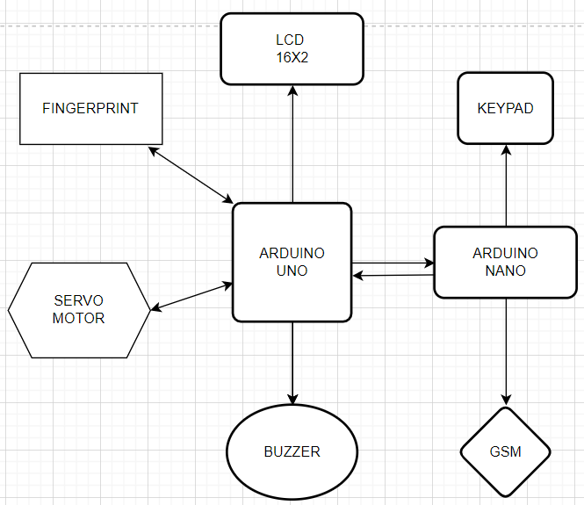

PROPOSED BLOCK DIAGRAM

Slide 6
HARDWARE SPECIFICATIONS
Finger Print Module
Microcontroller UNO
Microcontroller NANO
LCD Display
Servo motor
Relay module 5v
Keypad
GSM module 900A

Slide 7
SOFTWARE SPECIFICATIONS
Arduino compiler
Machine Learning Programming Language: Embedded C

Slide 8
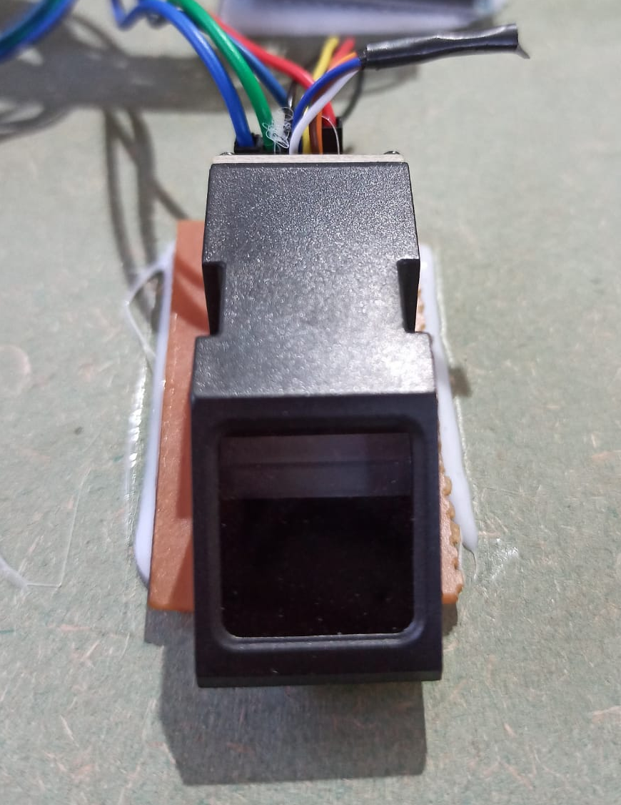

FINGERPRINT SENSOR
The sensor is a solid-type fingerprint sensor that reliably captures fingerprint information. It is designed to be combine into devices for added security and convenience. The sensor offers a reliable, fast and easy-to-use alternative to passwords, PINs and other forms of user authentication.

Slide 9
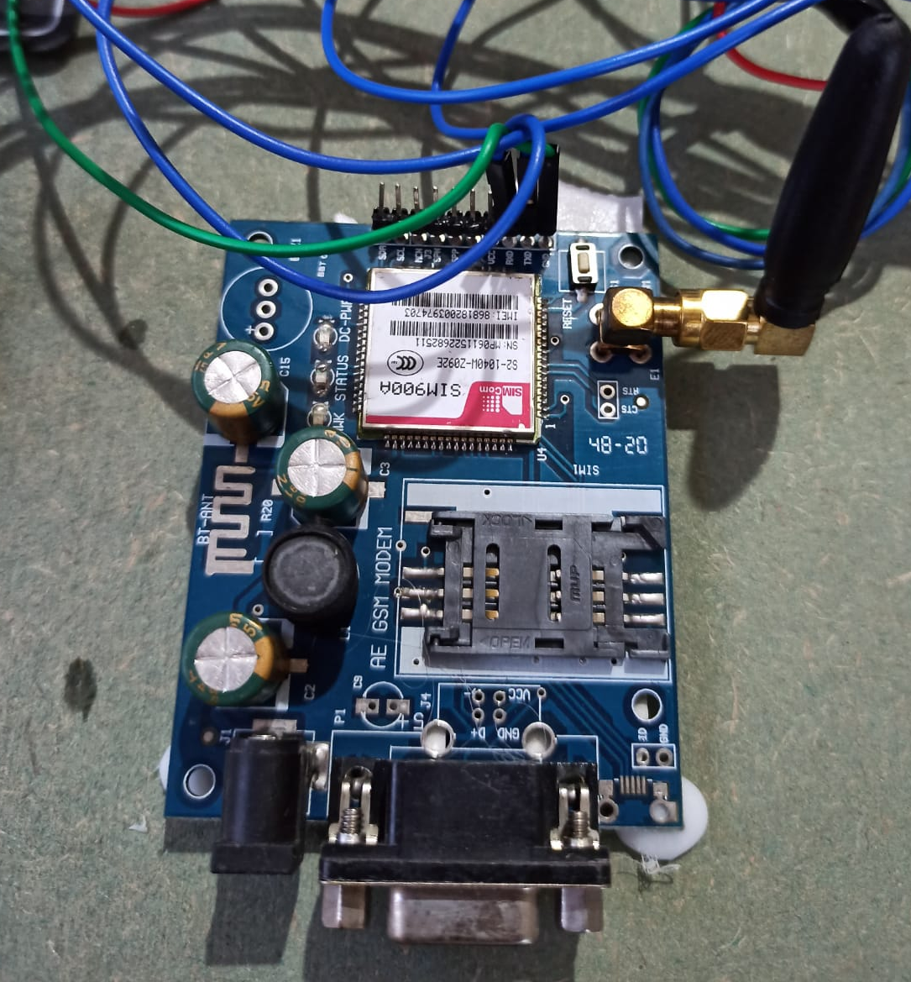
GSM MODULE
The GSM (Global System for Mobile Communication) modem used in this project is the SIM 900 module. It functions like a mobile phone, having its own SIM card slot and mobile number, enabling voice calls and SMS communication.
The modem has power and network LEDs for convenient debugging and a wire antenna for improved reception.

Slide 10
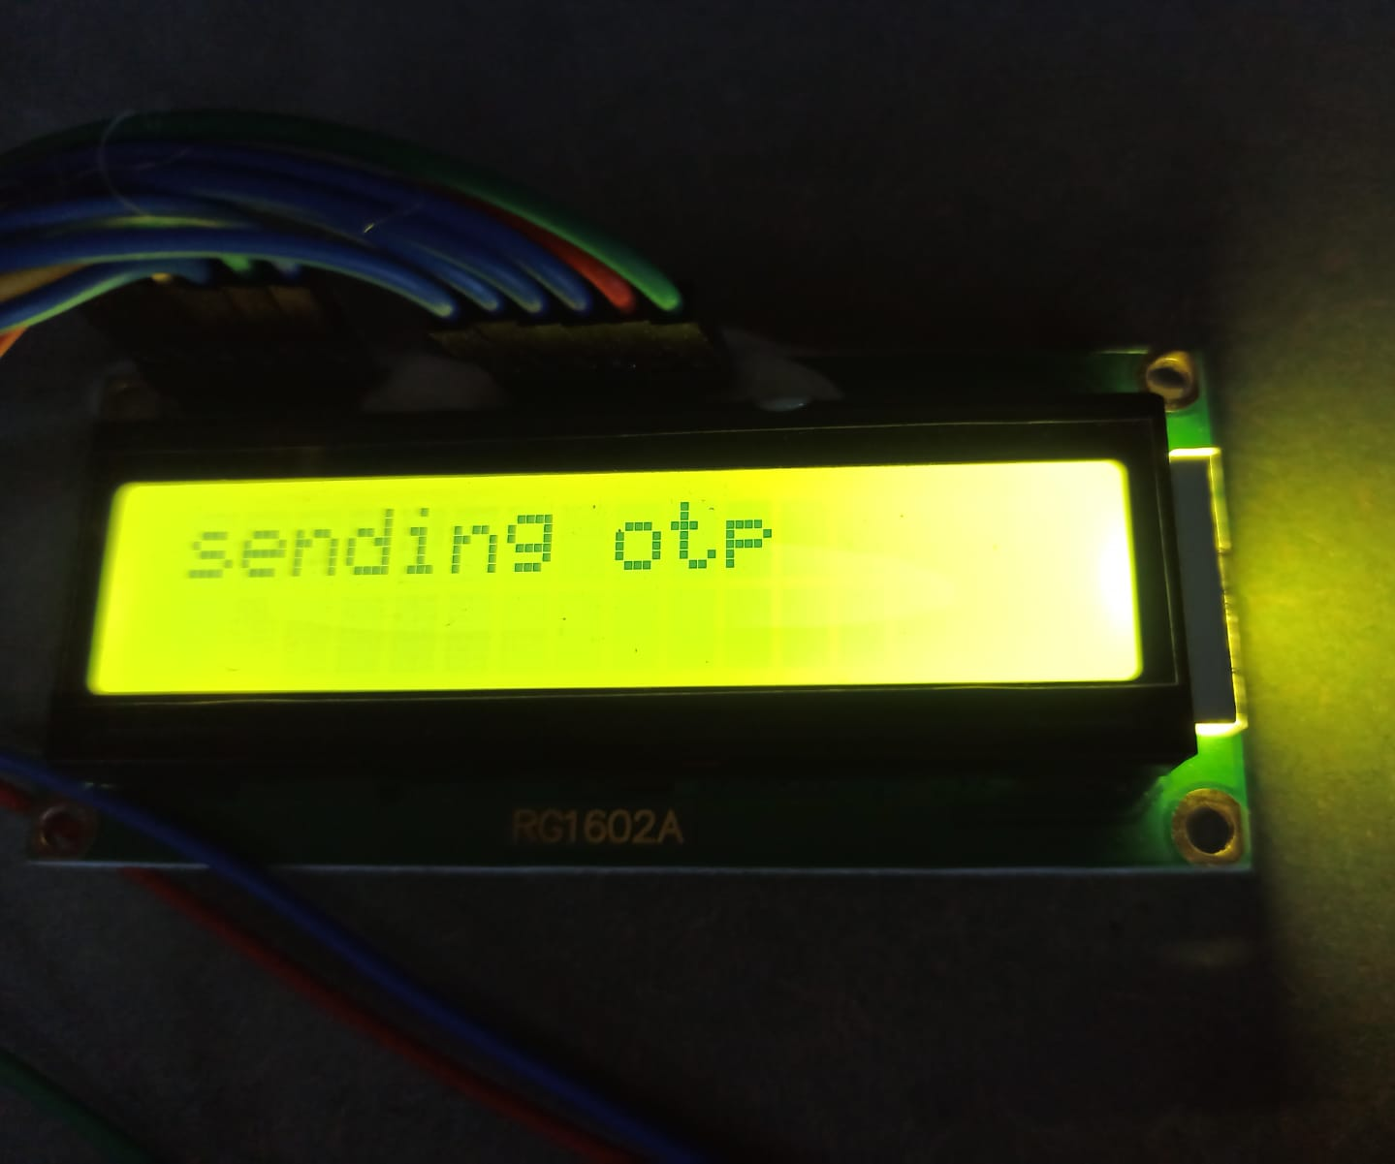
LCD
LCD (Liquid Crystal Display) screen is an electronic display module. A 16x2 LCD is very basic module. It can display 16 characters per line and there are 2 such lines.

Slide 11
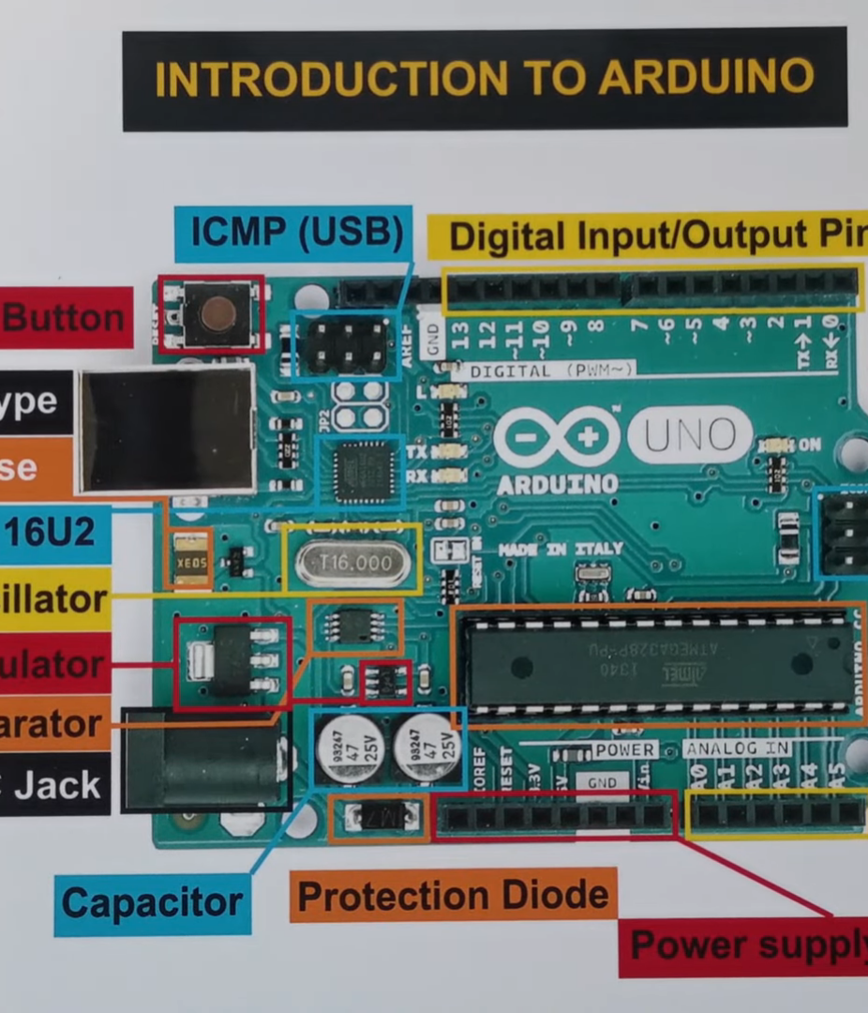
ARDUINO UNO
Communicate with a GSM module for OTP generation and SMS alerts.
Control a servo motor for physical lock/unlock operations and provide a user interface through LCD displays or LED indicators.

Slide 12
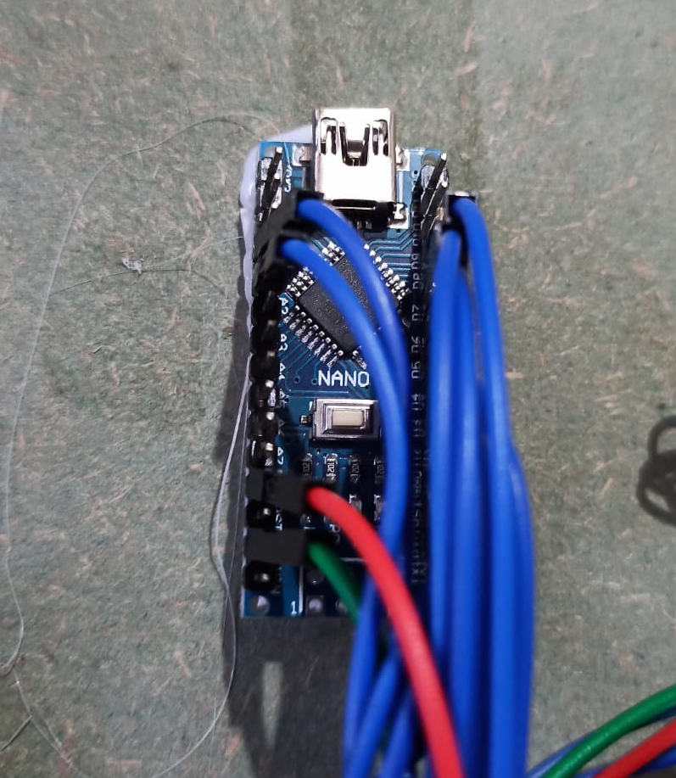
ARDUINO NANO
The Arduino Nano is a versatile microcontroller board.
By interfacing with keypads, the Arduino Nano processes inputs, execute authentication logic, and facilitate access control.
Also communicate with a GSM module, enabling features like OTP generation and SMS notifications.

Slide 13
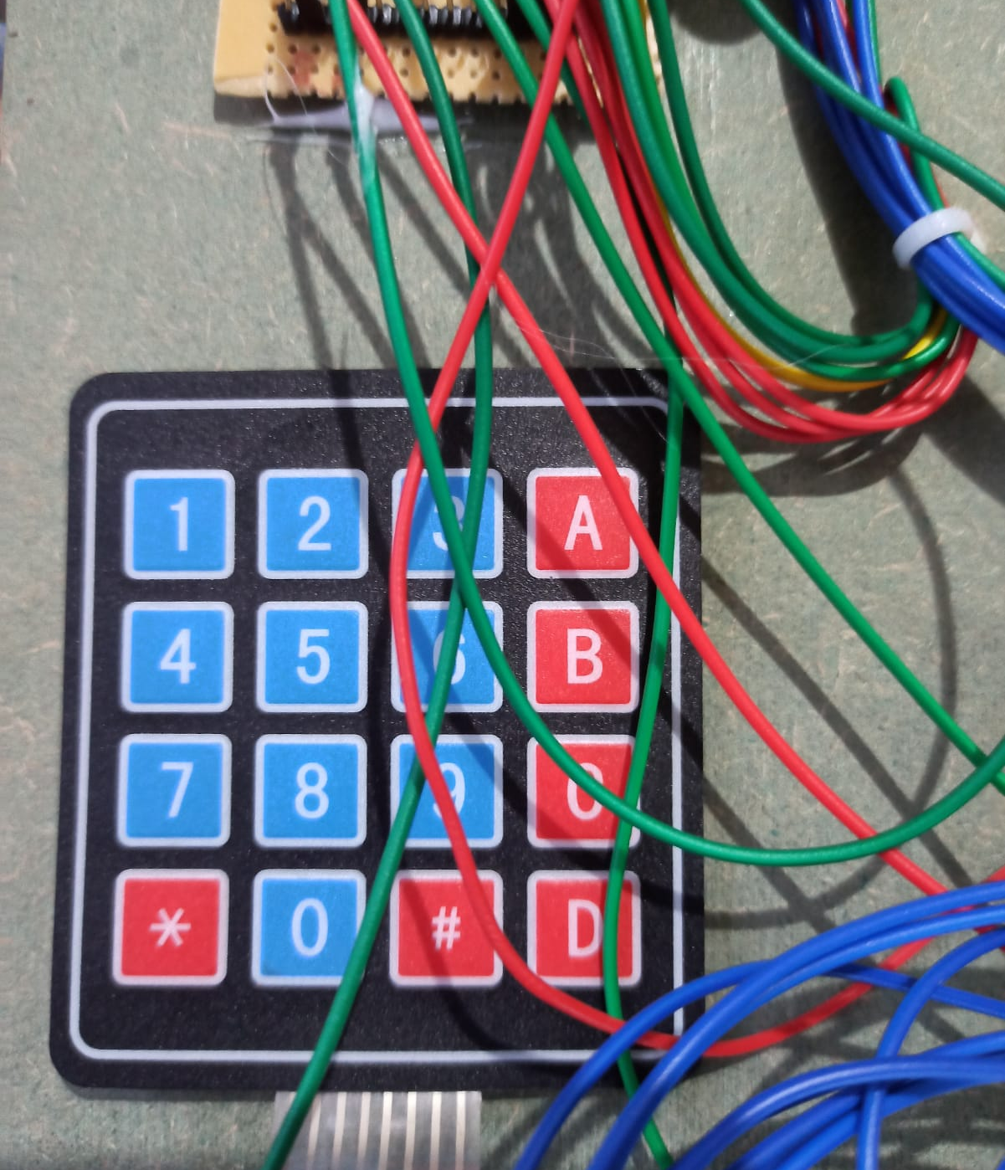
KEYPAD
Allows users to enter a PIN or password for authentication and access control.
It provides a user-friendly interface, enhances security, and can be integrated with other authentication methods.

Slide 14
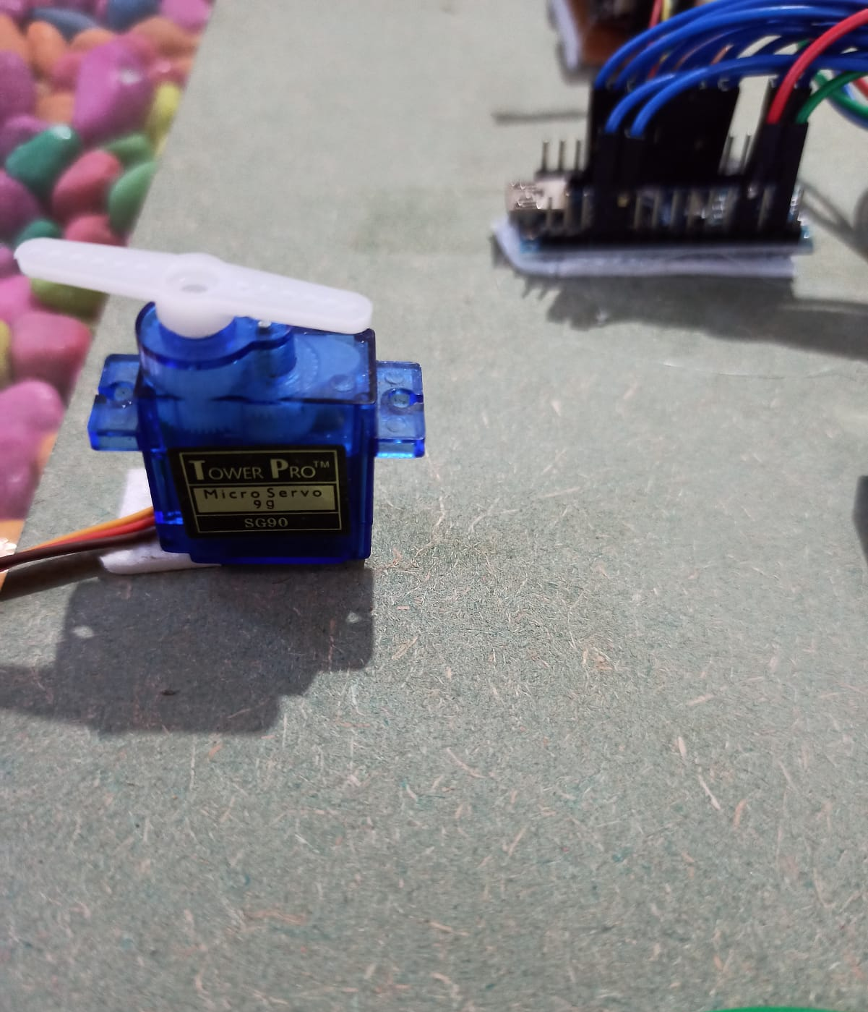
SeRvo Motor
controlling the physical movement of the door lock mechanism and is connected to the lock mechanism.
Its precise control allows for accurate rotation, ensuring secure and reliable locking and unlocking.

Slide 15
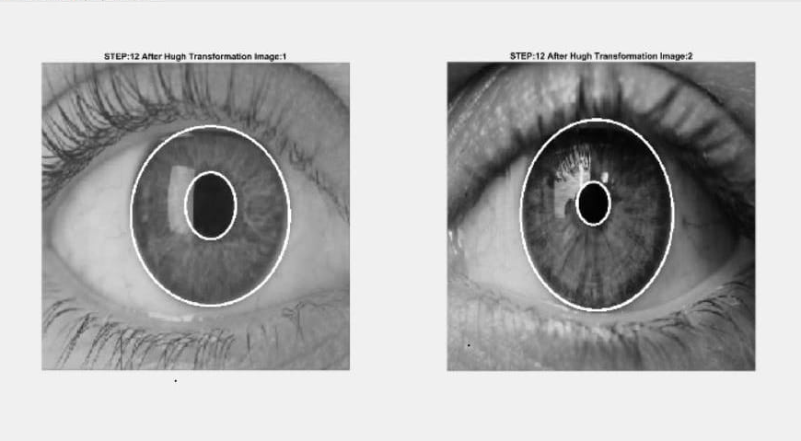
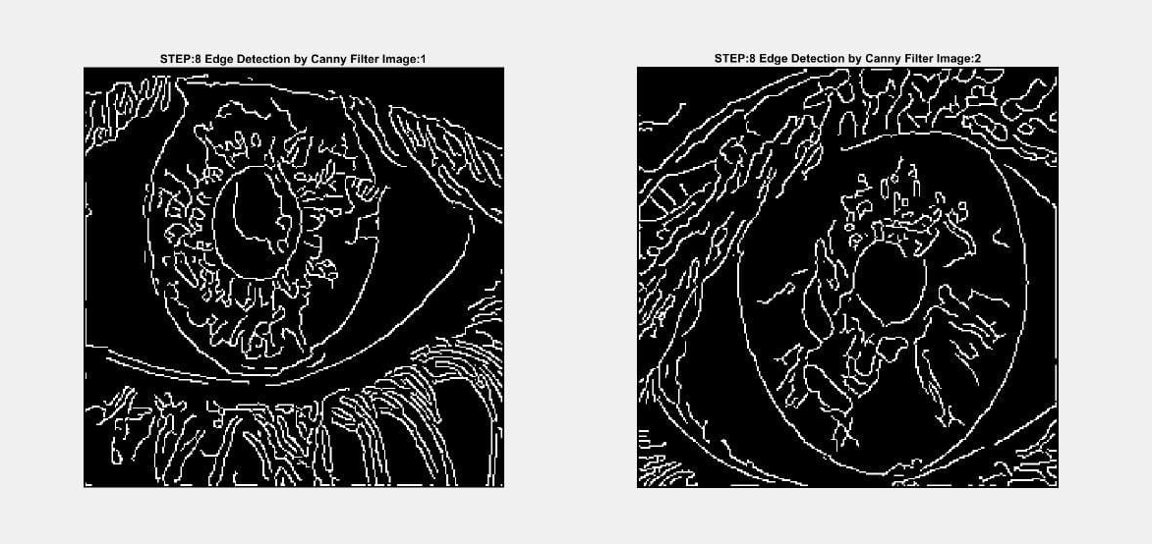
Iris Recognition

Slide 16
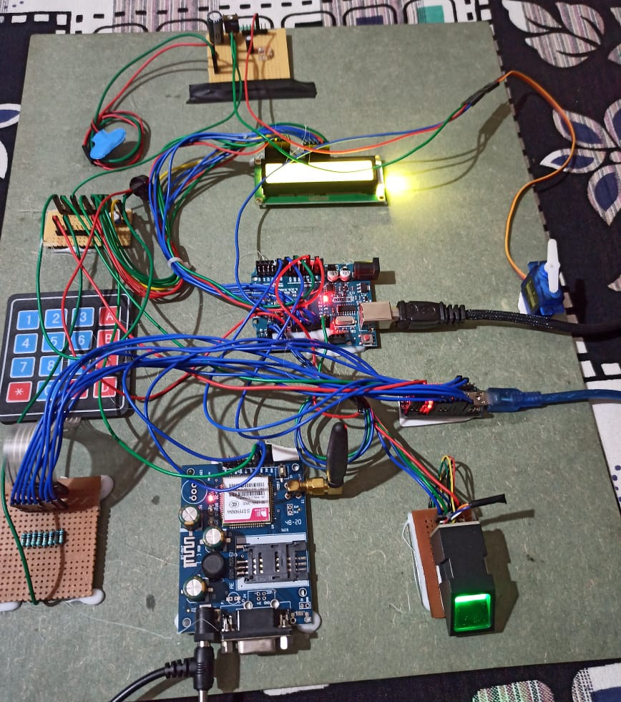
CONCLUSION
Successfully implemented a smart door lock security system.
The system achieved high levels of accuracy and reliability in recognizing biometric data, ensuring secure and reliable access control.
Multiple authentication factors, including biometrics and OTP, added an extra layer of security to the system.

