Slide 1
AdsKG-Agent
An AI assistant that finds the right ad data, and proof of which design works best
Anshika Chaurasia
AI Engineering Cohort capstone · 30 October 2026
Notes:
Hi, I'm Anshika. My capstone is AdsKG-Agent: an AI assistant that answers 'what happened' questions about ad performance, and a careful comparison of five ways to build it.

Slide 2
The problem: picking the right table
Ad teams ask simple questions, but the warehouse has many tables that look alike
“What was campaign 143747's CTR yesterday, excluding suspicious clicks?”
1
2
3
4
Time grain
Traffic
People vs views
Freshness
hourly, daily or weekly?
all clicks or valid only
(suspicious removed)?
unique people (reach)
or impressions?
live last 6 hours,
today so far, or final?
Input: one English question (or a follow-up). Output: the answer, the SQL behind it and the tables used, or “not sure”.
2
Notes:
A typical question. Writing the SQL is not the hard part. The hard part is choosing among near-identical tables and finding the lookup tables to join. Pick the wrong one and you get a confident, wrong number.

Slide 3
Data: a real ads log, a tricky warehouse
Public Taobao display/click data, 6–13 May 2017, built into DuckDB
26M
28
120
222
ad impressions
(+ ad features, user profiles)
tables in look-alike
families
benchmark questions + 20
three-turn conversations
extra distractor tables
for the scale test
Dimensions
dim_ad, dim_campaign, dim_user, dim_date ...
Events
fact_ad_events: every impression and click
Look-alike families
hourly / daily / weekly · all vs valid traffic · by audience · reach · live last 6 h
Benchmark
40 easy · 40 medium (joins) · 40 tricky (traps); 40 practice / 80 test; frozen before building
3
Notes:
I built 28 tables on purpose in look-alike families, wrote 19 rules first (time zone, what 'now' is, what a suspicious click is), and froze a 120-question benchmark before building versions B to E.

Slide 4
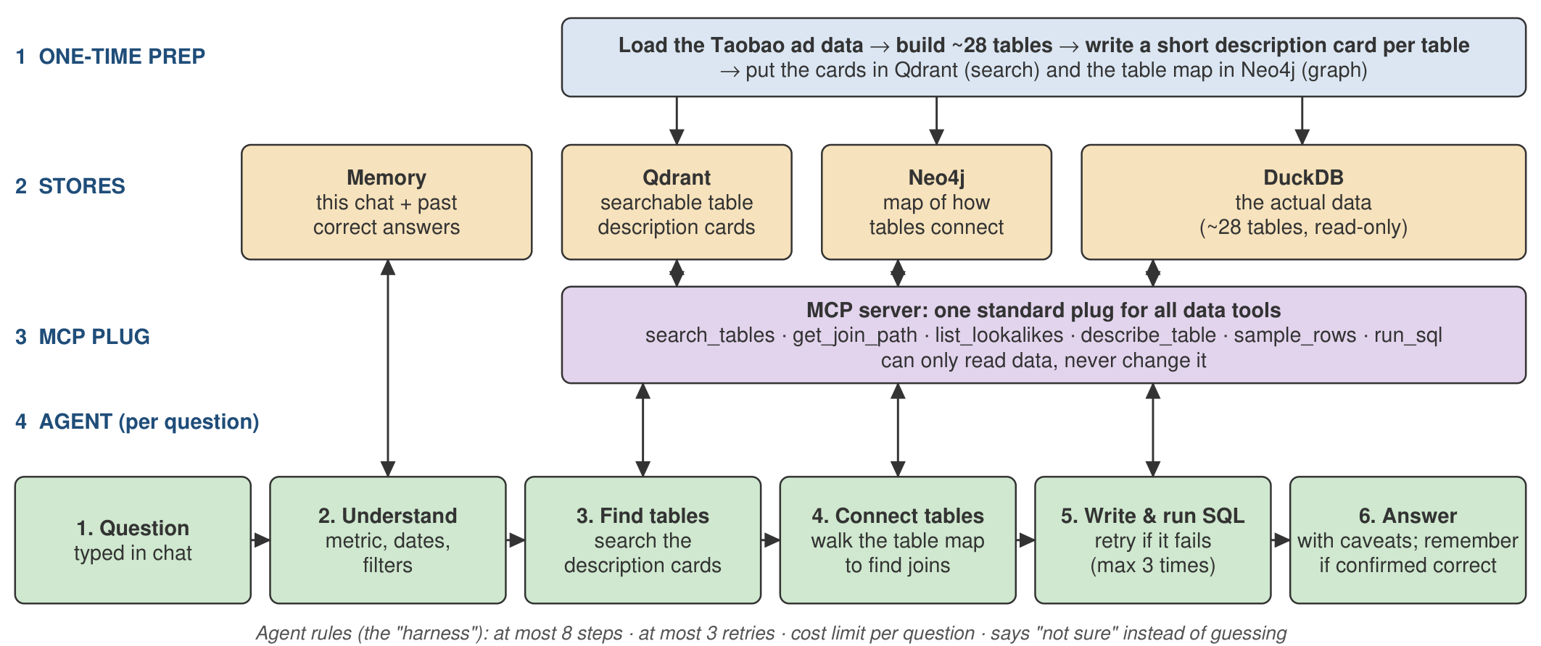
Architecture: RAG + table map + agent
All data tools sit behind one MCP server that can only read
Safety lives in the server: read-only DB · one SELECT · 1,000 rows · 20 s timeout · every call logged · 6/6 attacks blocked
4
Notes:
One-time prep builds tables and description cards. Qdrant searches the cards, Neo4j knows how tables join and which ones look alike, DuckDB holds the data. All tools sit behind one MCP server that can only read. The LangGraph agent calls those tools, with hard limits and memory.

Slide 5
Five versions, one idea at a time
Every version answers the same frozen questions, so each step is measured
A
B
C
D
E
No search
Basic search
Smart search
Search + map
Agent
all 28 table cards
in the prompt
top 5 cards by
meaning (RAG)
rewrite + hybrid
+ re-rank
+ join routes and
look-alikes (GraphRAG)
LangGraph ReAct over
6 MCP tools + memory
E also runs with example memory: 34 solved practice questions recalled as examples (test questions can never enter memory).
5
Notes:
This avoids complexity bias. A is the simple baseline: show every card. Each next version adds exactly one idea, so we can see what each idea is worth.

Slide 6
How we tested: a fair, frozen exam
Built and fixed on 40 practice questions; judged once on 80 unseen test questions
1
Execution accuracy
2
3 runs × 80 questions
3
95% confidence intervals
run the AI's SQL; its rows must match the correct answer
the AI isn't deterministic, so average it
bootstrap: re-draw the questions 10,000 times
4
McNemar test
5
LLM-as-a-judge
6
Human check
is a difference real? p < 0.05 to claim a gain
gpt-5 grades every answer, blind to version and gold
I graded 30 answers: kappa 0.65 vs the AI judge
6
Notes:
Execution accuracy is the main score: run the SQL, compare rows with the correct answer. Three runs per version, bootstrap confidence intervals, and McNemar tests before claiming any gain. Plus an LLM judge and my own grading of 30 answers.

Slide 7
Results: agent + memory wins, A is close
Execution accuracy, 80 test questions, mean of 3 runs (95% confidence interval in notes)
92.5%
agent + example memory
(95% CI 88–96)
Real differences (p < 0.05)
• A beats B and D
• memory beats no memory: 15 fixed, 0 broken
Not clearly different
• B, C, D and E
7
Notes:
E with example memory: 92.5% (88–96). A: 90.4% (84–96). E: 80.0%. D: 76.7%. B: 75.8%. C: 68.3%. Real differences by McNemar: A beats B and D; memory beats no memory (15 fixed, 0 broken). B, C, D and E are not clearly different from each other.

Slide 8
Memory: follow-ups go from 0% to 90%
15 test conversations × 3 turns, e.g. “…now split that by gender”
90% vs 28%
all turns, chat memory on vs off
+12.5
points from example memory
(72% → 85% even on unseen templates)
8
Notes:
Without chat memory, turns 2 and 3 are impossible: 0%. With it, about 90%. Example memory adds 12.5 points on single questions. Honesty check: 56 of 80 test questions share a template with a practice example, but on the other 24 memory still lifts E from 72% to 85%.

Slide 9
Two surprises: smart search hurt, A scaled
Bigger catalog: cost per question
Tables | 28 | 100 | 250
A | $0.0013 | $0.0037 | $0.0077
B | $0.0007 | $0.0007 | $0.0008
C | $0.0013 | $0.0012 | $0.0012
D | $0.0008 | $0.0008 | $0.0008
A keeps 90% accuracy at 250 tables, but costs 6× more; at thousands of tables it won't fit.
B, C and D cost the same at any size.
9
Notes:
Turning off rewrite or re-rank made C better. Search ranks tables one at a time and misses the lookup table a join needs. On scale: A stays at 90% with 250 tables, but its prompt grows from 3k to 29k tokens and cost goes up 6 times; search versions cost the same at any size.

Slide 10
Why answers fail: joins and look-alikes
All 91 wrong answers (first test run of every version), sorted by type
Missed the lookup table
“high-spending users” answered from a brand summary, without joining dim_user
Wrong look-alike
valid-traffic table used when all traffic was asked
Wrong calculation
audience table has a row per age level; rows not added up
10
Notes:
Most failures are a missing lookup table (search finds the summary table but not dim_user) or a similar-looking wrong table. 17 answers had the right value but failed our strict, frozen format rules, mostly the agent's ranked lists. I checked 27 labels by hand and agreed with 24.

Slide 11
What went wrong, and how we pivoted
1
D lost tables B had found
start D from B's 5 search hits (practice 77.5% → 85%)
2
Agent wrote SQL it never ran
grade only SQL that actually ran; otherwise “not sure”
3
Agent wasted steps hunting for names
add data facts and working habits to its prompt (75% → 85%)
4
langchain-mcp-adapters broke FastMCP
a 25-line bridge using FastMCP's own client
5
Final runs would take 3.5 hours
5 parallel runs, one search-index copy each: about 2 hours
11
Notes:
Every one of these changes was made on practice questions only and is written up in the README, including the negative result for advanced RAG.

Slide 12
Demo: ask it yourself
streamlit run app/streamlit_app.py · every answer shows its SQL, result and tool calls
1
“What was campaign 143747's CTR yesterday, excluding suspicious clicks?”
trap: valid vs all traffic
2
“Now split that by gender”
follow-up: needs chat memory
3
“How many unique people saw campaign 83237 in the last 6 hours?”
trap: reach vs impressions, live table
12
Notes:
Live demo. Question 1 tests the valid-traffic trap. Question 2 is a follow-up that needs chat memory. Question 3 tests reach versus impressions and the live table.

Slide 13
Final choice and lessons
Ship: agent + example memory
92.5% on unseen questions
90% on follow-ups
$0.002 and 8.6 s per question
answers faithful to the data (judge 4.8/5)
Small catalog? Use A: 90.4%, 2.7× faster
Lessons
Build the simple baseline first
“Advanced” RAG isn't automatically better
The hard part is joins and look-alikes
Memory matters most for an agent
Freeze the test and report everything
All 7 design-doc targets met · code, results and notebooks in the repository · Thank you!
Notes:
Final choice: ship the agent with memory. For a tiny catalog, the simple baseline is a fine alternative. Next stage: 'why did CTR drop?', with a multi-agent supervisor reusing the same MCP tools and test harness.

