Slide 1


Recipe Finder Using Decision Tree
A Java-Based Intelligent Recipe Suggestion System
Submitted by: Anshika 22CSU022
Arnav 22CSU028
Sajal 22CSU213
Class: DSA-VI-A
Department: CSE
Institution: The NorthCap University
Academic Year: 2024–2025

Slide 2

Introduction
Users often struggle to decide what to cook with the ingredients they have.
This project offers a solution by suggesting recipes that match user-provided ingredients.
Implemented using Java with a simplified decision tree logic.
Offers both a GUI and console-based interface.

Slide 3
Objectives
Develop a functional recipe recommendation tool in Java.
Allow ingredient input via a GUI or CLI.
Apply basic decision rules to filter relevant recipes.
Avoid using built-in data structure libraries in the console version.
Ensure correctness through automated and manual testing.

Slide 4
Tech Stack
Language: Java (JDK 8+)
GUI Framework: Java Swing
File Handling: BufferedReader, FileReader
Development Tools: IntelliJ IDEA / VS Code
Testing: Custom automated tests (no external frameworks)
Data Format: recipes_250.csv (custom CSV file)

Slide 5
System Overview
Loads recipe dataset from CSV file.
Users input ingredients they have at home.
Applies rule: suggest recipes with at least two matching ingredients.
Results shown in GUI or terminal.

Slide 6
Features
Add & Remove Ingredients dynamically.
Search Recipes via button or Enter key.
Matching Logic: ≥2 common ingredients.
Works Offline – no API dependency.
Supports GUI and Command Line interfaces.

Slide 7
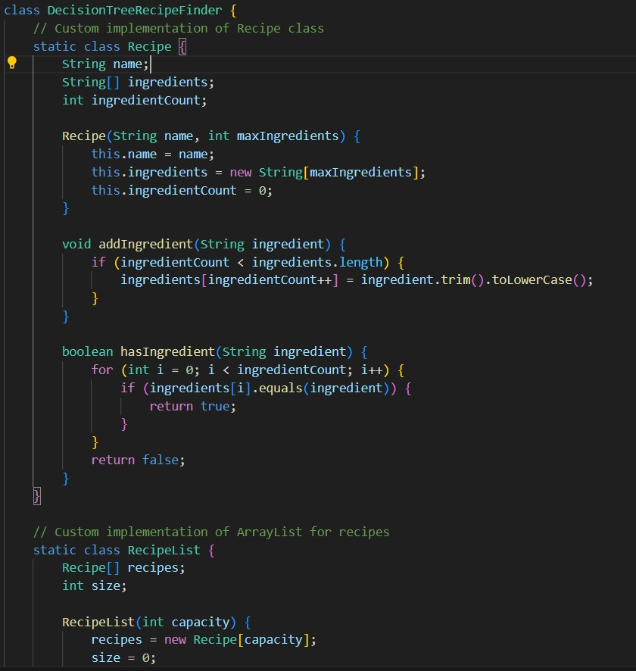
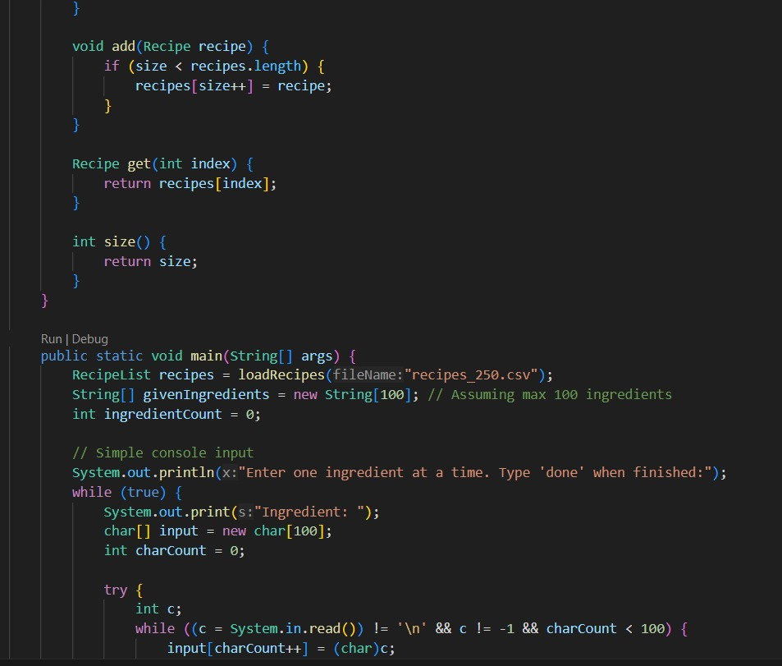
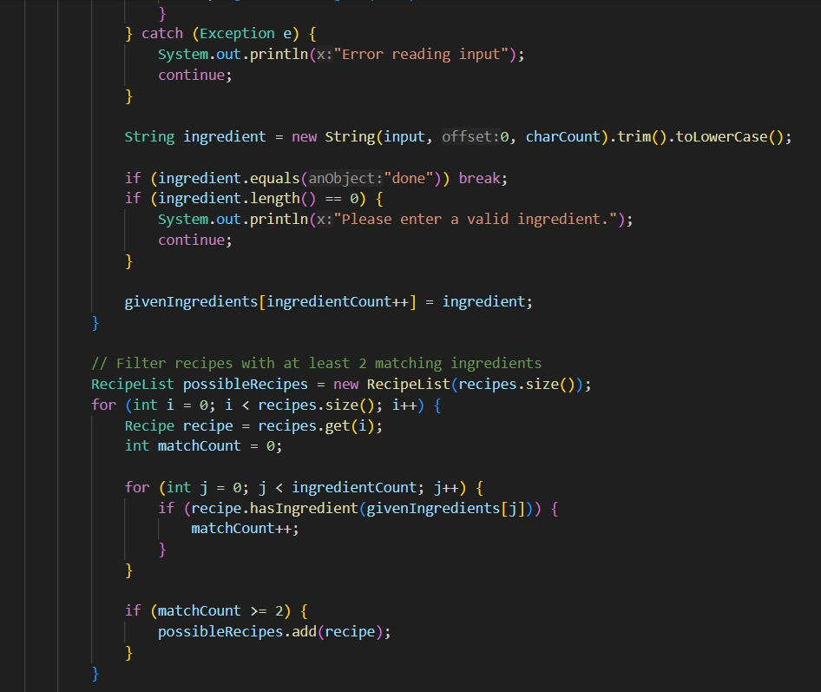
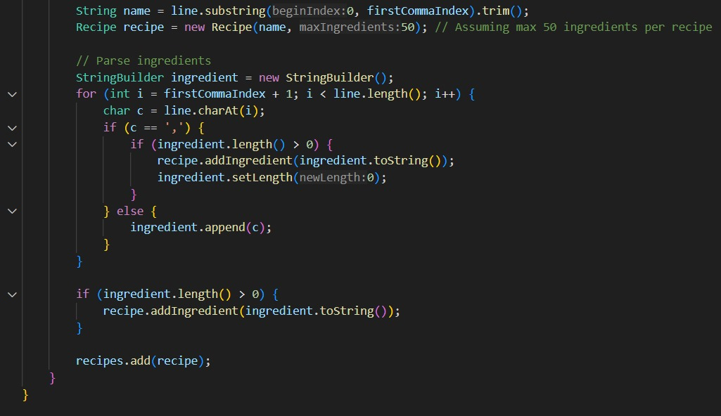

Slide 8
GUI Module
Built with Java Swing components: JFrame, JTextArea, JTextField, JList.
Users enter ingredients via text field.
Recipes displayed in scrollable result area.
Buttons trigger add/remove/search actions.

Slide 9
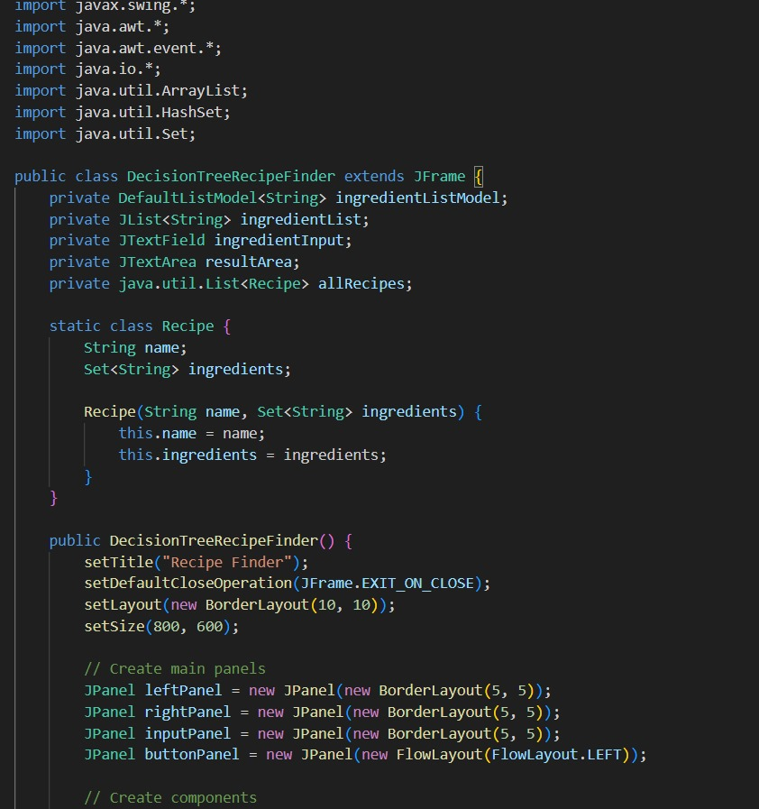
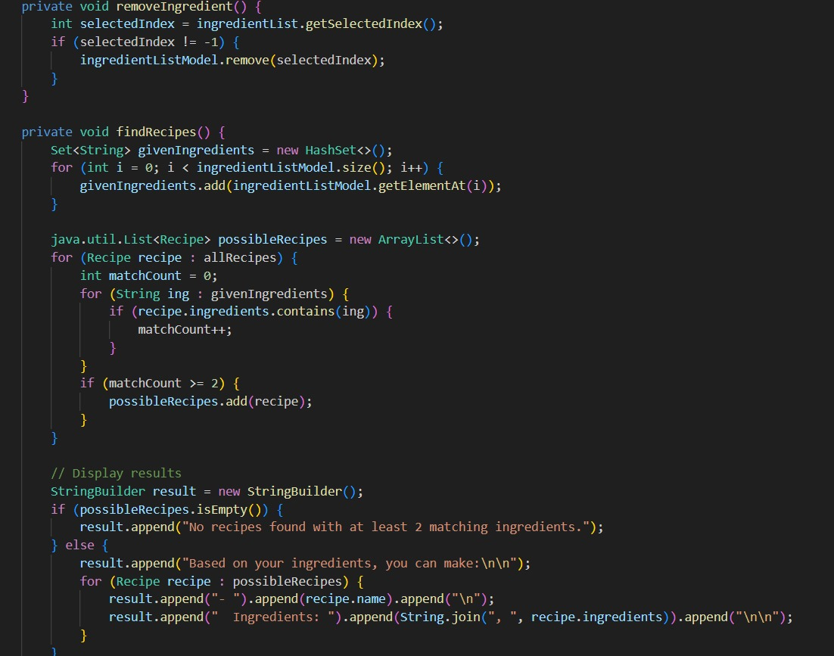
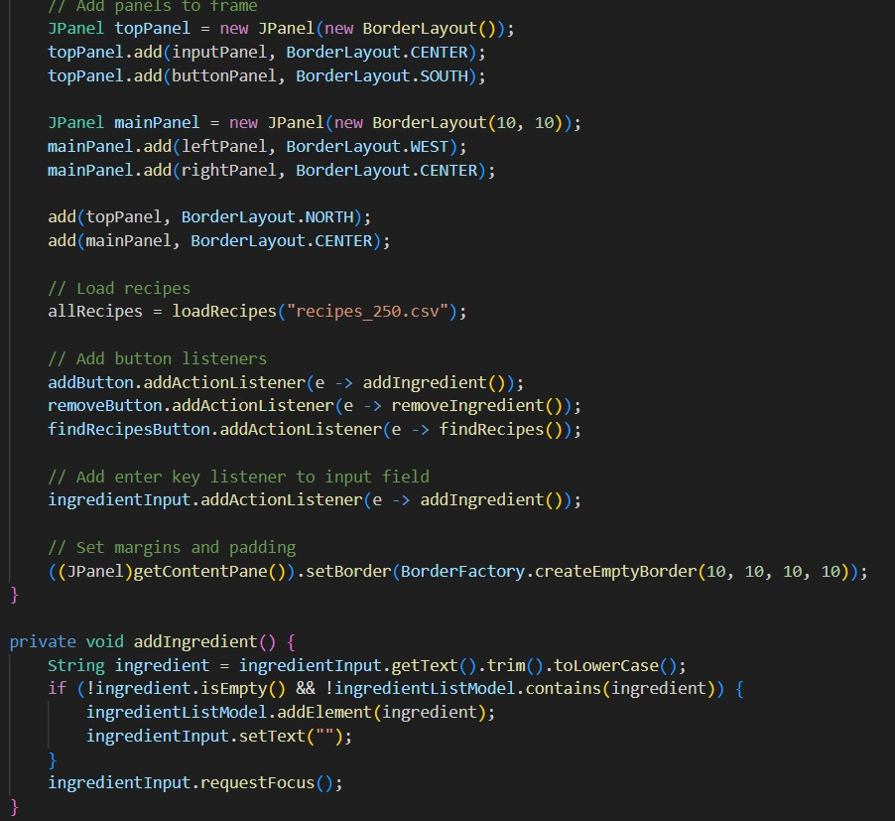

Slide 10
Console Module
Designed without Java built-in libraries.
Uses custom Recipe and RecipeList classes.
Manual string parsing and ingredient matching.
Text-based interaction through terminal.

Slide 11
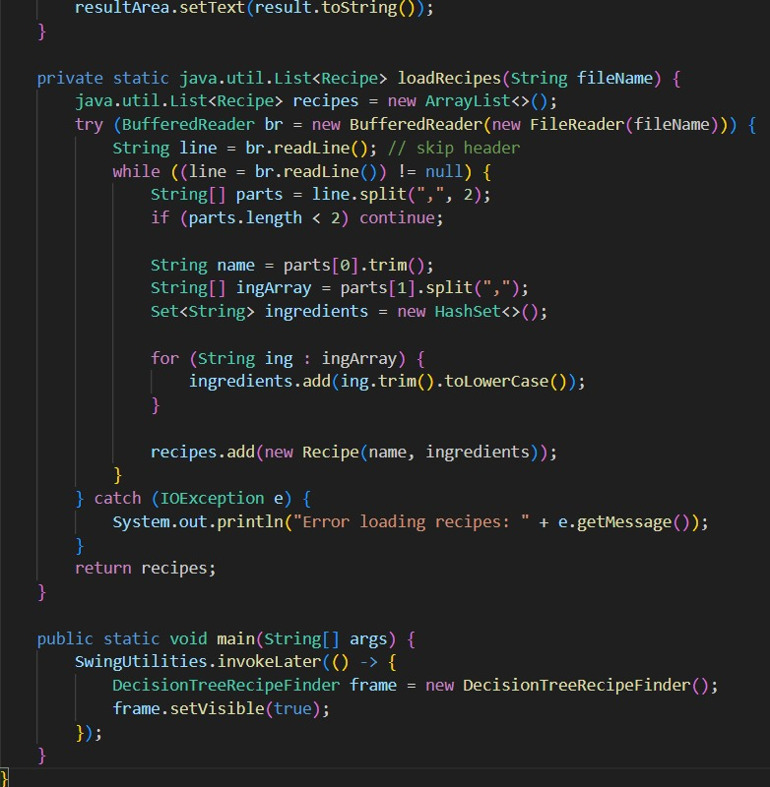
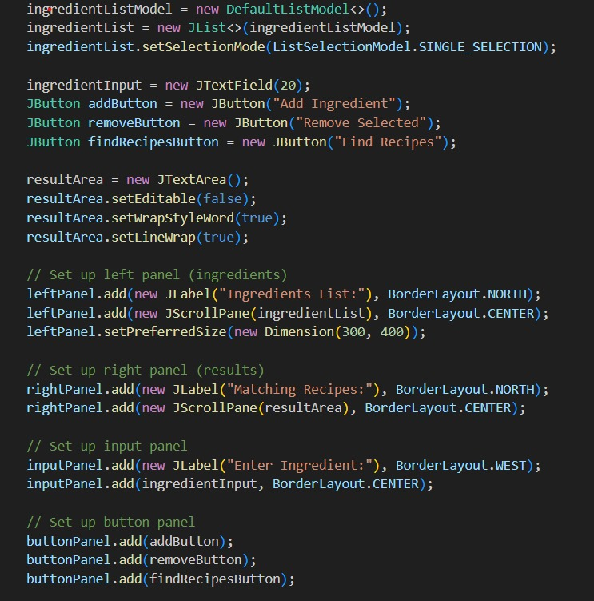
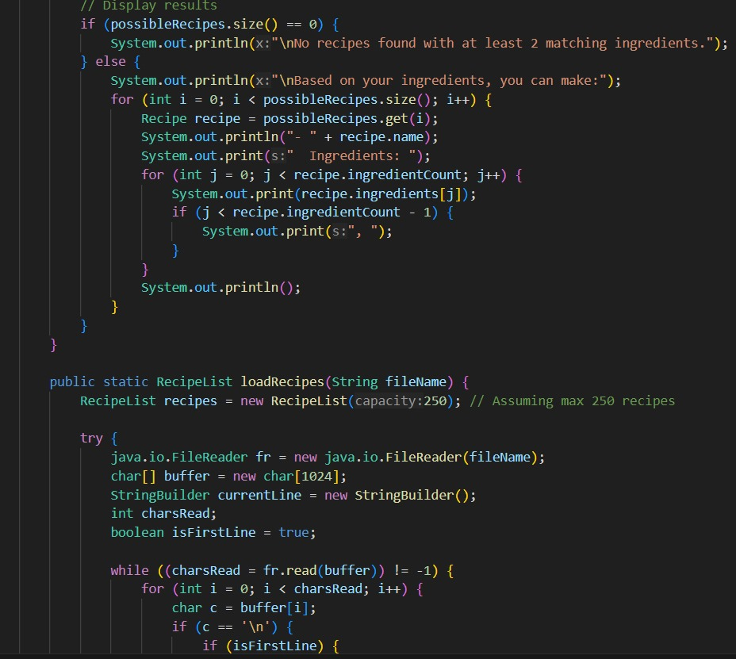

Slide 12
Decision Rule
Recipes are suggested if 2+ ingredients match.
Simulates binary decision logic.
IF ingredient match ≥ 2 → include recipe.
ELSE → exclude recipe.

Slide 14
Testing
Manual Tests: empty input, valid/invalid entries, correct results.
Automated Tests:
- File loading verification
- Matching logic validation
- Edge case handling (no match, empty input)

Slide 15
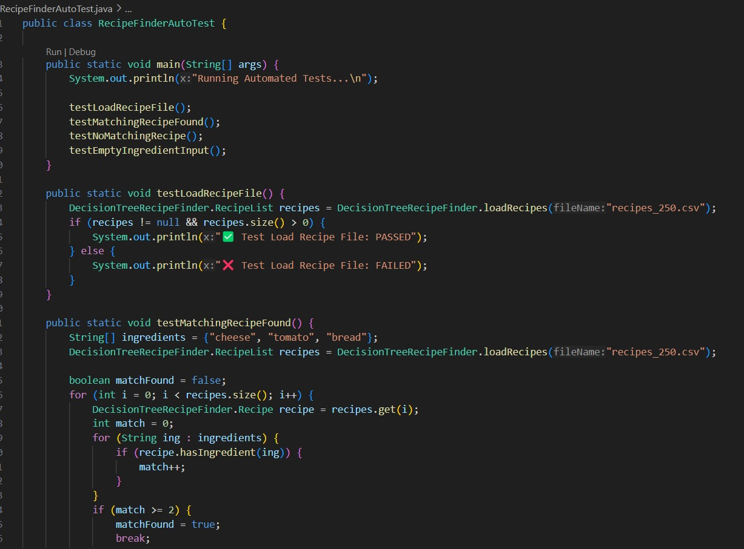
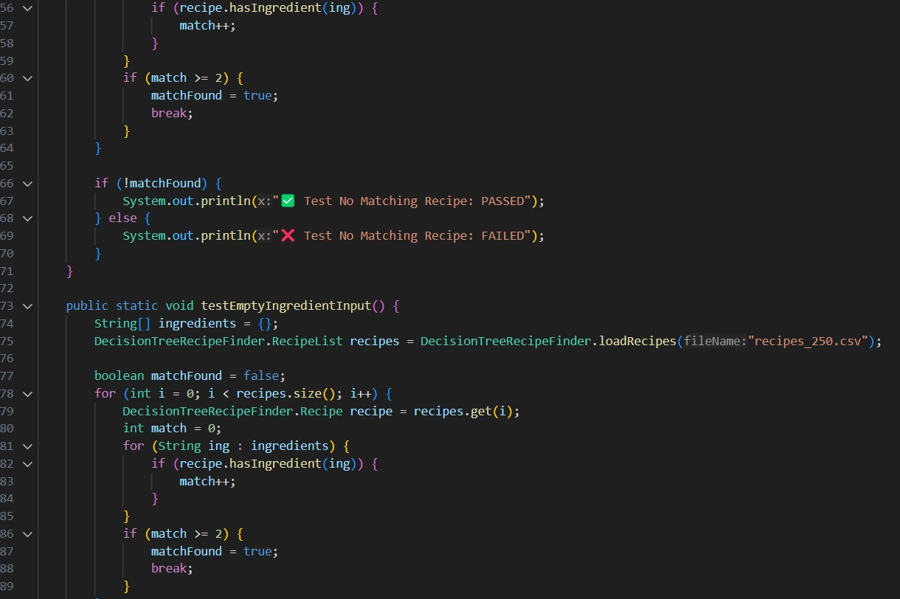
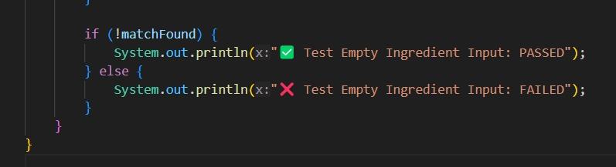

Slide 16
Results
GUI and CLI performed reliably.
Efficient filtering of recipes by ingredient match.
Responsive and robust to incorrect input.
Passed all manual and automated test cases.

Slide 17
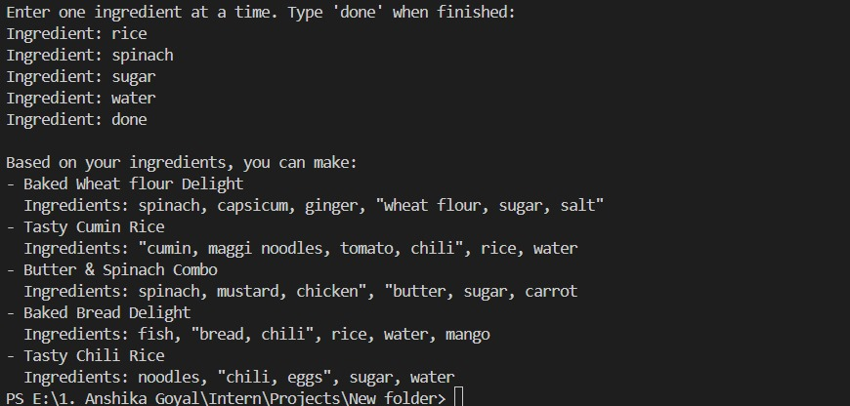
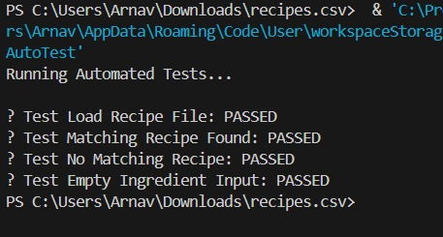
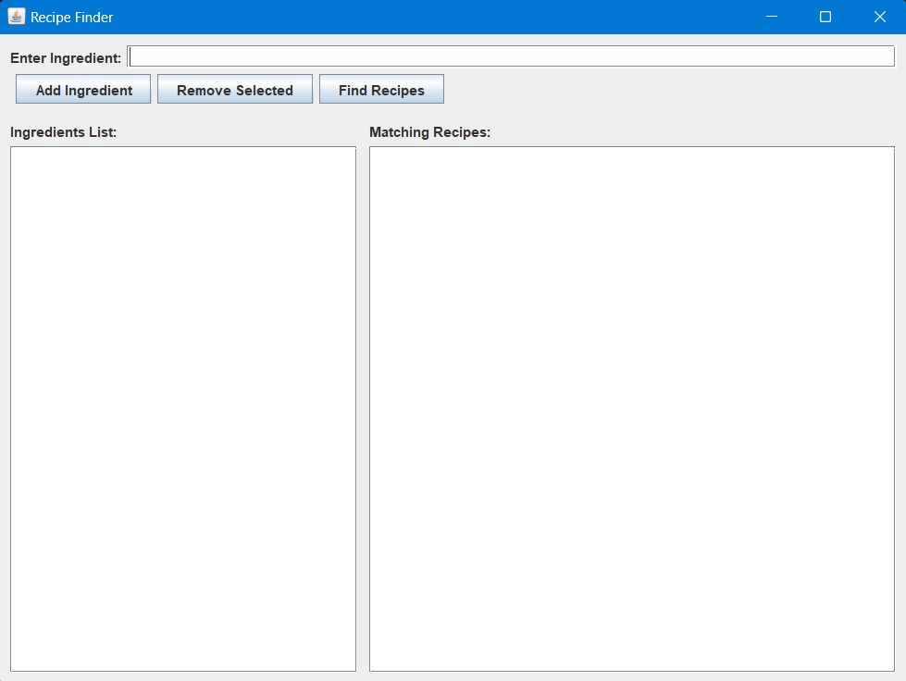
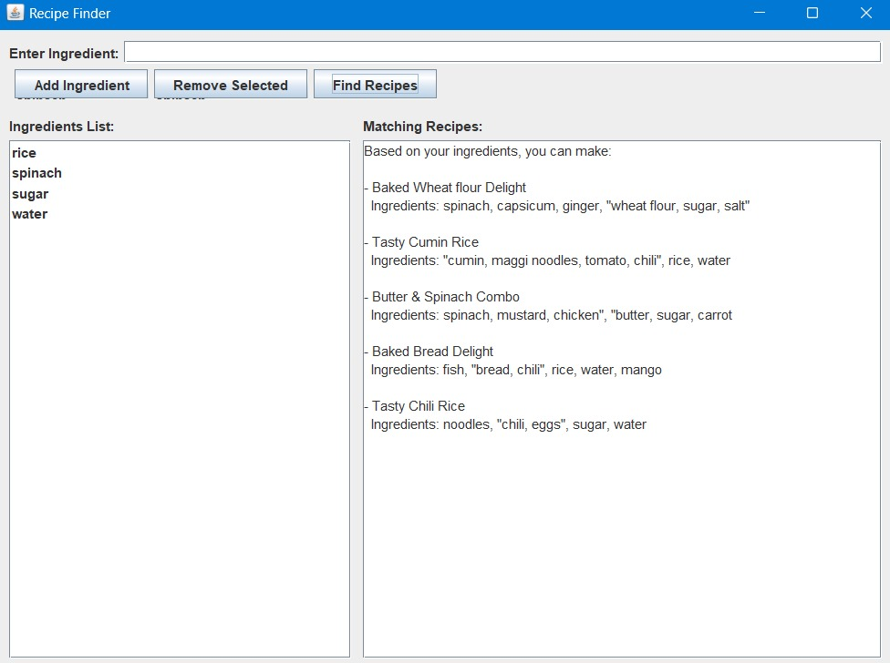

Slide 18
Challenges
No support for fuzzy matching or synonyms.
Static CSV file – no dynamic upload.
No ranking system for best matches.
Basic GUI layout – needs enhancement.
Not a true decision tree algorithm.

Slide 19
Conclusion
Practical and educational recipe suggestion tool.
CLI version supports algorithmic learning.
GUI version enhances usability.
Foundation for ML or data science upgrades.
Simple, useful, and portable.

Slide 20
References
Java SE Docs: https://docs.oracle.com/javase/8/
Swing Tutorials: https://docs.oracle.com/javase/tutorial/uiswing/
Dataset: recipes_250.csv
Study: AllRecipes.com, Tasty.co
Testing: Custom Java classes

Slide 21
GitHub Link: Recipe_Finder (https://github.com/anshikagoyal0916/Recipe_Finder)

