Slide 1

Project Title -
Seasonal Agriculture Performance Analysis
Student Name – Anshika Maurya
College Name – Babasaheb Bhimrao Ambedkar Central University
AICTE Student ID – STU6a1863a8001779983334

Slide 2

PROBLEM STATEMENT
Agricultural performance changes with seasons because of differences in rainfall, temperature, soil conditions, resource usage, farming practices and market conditions. However, raw agricultural data does not clearly show how these factors affect crop yield, production, water usage and profitability across different seasons.
This project aims to analyse agricultural data across Kharif, Rabi and Zaid seasons to identify important patterns, compare performance and understand the factors associated with seasonal agricultural outcomes.

Slide 3
Project Description
This project analyses agricultural data from different seasons to understand variations in crop performance. The analysis includes data cleaning, exploratory data analysis, seasonal comparison and visualization.
The project examines factors such as rainfall, temperature, soil conditions, irrigation, fertilizer usage, crop yield, production, water usage, revenue and profit. The results are used to identify seasonal patterns and provide data-based insights for better agriculture planning.

Slide 4

WHO ARE THE END USERS?
Farmers, agricultural planners, government agricultural departments, agricultural analysts and agribusinesses can use the insights from this analysis for better seasonal planning and resource management.

Slide 5

Technology Used
Python
Jupyter Notebook
Pandas — Data cleaning and Analysis
NumPy — Numerical operations
Matplotlib — Data visualization
Seaborn — Statistical visualization

Slide 6
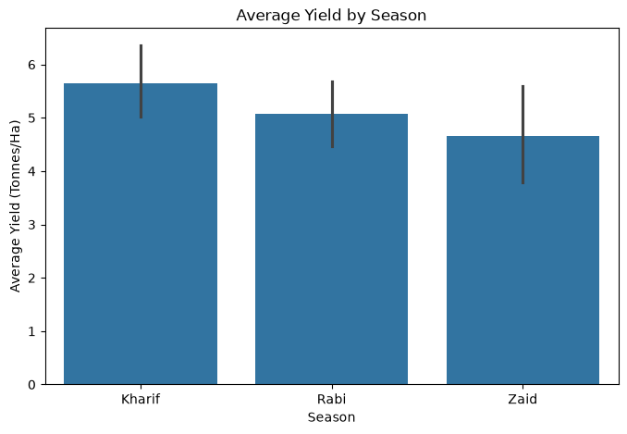
RESULTS
plt.figure(figsize=(8,5))
sns.barplot(
data=df,
x="Season",
y="Yield_Tonnes_Ha",
estimator="mean"
)
plt.title("Average Yield by Season")
plt.xlabel("Season")
plt.ylabel("Average Yield (Tonnes/Ha)")
plt.show()

Slide 7
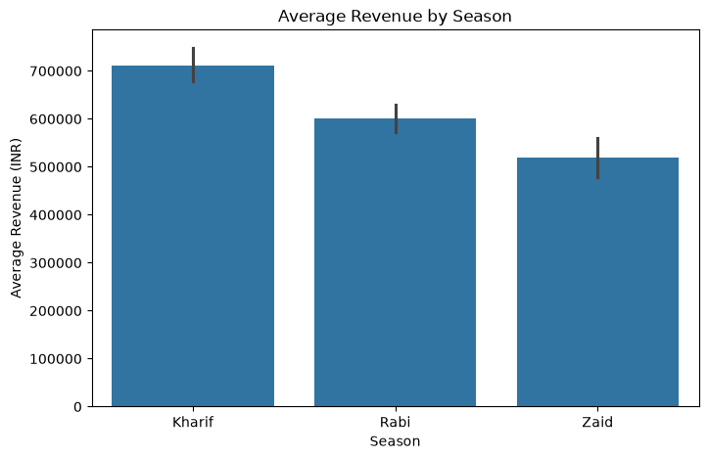
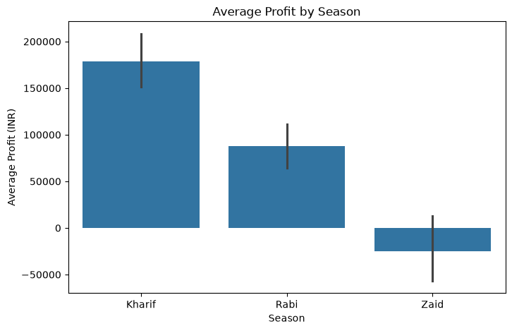
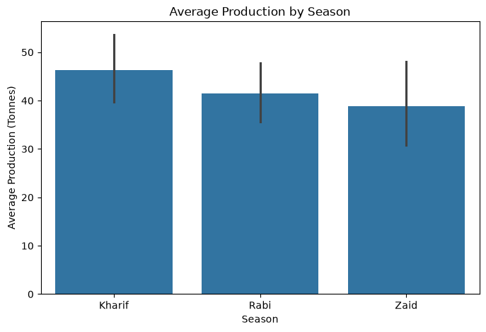
RESULTS
plt.figure(figsize=(8,5))
sns.barplot(
data=df,
x="Season",
y="Production_Tonnes",
estimator="mean"
)
plt.title("Average Production by Season")
plt.xlabel("Season")
plt.ylabel("Average Production (Tonnes)")
plt.show()
plt.figure(figsize=(8,5))
sns.barplot(
data=df,
x="Season",
y="Revenue_INR",
estimator="mean"
)
plt.title("Average Revenue by Season")
plt.xlabel("Season")
plt.ylabel("Average Revenue (INR)")
plt.show()
plt.figure(figsize=(8,5))
sns.barplot(
data=df,
x="Season",
y="Profit_INR",
estimator="mean"
)
plt.title("Average Profit by Season")
plt.xlabel("Season")
plt.ylabel("Average Profit (INR)")
plt.show()

Slide 8
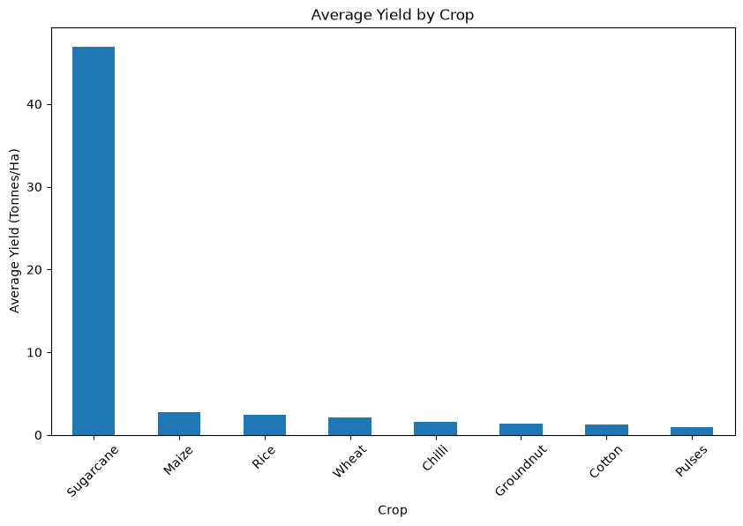
RESULTS
Season | Kharif | Rabi | Zaid
Crop
Chilli | 1.731413 | 1.461615 | 1.177742
Cotton | 1.372804 | 1.192915 | 0.951648
Groundnut | 1.483646 | 1.221445 | 1.037778
Maize | 2.966410 | 2.614913 | 2.297590
Pulses | 1.036063 | 0.871887 | 0.652131
Rice | 2.707621 | 2.333680 | 1.900490
Sugarcane | 53.459120 | 43.940394 | 38.423922
Wheat | 2.255430 | 2.058814 | 1.748588
plt.figure(figsize=(10,6))
crop_yield.plot(kind="bar")
plt.title("Average Yield by Crop")
plt.xlabel("Crop")
plt.ylabel("Average Yield (Tonnes/Ha)")
plt.xticks(rotation=45)
plt.show()
season_crop = df.pivot_table(
values="Yield_Tonnes_Ha",
index="Crop",
columns="Season",
aggfunc="mean"
)
season_crop

Slide 9
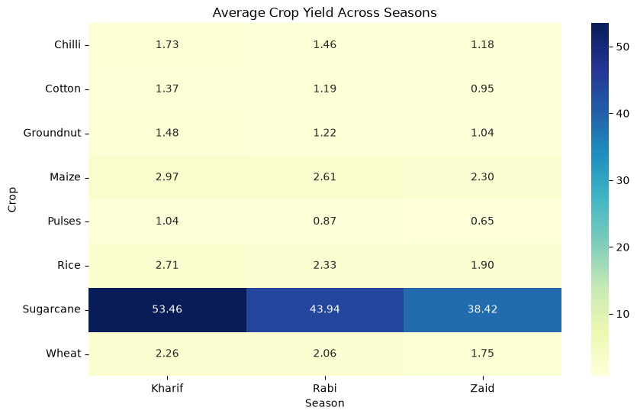
RESULTS
plt.figure(figsize=(10,6))
crop_yield.plot(kind="bar")
plt.title("Average Yield by Crop")
plt.xlabel("Crop")
plt.ylabel("Average Yield (Tonnes/Ha)")
plt.xticks(rotation=45)
plt.show()

Slide 10
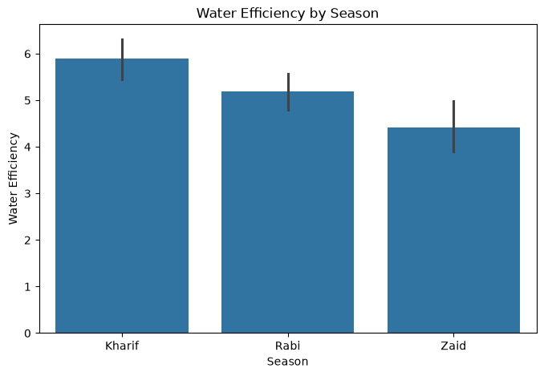
RESULTS
plt.figure(figsize=(8,5))
sns.barplot(
data=df,
x="Season",
y="Water_Efficiency_t_per_1000m3",
estimator="mean"
)
plt.title("Water Efficiency by Season")
plt.xlabel("Season")
plt.ylabel("Water Efficiency")
plt.show()

Slide 11
Future scope
]
Analyze agricultural performance using more years of data.
Include additional weather and market-related data.
Develop crop-wise seasonal prediction models.
Study regional differences in greater detail.
Develop early-warning insights for crop and pest risks.
Build an interactive dashboard for farmers and agricultural planners.

Slide 12
GitHub Link
anshikamaurya7/Seasonal-Agriculture-Performance-Analysis: A Python-based data analytics project that explores how agricultural performance varies across Kharif, Rabi, and Zaid seasons using crop, environmental, resource, yield, water-efficiency, and financial data.

Slide 13

VOIS Course completion certificate -
Course name- Data Visualization

Slide 14
Thank you
.
.

