Slide 1
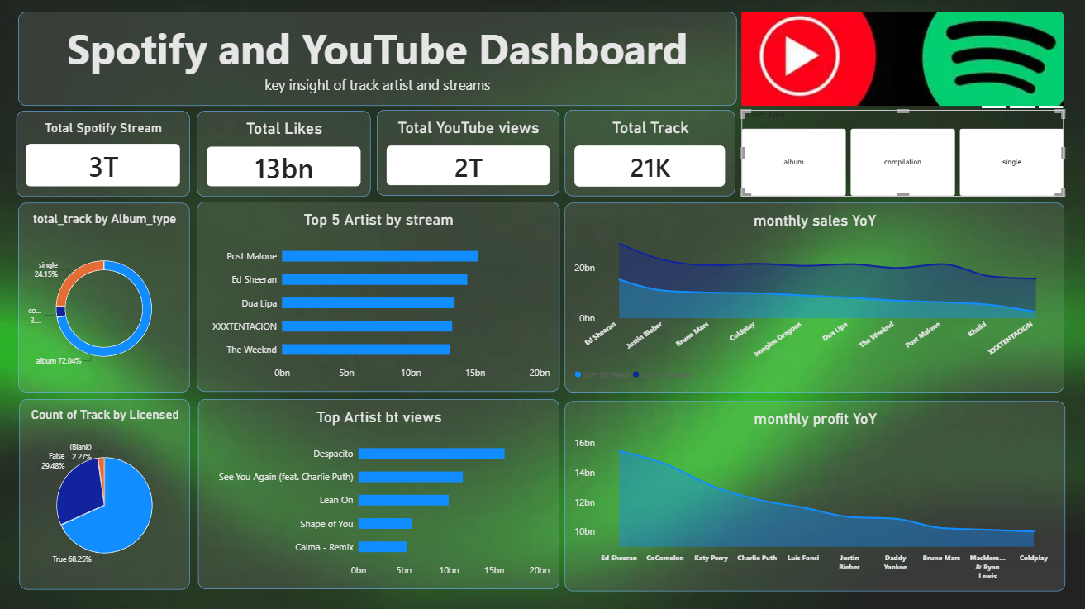
SPOTIFY &
YOUTUBE
MUSIC PERFORMANCE
DASHBOARD
An overview of streams, views, likes,
artist performance and monthly trends
POWER BI • DESCRIPTIVE ANALYSIS
Dashboard presentation

Slide 2
Dashboard at a glance
02
A single view of music engagement across Spotify and YouTube.
The dashboard combines high-level KPIs with artist rankings, album-type distribution and monthly performance trends.

Slide 3
Key performance indicators
03
Headline metrics summarise the scale of music consumption in the dataset.
3T
13bn
2T
21K
Total Spotify streams
Total likes
Total YouTube views
Total tracks
Large-scale listening activity
Audience interaction signal
Video reach and discovery
Breadth of the music catalogue
How to read these metrics
Streams and views represent consumption; likes indicate engagement; total tracks describe the catalogue size. Together, they provide a quick baseline before exploring which artists and formats lead.

Slide 4
Top artists by Spotify streams
04
The ranking highlights artists with the strongest stream totals in the displayed data.
Post Malone
15.3bn
Ed Sheeran
14.4bn
Dua Lipa
13.4bn
XXXTENTACION
13.2bn
The Weeknd
13.0bn
Insight: the top five artists appear relatively close in stream volume, so small differences may still matter when comparing performance.

Slide 5
Top tracks by YouTube views
05
Video views help identify tracks with broad reach on the video platform.
Despacito
16.0bn
See You Again (feat. Charlie Puth)
11.5bn
Lean On
10.0bn
Shape of You
5.8bn
Calma - Remix
5.2bn
Despacito leads the displayed view ranking, while the remaining tracks show a wider spread in audience reach.

Slide 6
Track catalogue: album type & licensing
06
Composition metrics describe the structure and licensing status of the available tracks.
Tracks by album type
Track licensing status
Album • 72.04%
True • 68.25%
Single • 24.15%
False • 29.48%
Compilation • 3.81%
Blank • 2.27%
Albums make up the majority of tracks in the displayed dataset.
Most tracks are marked True; the False and Blank categories may need further review.

Slide 7
Monthly performance trends
07
Year-over-year views and profit are presented as trend comparisons in the dashboard.
Monthly sales / views YoY
Monthly profit YoY
Trend varies slightly, with a gradual downward movement toward the final category.
The profit series declines across the displayed artist categories, suggesting a need to investigate what drives the difference.

Slide 8
Key findings & conclusion
08
What the dashboard helps us understand.
•
The dataset reports approximately 3T Spotify streams, 2T YouTube views, 13bn likes and 21K tracks.
•
Post Malone ranks first among the displayed artists by Spotify streams.
•
Despacito has the highest YouTube view total among the tracks shown.
•
Albums represent the largest share of the catalogue, at about 72%.
•
The monthly profit trend slopes downward across the displayed categories.
Conclusion
The dashboard turns music-platform data into an accessible summary of reach, engagement and catalogue composition. Further analysis could validate trends over time and investigate the factors behind differences in artist performance.
Note: figures and trend descriptions are based on the supplied dashboard; rounded values are retained as displayed.

