Slide 1
Data-Efficient Visual Quality Inspection
ViT-B/16 vs ResNet-18 for casting defect classification
Anshika Reddy Annapureddy · 1651353
MAAI901 · University of Wollongong in Dubai
Instructor: Dr. Milan Dordevic
Notes:
(~10 s) Introduce yourself and the project: a controlled comparison of a Vision Transformer and a CNN for casting defect classification when labelled data is reduced.

Slide 2
Problem statement
Research question
Can Vision Transformers (ViT) outperform Convolutional Neural Networks (CNN) for defect classification when trained on a small dataset?
Aim
Casting lines need a fast accept/reject decision on each impeller.
Fine-tune ViT-B/16 and ResNet-18 on the same Kaggle casting dataset at 100%, 50% and 25% of the training pool.
Evaluate every run on one fixed test set of 715 images.
Notes:
(~20 s) Read the research question. Quality inspection needs a quick yes/no decision and defect labels are scarce, so we ask whether a ViT holds up better than a CNN as labelled data shrinks. Mention the fixed 715-image test set.

Slide 3
Literature Review
Five studies were reviewed:
Study | Focus | Gap for this project
A survey of deep learning for industrial visual anomaly detection. | Industrial anomaly detection survey | No reduced-label ViT/CNN protocol
A survey on industrial image anomaly detection: Methods, benchmarks and rethinks. | Methods and benchmarks survey | No casting-photo ViT vs CNN
Beyond local receptive fields: Vision transformers for real-time surface defect detection in FDM. | ViT on FDM depth maps | Different modality; no CNN control
SDA-PVTDet: A spatial-cross dual attention pyramid vision transformer detector for casting defect detection in radiography images. | Radiography casting detection | Localization, not photo classification
Smart casting. | Smart casting impeller CNN/ViT | No data-efficiency or cost table
Three gaps motivate the experiments:
no controlled study of how performance changes as labelled training data decreases for both ViT and CNN on casting images.
no like-for-like comparison of ViT and ResNet on this modality.
results of defect detection performance and their computational cost are rarely reported together.
Notes:
(~20 s) Read the research question. Quality inspection needs a quick yes/no decision and defect labels are scarce, so we ask whether a ViT holds up better than a CNN as labelled data shrinks. Mention the fixed 715-image test set.

Slide 4
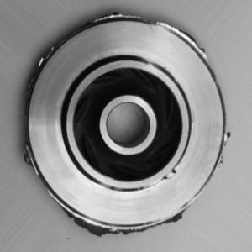
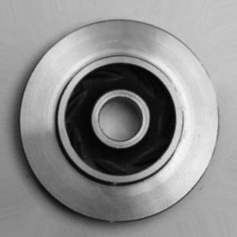
Dataset and Methodology
Dataset
Method
ImageNet-pretrained ViT-B/16 and ResNet-18.
224×224 RGB, ImageNet normalisation; flip and ±10° rotation on training images only.
Seed 42, Colab GPU, early stopping on validation macro-F1 (max 30 epochs).
Six runs: 2 models × 3 training fractions.
Acceptable
Defective
Used Kaggle Casting Product Image Data (CC BY-SA 4.0).
Data split: Train pool 5,638, validation 995, Test 715 (262 acceptable, 453 defective).
Augmented copies grouped by filename to prevent leakage.
Notes:
(~35 s) Top-view photographs of cast impellers, split into train, validation and a fixed test set. Both models start from ImageNet weights and share the same pre-processing and training protocol, so the only variables are architecture and training-set size.

Slide 5
Results
Both models reach 99.4–99.7% accuracy; ResNet-18 does so at a fraction of the cost.
Model | Train | Acc. % | F1 % | Recall % | Train (s) | Infer (ms)
ResNet-18 | 100% | 99.72 | 99.70 | 99.56 | 213 | 0.94
ResNet-18 | 50% | 99.58 | 99.55 | 99.34 | 108 | 0.94
ResNet-18 | 25% | 99.72 | 99.70 | 99.56 | 118 | 0.93
ViT-B/16 | 100% | 99.72 | 99.70 | 99.78 | 1781 | 12.30
ViT-B/16 | 50% | 99.44 | 99.40 | 99.56 | 1534 | 12.27
ViT-B/16 | 25% | 99.44 | 99.40 | 99.34 | 534 | 12.41
Observations:
ResNet-18 slightly ahead at 50% and 25% data
Inference: 0.9 ms vs 12 ms per image
Model size: 43 MB vs 327 MB
1–3 missed defects per run.
Notes:
(~45 s) Accuracy is near ceiling for both models, between 99.4% and 99.7%. At 50% and 25% of the training data ResNet is slightly ahead on accuracy and macro-F1. The real difference is cost: ResNet is about 43 MB and under 1 ms per image, ViT about 327 MB and around 12 ms. Defect recall matters most because a missed defect is the costly error; there were one to three per run.

Slide 6
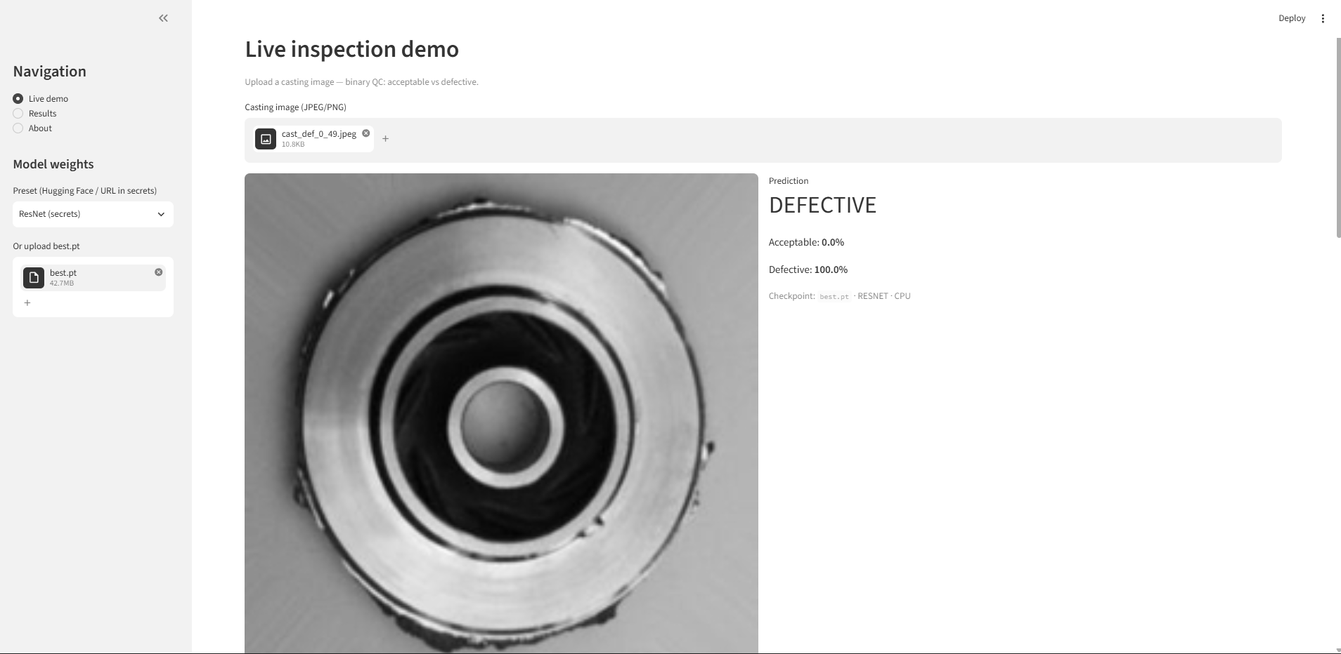
Demonstration
Built on the same trained checkpoints
Upload an image to get class scores
Grad-CAM overlay shows the regions behind a ResNet decision
Results page reads comparison_table.csv
Live demo: ResNet-18 classifies an uploaded impeller as defective (100.0%).
streamlit run streamlit_app.py
(runs locally)
Notes:
(~25 s) Show the Streamlit app: upload an impeller image, read the class scores, view the Grad-CAM overlay, and open the Results page. It runs locally with: streamlit run streamlit_app.py.

Slide 7
Challenges, limitations and future scope
Challenges
Limitations
Future scope
Re-uploading repo and data on every Colab session
Writing metrics to CSV reliably
Grad-CAM batch dimensions in Streamlit
Fitting ViT at 100% into Colab time limits
One product type and lighting setup
Near-ceiling scores suggest an easy task
Single seed (42)
Human review still needed on the line
Multiple seeds; report mean ± std
Edge test with a quantised ResNet
ViT attention maps beside Grad-CAM
New site or partner dataset
Notes:
(~25 s) Challenges were mostly practical: Colab sessions, CSV logging, Grad-CAM in Streamlit and GPU time for ViT. Main limitations: one product and lighting setup, very high scores, and a single seed. Next steps: multiple seeds, edge deployment, ViT attention maps and a new site.

Slide 8
Conclusion
ResNet-18 is the practical choice when labels or hardware are limited.
ViT-B/16 remains viable with full data and GPU capacity.
Thank you. Questions welcome.
Notes:
(~20 s) Both models work well. With limited labels or edge hardware, ResNet-18 matched or beat ViT at far lower cost; ViT is reasonable when full data and GPU time are available. Thank the audience and invite questions.

