Slide 1
Evidence-Based Answer Classification on PubMedQA
Text classification · TF–IDF · BERT · PubMedBERT
Anshika Reddy Annapureddy (1651353)
MAAI902 - NLP and LLMs
University of Wollongong in Dubai
Instructor: Dr. Pallavi Ranjan
Notes:
(~10 s) Introduce yourself and the project: a controlled comparison of a Vision Transformer and a CNN for casting defect classification when labelled data is reduced.

Slide 2
Problem statement
Research question
Can fine-tuned biomedical text encoders (BERT-base, PubMedBERT) improve three-way evidence classification (yes / no / maybe) over a TF–IDF + logistic regression baseline on PubMedQA expert question–abstract pairs?
Aim
Input is text only: research question + PubMed abstract (module emphasis on pre-processing, representation, and NLP pipelines).
Output: whether the abstract supports yes, no, or maybe as an answer.
Compare three discriminative classifiers on the same fused strings.
Evaluation: expert pqa_labeled subset only; official test n = 500 (train 425, validation 75, seed 42). [2]
Notes:
(~20 s) Read the research question. Quality inspection needs a quick yes/no decision and defect labels are scarce, so we ask whether a ViT holds up better than a CNN as labelled data shrinks. Mention the fixed 715-image test set.

Slide 3
Literature Review
Papers reviewed:
Paper | Focus | Link to this work
PubMedQA: A dataset for biomedical research question answering [2] | Question + abstract → yes / no / maybe (expert labels) | Task, dataset, expert-only test policy
Benchmarking LLMs for biomedical NLP (Nature Communications, 2025) [1] | Fine-tuned encoders vs zero / few-shot LLMs on BioNLP tasks | Justifies BERT / PubMedBERT fine-tuning over prompts
Reasoning or knowledge: Stratified evaluation of biomedical LLMs [5] | Separates knowledge-recall vs multi-step reasoning items | Motivates macro-F1 and per-class text metrics
MedHallu: Detecting medical hallucinations in LLMs [4] | Hallucination benchmark incl. PubMedQA expert subset | Treats maybe / uncertainty as safety-relevant
Questioning our questions: Medical QA benchmarks vs clinical capability [3] | Meta-analysis of benchmark vs clinical LLM performance | Literature triage only — not bedside diagnosis
This study closes the gap between prompt-LLM hype and fine-tuned encoders on a small, expert-validated text corpus. [1]
Pre-processing is explicit: sparse TF–IDF n-grams vs subword transformer tokenisation. [8] [9]
Uncertainty (maybe) is reported with confusion structure, not hidden by accuracy alone.
Claims stay at literature-support level (UAE research triage), not clinical decision-making.
Notes:
(~20 s) Read the research question. Quality inspection needs a quick yes/no decision and defect labels are scarce, so we ask whether a ViT holds up better than a CNN as labelled data shrinks. Mention the fixed 715-image test set.

Slide 4
Text inputs and dataset
Text fields (input)
Labels & splits
Question field: natural-language research question (PubMed title style).
Context field: abstract sentences concatenated into one string.
Fused model input: question: {q} abstract: {a} (identical for all models).
Corpus: Hugging Face qiaojin/PubMedQA, pqa_labeled (1,000 expert annotations). [2] [9]
English biomedical text; UTF-8 normalisation before vectorisation / tokenisation. [9]
Target: one label — yes, no, or maybe (strength of evidence in text).
Official test: 500 publication IDs held out by PubMedQA. [2]
Training fit: 425 examples; validation: 75 (stratified split, seed 42).
Class imbalance: maybe ≈ 11% → macro-F1 and confusion analysis required.
pqa_artificial excluded from reported metrics (module requirement).
Notes:
(~35 s) Top-view photographs of cast impellers, split into train, validation and a fixed test set. Both models start from ImageNet weights and share the same pre-processing and training protocol, so the only variables are architecture and training-set size.

Slide 5
Pre-processing and text embeddings
Classical pipeline
Transformer pipeline
Lowercasing; unigrams and bigrams from the fused string.
TfidfVectorizer: max_features 50,000, sublinear_tf, min document frequency. [8]
Sparse bag-of-n-grams → multinomial logistic regression (class-balanced). [8]
Same text input as transformers to isolate embedding choice. [9]
Subword tokenisation (WordPiece) via Hugging Face. [9]
Max sequence length 512 tokens; truncate / pad as required.
PubMedBERT checkpoint: BiomedNLP-PubMedBERT-base-uncased-abstract-fulltext. [7]
Fine-tune sequence classification head; 3 epochs; early stopping on validation macro-F1.

Slide 6
Models, tools and text evaluation
Three text classifiers
Metrics & reproducibility
TF–IDF + logistic regression — interpretable sparse baseline. [8]
BERT-base-uncased — general-domain transformer encoder. [6]
PubMedBERT — biomedical domain pre-training on PubMed text. [7]
All models trained and evaluated on identical fused strings.
Primary metrics: accuracy, macro-F1, per-class precision / recall / F1.
Error analysis: confusion matrices; qualitative maybe → yes / no cases.
Efficiency: training wall-clock and ms per example (Colab T4 GPU).
Stack: Python 3, Hugging Face Transformers, scikit-learn, pandas, Streamlit. [9] [8]

Slide 7
Results
Official expert test set (n = 500). PubMedBERT achieves the highest accuracy (60.4%) and macro-F1 (0.391). Only the TF–IDF baseline assigns non-zero maybe F1. [7] [8]
Model | Acc. % | Macro-F1 | F1 maybe | Train (s) | Infer (ms) | Notes
TF–IDF + LogReg [8] | 53.2 | 0.363 | 0.067 | 1.3 | 2.7 | Text baseline
BERT-base [6] | 55.2 | 0.237 | 0.000 | 93.9 | 27.9 | All-yes collapse
PubMedBERT [7] | 60.4 | 0.391 | 0.000 | 67.2 | 25.5 | Best on text
Observations:
BERT-base collapses to predicting yes for all 500 test instances (accuracy misleading). [6]
PubMedBERT improves yes / no separation but predicts maybe zero times on test. [7]
Baseline remains fastest at inference (~2.7 ms / example) with weak maybe recall.
Notes:
(~45 s) Accuracy is near ceiling for both models, between 99.4% and 99.7%. At 50% and 25% of the training data ResNet is slightly ahead on accuracy and macro-F1. The real difference is cost: ResNet is about 43 MB and under 1 ms per image, ViT about 327 MB and around 12 ms. Defect recall matters most because a missed defect is the costly error; there were one to three per run.

Slide 8
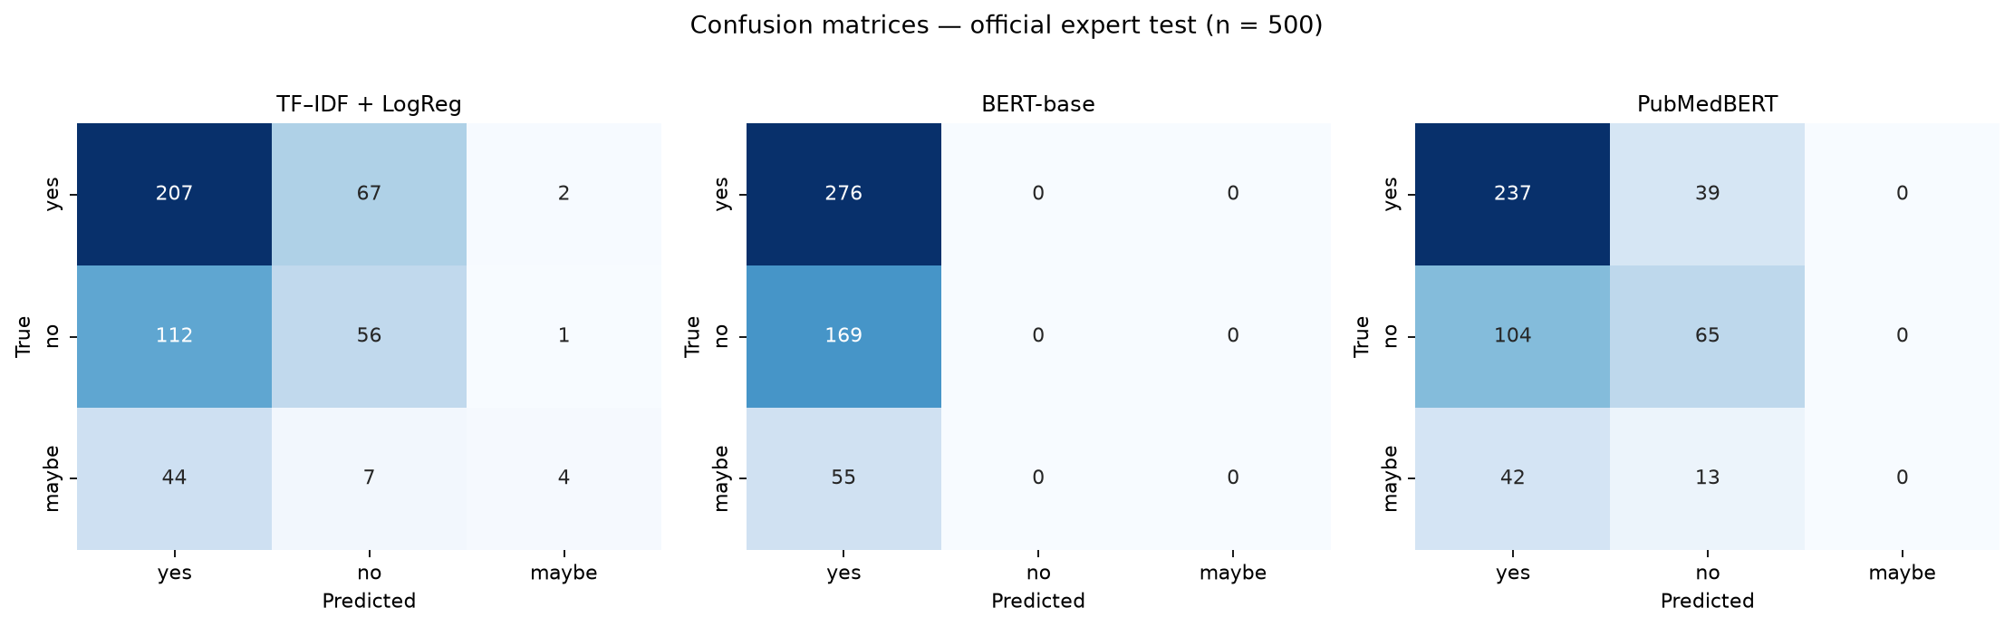
Confusion matrices (official test, n = 500)
BERT-base: single-column matrix (all predictions = yes). [6]
PubMedBERT: strongest diagonal for yes and no; no predicted maybe. [7]
Baseline: only heatmap with non-zero maybe column (low recall).
Reading: rows = gold label; columns = predicted label on fused text.
PubMedBERT: strongest yes/no diagonal mass; still no predicted maybe. [7]
Baseline: sparse text model retains a thin maybe column (recall ≈ 4%).
Error structure on held-out expert text (seed 42, n = 500).

Slide 9
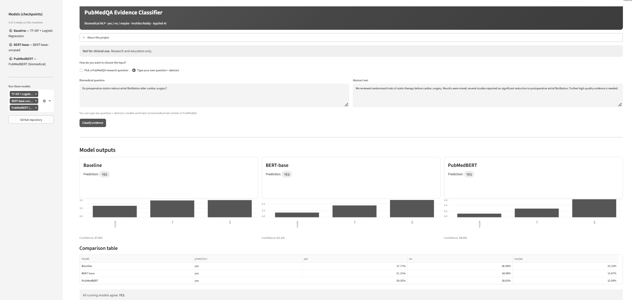
Demonstration
Side-by-side inference for all three trained text classifiers.
Select an expert PubMedQA item or paste custom biomedical text. [2]
Probability bars per label; optional reveal of gold expert label.
Research prototype only — not for diagnosis or treatment decisions.
Local run:
streamlit run pubmedqa_evidence_demo.py --server.port 8510
Notes:
(~25 s) Show the Streamlit app: upload an impeller image, read the class scores, view the Grad-CAM overlay, and open the Results page. It runs locally with: streamlit run streamlit_app.py.

Slide 10
Challenges, limitations and future scope
Challenges
Limitations
Future scope
Colab TrainingArguments recursion (resolved in train_transformer.py).
Large transformer checkpoints re-synced each session (gitignored).
Streamlit / sklearn joblib version alignment (sklearn_compat helper). [8]
Initial Hugging Face dataset download latency on Colab. [9]
Small expert-labelled corpus; single official test split.
Class imbalance — maybe is the hardest text class.
Short fine-tuning budget; hedging and negation still misclassified.
English PubMed abstracts only; benchmark ≠ clinical competence. [3]
Class-weighted loss; longer fine-tuning; calibration or abstain option.
Multi-seed runs; Arabic–English extension aligned with UAE research needs.
Deploy as literature-support under national AI priorities — not bedside NLP. [3]
Notes:
(~25 s) Challenges were mostly practical: Colab sessions, CSV logging, Grad-CAM in Streamlit and GPU time for ViT. Main limitations: one product and lighting setup, very high scores, and a single seed. Next steps: multiple seeds, edge deployment, ViT attention maps and a new site.

Slide 11
Conclusion
PubMedBERT delivers the best accuracy and macro-F1 on expert test text. [7]
TF–IDF + logistic regression remains useful for speed and faint maybe detection. [8]
Pre-processing and embedding choice (sparse vs contextual) is central to NLP evaluation.
Intended use: research literature triage in the UAE — not clinical decision support.
Thank you — questions welcome.
Notes:
(~20 s) Both models work well. With limited labels or edge hardware, ResNet-18 matched or beat ViT at far lower cost; ViT is reasonable when full data and GPU time are available. Thank the audience and invite questions.

Slide 12
References
[1] Chen, Q., Hu, Y., Peng, X., Xie, Q., Jin, Q., Gilson, A., Singer, M. B., Ai, X., Lai, P.-T., Wang, Z., Keloth, V. K., Raja, K., Huang, J., He, H., Lin, F., Du, J., Zhang, R., Zheng, W. J., Adelman, R. A., Lu, Z., & Xu, H. (2025). Benchmarking large language models for biomedical natural language processing applications and recommendations. Nature Communications, 16(1), 3280. https://doi.org/10.1038/s41467-025-56989-2
[2] Jin, Q., Dhingra, B., Liu, Z., Cohen, W., & Lu, X. (2019). PubMedQA: A dataset for biomedical research question answering. In Proceedings of the 2019 Conference on Empirical Methods in Natural Language Processing and the 9th International Joint Conference on Natural Language Processing (EMNLP-IJCNLP) (pp. 2567–2577). Association for Computational Linguistics. https://doi.org/10.18653/v1/D19-1259
[3] Kim, S., & Yoon, H.-J. (2025). Questioning our questions: How well do medical QA benchmarks evaluate clinical capabilities of language models? In Proceedings of the 24th Workshop on Biomedical Language Processing (pp. 274–296). Association for Computational Linguistics. https://doi.org/10.18653/v1/2025.bionlp-1.24
[4] Pandit, S., Xu, J., Hong, J., Wang, Z., Chen, T., Xu, K., & Ding, Y. (2025). MedHallu: A comprehensive benchmark for detecting medical hallucinations in large language models. In Proceedings of the 2025 Conference on Empirical Methods in Natural Language Processing (pp. 27991–28012). Association for Computational Linguistics. https://aclanthology.org/2025.emnlp-main.143/
[5] Thapa, R., Wu, Q., Wu, K., Zhang, H. G., Zhang, A., Wu, E., Ye, H., & Zou, J. (2026). Reasoning or knowledge: Stratified evaluation of biomedical LLMs. In Proceedings of the 19th Conference of the European Chapter of the Association for Computational Linguistics (pp. 2450–2483). Association for Computational Linguistics. https://doi.org/10.18653/v1/2026.eacl-long.111
[6] Devlin, J., Chang, M.-W., Lee, K., & Toutanova, K. (2019). BERT: Pre-training of deep bidirectional transformers for language understanding. In Proceedings of the 2019 Conference of the North American Chapter of the Association for Computational Linguistics: Human Language Technologies (Vol. 1, pp. 4171–4186). Association for Computational Linguistics.
[7] Gu, Y., Tinn, R., Cheng, H., Lucas, M., Usuyama, N., Liu, X., Naumann, T., Gao, J., & Poon, H. (2021). Domain-specific language model pretraining for biomedical natural language processing. ACM Transactions on Computing for Healthcare, 3(1), Article 2. https://doi.org/10.1145/3453474
[8] Pedregosa, F., Varoquaux, G., Gramfort, A., Michel, V., Thirion, B., Grisel, O., Blondel, M., Prettenhofer, P., Weiss, R., Dubourg, V., Vanderplas, J., Passos, A., Cournapeau, D., Brucher, M., Perrot, M., & Duchesnay, E. (2011). Scikit-learn: Machine learning in Python. Journal of Machine Learning Research, 12, 2825–2830.
[9] Wolf, T., Debut, L., Sanh, V., Chaumond, J., Delangue, C., Moi, A., Cistac, P., Rault, T., Louf, R., Funtowicz, M., Davison, J., Shleifer, S., von Platen, P., Ma, C., Jernite, Y., Plu, J., Xu, C., Le Scao, T., Gugger, S., Drame, M., Lhoest, Q., & Rush, A. M. (2020). Transformers: State-of-the-art natural language processing. In Proceedings of the 2020 Conference on Empirical Methods in Natural Language Processing: System Demonstrations (pp. 38–45). Association for Computational Linguistics.
Notes:
(~20 s) Both models work well. With limited labels or edge hardware, ResNet-18 matched or beat ViT at far lower cost; ViT is reasonable when full data and GPU time are available. Thank the audience and invite questions.

