Slide 1



Slide 2
NETFLIX

Slide 3
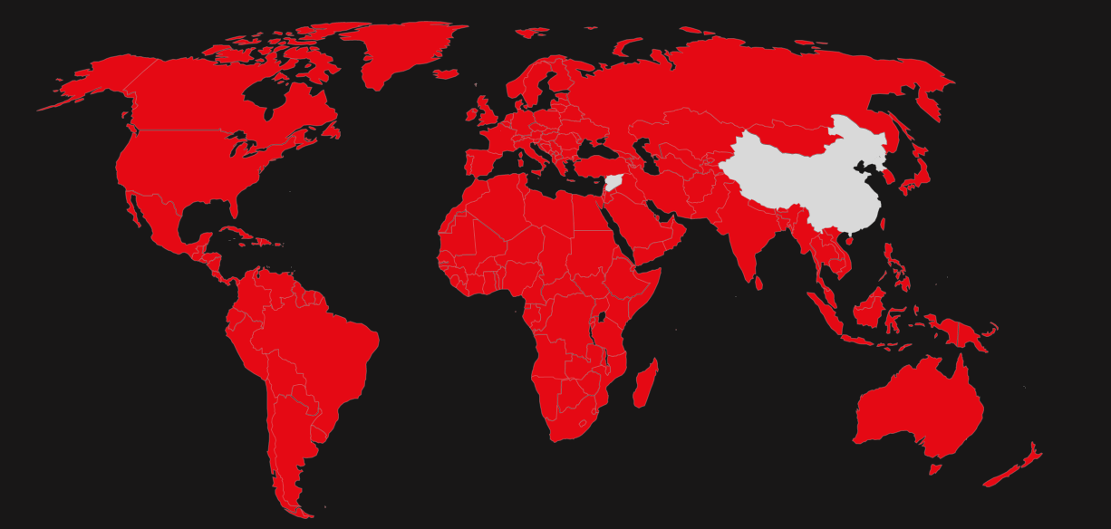
NETFLIX
Netflix is the world's leading video streaming service with over 247.15 million paid subscribers
worldwide broadcasting movies, tv shows, mini series ,tv specials and many more
79 countries

Slide 4

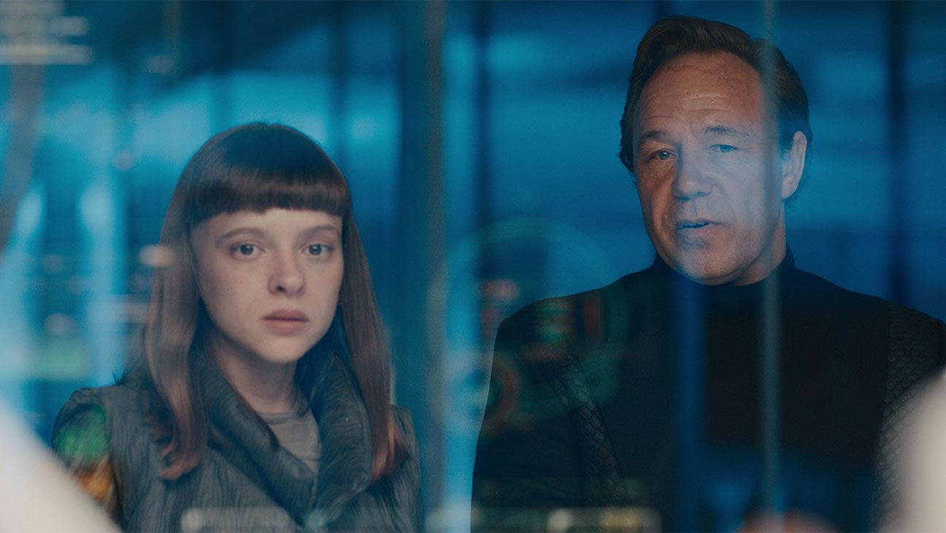


NETFLIX
Home
Tv shows
Movies
Episodes
categories
INTRODUCTION
Welcome to our Netflix GUI, an interactive web application designed to explore and discover insights from a curated dataset of movies and TV shows. Leveraging Streamlit, a powerful Python library for building web apps, we've created an engaging platform that combines Exploratory Data Analysis (EDA), captivating visualizations, and personalized content suggestions tailored to individual preferences.
User Experience:
Our Netflix GUI is designed with user experience in mind. Navigating through different tabs—Home, EDA, Visualizations, and Suggestions—users can seamlessly interact with data, explore intriguing visuals, and discover personalized recommendations. The interface is intuitive, providing a delightful experience for content enthusiasts.

Slide 5




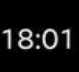




Breaking Bad|S1 EP 1
OBJECTIVES
The main objective of making a movie recommender system is to enhance user experience and engagement by providing personalized movie recommendations tailored to each user's preferences and interests.
Improving User Satisfaction
Increasing User Engagement
Enhancing Discoverability
Boosting Platform Loyalty
Driving Revenue and Business Growth
Optimizing Content Curation

Slide 6



NETFLIX
METHODOLOGY
Interactive
GUI
COLLECT THE DATA
Cleaning &
Preprocessing
EDA/
VISUALIZATION

Slide 7
Breaking Bad|S1 EP 1
Key Features
Exploratory Data Analysis (EDA): We began by diving deep into the dataset to understand its composition. This phase involved analyzing content distribution by type (movies vs. TV shows), exploring popular genres, examining release trends over time, and identifying top-producing countries.
Visualizations: To bring insights to life, we crafted interactive visualizations using tools like Plotly Express and Seaborn. These visualizations showcase trends, patterns, and relationships within the dataset, allowing users to interactively explore content dynamics.
Personalized Content Suggestions: One of the standout features of our Netflix GUI is its recommendation engine. Users can input their preferred genres, release year range, and other criteria to receive tailored content suggestions. Leveraging user preferences, our algorithm recommends titles that align with individual tastes.

Slide 8
NETFLIX
Netflix Dataset Description
The dataset used in our Netflix GUI project contains information about a diverse range of movies and TV shows available on the Netflix platform. This dataset provides valuable metadata and attributes for each title, enabling comprehensive exploration and analysis. Here are the key details and columns included in the dataset:
`show_id`: Unique identifier for each title in the dataset.
`title`: Title of the movie or TV show.
`director`: Director(s) of the movie or TV show.
`cast`: Cast members starring in the movie or TV show.
`country`: Country of origin where the movie or TV show was produced.
`date_added`: Date when the title was added to Netflix.
`release_year`: Year when the movie or TV show was released.
`rating`: Content rating assigned to the title (e.g., TV-MA, TV-14, etc.).
`duration`: Duration of the title (e.g., runtime for movies or number of seasons for TV shows).
`listed_in`: Categories or genres to which the title belongs.
`description`: Brief description or synopsis of the title.
`type`: Type of content (e.g., Movie or TV Show).

Slide 9
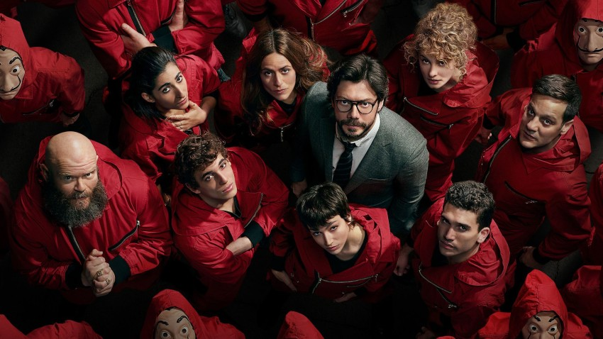
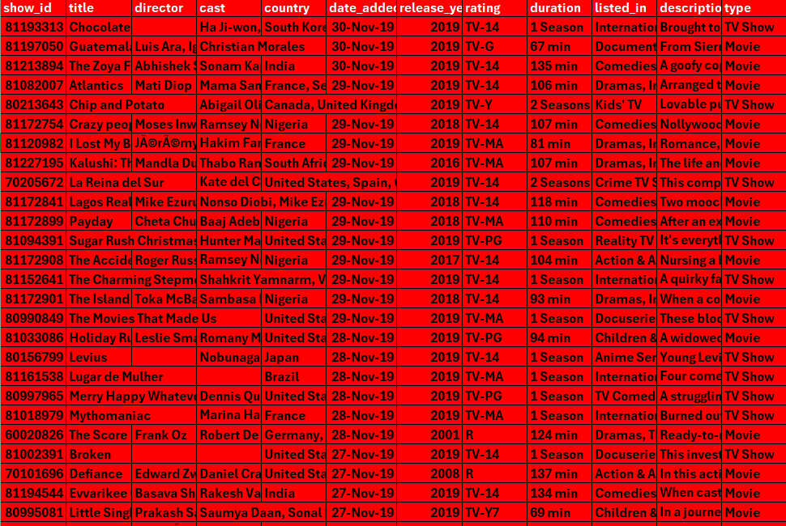

DATASET
1925-2020

Slide 10
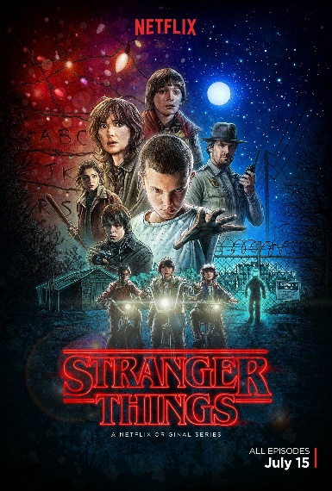




Available Langauges
NETFLIX
1 2 3 4 5
TOTAL CONTENT 5887
69 LANGUAGES
ENGLISH SPANISH KOREAN GREEK CHINESE HINDI FRENCH DUTCH GERMAN

Slide 11
THANKS
PROJECT BY
Anshika Sharma(A061)

