Slide 1
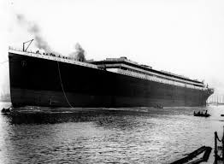
Titanic: Machine Learning from Disaster
By:Anshit Hayaran
(151239)

Slide 2
INDEX
Introduction
Goals
Language and Software used
Libraries used
Implementation
Graphs
Models
Conclusion

Slide 3
INTRODUCTION
The sinking of the RMS Titanic is one of the most infamous shipwrecks in history. On April 15, 1912, during her maiden voyage, the Titanic sank after colliding with an iceberg, killing 1502 out of 2224 passengers and crew. This sensational tragedy shocked the international community and led to better safety regulations for ships.

Slide 4
GOALS
The primary goal is to find what sorts of people were more likely to survive.
The secondary to compare different Machine Learning Techniques.

Slide 5
Language and Software used
Language: Python 2.7
Software: Pycharm

Slide 6
Libraries used
Numpy
Matplot-lib
Pandas
Scikit-learn
Sklearn

Slide 7
Implementation
Import necessary libraries
Read in an explore data
Data analysis
Data visualization
Cleaning data
Choosing best model

Slide 8
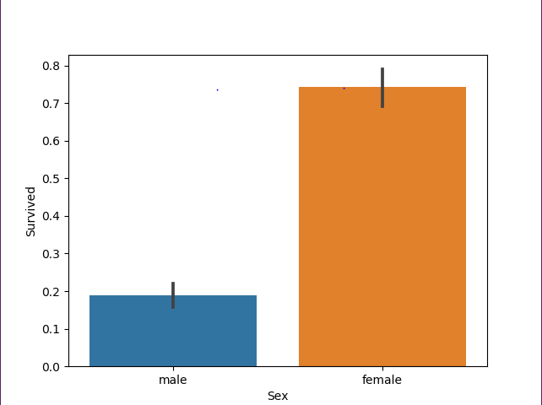
Sex vs Survived

Slide 9
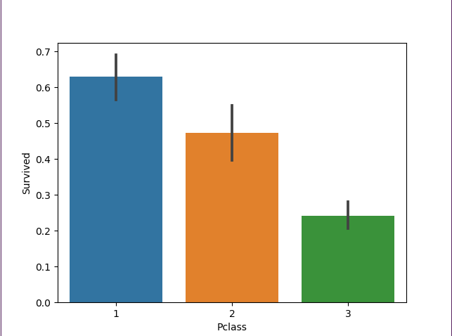
Class vs Survived

Slide 10
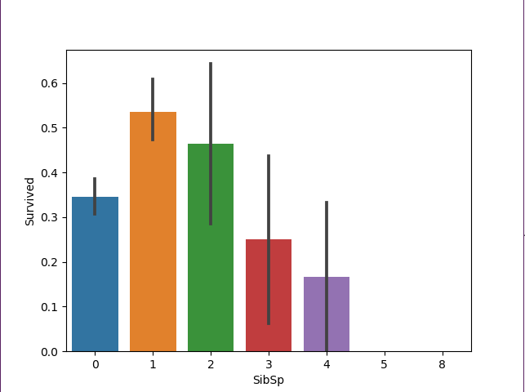
Siblings vs Survived

Slide 11
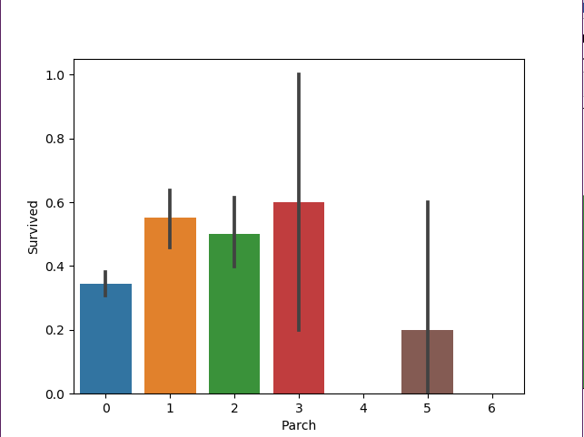
Parent-child relationship vs Survived

Slide 12
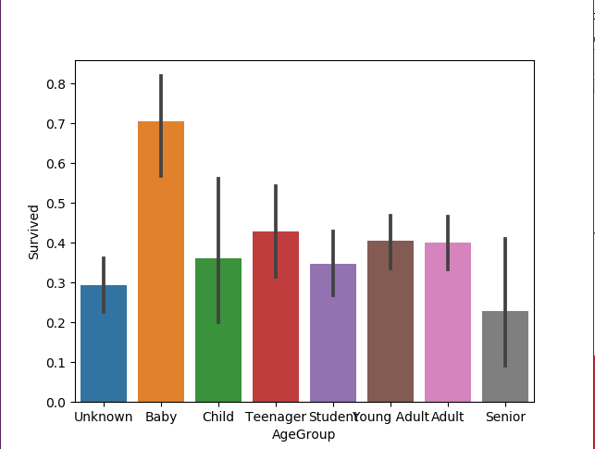
Age vs Survived

Slide 13
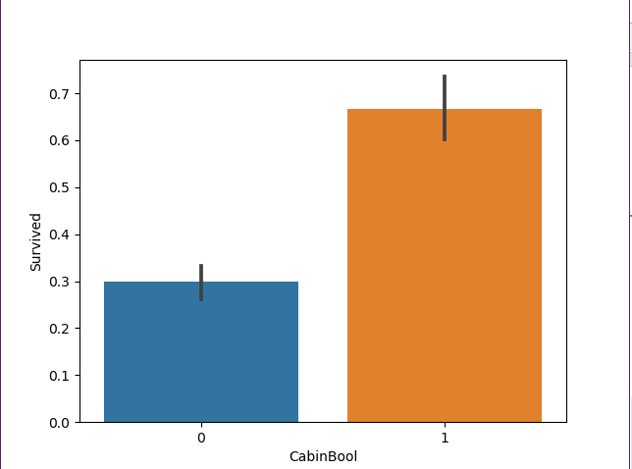
Cabin vs Survived

Slide 14
Models used
Logistic Regression
Gaussian Naïve Bayes
SVM
Decision tree
Random Forest
KNN

Slide 15
Comparing different models
Model Score
Random Forest 86.29
Support Vector Machines 82.74
Decision Tree 80.20
Logistic Regression 79.19
Gaussian Naive Bayes 78.68
KNN 77.66

Slide 16
Conclusion
One of the reasons that the shipwreck led to such loss of life was that there were not enough lifeboats for the passengers and crew. Although there was some element of luck involved in surviving the sinking, some groups of people were more likely to survive than others, such as women, children, and the upper-class.

Slide 17
THANK
YOU

