Slide 1
E-Commerce Sales & Customer Behavior Analysis
EDA of the UCI Online Retail dataset using Python
541,909 transactions | Dec 2010 to Dec 2011 | Pandas, NumPy, Matplotlib, Seaborn

Slide 2
Data Cleaning: 541,909 rows to 522,502
5,268 duplicate rows removed
9,288 cancelled-invoice rows kept in a separate table
Zero/negative price or quantity, postage and fee entries removed
1,454 rows without Description removed
135,080 rows (25%) have no CustomerID: kept for sales, excluded from customer analysis
2 invoices (74,215 and 80,995 units) removed: both cancelled later
Final: 4,333 customers, 19,771 invoices, 3,899 products, 38 countries, revenue 10.0 million

Slide 3
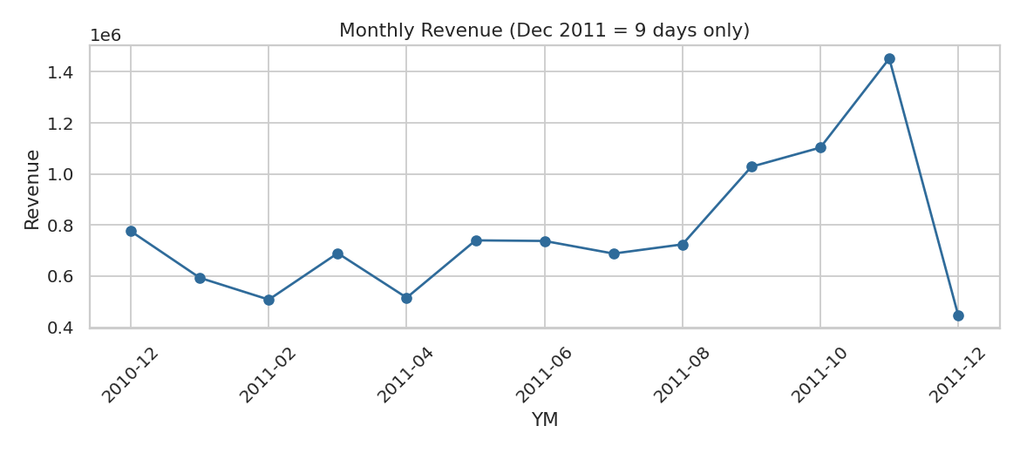
Revenue peaks in November
Nov 2011: 1,452,113, about 2.9x the weakest full month
Jan to Aug stays near 5 to 7.7 lakh
Dec 2011 is low only because data ends on 9 Dec

Slide 4
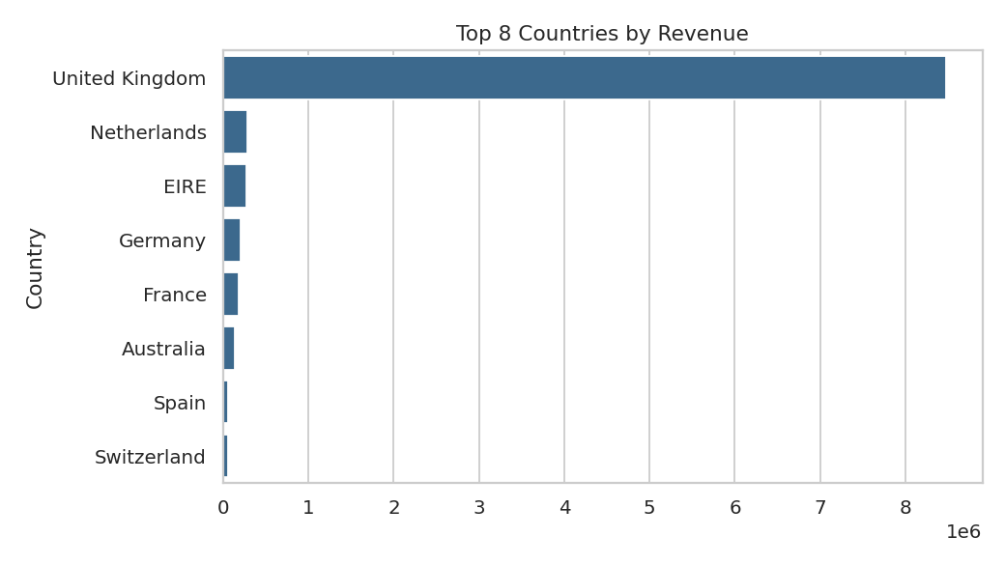
85% of revenue comes from the UK
UK: 84.8% of revenue
37 other countries: 15.2%
Top 20% of customers give 73.9% of revenue
High dependence on one market and a few customers

Slide 5
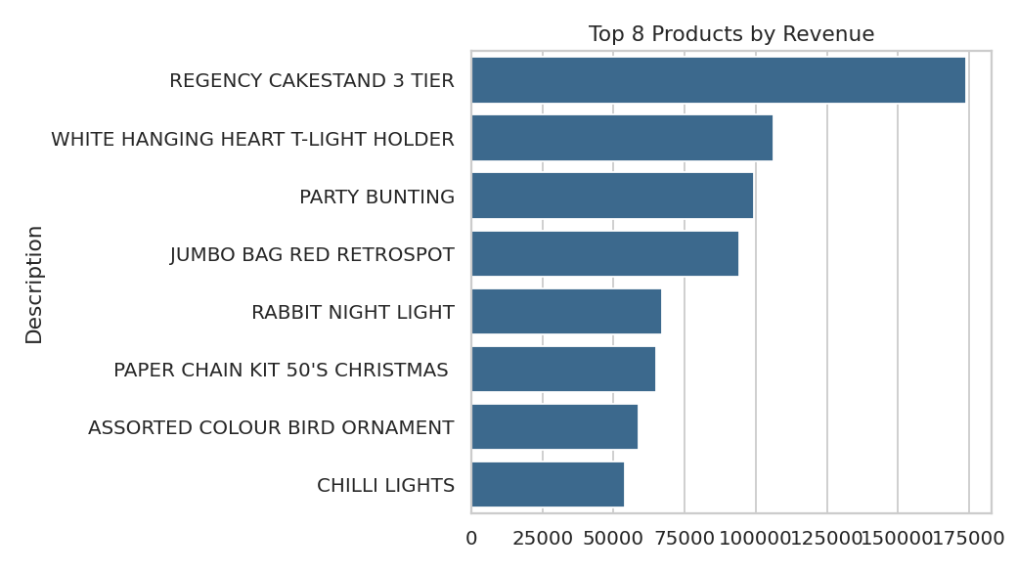
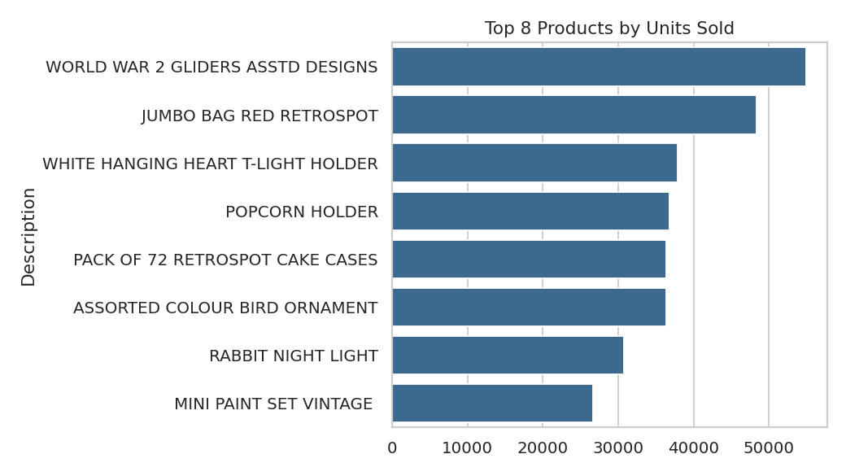
Best sellers differ by revenue and units
Revenue leader: Regency Cakestand 3 Tier. Units leader: World War 2 Gliders (54,951). Falling demand: White Hanging Heart T-Light Holder (-24.7%); growing: Jumbo Bag Pink Polkadot (+79.6%).

Slide 6
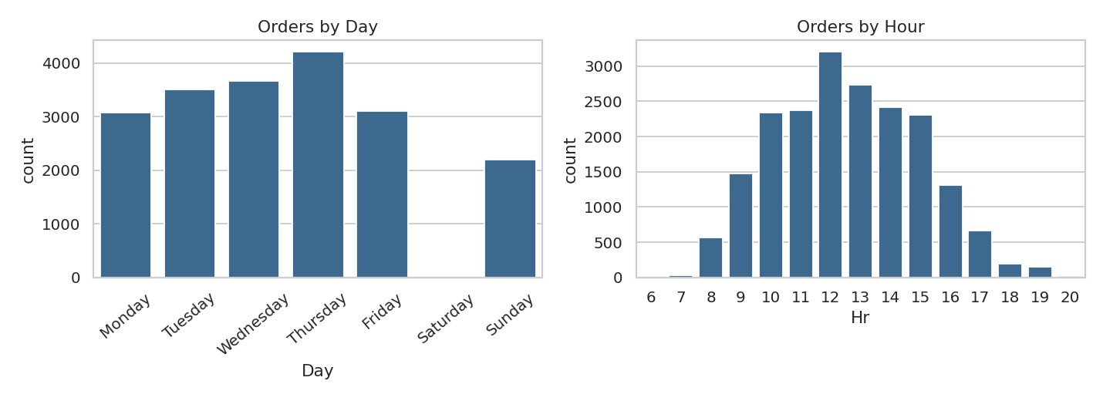
Customers order in office hours
Thursday busiest (4,209 orders), no Saturday orders
Peak at 12:00 (3,204 orders)
14.81% of invoices are cancelled
Avg order value 505.85, median 302.20

Slide 7
Recommendations
Prepare stock and marketing for September to November
Grow Netherlands, EIRE, Germany and France to reduce UK dependence
Loyalty offers for top customers, who bring most revenue
Investigate the 14.8% cancellation rate
Send promotions Tuesday to Thursday in office hours
Bundle products with falling demand; stock rising ones
Limitation: one year of data, 25% rows without CustomerID

